Slide 1
P1 Chapter 11: Vectors Magnitude and Direction

Slide 2
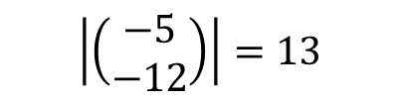


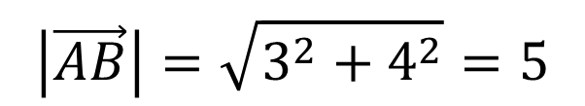





Magnitude of a Vector
! The magnitude $|a|$ of a vector $\vec{a}$ is its length.
If $\vec{a}=\left(\begin{matrix}x \\ y\end{matrix}\right) ⇒ \left|\vec{a}\right|=\sqrt{x^{2}+y^{2}}$
$$\left(\begin{matrix}3 \\ 4\end{matrix}\right)$$
$$B$$
?
4
$$\left|\vec{AB}\right|=\sqrt{3^{2}+4^{2}}=5$$
$$A$$
3
?
?
$$\left|\left(\begin{matrix}1 \\ −1\end{matrix}\right)\right|=\sqrt{2}$$
$$\left|\left(\begin{matrix}−5 \\ −12\end{matrix}\right)\right|=13$$
$$\vec{a}=\left(\begin{matrix}4 \\ −1\end{matrix}\right) \left|\vec{a}\right|=\sqrt{4^{2}+1^{2}}=\sqrt{17}$$
?
?
$$\vec{b}=\left(\begin{matrix}2 \\ 0\end{matrix}\right) \left|\vec{b}\right|=\sqrt{2^{2}+0^{2}}=2$$

Slide 3
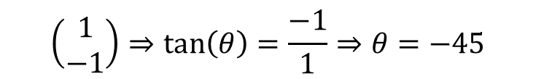


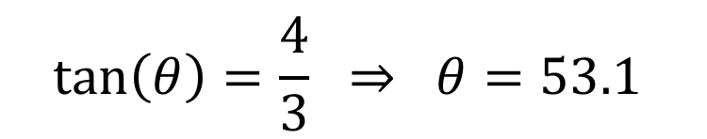



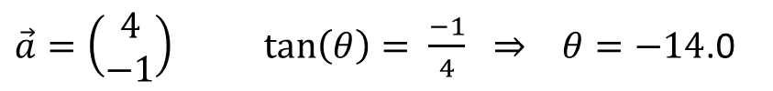
Direction of a Vector
! The direction of a vector $\vec{a}$ is the angle it makes with the $x$-axis.
If $\vec{a}=\left(\begin{matrix}x \\ y\end{matrix}\right) ⇒ \tan\left(θ\right)= \frac{y}{x}$
$$\left(\begin{matrix}3 \\ 4\end{matrix}\right)$$
$$B$$
4
$$\tan\left(θ\right)=\frac{4}{3} ⇒ θ=53.1$$
?
$$A$$
$$\left(\begin{matrix}1 \\ −1\end{matrix}\right)⇒\tan\left(θ\right)=\frac{−1}{1}⇒θ=−45$$
?
$\vec{a}=\left(\begin{matrix}4 \\ −1\end{matrix}\right) \tan\left(θ\right)= \frac{−1}{4} ⇒ θ=−14$.0
?
$$\vec{b}=\left(\begin{matrix}2 \\ 0\end{matrix}\right) \tan\left(θ\right)= \frac{0}{2} ⇒ θ= \text{0}$$
?

Slide 4



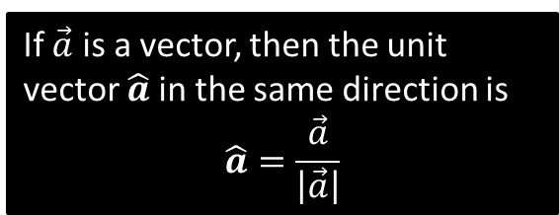
Unit Vectors
! A unit vector is a vector whose magnitude is 1
There’s certain operations on vectors that require the vectors to be ‘unit’ vectors. We just scale the vector so that its magnitude is now 1.
$$\vec{a}=\left(\begin{matrix}3 \\ 4\end{matrix}\right) \\ \left|\vec{a}\right|=\sqrt{3^{2}+4^{2}}=5 \\ \hat{a}=\left(\begin{matrix}3/5 \\ 4/5\end{matrix}\right)$$
If $\vec{a}$ is a vector, then the unit vector $\hat{a}$in the same direction is
$$\hat{a}=\frac{\vec{a}}{\left|\vec{a}\right|}$$
?
Test Your Understanding: Convert the following vectors to unit vectors.
$$\vec{a}=\left(\begin{matrix}12 \\ −5\end{matrix}\right)$$
$$\left|\vec{a}\right|=\sqrt{{12}^{2}+5^{2}}=13 \\ ∴\hat{a}=\left(\begin{matrix}\frac{12}{13} \\ −\frac{5}{13}\end{matrix}\right)$$
$$\vec{b}=\left(\begin{matrix}1 \\ 1\end{matrix}\right)$$
$$\left|\vec{b}\right|=\sqrt{1^{2}+1^{2}}=\sqrt{2} \\ ∴\hat{b}=\left(\begin{matrix}\frac{1}{\sqrt{2}} \\ \frac{1}{\sqrt{2}}\end{matrix}\right)$$
?
?

Slide 5
Exercise 11.3
Pearson Pure Mathematics Year 1/AS
Pages 87-88

Slide 6
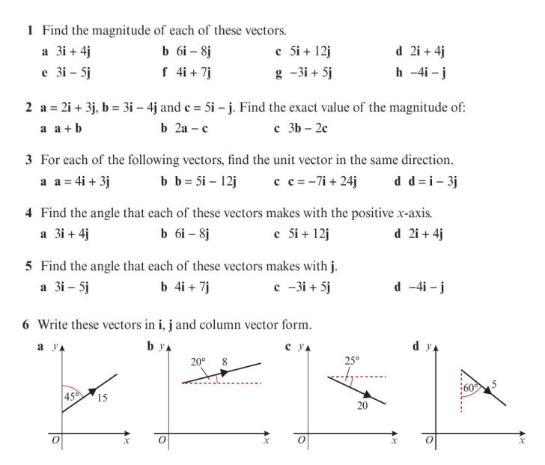
Homework Exercise

Slide 7
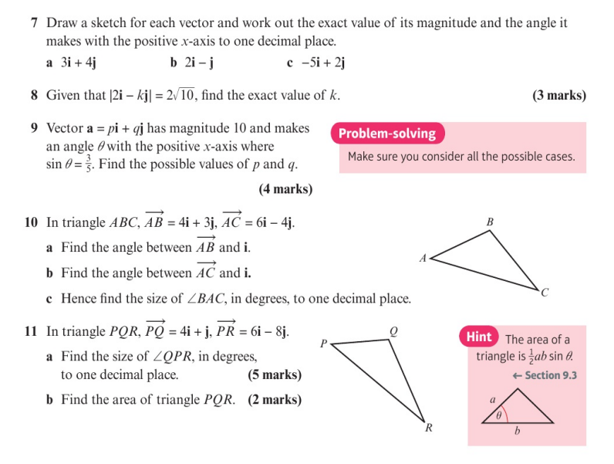
Homework Exercise

Slide 8
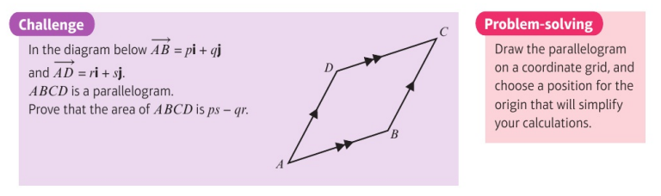
Homework Exercise
When multiplying two vectors together would the resulting object be another vector or something else?
When multiplying two vectors together would the magnitude of the resulting object be equal to the area of parallelogram?
Would the answer to either of the above questions ever be used in physics to describe the real universe!

Slide 9
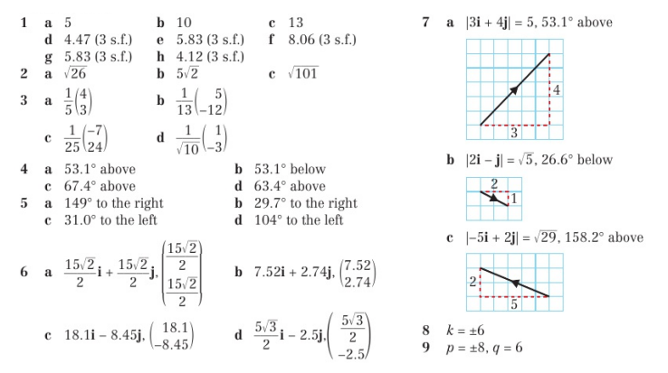
Homework Answers

Slide 10
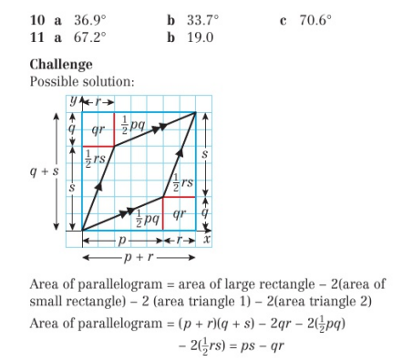
Homework Answers

