Slide 1
P1 Chapter 2: Quadratics Completing The Square

Slide 2
Completing the Square
“Completing the square” means putting a quadratic in the form ${\left(x+a\right)}^{2}+b$
or $a{\left(x+b\right)}^{2}+c$
The underlying reason we do this is because $x$ only appears once in the expression (e.g. in ${\left(x+2\right)}^{2}+3$ vs $x^{2}+4x+7$), which makes it algebraically easier to handle. This has a number of consequences:
a. Solving Quadratics
b. Sketching Quadratics
If we have a completed square:
$${\left(x+4\right)}^{2}−7=0$$
we saw at the start of the chapter how we could rearrange to make $x$ the subject.
Indeed using the quadratic formula is actually solving the quadratic by completing the square – it’s just someone has done the work for us already!
We’ll see later that if $y={\left(x+a\right)}^{2}+b$, then the minimum point is $\left(−a,b\right)$
c. In integration
In Further Maths, completing the square allows us to ‘integrate’ expressions like:
$$\int{\frac{1}{x^{2}−4x+5}dx}$$
(you will cover integration later this module)

Slide 3
Completing the Square Recap
Textbook Note:
The textbook uses the formula
$$x^{2}+bx={\left(x+\frac{b}{2}\right)}^{2}−{\left(\frac{b}{2}\right)}^{2}$$
and similarly
$$ax^{2}+bx+c=a{\left(x+\frac{b}{2a}\right)}^{2}+\left(c−\frac{b^{2}}{4a}\right)$$
My personal judgement is that it’s not worth memorising these and you should instead think through the steps. Even the textbook agrees!
Expand:
$${\left(x+9\right)}^{2}=x^{2}+18x+81 \\ {\left(x−5\right)}^{2}=x^{2}−10x+25$$
What do you notice about the relationship between the bold numbers?
The $a$ in ${\left(x+a\right)}^{2}$ is half the coefficient of $x$ in the expansion.
?
?
?
Therefore if we had $x^{2}+12x$, how could we write it in the form ${\left(x+a\right)}^{2}+b$?
$$x^{2}+12x={\left(x+6\right)}^{2}−36$$
?
Since ${\left(x+6\right)}^{2}=x^{2}+12x+36$, we want to discard the 36, so ‘throw it away’ by subtracting.
Further Examples:
$$x^{2}+8x={\left(x+4\right)}^{2}−16 \\ x^{2}−2x={\left(x−1\right)}^{2}−1 \\ x^{2}−6x+7={\left(x−3\right)}^{2}−9+7 \\ ={\left(x−3\right)}^{2}−2$$
?
Notice that despite the $a$ being negative, we still subtract after the bracket as ${\left(−1\right)}^{2}$ is positive.
?
?

Slide 4
Completing the Square
Express $2x^{2}+12x+7$ in the form $a{\left(x+b\right)}^{2}+c$
?
Factorise out coefficient of $x^{2}$. You can leave the constant term outside the bracket.
$$=2\left(x^{2}+6x\right)+7 \\ =2\left({\left(x+3\right)}^{2}−9\right)+7 \\ =2{\left(x+3\right)}^{2}−18+7 \\ =2{\left(x+3\right)}^{2}−11$$
?
?
Complete the square inside the bracket (you should have two sets of brackets)
?
Expand out outer bracket.
Express $5−3x^{2}+6x$ in the form $a−b{\left(x+c\right)}^{2}$
$$=−3x^{2}+6x+5 \\ =−3\left(x^{2}−2x\right)+5 \\ =−3\left({\left(x−1\right)}^{2}−1\right)+5 \\ =−3{\left(x−1\right)}^{2}+3+5 \\ =8−3{\left(x−1\right)}^{2}$$
?
?
It may help to write in the form $ax^{2}+bx+c$ first.
?
?
?

Slide 5
Test Your Understanding
Express $3x^{2}−18x+4$ in the form $a{\left(x+b\right)}^{2}+c$
$$=3\left(x^{2}−6x\right)+4 \\ =3\left({\left(x−3\right)}^{2}−9\right)+4 \\ =3{\left(x−3\right)}^{2}−27+4 \\ =3{\left(x−3\right)}^{2}−23$$
?
Express $20x−5x^{2}+3$ in the form $a−b{\left(x+c\right)}^{2}$
$$=−5x^{2}+20x+3 \\ =−5\left(x^{2}−4x\right)+3 \\ =−5\left({\left(x−2\right)}^{2}−4\right)+3 \\ =−5{\left(x−2\right)}^{2}+20+3 \\ =23−5{\left(x−2\right)}^{2}$$
?

Slide 6
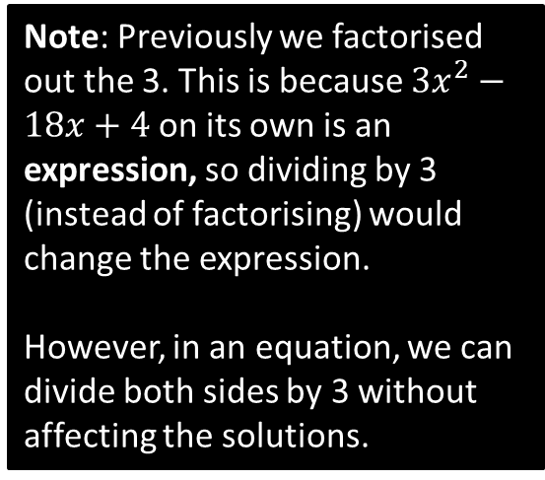
Solving by Completing the Square
Solve the equation:
$$3x^{2}−18x+4=0$$
? First step
$$x^{2}−6x+\frac{4}{3}=0 \\ {\left(x−3\right)}^{2}−9+\frac{4}{3}=0 \\ {\left(x−3\right)}^{2}=\frac{23}{3} \\ x−3=±\sqrt{\frac{23}{3}} \\ x=3±\sqrt{\frac{23}{3}}$$
Note: Previously we factorised out the 3. This is because $3x^{2}−18x+4$ on its own is an expression, so dividing by 3 (instead of factorising) would change the expression.
However, in an equation, we can divide both sides by 3 without affecting the solutions.
? And the rest…

Slide 7
Proving the Quadratic Formula
If $ax^{2}+bx+c=0$, prove that $x=\frac{−b±\sqrt{b^{2}−4ac}}{2a}$
$$ax^{2}+bx+c=0 \\ x^{2}+\frac{b}{a}x+\frac{c}{a}=0 \\ {\left(x+\frac{b}{2a}\right)}^{2}−\frac{b^{2}}{4a^{2}}+\frac{c}{a}=0 \\ {\left(x+\frac{b}{2a}\right)}^{2}=\frac{b^{2}}{4a^{2}}−\frac{c}{a} \\ {\left(x+\frac{b}{2a}\right)}^{2}=\frac{b^{2}−4ac}{4a^{2}} \\ x+\frac{b}{2a}=\frac{±\sqrt{b^{2}−4ac}}{2a} \\ x=\frac{−b±\sqrt{b^{2}−4ac}}{2a}$$
Just use exactly the same method as you usually would!
?

Slide 8
Exercise 2.2
Pearson Pure Mathematics Year 1/AS
Page 8

Slide 9
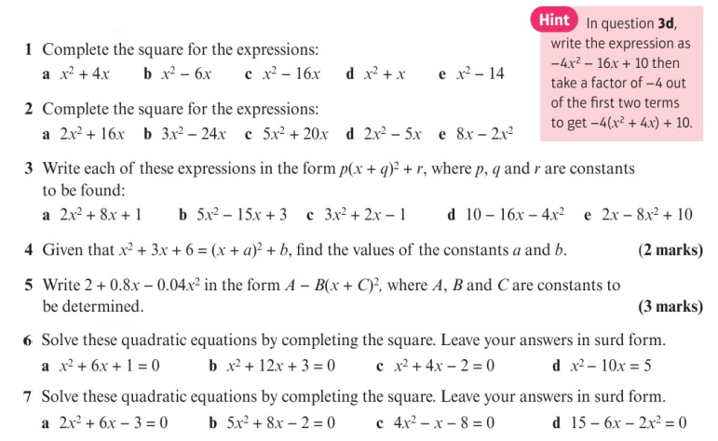
Homework Exercise

Slide 10
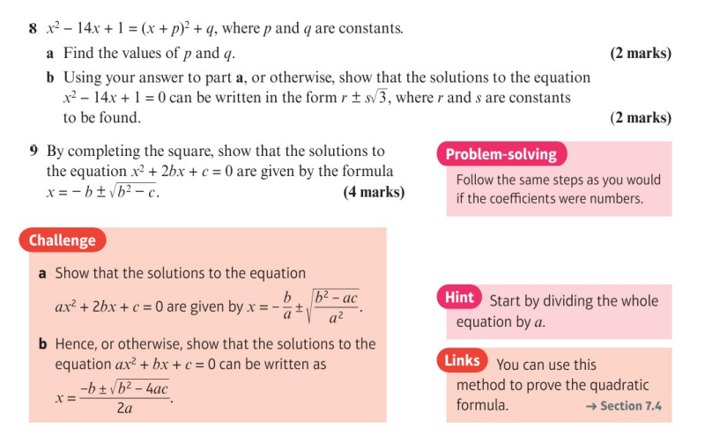
Homework Exercise

Slide 11
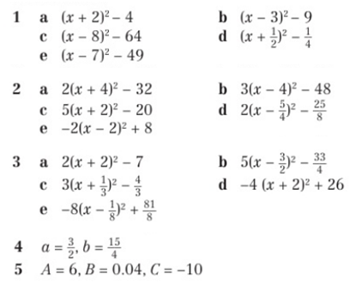
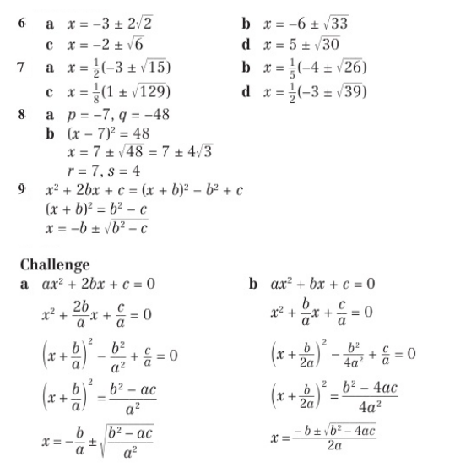
Homework Answers

