Slide 1
M2 Chapter 8: Further Kinematics Vector Differentiation

Slide 2
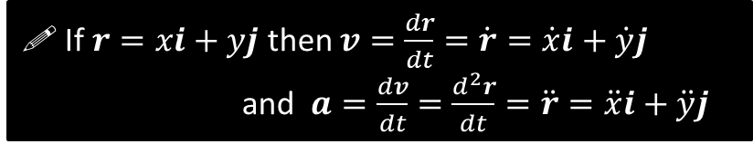


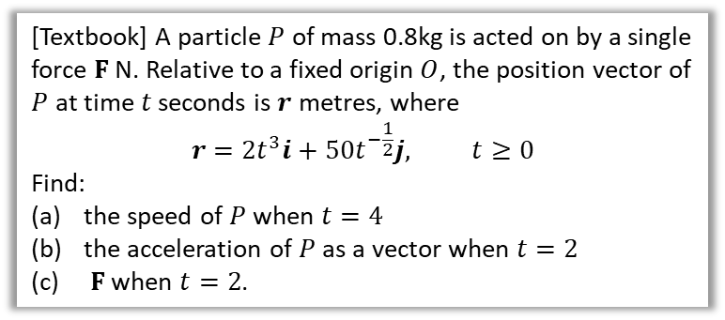
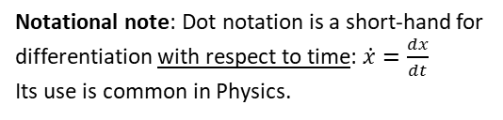
Differentiating Vectors
Suppose that $v=\left(\begin{matrix}t^{2} \\ \sin{t}\end{matrix}\right)$. What would be the acceleration?
We can simply differentiate the $i$ and $j$ components independently:
$$a=\frac{dv}{dt}=\left(\begin{matrix}2t \\ \cos{t}\end{matrix}\right)$$
?
! If $r=xi+yj$ then $v=\frac{dr}{dt}=\dot{r}=\dot{x}i+\dot{y}j$ and $a=\frac{dv}{dt}=\frac{d^{2}r}{dt}=\ddot{r}=\ddot{x}i+\ddot{y}j$
Notational note: Dot notation is a short-hand for differentiation with respect to time: $\dot{x}=\frac{dx}{dt}$
Its use is common in Physics.
$v=\dot{r}=\left(\begin{matrix}6t^{2} \\ −25t^{−\frac{3}{2}}\end{matrix}\right) ms^{−1}$ When $t=4, v=\left(\begin{matrix}96 \\ −\frac{25}{8}\end{matrix}\right)$
Speed $=\sqrt{{96}^{2}+{\left(\frac{25}{8}\right)}^{2}}=96.1{ms}^{−1}$
$$a=\dot{v}=\left(\begin{matrix}12t \\ \frac{75}{2}t^{−\frac{3}{2}}\end{matrix}\right)ms^{−2}$$
When $t=2, a=\left(\begin{matrix}24 \\ 6.6291…\end{matrix}\right) ms^{−2}$
$$F=ma=0.8\left(\begin{matrix}24 \\ 6.6291…\end{matrix}\right)=\left(\begin{matrix}19.2 \\ 5.30\end{matrix}\right) N$$
[Textbook] A particle $P$ of mass 0.8kg is acted on by a single force $F$ N. Relative to a fixed origin $O$, the position vector of $P$ at time $t$ seconds is $r$ metres, where
$$r=2t^{3}i+50t^{−\frac{1}{2}}j, t≥0$$
Find:
the speed of $P$ when $t=4$
the acceleration of $P$ as a vector when $t=2$
$F$ when $t=2$.
a
?
b
?
c
?

Slide 3
Exercise 8.4
Pearson Stats/Mechanics Year 2
Pages 72-73

Slide 4
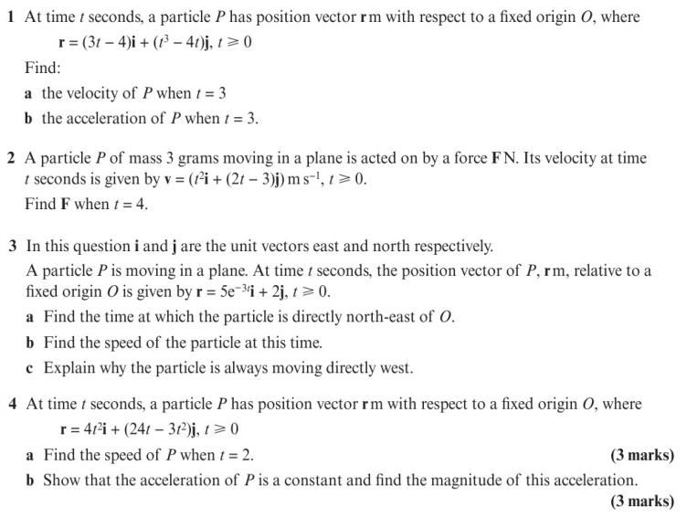
Homework Exercise

Slide 5
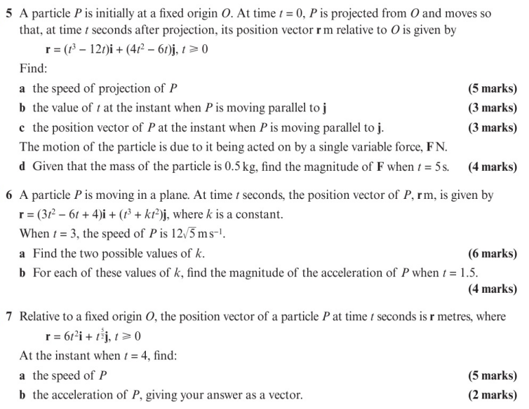
Homework Exercise

Slide 6
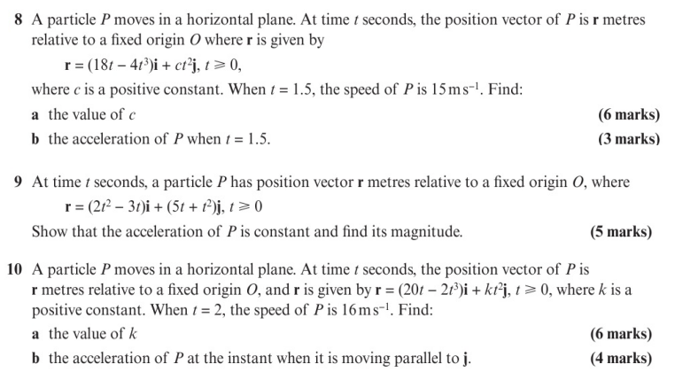
Homework Exercise

Slide 7
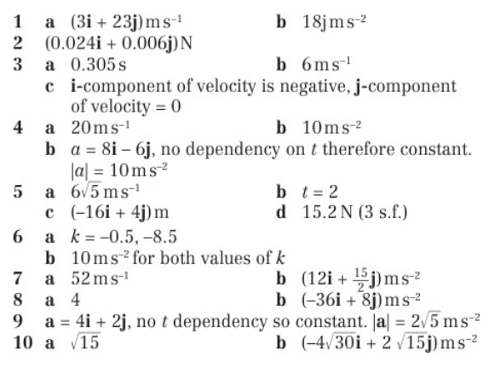
Homework Answers

