Slide 1
P2 Chapter 5: Radians
Sectors and Segments

Slide 2


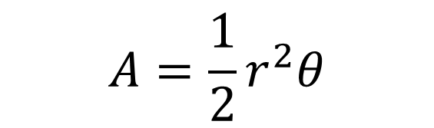
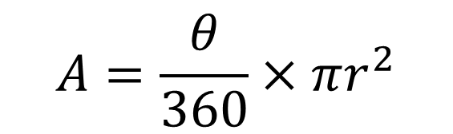
Sector Area
$$r$$
$$θ$$
Area using Degrees
Area using Radians
?
?
$$A=\frac{θ}{360}×πr^{2}$$
$$A=\frac{1}{2}r^{2}θ$$

Slide 3
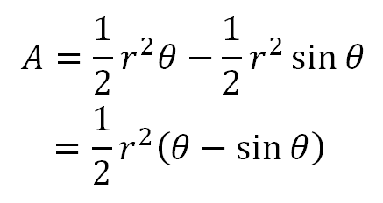

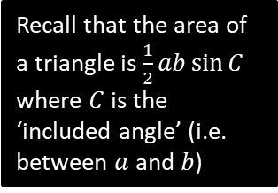


Segment Area
A segment is the region bound between a chord and the circumference.
This is just a sector with a triangle cut out.
$$r$$
$$θ$$
$$r$$
Area using radians:
Recall that the area of a triangle is $\frac{1}{2}ab\sin{C}$ where $C$ is the ‘included angle’ (i.e. between $a$ and $b$)
?

Slide 4














Examples
[Textbook] In the diagram, the area of the minor sector $AOB$ is 28.9 cm². Given that $∠AOB=0.8$ radians, calculate the value of $r$.
[Textbook] A plot of land is in the shape of a sector of a circle of radius 55 m. The length of fencing that is erected along the edge of the plot to enclose the land is 176 m. Calculate the area of the plot of land.
$$A$$
$$A$$
$$55 m$$
$r$cm
$$0.8$$
$$O$$
$$θ$$
$r$cm
$$55 m$$
$$B$$
$$B$$
?
?
Arc $AB=176−55−55=66 m$
$$66=5θ \\ ∴θ=1.2 rad$$
Area $=\frac{1}{2}×{55}^{2}×1.2=1815$m²
$$28.9=\frac{1}{2}r^{2}×0.8 \\ 28.9=0.4r^{2} \\ r^{2}=\frac{28.9}{0.4}=72.25 \\ r=\sqrt{72.25}=8.5$$

Slide 5


















Segment Examples
[Textbook] In the diagram above, $OAB$ is a sector of a circle, radius 4m. The chord $AB$ is 5m long. Find the area of the shaded segment.
[Textbook] In the diagram, $AB$ is the diameter of a circle of radius $r$cm, and $∠BOC=θ$ radians. Given that the area of $ΔAOC$ is three times that of the shaded segment, show that
$3θ−4\sin{θ}=0$.
$$A$$
$$4 m$$
$$C$$
$$O$$
$$θ$$
$$5m$$
$$4 m$$
$$θ$$
$$B$$
$$B$$
$$A$$
$$r$$
$$O$$
$$r$$
?
?
Using cosine rule:
$$5^{2}=4^{2}+4^{2}−\left(2×4×4×\cos{θ}\right) \\ 25=32−32\cos{θ} \\ 32\cos{θ}=32−25=7 \\ θ=\cos^{−1}\left(\frac{7}{32}\right)=1.3502…$$
Area of shaded segment:
$$\frac{1}{2}×4^{2}\left(1.3502…−\sin{1.3502…}\right)$$
$=3.00$ m².
Area of segment $=\frac{1}{2}r^{2}\left(θ−\sin{θ}\right)$
Area of $ΔAOC=\frac{1}{2}r^{2}\sin\left(π−θ\right)$
$$=\frac{1}{2}r^{2}sinθ$$
$$∴\frac{1}{2}r^{2}\sin{θ}=3×\frac{1}{2}r^{2}\left(θ−\sin{θ}\right) \\ \sin{θ}=3\left(θ−\sin{θ}\right)$$
$$∴3θ−4\sin{θ}=0$$
Recall that
$$\sin\left(θ\right)=\sin\left(π−θ\right)$$

Slide 6
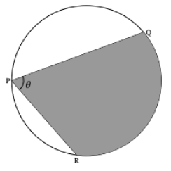


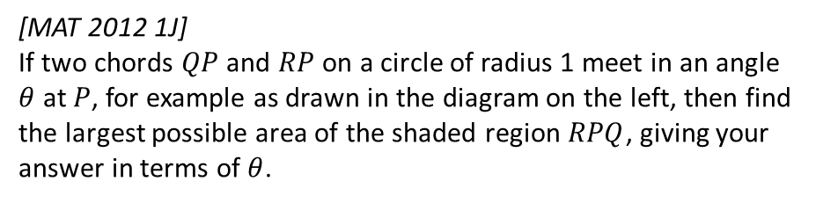






Exercise 5.3
Pearson Pure Year 2
Page 37
Extension
[MAT 2012 1J]
If two chords $QP$ and $RP$ on a circle of radius 1 meet in an angle $θ$ at $P$, for example as drawn in the diagram on the left, then find the largest possible area of the shaded region $RPQ$, giving your answer in terms of $θ$.
?
For a fixed $θ$ the largest area is obtained when the angle bisector of $PQ$ and $PR$ is the diameter of the circle. This can be broken up into two isosceles triangles and a sector as shown.
$∠BOC=2θ$ as angle at centre is twice angle at circumference.
$$∠AOB=π−\frac{θ}{2}−\frac{θ}{2}=π−θ$$
Area of $AOB=\frac{1}{2}×1^{2}×\sin\left(π−θ\right)=\frac{1}{2}\sin\left(θ\right)$
Area of sector $BOC=\frac{1}{2}×1^{2}×2θ=θ$.
Total shaded area $=2×\frac{1}{2}\sin{θ}+θ=θ+\sin{θ}$.
$$B$$
$$\frac{θ}{2}$$
$$π−θ$$
$$1$$
$$A$$
$$1$$
$$2θ$$
$$\frac{θ}{2}$$
$$O$$
$$1$$
$$C$$

Slide 7
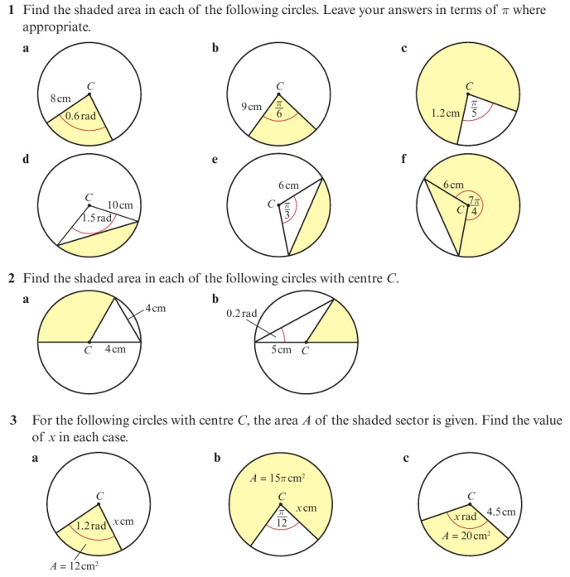
Homework Exercise

Slide 8
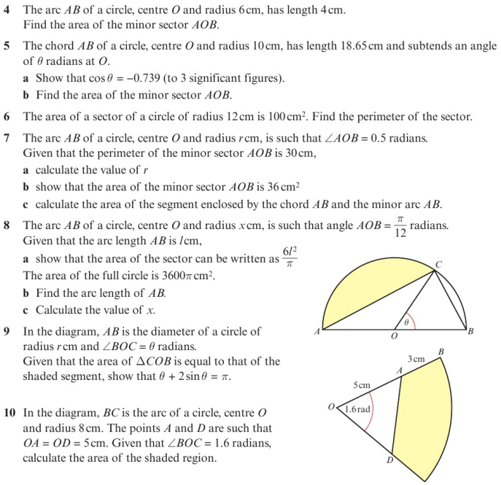
Homework Exercise

Slide 9
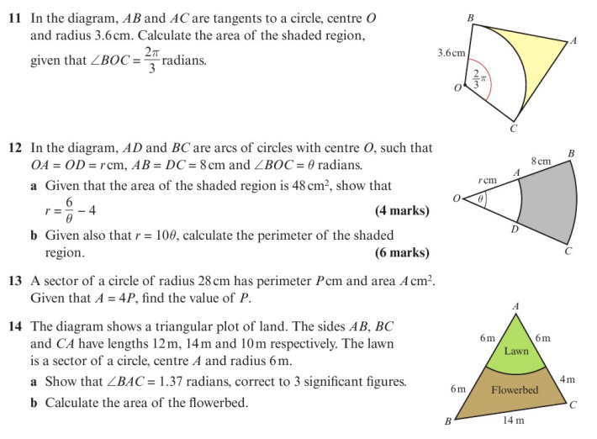
Homework Exercise

Slide 10
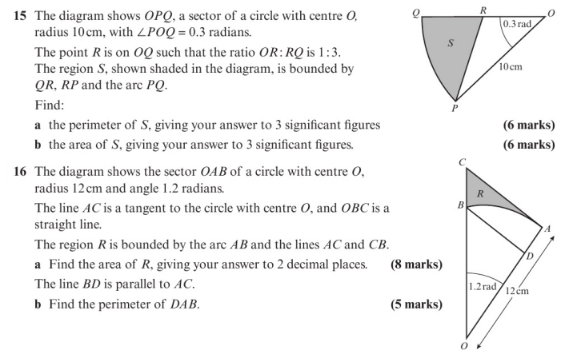
Homework Exercise

Slide 11
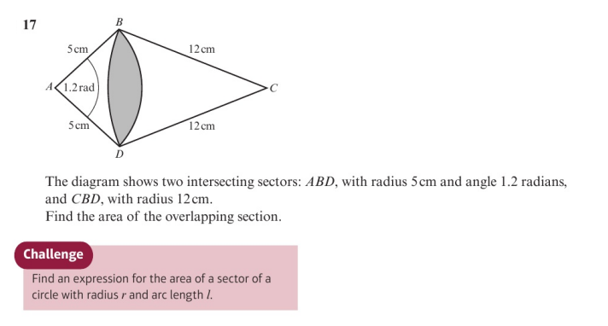
Homework Exercise

Slide 12
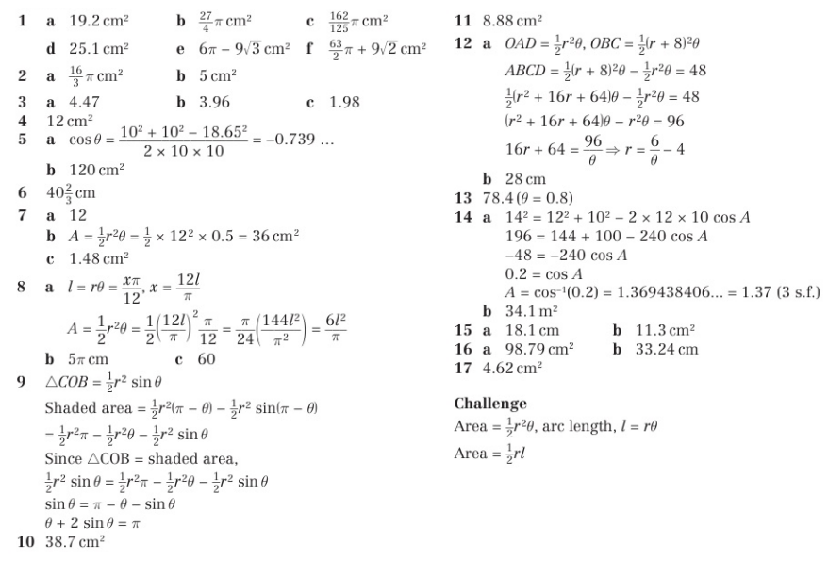
Homework Answers

