Slide 1
P2 Chapter 9: Differentiation Using The Second Derivative

Slide 2
Using the second derivative
Year 1 slides you may remember that a point of inflection was where the concavity of a curve changes, i.e. concave to convex or vice versa, or informally, ‘swerving one way to swerving the other’.
Memory tip:
Concave = hill
Convex = valley
In this region the gradient, although initially negative, is still also increasing. The curve is swerving left.
We say the curve is concave when it is swerving right: we can see the gradient is always decreasing, i.e. the change in the gradient is negative.
! $f(x)$ convex when $f^{′′}\left(x\right)≥0$
At point of inflection, the gradient is not changing, i.e. the gradient of the gradient is 0. Note that points of inflection (as with this example) are not necessarily stationary points.
! $f(x)$ concave when $f^{′′}\left(x\right)≤0$
! Point of inflection when $f^{′′}\left(x\right)=0$

Slide 3
Examples
[Textbook] Find the interval on which the function $f\left(x\right)=x^{3}+4x+3$ is concave.
[Textbook] Show that $f\left(x\right)=e^{2x}+x^{2}$ is convex for all real values of $x$.
?
?
$$f^{′}\left(x\right)=2e^{2x}+2x \\ f^{′′}\left(x\right)=4e^{2x}+2$$
$e^{2x}>0$ for all $x∈ℝ$
$∴f^{′′}\left(x\right)>0$ for all $x∈ℝ$therefore convex for all $x∈ℝ$
$$f′\left(x\right)=3x^{2}+4 \\ f^{′′}\left(x\right)=6x$$
Concave $∴6x≤0$ $$x≤0$$
[Textbook] The curve $C$ has equation $y=x^{3}−2x^{2}−4x+5$
Find the coordinates of the point of inflection.
?
$$\frac{dy}{dx}=3x^{2}−4x−4 \frac{d^{2}y}{dx^{2}}=6x−4$$
Point of inflection $∴6x−4=0$ $$x=\frac{2}{3} \\ ∴y={\left(\frac{2}{3}\right)}^{3}−2{\left(\frac{2}{3}\right)}^{2}−4\left(\frac{2}{3}\right)+5=\frac{47}{27} \\ \left(\frac{2}{3},\frac{47}{27}\right)$$

Slide 4
Exercise 9.9
Pearson Pure Year 2
Page 77

Slide 5
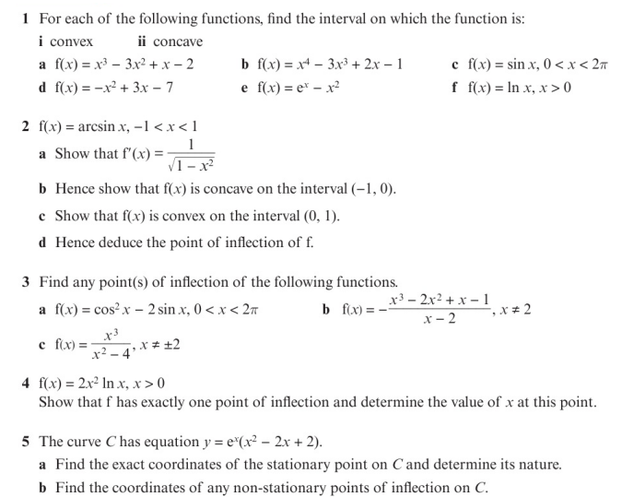
Homework Exercise

Slide 6
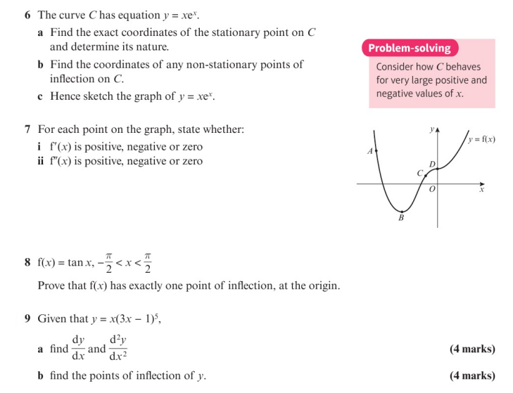
Homework Exercise

Slide 7
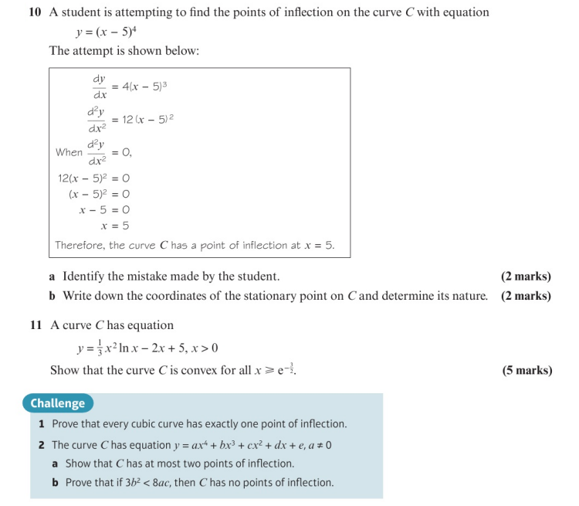
Homework Exercise

Slide 8
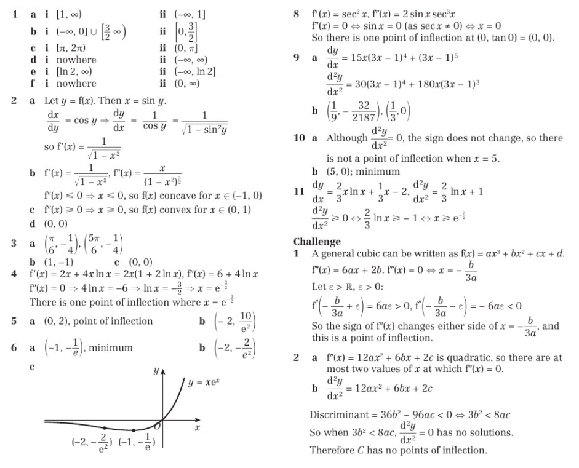
Homework Answers

