Slide 1
Stats1 Chapter 2: Measures of Data Quartiles

Slide 2
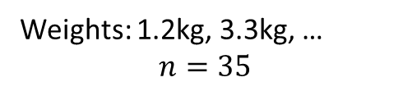
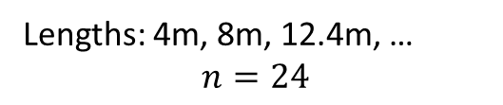
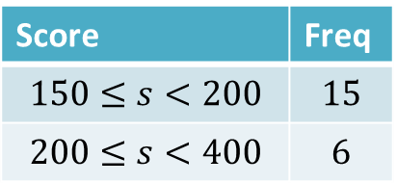
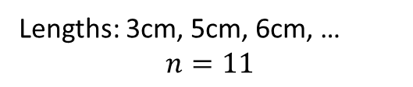
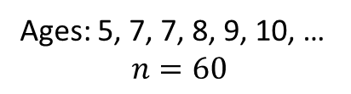
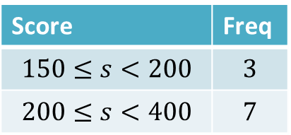
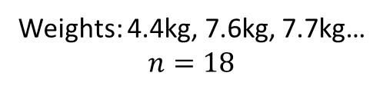
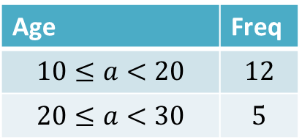
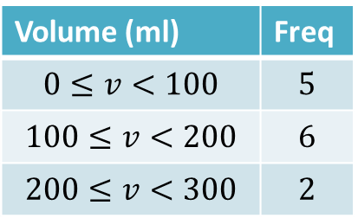
Quickfire Questions…
What position do we use for the median?
Lengths: 3cm, 5cm, 6cm, …
$$n=11$$
Score | Freq
$$150≤s<200$$ | $$3$$
$$200≤s<400$$ | $$7$$
Weights: 1.2kg, 3.3kg, …
$$n=35$$
?
Median position: 18th
?
Median position: 6th
Volume (ml) | Freq
$$0≤v<100$$ | $$5$$
$$100≤v<200$$ | $$6$$
$$200≤v<300$$ | $$2$$
?
Lengths: 4m, 8m, 12.4m, …
$$n=24$$
Median position: 5
Ages: 5, 7, 7, 8, 9, 10, …
$$n=60$$
?
Median position: 12th/13th
?
Age | Freq
$$10≤a<20$$ | $$12$$
$$20≤a<30$$ | $$5$$
Median position: 30th/31st
?
Median position: 6.5
Score | Freq
$$150≤s<200$$ | $$15$$
$$200≤s<400$$ | $$6$$
Weights: 4.4kg, 7.6kg, 7.7kg…
$$n=18$$
Median position: 9th/10th
?
?
Median position: 8.5
Median position: 10.5
?

Slide 3
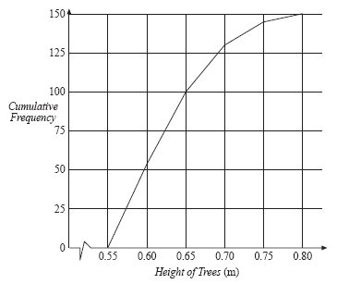
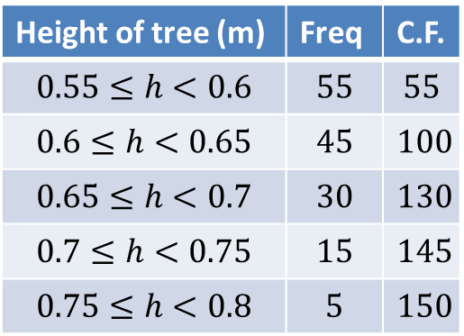
Linear Interpolation
Height of tree (m) | Freq | C.F.
$$0.55≤h<0.6$$ | $$55$$ | $$55$$
$$0.6≤h<0.65$$ | $$45$$ | $$100$$
$$0.65≤h<0.7$$ | $$30$$ | $$130$$
$$0.7≤h<0.75$$ | $$15$$ | $$145$$
$$0.75≤h<0.8$$ | $$5$$ | $$150$$
At GCSE we could find the median by drawing a suitable line on a cumulative frequency graph. How could we read off this value exactly using a suitable calculation?
We could find the fraction of the way along the line segment using the frequencies, then go this same fraction along the class interval.
?

Slide 4
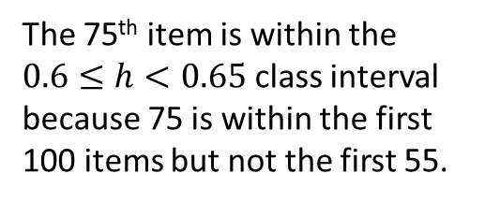
Linear Interpolation
Height of tree (m) | Freq | C.F.
$$0.55≤h<0.6$$ | $$55$$ | $$55$$
$$0.6≤h<0.65$$ | $$45$$ | $$100$$
$$0.65≤h<0.7$$ | $$30$$ | $$130$$
$$0.7≤h<0.75$$ | $$15$$ | $$145$$
$$0.75≤h<0.8$$ | $$5$$ | $$150$$
The 75th item is within the $0.6≤h<0.65$ class interval because 75 is within the first 100 items but not the first 55.
Frequency up until this interval
Item number we’re interested in.
Frequency by end of this interval
?
?
?
55
75
100
0.6m
Med
0.65m
?
?
Height at start of interval.
Height by end of interval.

Slide 5
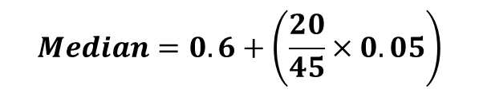
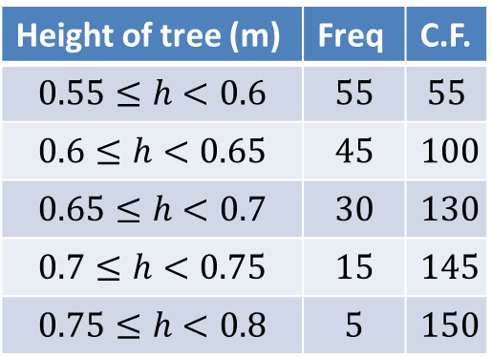
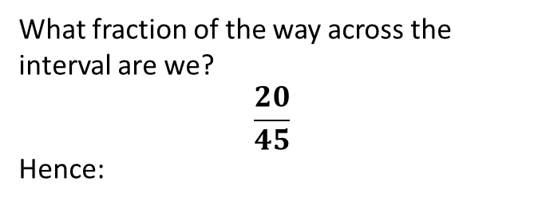
Linear Interpolation
Height of tree (m) | Freq | C.F.
$$0.55≤h<0.6$$ | $$55$$ | $$55$$
$$0.6≤h<0.65$$ | $$45$$ | $$100$$
$$0.65≤h<0.7$$ | $$30$$ | $$130$$
$$0.7≤h<0.75$$ | $$15$$ | $$145$$
$$0.75≤h<0.8$$ | $$5$$ | $$150$$
What fraction of the way across the interval are we?
$$\frac{20}{45}$$
Hence:
?
$$Median=0.6+\left(\frac{20}{45}×0.05\right)$$
?
Frequency up until this interval
Item number we’re interested in.
Frequency by end of this interval
55
75
100
0.6m
Med
0.65m
Height at start of interval.
Height by end of interval.
Tip: To quickly get frequency before and after, just look for the two cumulative frequencies that surround the item number.
Tip: Put the units to avoid getting frequencies confused with values of the variable.

Slide 6
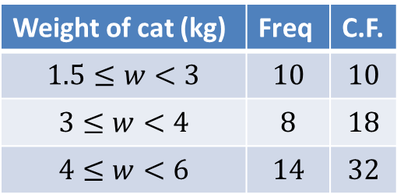
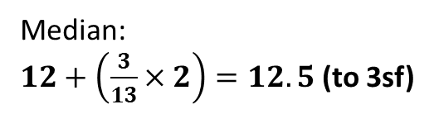
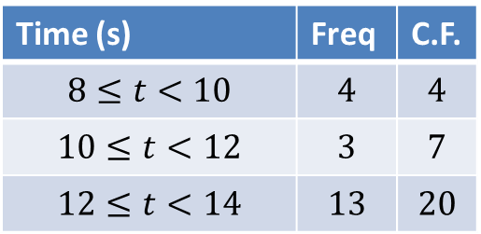
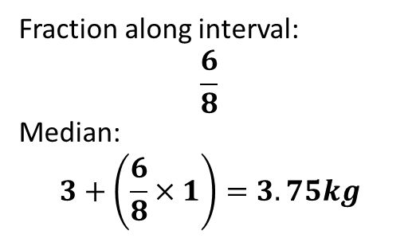
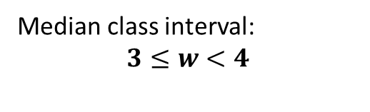
More Examples
Weight of cat (kg) | Freq | C.F.
$$1.5≤w<3$$ | $$10$$ | $$10$$
$$3≤w<4$$ | $$8$$ | $$18$$
$$4≤w<6$$ | $$14$$ | $$32$$
Time (s) | Freq | C.F.
$$8≤t<10$$ | $$4$$ | $$4$$
$$10≤t<12$$ | $$3$$ | $$7$$
$$12≤t<14$$ | $$13$$ | $$20$$
Median class interval:
$$3≤w<4$$
?
?
10
20
7
?
?
?
?
?
12s
14s
10
16
18
?
Med
?
3kg
Med
4kg
?
?
Median:
$12+\left(\frac{3}{13}×2\right)=12.5$ (to 3sf)
Fraction along interval:
$$\frac{6}{8}$$
Median:
$$3+\left(\frac{6}{8}×1\right)=3.75kg$$
?
?
?

Slide 7
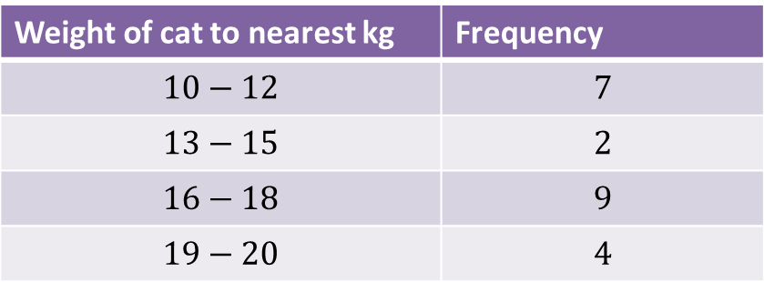


What’s different about the intervals here?
Weight of cat to nearest kg | Frequency
$$10−12$$ | $$7$$
$$13−15$$ | $$2$$
$$16−18$$ | $$9$$
$$19−20$$ | $$4$$
There are GAPS between intervals!
What interval does this actually represent?
$$10−12$$
?
$$9.5−12.5$$
Lower class boundary
Upper class boundary
Class width = 3
?

Slide 8
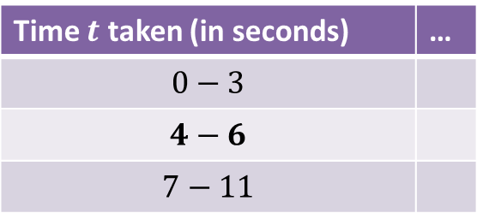
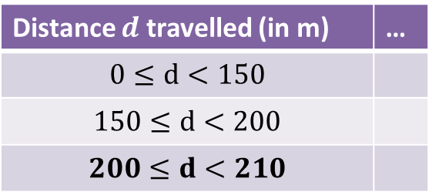
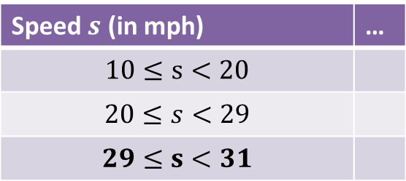
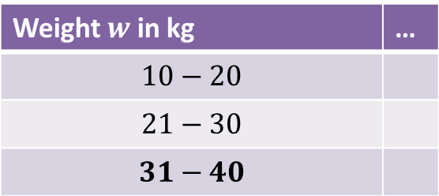
Identify the class width
Distance $d$ travelled (in m) | …
$$0≤d<150$$
$$150≤d<200$$
$$200≤d<210$$
Time $t$ taken (in seconds) | …
$$0−3$$
$$4−6$$
$$7−11$$
?
?
Lower class boundary = 200
Lower class boundary = 3.5
Class width = 3
Class width = 10
?
?
Weight $w$ in kg | …
$$10−20$$
$$21−30$$
$$31−40$$
Speed $s$ (in mph) | …
$$10≤s<20$$
$$20≤s<29$$
$$29≤s<31$$
?
?
Lower class boundary = 30.5
Lower class boundary = 29
?
Class width = 10
Class width = 2
?

Slide 9
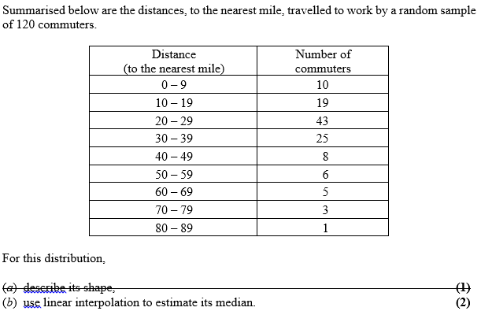
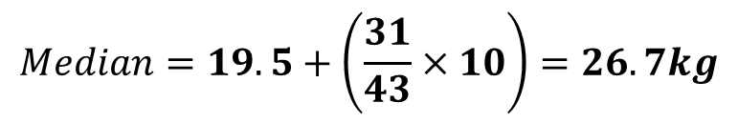
Linear Interpolation with gaps
Edexcel S1 Jan 2007 Q4
10
29
72
97
105
111
116
119
120
?
?
?
$$Median=19.5+\left(\frac{31}{43}×10\right)=26.7kg$$
29
60
72
?
19.5 miles
29.5 miles
?
Med
?

Slide 10
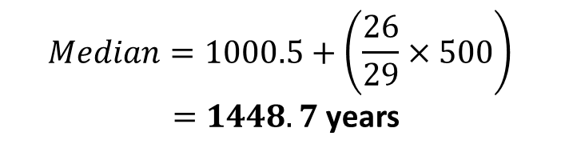
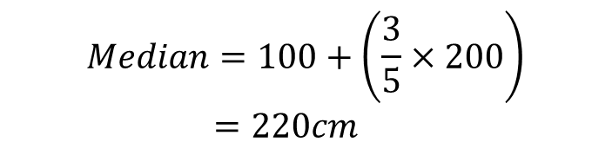
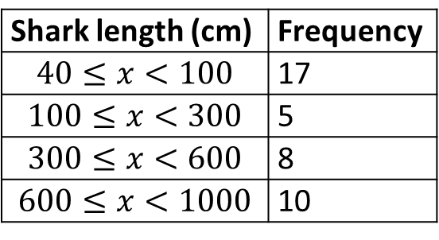
Test Your Understanding
Questions should be on a printed sheet…
Age of relic (years) | Frequency
0-1000 | 24
1001-1500 | 29
1501-1700 | 12
1701-2000 | 35
Shark length (cm) | Frequency
$$40≤x<100$$ | 17
$$100≤x<300$$ | 5
$$300≤x<600$$ | 8
$$600≤x<1000$$ | 10
$$Median=1000.5+\left(\frac{26}{29}×500\right)$$ $=1448.7$ years
$$Median=100+\left(\frac{3}{5}×200\right) \\ =220cm$$
?
?
Notes:
There’s a slip to print out here.

Slide 11
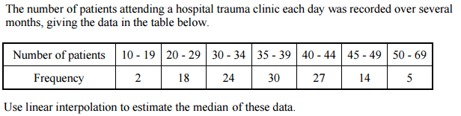
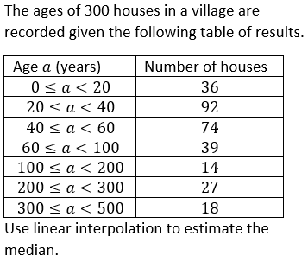
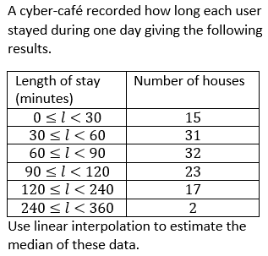
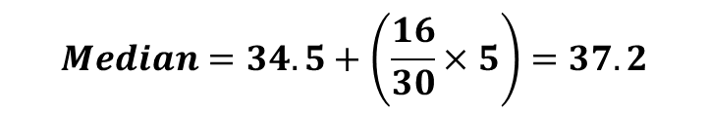
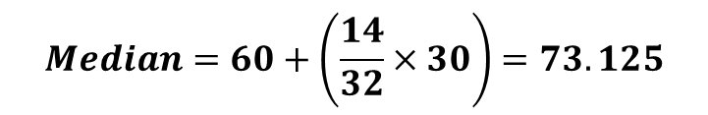
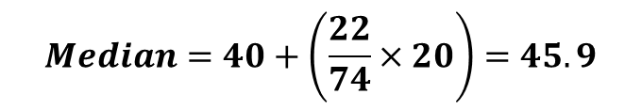
Supplementary Exercise 1
1
Questions should be on a printed sheet…
$$Median=34.5+\left(\frac{16}{30}×5\right)=37.2$$
?
2
3
$$Median=40+\left(\frac{22}{74}×20\right)=45.9$$
?
$$Median=60+\left(\frac{14}{32}×30\right)=73.125$$
?

Slide 12
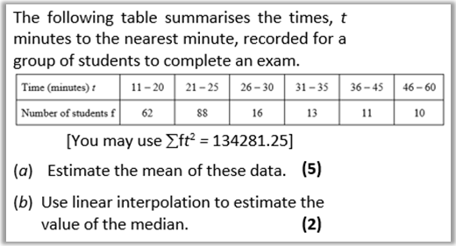
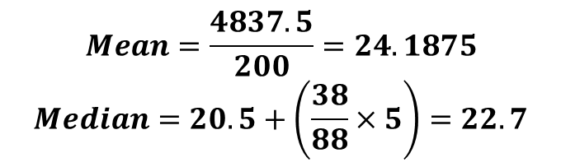
Supplementary Exercise 1
4
?
$$Mean=\frac{4837.5}{200}=24.1875$$
$$Median=20.5+\left(\frac{38}{88}×5\right)=22.7$$
?

Slide 13
Exercises 2.2
Pearson Statistics & Mechanics Year 1/AS
Pages 9-10

Slide 14
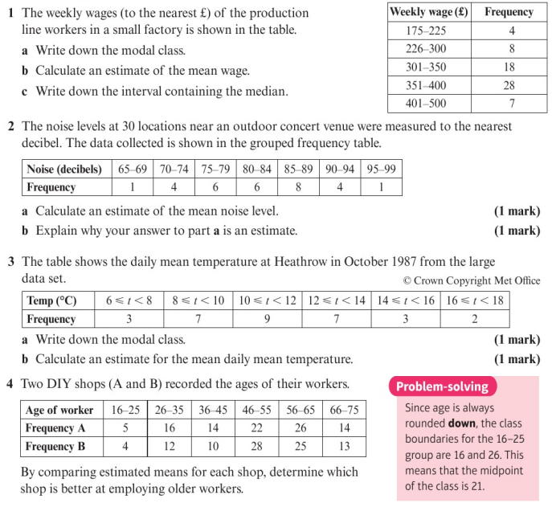
Homework Exercise

Slide 15
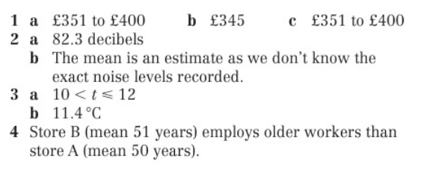
Homework Answers

