Slide 1
P2 Chapter 7: Trigonometric Equations
Identity Modelling

Slide 2
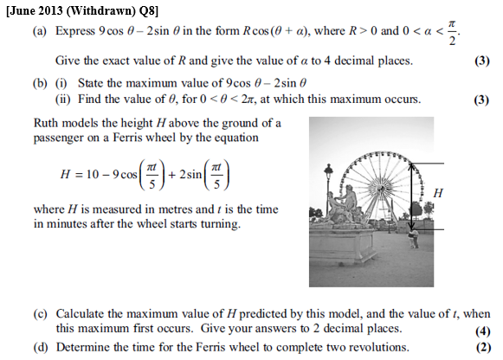
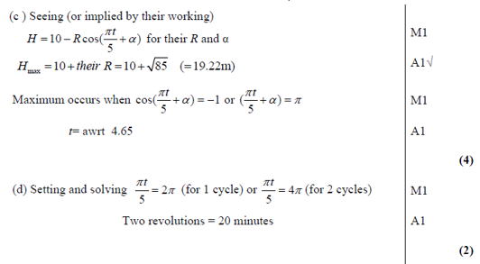
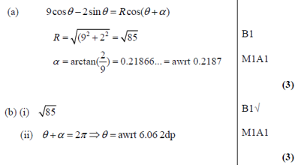
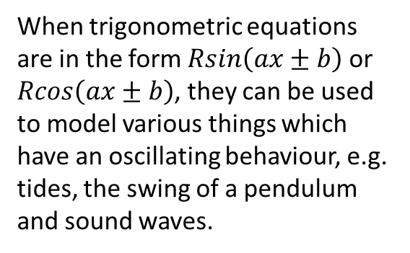
Modelling
When trigonometric equations are in the form $Rsin\left(ax±b\right)$ or $Rcos\left(ax±b\right)$, they can be used to model various things which have an oscillating behaviour, e.g. tides, the swing of a pendulum and sound waves.
? c
? a
? b
? d

Slide 3
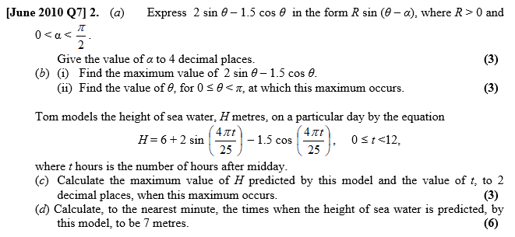
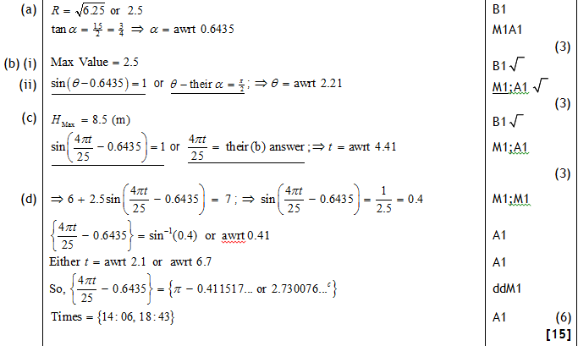
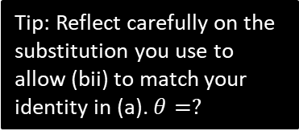
Test Your Understanding
Tip: Reflect carefully on the substitution you use to allow (bii) to match your identity in (a). $θ=?$
? a
? bi
? bii
? c
? d

Slide 4
Exercise 7.7
Pearson Pure Mathematics Year 2/AS
Page 54

Slide 5
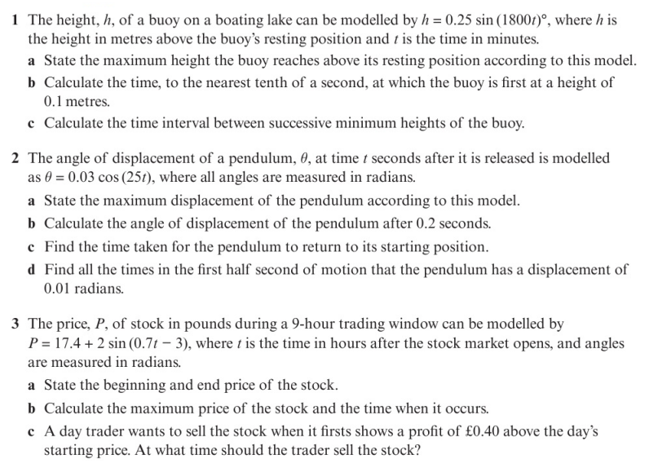
Homework Exercise

Slide 6
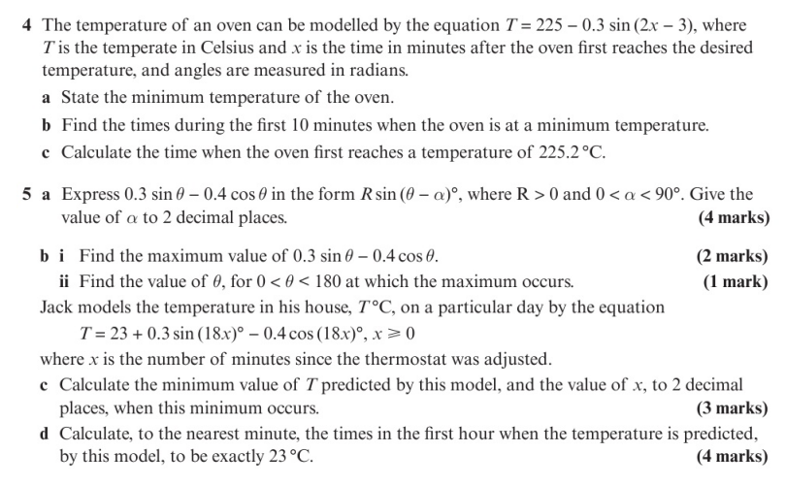
Homework Exercise

Slide 7
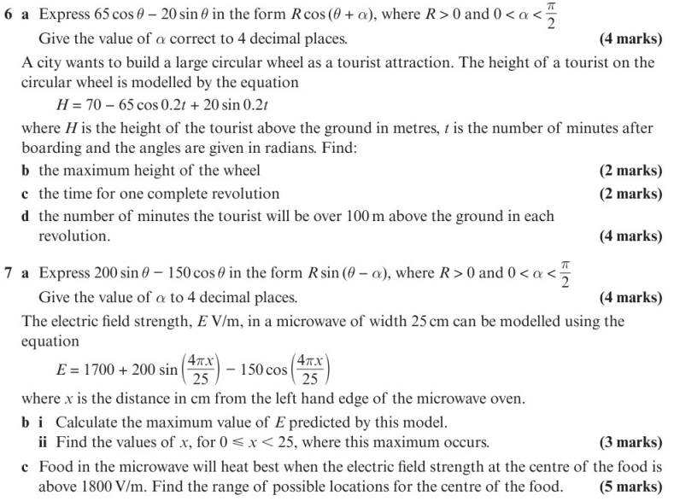
Homework Exercise

Slide 8
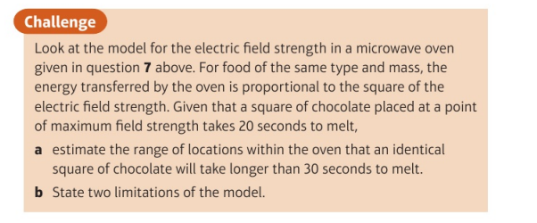
Homework Exercise

Slide 9
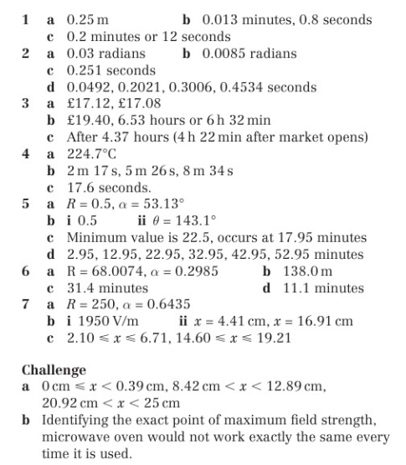
Homework Answers

