Slide 1
P2 Chapter 7: Trigonometric Equations
Addition Formulae

Slide 2
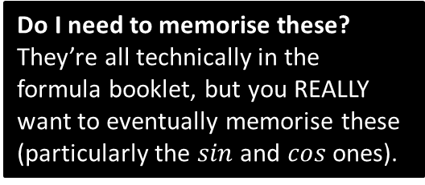
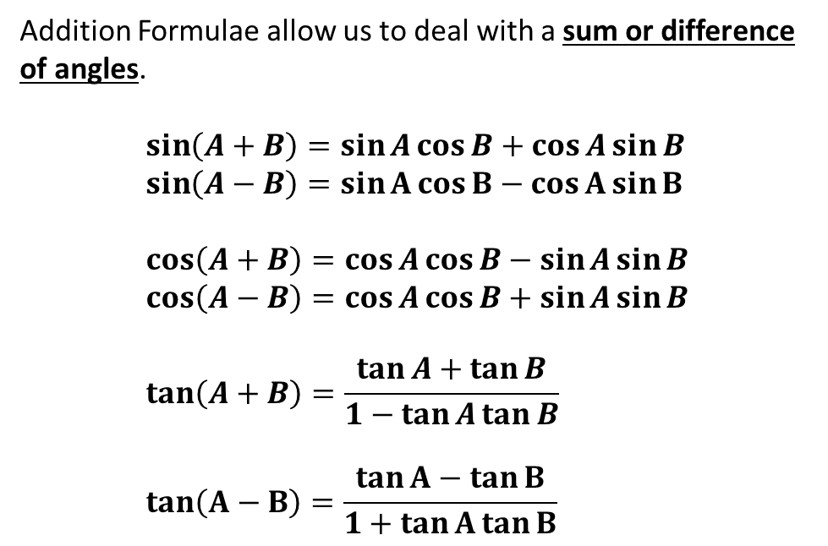
Addition Formulae
Addition Formulae allow us to deal with a sum or difference of angles.
$$\sin\left(A+B\right)=\sin{A}\cos{B}+\cos{A}\sin{B} \\ \sin\left(A−B\right)=\sin{A}\cos{B}−\cos{A}\sin{B} \\ \cos\left(A+B\right)=\cos{A}\cos{B}−\sin{A}\sin{B} \\ \cos\left(A−B\right)=\cos{A}\cos{B}+\sin{A}\sin{B} \\ \tan\left(A+B\right)=\frac{\tan{A}+\tan{B}}{1−\tan{A}\tan{B}} \\ \tan\left(A−B\right)=\frac{\tan{A}−\tan{B}}{1+\tan{A}\tan{B}}$$
How to memorise:
First notice that for all of these the first thing on the RHS is the same as the first thing on the LHS!
For sin, the operator in the middle is the same as on the LHS.
For cos, it’s the opposite.
For tan, it’s the same in the numerator, opposite in the denominator.
Do I need to memorise these?
They’re all technically in the formula booklet, but you REALLY want to eventually memorise these (particularly the $sin$ and $cos$ ones).
For sin, we mix sin and cos.
For cos, we keep the cos’s and sin’s together.

Slide 3
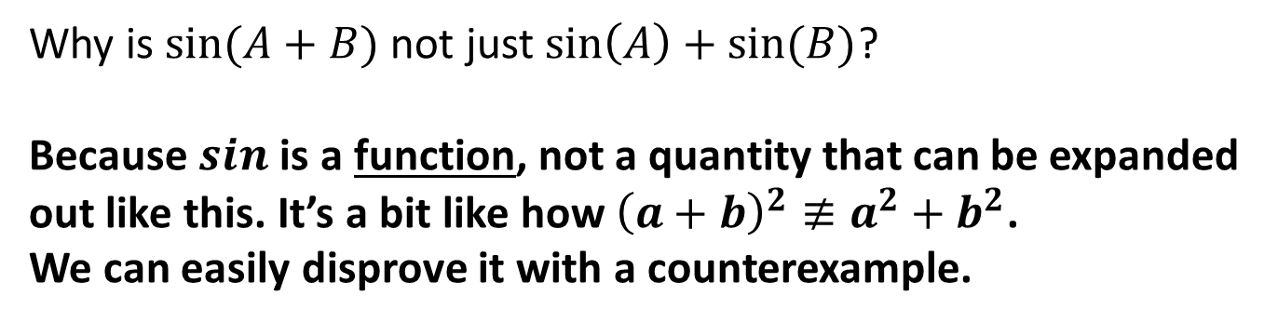
Common Student Error
Why is $sin⁡(A+B)$ not just $\sin\left(A\right)+sin⁡(B)$?
Because $sin$ is a function, not a quantity that can be expanded out like this. It’s a bit like how ${\left(a+b\right)}^{2}≢a^{2}+b^{2}$.
We can easily disprove it with a counterexample.
?

Slide 4

Addition Formulae
Now can you reproduce them without peeking at your notes?
$$\sin\left(A+B\right)≡\sin{A}\cos{B}+\cos{A}\sin{B} \\ \sin\left(A−B\right)\text{≡}\sin{A}\cos{B}−\cos{A}\sin{B} \\ \cos\left(A+B\right)\text{≡}\cos{A}\cos{B}−\sin{A}\sin{B} \\ \cos\left(A−B\right)≡\cos{A}\cos{B}+\sin{A}\sin{B} \\ \tan\left(A+B\right)≡\frac{\tan{A}+\tan{B}}{1−\tan{A}\tan{B}} \\ \tan\left(A−B\right)≡\frac{\tan{A}−\tan{B}}{1+\tan{A}\tan{B}}$$
How to memorise:
?
First notice that for all of these the first thing on the RHS is the same as the first thing on the LHS!
?
?
?
?
For sin, the operator in the middle is the same as on the LHS.
For cos, it’s the opposite.
For tan, it’s the same in the numerator, opposite in the denominator.
?
For sin, we mix sin and cos.
For cos, we keep the cos’s and sin’s together.

Slide 5

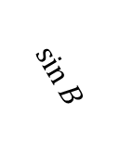


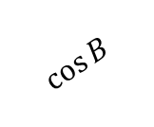
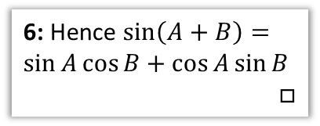








Proof of $\sin\left(A+B\right)≡\sin{A}\cos{B}+\cos{A}\sin{B}$
(Not needed for exam)
2: We can achieve this by forming two right-angled triangles.
3: Then we’re looking for the combined length of these two lines.
1: Suppose we had a line of length 1 projected an angle of $A+B$ above the horizontal.
Then the length of $XY=\sin\left(A+B\right)$
It would seem sensible to try and find this same length in terms of $A$ and $B$ individually.
$$Y$$
4: We can get the lengths of the top triangle…
$$\sin{B}$$
$$\cos{A} \sin{B}$$
$$A$$
5: Which in turn allows us to find the green and blue lengths.
$$1$$
$$sin⁡(A+B)$$
$$\cos{B}$$
6: Hence $\sin\left(A+B\right)=\sin{A}\cos{B}+\cos{A}\sin{B}$
$$□$$
$$\sin{A}\cos{B}$$
$$B$$
$$A$$
$$O$$
$$X$$

Slide 6
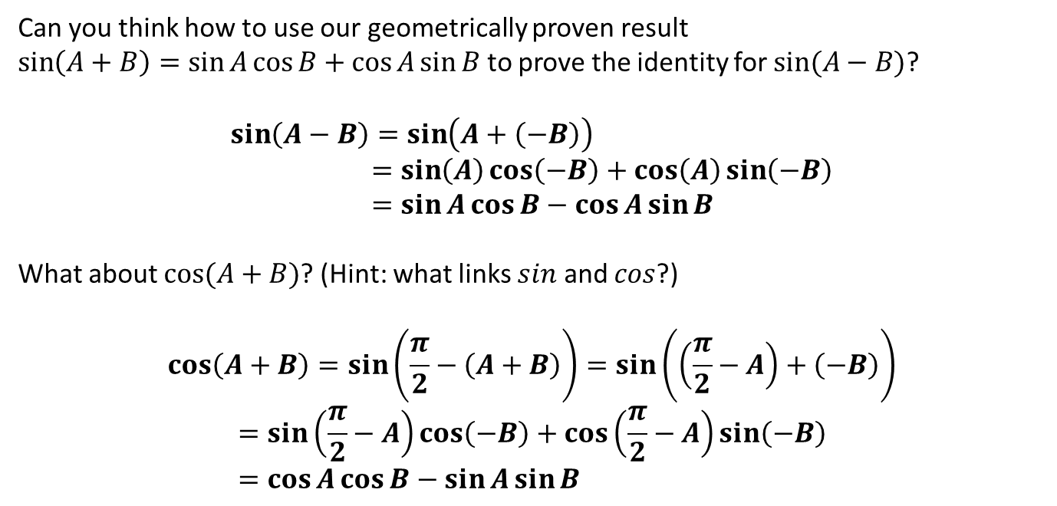
Proof of other identities
Can you think how to use our geometrically proven result
$\sin\left(A+B\right)=\sin{A}\cos{B}+\cos{A}\sin{B}$ to prove the identity for $sin⁡(A−B)$?
$$\sin\left(A−B\right)=\sin\left(A+\left(−B\right)\right) \\ =\sin\left(A\right)\cos\left(−B\right)+\cos\left(A\right)\sin\left(−B\right) \\ =\sin{A}\cos{B}−\cos{A}\sin{B}$$
What about $cos⁡(A+B)$? (Hint: what links $sin$ and $cos$?)
$$\cos\left(A+B\right)=\sin\left(\frac{π}{2}−\left(A+B\right)\right)=\sin\left(\left(\frac{π}{2}−A\right)+\left(−B\right)\right) \\ =\sin\left(\frac{π}{2}−A\right)\cos\left(−B\right)+\cos\left(\frac{π}{2}−A\right)\sin\left(−B\right) \\ =\cos{A}\cos{B}−\sin{A}\sin{B}$$
?
?
?
?

Slide 7
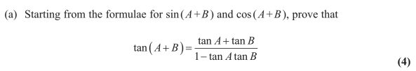
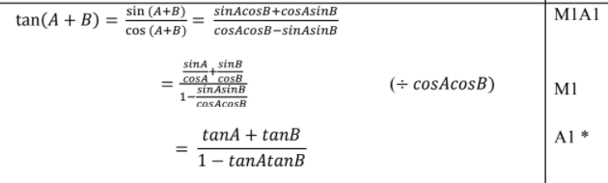
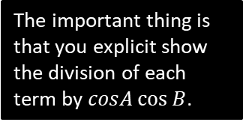
Proof of other identities
Edexcel C3 Jan 2012 Q8
?
The important thing is that you explicit show the division of each term by $cosA\cos{B}$.

Slide 8
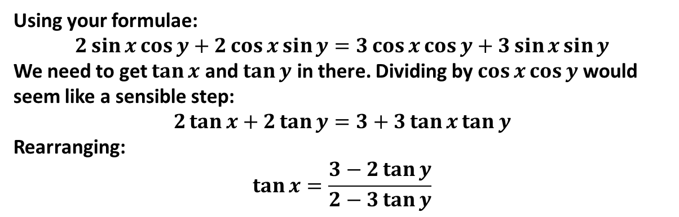
Examples
Q
Given that $2\sin{(x+y)}=3\cos\left(x−y\right)$ express $\tan{x}$ in terms of $\tan{y}$.
?
Using your formulae:
$$2\sin{x}\cos{y}+2\cos{x}\sin{y}=3\cos{x}\cos{y}+3\sin{x}\sin{y}$$
We need to get $\tan{x}$ and $\tan{y}$ in there. Dividing by $\cos{x}\cos{y}$ would seem like a sensible step:
$$2\tan{x}+2\tan{y}=3+3\tan{x}\tan{y}$$
Rearranging:
$$\tan{x}=\frac{3−2\tan{y}}{2−3\tan{y}}$$

Slide 9
Exercise 7.1
Pearson Pure Mathematics Year 2/AS
Page 49

Slide 10
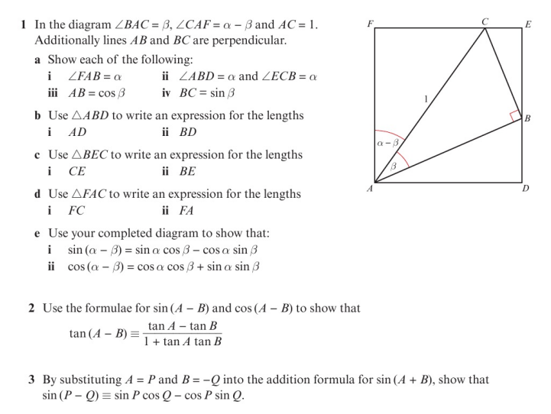
Homework Exercise

Slide 11
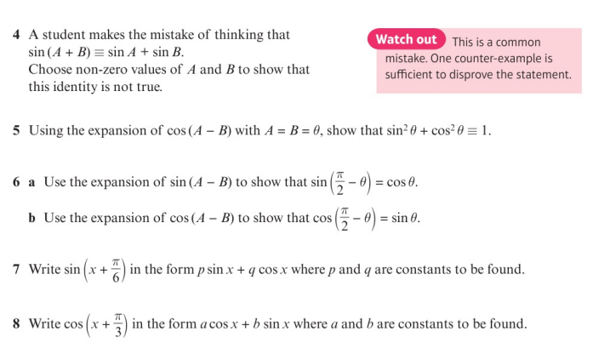
Homework Exercise

Slide 12
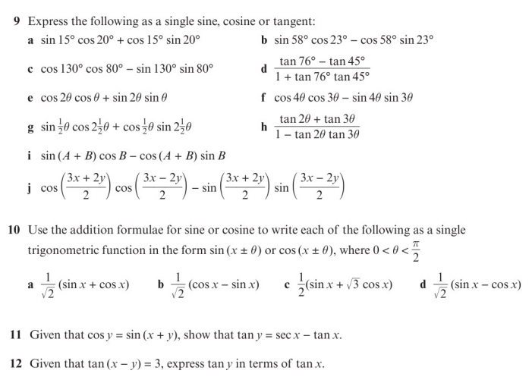
Homework Exercise

Slide 13
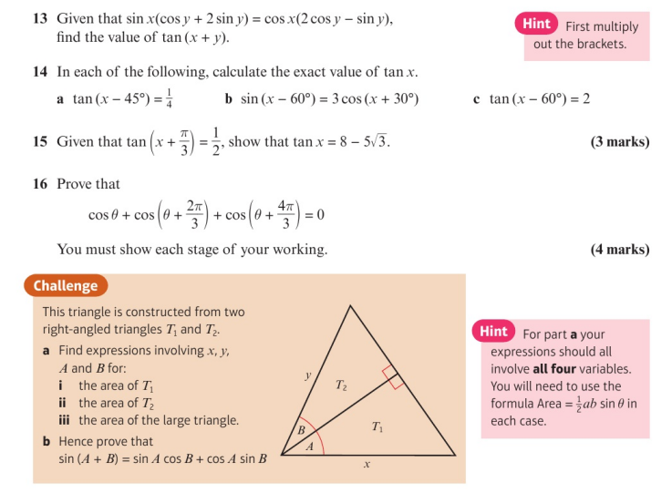
Homework Exercise

Slide 14
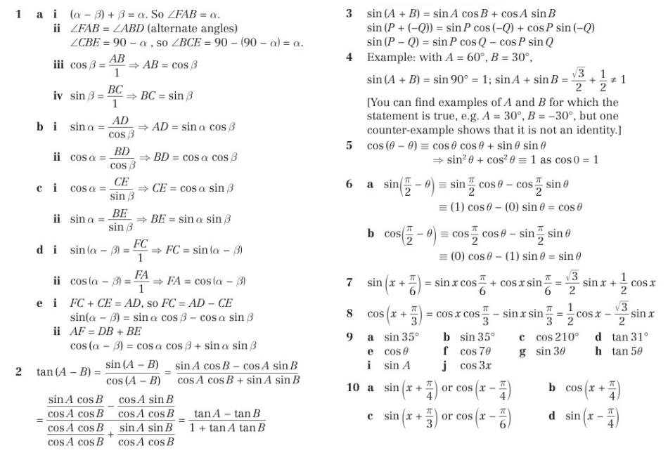
Homework Answers

Slide 15
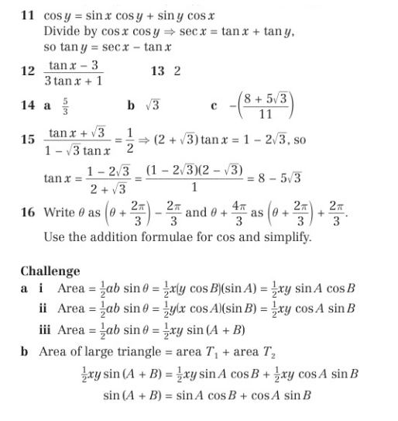
Homework Answers

