Slide 1
P2 Chapter 9: Differentiation Differentiating Exponents and Logs

Slide 2
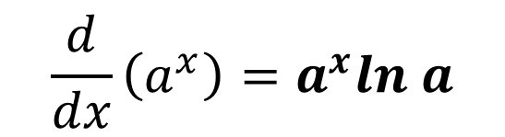
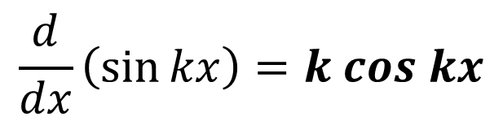
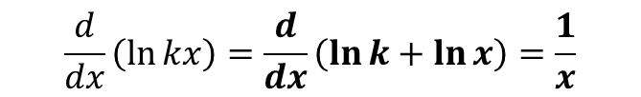
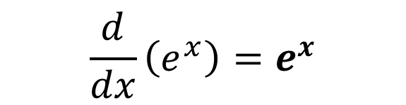
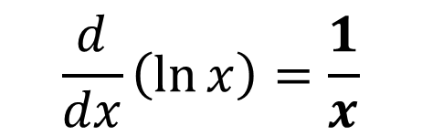
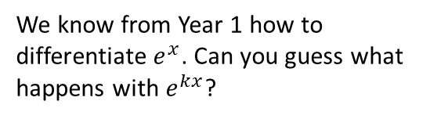
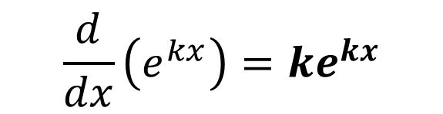
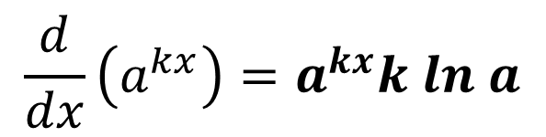
Differentiation exponential and log functions
We know from Year 1 how to differentiate $e^{x}$. Can you guess what happens with $e^{kx}$?
$$\frac{d}{dx}\left(e^{x}\right)=e^{x}$$
?
$$\frac{d}{dx}\left(e^{kx}\right)=ke^{kx}$$
?
$$\frac{d}{dx}\left(\sin{kx}\right)=k cos kx$$
?
$$\frac{d}{dx}\left(\ln{kx}\right)=\frac{d}{dx}\left(\ln{k}+\ln{x}\right)=\frac{1}{x}$$
$$\frac{d}{dx}\left(\ln{x}\right)=\frac{1}{x}$$
?
i.e. Scaling the input of a log does not affect the gradient.
This variant occurs regularly in exams!
$$\frac{d}{dx}\left(a^{x}\right)=a^{x}ln a$$
i.e. When we differentiate an exponential function, we multiply by ln of the base.
We will prove this after we cover implicit differentiation.
?
$$\frac{d}{dx}\left(a^{kx}\right)=a^{kx}k ln a$$
?

Slide 3

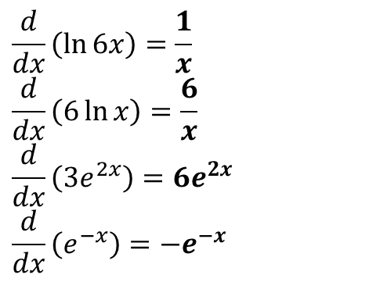
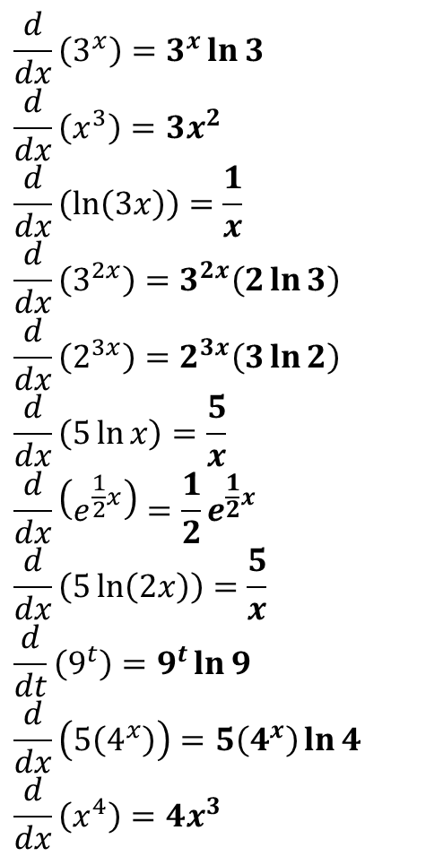

Quickfire Questions
$$\frac{d}{dx}\left(3^{x}\right)=3^{x}\ln{3} \\ \frac{d}{dx}\left(x^{3}\right)=3x^{2} \\ \frac{d}{dx}\left(\ln\left(3x\right)\right)=\frac{1}{x} \\ \frac{d}{dx}\left(3^{2x}\right)=3^{2x}\left(2\ln{3}\right) \\ \frac{d}{dx}\left(2^{3x}\right)=2^{3x}\left(3\ln{2}\right) \\ \frac{d}{dx}\left(5\ln{x}\right)=\frac{5}{x} \\ \frac{d}{dx}\left(e^{\frac{1}{2}x}\right)=\frac{1}{2}e^{\frac{1}{2}x} \\ \frac{d}{dx}\left(5\ln\left(2x\right)\right)=\frac{5}{x} \\ \frac{d}{dt}\left(9^{t}\right)=9^{t}\ln{9} \\ \frac{d}{dx}\left(5\left(4^{x}\right)\right)=5\left(4^{x}\right)\ln{4} \\ \frac{d}{dx}\left(x^{4}\right)=4x^{3}$$
?
?
$$\frac{d}{dx}\left(\ln{6x}\right)=\frac{1}{x} \\ \frac{d}{dx}\left(6\ln{x}\right)=\frac{6}{x}$$
$$\frac{d}{dx}\left(3e^{2x}\right)=6e^{2x} \\ \frac{d}{dx}\left(e^{−x}\right)=−e^{−x}$$
?
?
?
?
?
?
?
bun pun intended
‘Meatier’ Example:
?
A rabbit population $P$ after $t$ years can be modelled using $P=1000(2^{t})$. Determine after how many years the rate of population increase will reach 20,000 rabbits per year.
$$\frac{dP}{dt}=1000\left(2^{t}\right)\ln{2}=20 000 \\ 2^{t}=\frac{20000}{1000\ln{2}}=\frac{20}{\ln{2}} \\ t=\log_{2}\left(\frac{20}{\ln{2}}\right)=4.85 years (3sf)$$
?
?
?
?
?
?

Slide 4
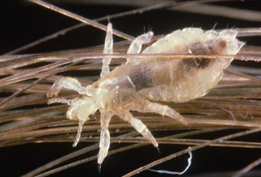
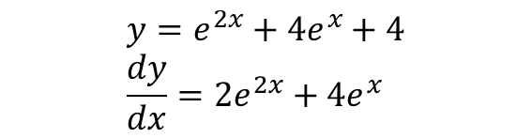


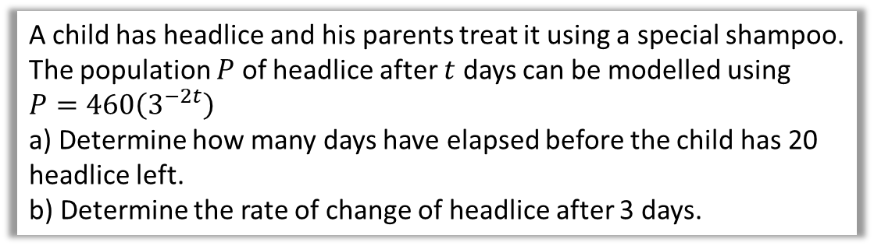
Test Your Understanding
Differentiate ${y=\left(e^{x}+2\right)}^{2}$ (Hint: Expand first)
?
$$y=e^{2x}+4e^{x}+4 \\ \frac{dy}{dx}=2e^{2x}+4e^{x}$$
This one is a bit of a headscratcher (pun intended)
A child has headlice and his parents treat it using a special shampoo. The population $P$ of headlice after $t$ days can be modelled using $P=460\left(3^{−2t}\right)$
a) Determine how many days have elapsed before the child has 20 headlice left.
b) Determine the rate of change of headlice after 3 days.
?
a
$$20=460\left(3^{−2t}\right) \\ 3^{−2t}=\frac{1}{23} \\ −2t=\log_{3}\left(\frac{1}{23}\right)=−2.85… \\ t=1.43 days$$
b
$$\frac{dP}{dt}=−920\left(3^{−2t}\right)\ln{3}$$ When $t=3$,
$$\frac{dP}{dt}=−920\left(3^{−6}\right)\ln{3}=−1.39 headlice/day$$
?

Slide 5
Exercise 9.2
Pearson Pure Year 2
Page 70/71

Slide 6
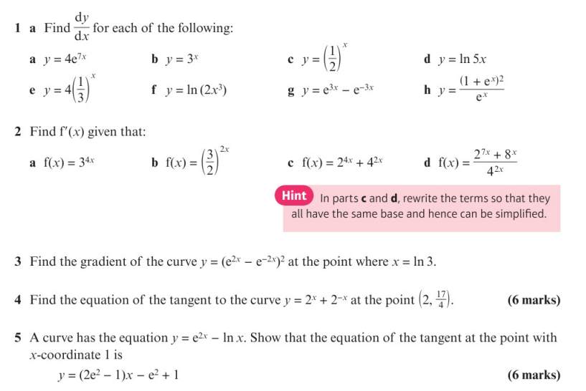
Homework Exercise

Slide 7
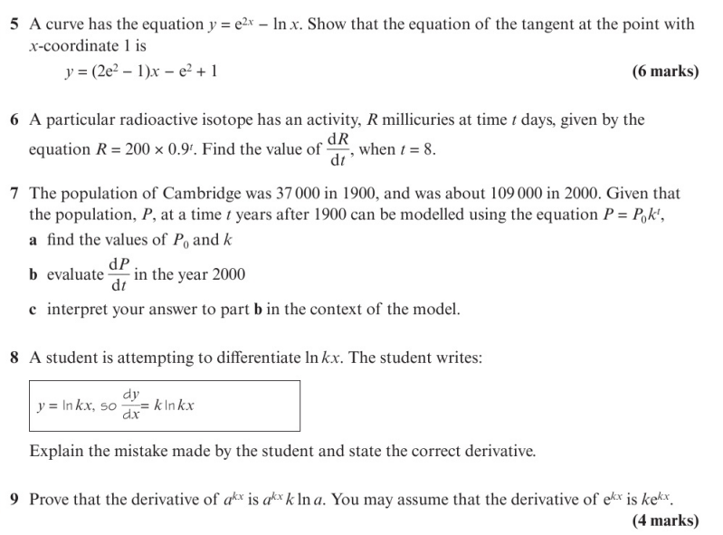
Homework Exercise

Slide 8
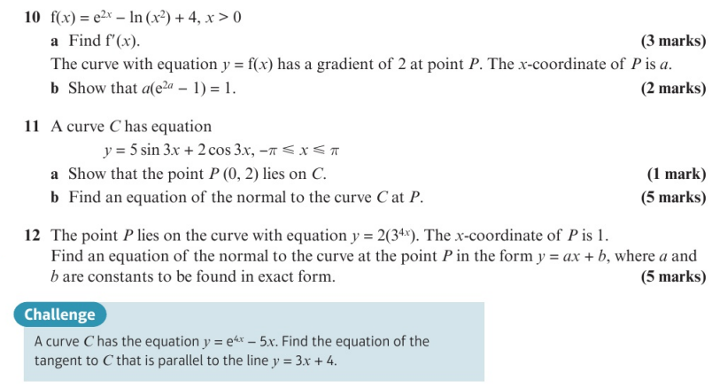
Homework Exercise

Slide 9
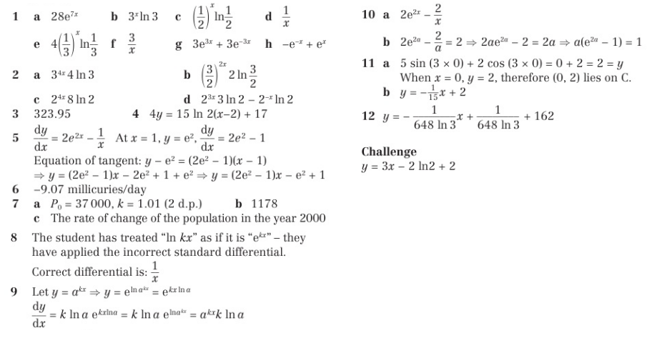
Homework Answers

