Slide 1
Stats1 Chapter 5: Probability Calculating Probability

Slide 2
Experimental
i.e. Dealing with collected data.
Chp2: Measures of Location/Spread
Chp3: Representation of Data
Chp1: Data Collection
Statistics used to summarise data, including mean, standard deviation, quartiles, percentiles. Use of linear interpolation for estimating medians/quartiles.
Producing and interpreting visual representations of data, including box plots and histograms.
Methods of sampling, types of data, and populations vs samples.
Chp4: Correlation
Measuring how related two variables are, and using linear regression to predict values.
Theoretical
Deal with probabilities and modelling to make inferences about what we ‘expect’ to see or make predictions, often using this to reason about/contrast with experimentally collected data.
Chp5: Probability
Chp6: Statistical Distributions
Chp7: Hypothesis Testing
Venn Diagrams, mutually exclusive + independent events, tree diagrams.
Common distributions used to easily find probabilities under certain modelling conditions, e.g. binomial distribution.
Determining how likely observed data would have happened ‘by chance’, and making subsequent deductions.

Slide 3



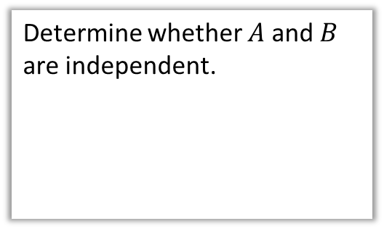






This Chapter Overview
This chapter is a recap of the concepts you learnt at GCSE.
1 :: Basic Probability
2 :: Venn Diagrams
“I throw two fair die. Calculate the probability the sum of the two dice is more than 6.”
“Out of 50 students, 12 play both piano and drums, 30 play piano and 25 play drums. Find the probability a randomly chosen student plays neither instrument.”
3 :: Mutually Exclusive/Independent Events
4 :: Tree Diagrams
“The probability I hit a target is 0.3. If I hit it, the probability I hit again on the next shot is 0.4. If I miss, the probability I hit on the next shot is 0.1. If I shoot 3 times, what’s the probability I hit on the first and third shot?”
Determine whether $A$ and $B$ are independent.
$$A$$
$$B$$
$$C$$
$$3$$
$$1$$
$$4$$
$$6$$
$$2$$
$$5$$

Slide 4
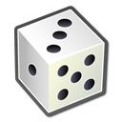

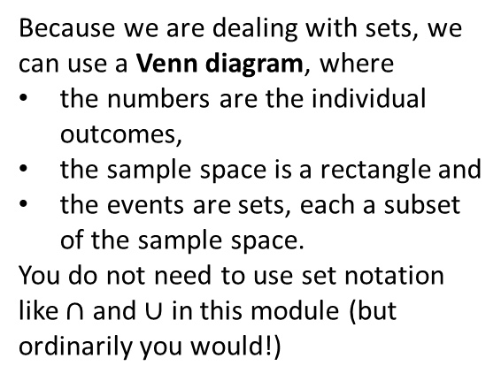


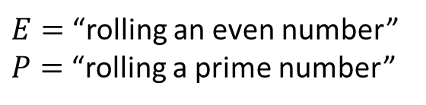
Probability concepts
! An experiment is a repeatable process that gives rise a number a number of outcomes.
! An event is a set of one or more of these outcomes. (We often use capital letters to represent them)
$$S$$
$$P$$
$E=$“rolling an even number”
$P=$“rolling a prime number”
1
3
5
! A sample space is the set of all possible outcomes.
$$E$$
Because we are dealing with sets, we can use a Venn diagram, where
the numbers are the individual outcomes,
the sample space is a rectangle and
the events are sets, each a subset of the sample space.
You do not need to use set notation like $∩$ and $∪$ in this module (but ordinarily you would!)
2
6
4

Slide 5
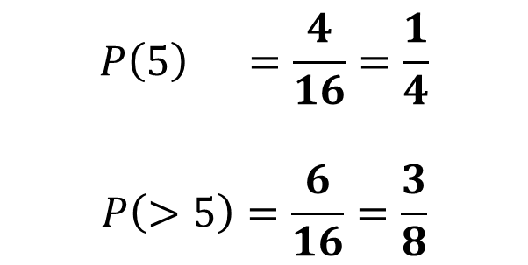
Example
Two fair spinners each have four sectors numbered 1 to 4. The two spinners are spun together and the sum of the numbers indicated on each spinner is recorded.
Find the probability of the spinners indicating a sum of
(a) exactly 5 (b) more than 5
Spinner 1
?
$$P\left(5\right) =\frac{4}{16}=\frac{1}{4}$$
$$P\left(>5\right)=\frac{6}{16}=\frac{3}{8}$$
+
1 2 3 4
1
2
3
4
2 3 4 5
3 4 5 6
?
Spinner 2
4 5 6 7
5 6 7 8
If the sample space is the amalgamation of two underlying experiments, a table is a helpful way to list the outcomes.

Slide 6
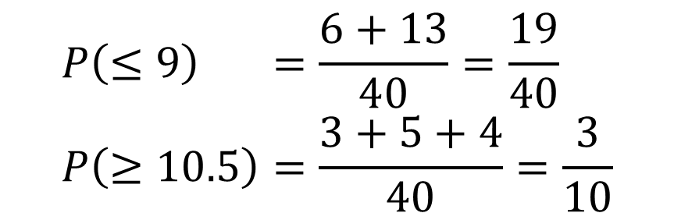
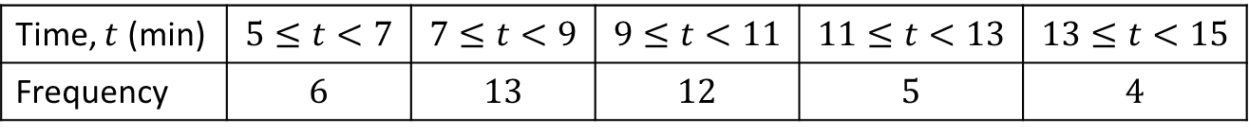
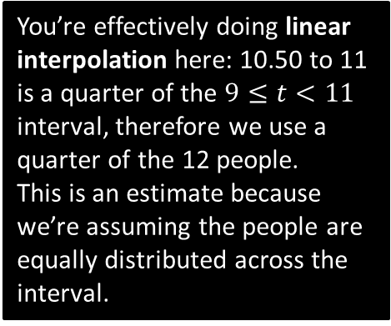
Another Example
The table shows the times taken, in minutes, for a group of students to complete a number puzzle.
A student is chosen at random. Find the probability for a group of students to complete a number puzzle
(a) In under 9 minutes (b) in over 10.5 minutes.
Time, $t$ (min) | $$5≤t<7$$ | $$7≤t<9$$ | $$9≤t<11$$ | $$11≤t<13$$ | $$13≤t<15$$
Frequency | $$6$$ | $$13$$ | $$12$$ | $$5$$ | $$4$$
?
$$P\left(≤9\right) =\frac{6+13}{40}=\frac{19}{40} \\ P\left(≥10.5\right)=\frac{3+5+4}{40}=\frac{3}{10}$$
You’re effectively doing linear interpolation here: 10.50 to 11 is a quarter of the $9≤t<11$ interval, therefore we use a quarter of the 12 people.
This is an estimate because we’re assuming the people are equally distributed across the interval.
?

Slide 7
Exercise 5.1
Pearson Applied Year 1/AS
Page 31

Slide 8
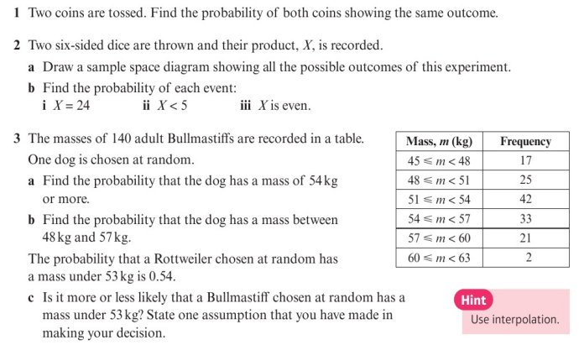
Homework Exercise

Slide 9
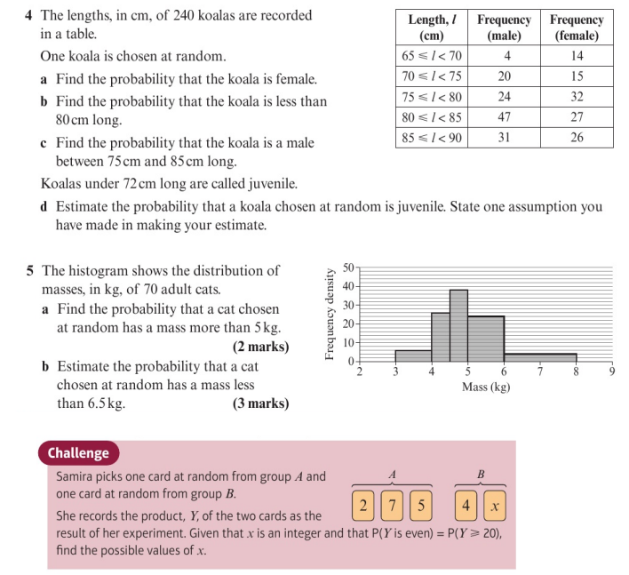
Homework Exercise

Slide 10
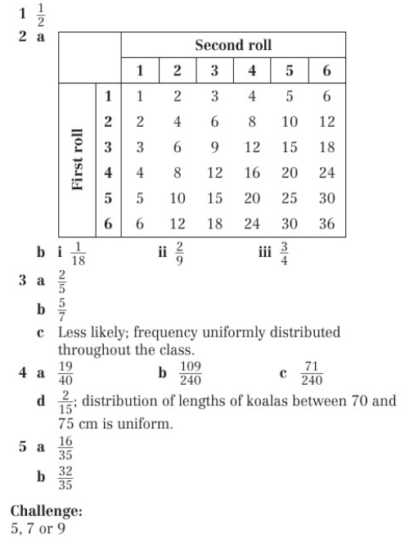
Homework Answers

