Slide 1
P2 Chapter 8: Parametric Equations Angular Parameters

Slide 2

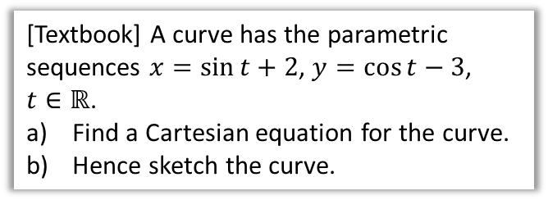





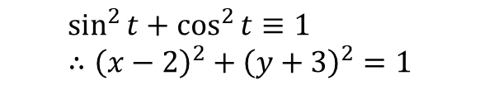
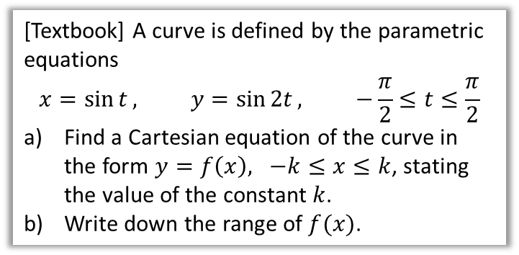
Using Trig Identities
It’s often helpful to use $\sin^{2}{t}+\cos^{2}{t}≡1$ or $1+\tan^{2}{t}≡\sec^{2}{t}$ to turn parametric equations into a single Cartesian one.
[Textbook] A curve has the parametric sequences $x=\sin{t}+2$, $y=\cos{t}−3$, $t∈ℝ$.
Find a Cartesian equation for the curve.
Hence sketch the curve.
[Textbook] A curve is defined by the parametric equations
$$x=\sin{t}, y=\sin{2t}, −\frac{π}{2}≤t≤\frac{π}{2}$$
Find a Cartesian equation of the curve in the form $y=f\left(x\right), −k≤x≤k$, stating the value of the constant $k$.
Write down the range of $f(x)$.
?
$$\sin^{2}{t}+\cos^{2}{t}≡1 \\ ∴{\left(x−2\right)}^{2}+{\left(y+3\right)}^{2}=1$$
a
$$y=2\sin{t}\cos{t} \\ =2\sin{t} \sqrt{1−\sin^{2}{t}} \\ =2x\sqrt{1−x^{2}}$$
When $t=−\frac{π}{2}$, $x=\sin\left(−\frac{π}{2}\right)=−1$.
When $t=\frac{π}{2}, x=\sin\left(\frac{π}{2}\right)=1$
$$∴k=1$$
$\sin\left(2t\right)$ varies between -1 and 1 when $−\frac{π}{2}≤t≤\frac{π}{2}$, therefore range is $−1≤y≤1$.
?
$$y$$
If we have $\cos{t}$, we need to turn in into $\sin{t}$ so that we can replace it with $x$. It’s quite common to have to interchange between $\sin{t}$ and $\cos{t}$ in this way. You may find it helpful to write out the identity $\sin^{2}{t}+\cos^{2}{t}=1$ first.
$$x$$
$$(2,−3)$$
$$1$$
b
?

Slide 3
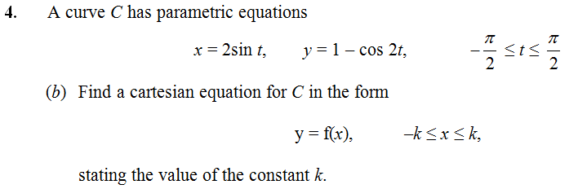




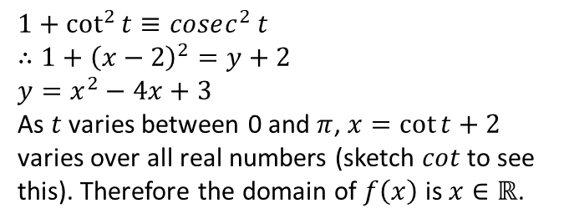
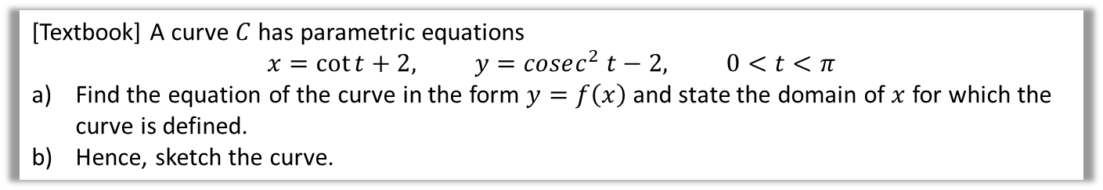

Test Your Understanding
C4 June 2013
which double angle formula would be best here?
?
$$\sin{t}=\frac{x}{2} \\ y=1−\left(1−2\sin^{2}{t}\right) \\ =2\sin^{2}{t} \\ =2{\left(\frac{x}{2}\right)}^{2} \\ =\frac{x^{2}}{2}$$
$$k=2$$
[Textbook] A curve $C$ has parametric equations
$$x=\cot{t}+2, y=cosec^{2} t−2, 0<t<π$$
Find the equation of the curve in the form $y=f\left(x\right)$ and state the domain of $x$ for which the curve is defined.
Hence, sketch the curve.
? a
? b
$$1+\cot^{2}{t}≡cosec^{2} t \\ ∴1+{\left(x−2\right)}^{2}=y+2 \\ y=x^{2}−4x+3$$
As $t$ varies between 0 and $π$, $x=\cot{t+2}$ varies over all real numbers (sketch $cot$ to see this). Therefore the domain of $f\left(x\right)$ is $x∈ℝ$.
$$y$$
$$3$$
$$x$$
$$1$$
$$3$$

Slide 4
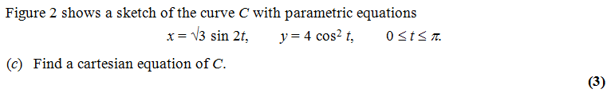

Exercise 8.2
Pearson Pure Mathematics Year 2/AS
Page 61
Further Exam Practice
$$x=2\sqrt{3}\sin{t}\cos{t} \\ x^{2}=12\sin^{2}{t}\cos^{2}{t} \\ x^{2}=12\left(1−\cos^{2}{t}\right)\cos^{2}{t} \\ x^{2}=12\left(1−\frac{y}{4}\right)\left(\frac{y}{4}\right)$$
C4 June 2012 Q6
?

Slide 5
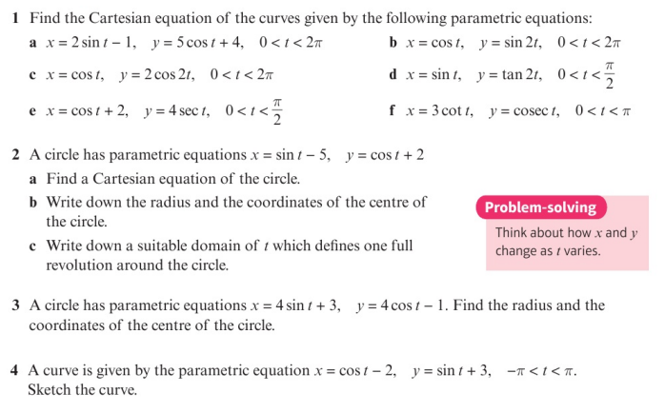
Homework Exercise

Slide 6
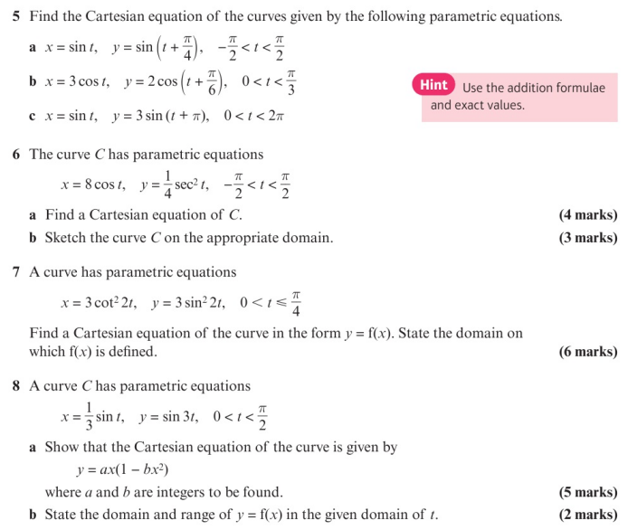
Homework Exercise

Slide 7
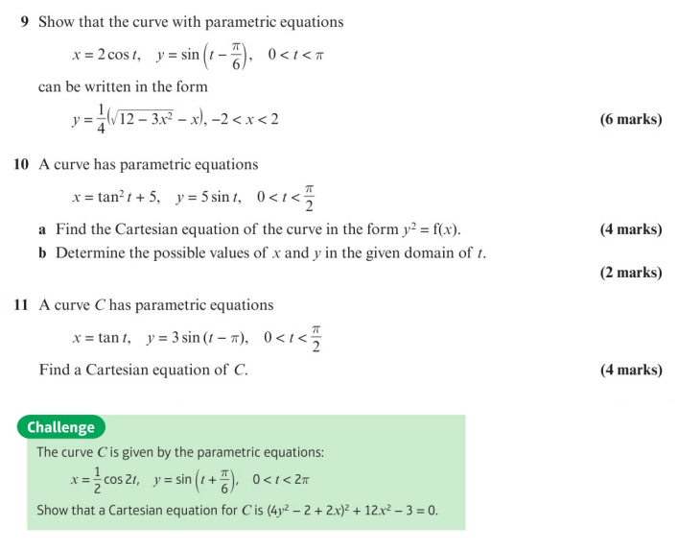
Homework Exercise

Slide 8
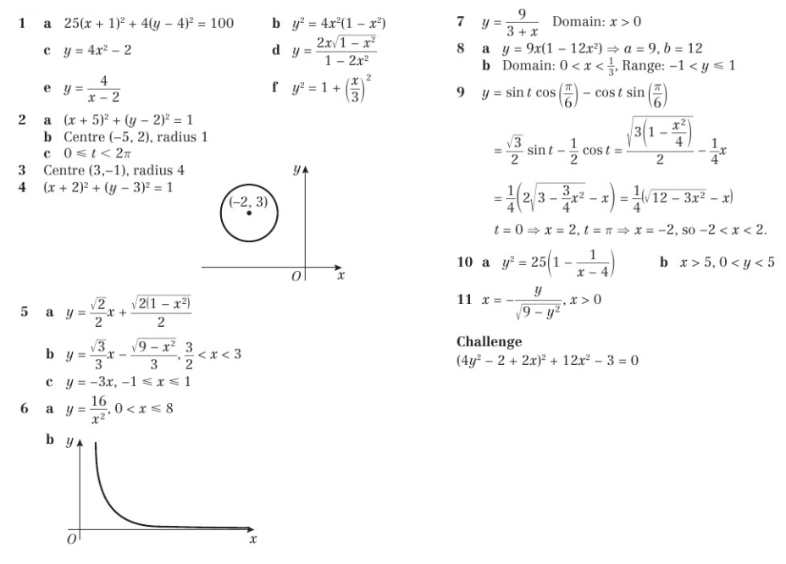
Homework Answers

