Slide 1
P1 Chapter 5: Linear Graphs Linear Formulae

Slide 2


y
Let’s start simple…
What is the equation of this line?
And more importantly, why is it that?
4
3
2
1
-1
-2
-3
-4
x -5 -4 -3 -2 -1 0 1 2 3 4 5 6
$$x=2$$
?
For any point we pick on the line, the $x$ value is always 2.

Slide 3
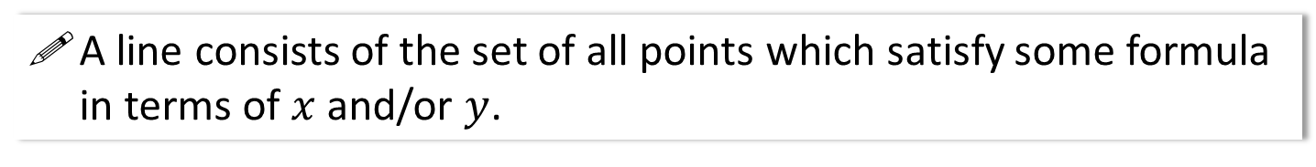
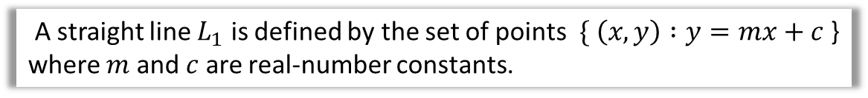
Lines and Equations of Lines
A line consists of the set of all points which satisfy some formula in terms of $x$ and/or $y$.
A line $L_{1}$ is defined by the set of points $\{ \left(x, y\right) :y=3x+2$ }.
A curved line $L_{2}$ is defined by the set of points $\{ \left(x, y\right) :y=x^{2}$ }.
A straight line $L_{1}$ is defined by the set of points $\{ \left(x, y\right) :y=mx+c$ } where $m$ and $c$ are real-number constants.
This chapter will focus on straight lines of the last example type.

Slide 4
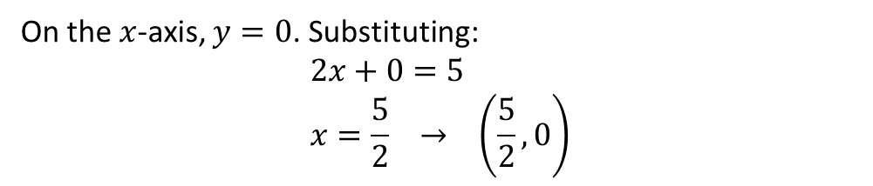

Examples
This means we can substitute the values of a coordinate into our equation whenever we know the point lies on the line.
The point $\left(5,a\right)$ lies on the line with equation $y=3x+2$. Determine the value of $a$.
?
Substituting in $x$ and $y$ value:
$$a=3\left(5\right)+2 \\ a=17$$
Find the coordinate of the point where the line $2x+y=5$ cuts the $x$-axis.
On the $x$-axis, $y=0$. Substituting:
$$2x+0=5 \\ x=\frac{5}{2} → \left(\frac{5}{2}, 0\right)$$
?

Slide 5
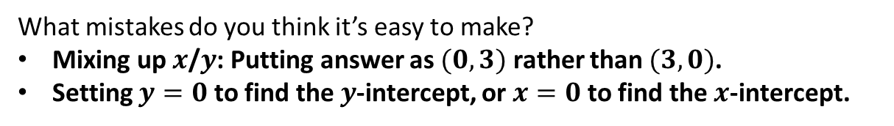

Test Your Understanding
Determine where the line $x+2y=3$ crosses the:
$y$-axis: Let $x=0$. $2y=3 → y=\frac{3}{2}$ $\left(0,\frac{3}{2}\right)$
$x$-axis: Let $y=0$ $x+0=3$ $\left(3,0\right)$
?
?
What mistakes do you think it’s easy to make?
Mixing up $x$/$y$: Putting answer as $(0,3)$ rather than $(3,0)$.
Setting $y=0$ to find the $y$-intercept, or $x=0$ to find the $x$-intercept.
?

Slide 6
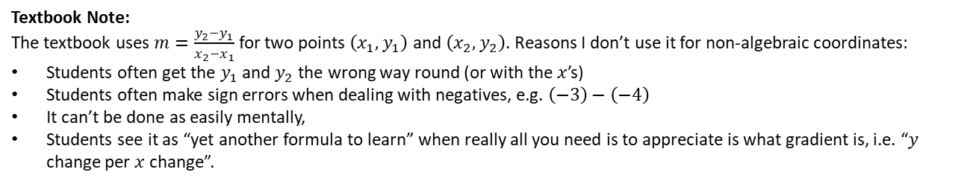

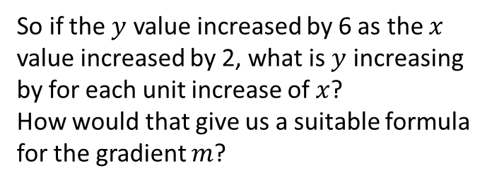


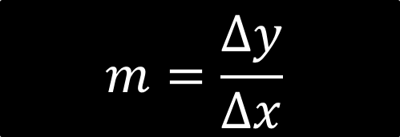

Recap of gradient
The steepness of a line is known as the gradient.
It tells us what $y$ changes by as $x$ increases by 1.
So if the $y$ value increased by 6 as the $x$ value increased by 2, what is $y$ increasing by for each unit increase of $x$?
How would that give us a suitable formula for the gradient $m$?
$$m$$
$$1$$
$$m=\frac{Δy}{Δx}$$
?
$Δ$ is the (capital) Greek letter “delta” and means “change in”.
Textbook Note:
The textbook uses $m=\frac{y_{2}−y_{1}}{x_{2}−x_{1}}$ for two points $\left(x_{1},y_{1}\right)$ and $\left(x_{2},y_{2}\right)$. Reasons I don’t use it for non-algebraic coordinates:
Students often get the $y_{1}$ and $y_{2}$ the wrong way round (or with the $x$’s)
Students often make sign errors when dealing with negatives, e.g. $\left(−3\right)−\left(−4\right)$
It can’t be done as easily mentally,
Students see it as “yet another formula to learn” when really all you need is to appreciate is what gradient is, i.e. “$y$ change per $x$ change”.

Slide 7
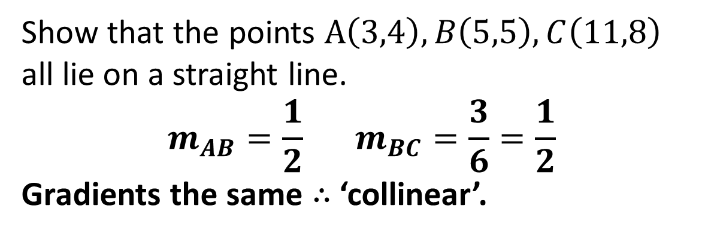



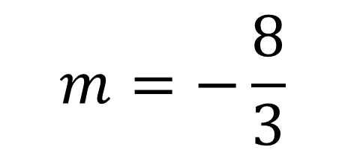
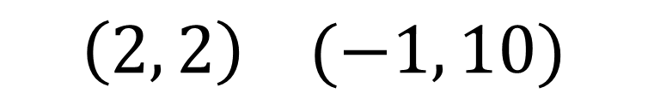
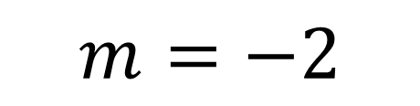
Examples
Find the gradient of the line that goes through the points:
$$\left(1, 4\right) (3, 10)$$
$$m=3$$
1
?
$$m=−2$$
$$\left(5, 7\right) (8, 1)$$
?
2
$$m=−\frac{8}{3}$$
?
$$\left(2, 2\right) (−1, 10)$$
3
4
Show that the points $A\left(3,4\right),B\left(5,5\right),C\left(11,8\right)$ all lie on a straight line.
$$m_{AB}=\frac{1}{2} m_{BC}=\frac{3}{6}=\frac{1}{2}$$
Gradients the same $∴$ ‘collinear’.
?
If points are ‘collinear’ they lie on the same line.

Slide 8

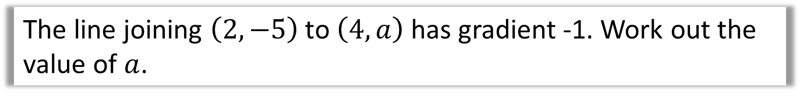
Further Example
The line joining $\left(2,−5\right)$ to $\left(4,a\right)$ has gradient -1. Work out the value of $a$.
?
$$\frac{a−−5}{4−2}=−1 \\ \frac{a+5}{2}=−1 \\ a=−7$$

Slide 9
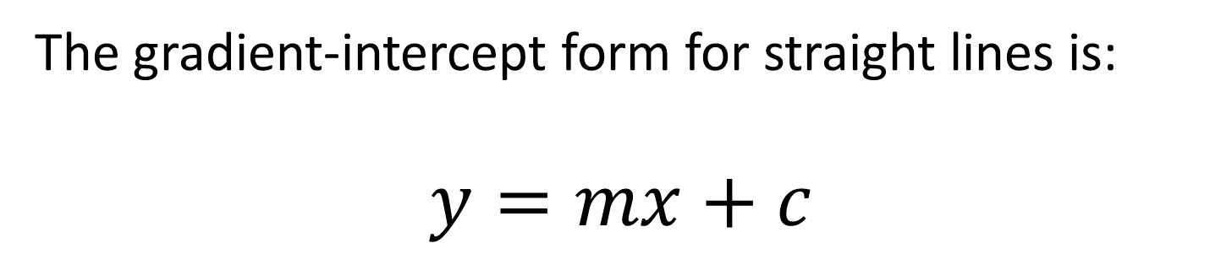
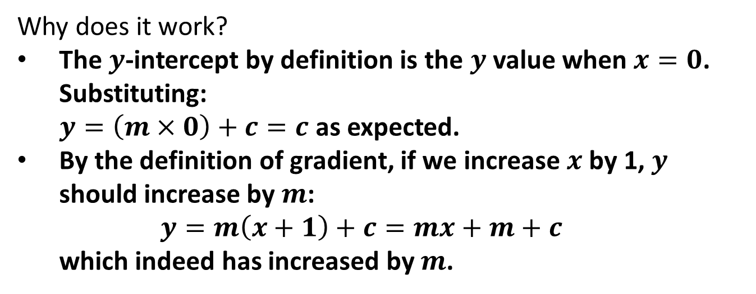
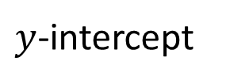
$$y=mx+c$$
The gradient-intercept form for straight lines is:
$$y=mx+c$$
Gradient
$y$-intercept
Why does it work?
The $y$-intercept by definition is the $y$ value when $x=0$. Substituting: $y=\left(m×0\right)+c=c$ as expected.
By the definition of gradient, if we increase $x$ by 1, $y$ should increase by $m$: $y=m\left(x+1\right)+c=mx+m+c$ which indeed has increased by $m$.
?

Slide 10
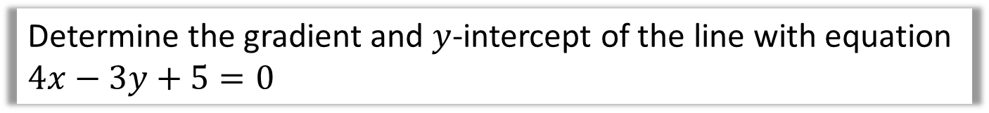
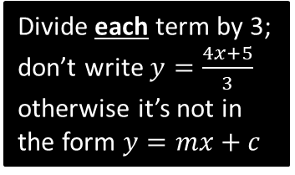

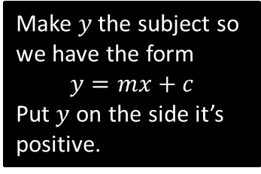
$$y=mx+c$$
Determine the gradient and $y$-intercept of the line with equation $4x−3y+5=0$
?
Make $y$ the subject so we have the form
$$y=mx+c$$
Put $y$ on the side it’s positive.
$$3y=4x+5 \\ y=\frac{4}{3}x+\frac{5}{3}$$
$$∴m=\frac{4}{3}, c=\frac{5}{3}$$
Divide each term by 3; don’t write $y=\frac{4x+5}{3}$ otherwise it’s not in the form $y=mx+c$
This is algebra, so use improper fractions, and not mixed numbers or recurring decimals.

Slide 11
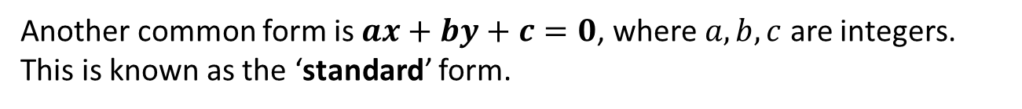

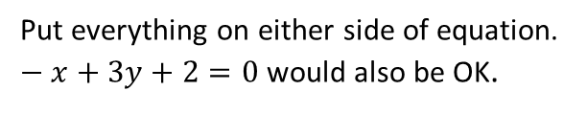

$$ax+by+c=0$$
Another common form is $ax+by+c=0$, where $a,b,c$ are integers. This is known as the ‘standard’ form.
Express $y=\frac{1}{3}x−\frac{2}{3}$ in the form $ax+by+c=0$, where $a,b,c$ are integers.
?
$$3y=x−2 \\ x−3y−2=0$$
We don’t want fractions, so multiply by an appropriate number.
Put everything on either side of equation. $−x+3y+2=0$ would also be OK.
We’ll see on the next slide WHY we might want to put an equation in this form over $y=mx+c$…

Slide 12

Test Your Understanding
Express $y=\frac{2}{5}x+\frac{3}{5}$ in the form $ax+by+c=0$, where $a,b,c$ are integers.
?
$$5y=2x+3 \\ 2x−5y+3=0$$

Slide 13

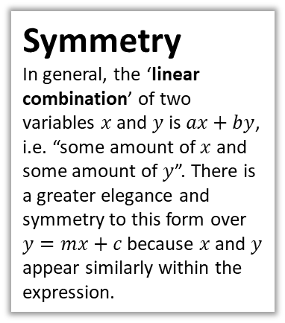



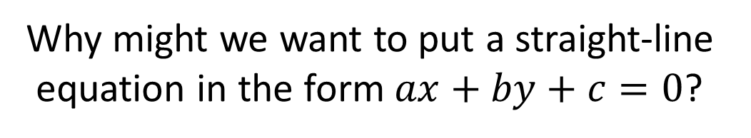
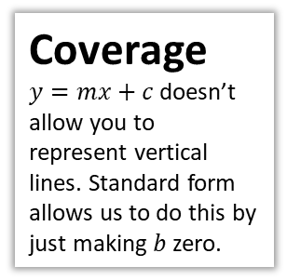

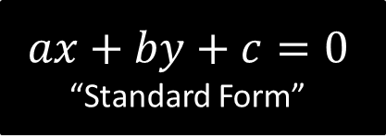

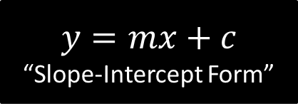

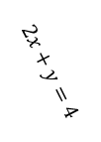
Just for your interest…
Why might we want to put a straight-line equation in the form $ax+by+c=0$?
$$y=mx+c$$
“Slope-Intercept Form”
$$ax+by+c=0$$
“Standard Form”
Usefulness
This more ‘elegant’ form also means it ties in with vectors and matrices. For vectors, you will learn about the ‘dot product’ of two vectors:
$$\left(\begin{matrix} \\ \\ \end{matrix}\begin{matrix}a \\ b\end{matrix}\right)⋅\left(\begin{matrix}x \\ y\end{matrix}\right)=ax+by$$
Since $ax+by+c=0$, we can represent a straight line using: $$\left(\begin{matrix} \\ \\ \end{matrix}\begin{matrix}a \\ b\end{matrix}\right)⋅\left(\begin{matrix}x \\ y\end{matrix}\right)+c=0 (1)$$
Coverage
$y=mx+c$ doesn’t allow you to represent vertical lines. Standard form allows us to do this by just making $b$ zero.
Symmetry
In general, the ‘linear combination’ of two variables $x$ and $y$ is $ax+by$, i.e. “some amount of $x$ and some amount of $y$”. There is a greater elegance and symmetry to this form over $y=mx+c$ because $x$ and $y$ appear similarly within the expression.
We can extend to 3D points to get the equation of a plane:
$$\left(\begin{matrix}a \\ b \\ c\end{matrix}\right)⋅\left(\begin{matrix}x \\ y \\ z\end{matrix}\right)+d=0 (2)$$
Conveniently, in equation $(1)$, the vector $\left(\begin{matrix} \\ \\ \end{matrix}\begin{matrix}a \\ b\end{matrix}\right)$ is perpendicular to the line. And in equation $(2)$, the vector $\left(\begin{matrix}a \\ b \\ c\end{matrix}\right)$ is perpendicular to the plane. Nice!
$$x+4=0$$
$$2x+y=4$$
$$\left(\begin{matrix}2 \\ 1\end{matrix}\right)⋅\left(\begin{matrix}x \\ y\end{matrix}\right)=4$$
$$2x+y=4$$
$$\left(\begin{matrix}2 \\ 1\end{matrix}\right)$$

Slide 14
Exercise 5.1
Pearson Pure Mathematics Year 1/AS
Page 37

Slide 15
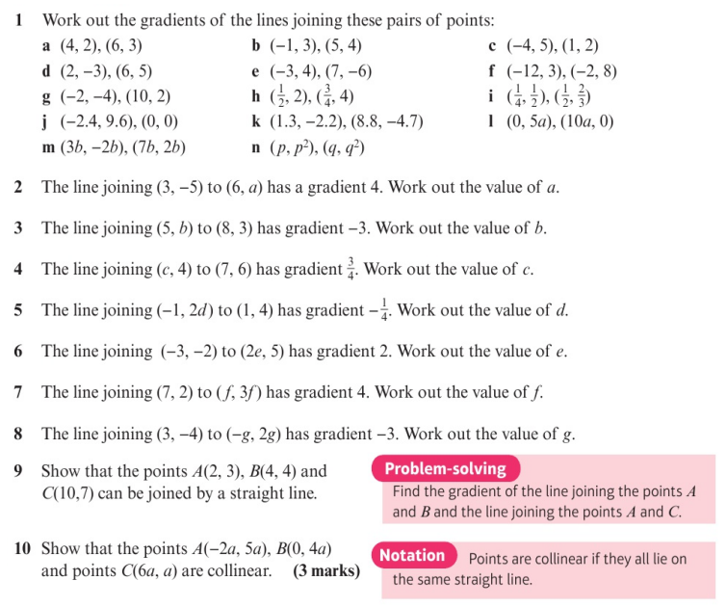
Homework Exercise

Slide 16
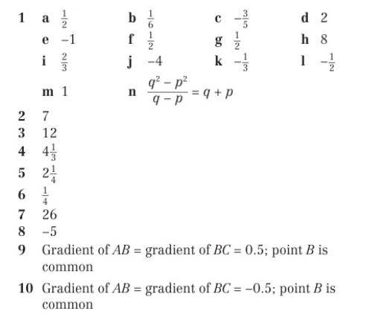
Homework Answers

Slide 17
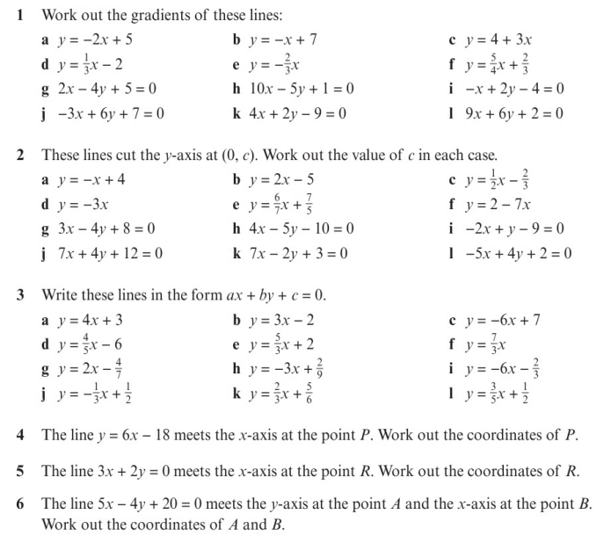
Homework Exercise

Slide 18
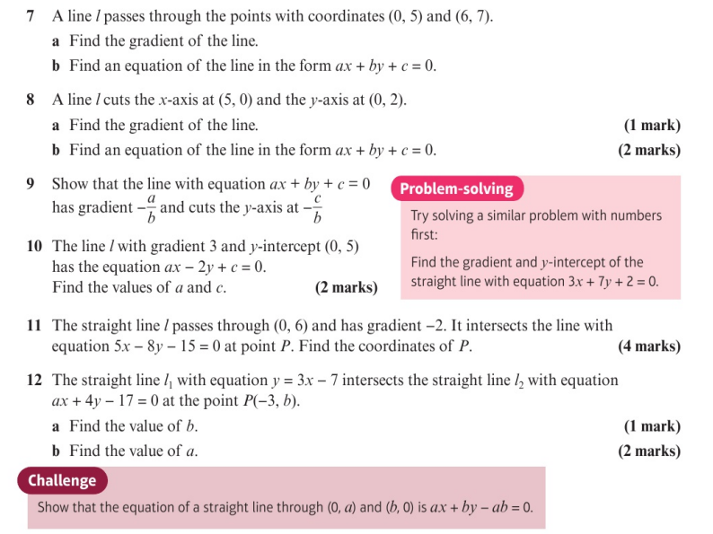
Homework Exercise

Slide 19
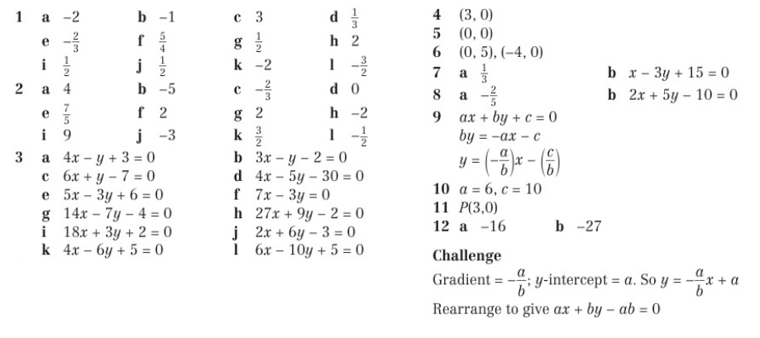
Homework Answers

