Slide 1
P1 Chapter 10: Trigonometry Equations Exact Values

Slide 2





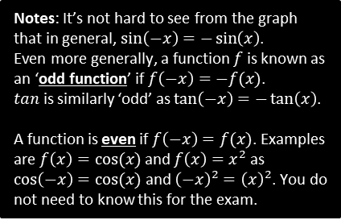


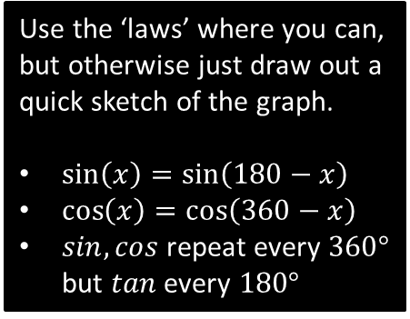

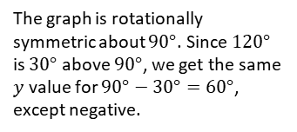









Examples
Without a calculator, work out the value of each below.
$tan$ repeats every $180°$ so can subtract $180°$
Use the ‘laws’ where you can, but otherwise just draw out a quick sketch of the graph.
$\sin\left(x\right)=\sin\left(180−x\right)$
$\cos\left(x\right)=\cos\left(360−x\right)$
$sin,cos$ repeat every $360°$ but $tan$ every $180°$
?
$$\tan\left(225°\right)=\tan\left(45°\right)=1$$
$$\tan\left(210°\right)=\tan\left(30°\right)=\frac{1}{\sqrt{3}} \\ \sin\left(150°\right)=\sin\left(30°\right)=\frac{1}{2} \\ \cos\left(300°\right)=\cos\left(60°\right)=\frac{1}{2} \\ \sin\left(−45°\right)=−\sin\left(45°\right)=−\frac{1}{\sqrt{2}}$$
$$\cos\left(750°\right)=\cos\left(30°\right)=\frac{\sqrt{3}}{2}$$
$$\cos\left(120°\right)=−\cos\left(60°\right)=−\frac{1}{2}$$
?
For $sin$ we can subtract from $180°$.
?
?
For $cos$ we can subtract from $360°$.
?
We have to resort to a sketch for this one.
$$y=\sin\left(x\right)$$
Notes: It’s not hard to see from the graph that in general, $\sin\left(−x\right)=−\sin\left(x\right)$.
Even more generally, a function $f$ is known as an ‘odd function’ if $f\left(−x\right)=−f(x)$.
$tan$ is similarly ‘odd’ as $\tan\left(−x\right)=−\tan\left(x\right)$.
A function is even if $f\left(−x\right)=f(x)$. Examples are $f\left(x\right)=cos⁡(x)$ and $f\left(x\right)=x^{2}$ as $\cos\left(−x\right)=cos⁡(x)$ and ${\left(−x\right)}^{2}={\left(x\right)}^{2}$. You do not need to know this for the exam.
?
cos repeats every $360°$.
$$\frac{1}{\sqrt{2}}$$
$$−45$$
$$45$$
$$x$$
?
$$−\frac{1}{\sqrt{2}}$$
Again, let’s just use a graph.
$$y=\cos\left(x\right)$$
$$\frac{1}{2}$$
The graph is rotationally symmetric about $90°$. Since $120°$ is $30°$ above $90°$, we get the same $y$ value for $90°−30°=60°$, except negative.
$$60$$
$$120$$
$$x$$
$$90$$
$$180$$

Slide 3
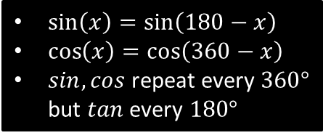

Test Your Understanding
Without a calculator, work out the value of each below.
?
$$\cos\left(315°\right)=\cos\left(45°\right)=\frac{1}{\sqrt{2}}$$
$$\sin\left(420°\right)=\sin\left(60°\right)=\frac{\sqrt{3}}{2} \\ \tan\left(−120°\right)=\tan\left(60°\right)=\sqrt{3}$$
$$\tan\left(−45°\right)=−tan\left(45°\right)=−1 \\ \sin\left(135°\right)=\sin\left(45°\right)=\frac{1}{\sqrt{2}}$$
$\sin\left(x\right)=\sin\left(180−x\right)$
$\cos\left(x\right)=\cos\left(360−x\right)$
$sin,cos$ repeat every $360°$ but $tan$ every $180°$
?
?
?
?

Slide 4
Exercise 10.2
Pearson Pure Mathematics Year 1/AS
Page 79

Slide 5
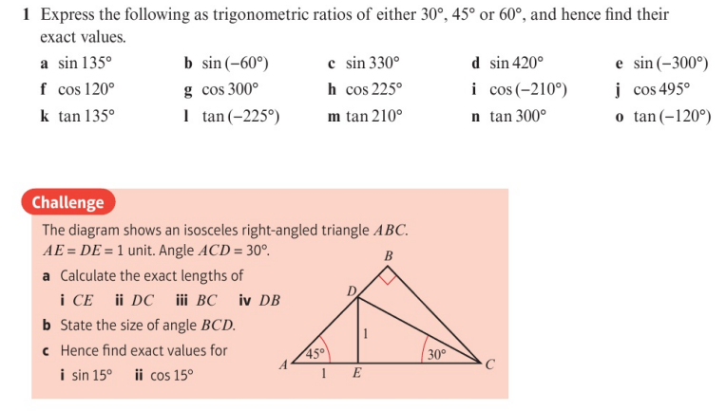
Homework Exercise

Slide 6
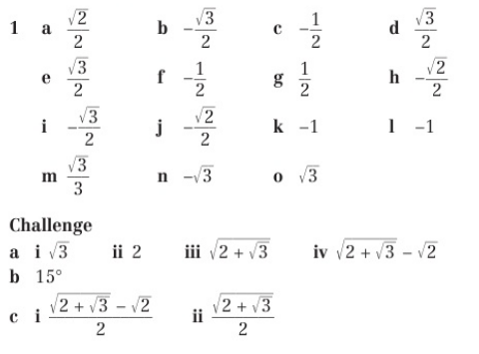
Homework Answers

