Slide 1
P1 Chapter 8: Binomial Expansion Coefficient Formula

Slide 2

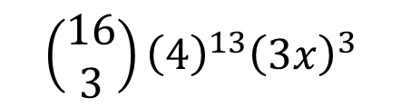







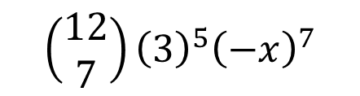

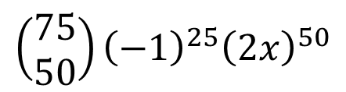

Getting a single term in the expansion
In the expansion of ${\left(a+b\right)}^{n}$ the general term is given by $\left(\begin{matrix}n \\ r\end{matrix}\right)a^{n−r}b^{r}$
Expression
Power of $x$ in term wanted.
Term in expansion
?
$${\left(a+x\right)}^{10}$$
$$3$$
$$\left(\begin{matrix}10 \\ 3\end{matrix}\right){a^{7}x}^{3}$$
Note: The two powers add up to 10.
$$\left(\begin{matrix}75 \\ 50\end{matrix}\right){\left(−1\right)}^{25}{\left(2x\right)}^{50}$$
$${\left(2x−1\right)}^{75}$$
$$50$$
?
$$\left(\begin{matrix}12 \\ 7\end{matrix}\right){\left(3\right)}^{5}{\left(−x\right)}^{7}$$
$${\left(3−x\right)}^{12}$$
$$7$$
?
?
$${\left(3x+4\right)}^{16}$$
$$3$$
$$\left(\begin{matrix}16 \\ 3\end{matrix}\right){\left(4\right)}^{13}{\left(3x\right)}^{3}$$

Slide 3

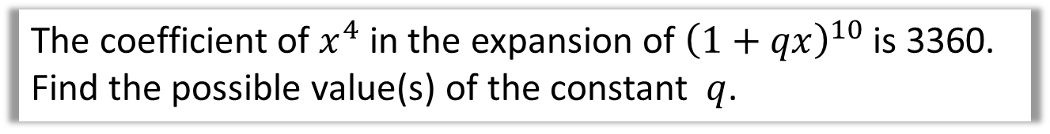
Getting a single term in the expansion
The coefficient of $x^{4}$ in the expansion of ${\left(1+qx\right)}^{10}$ is 3360. Find the possible value(s) of the constant $q$.
Term is:
$$\left(\begin{matrix}10 \\ 4\end{matrix}\right)\left(1^{6}\right){\left(qx\right)}^{4}=210q^{4}x^{4}$$
Therefore:
$$210q^{4}=3360 \\ q^{4}=16 \\ q=±2$$
?
?

Slide 4

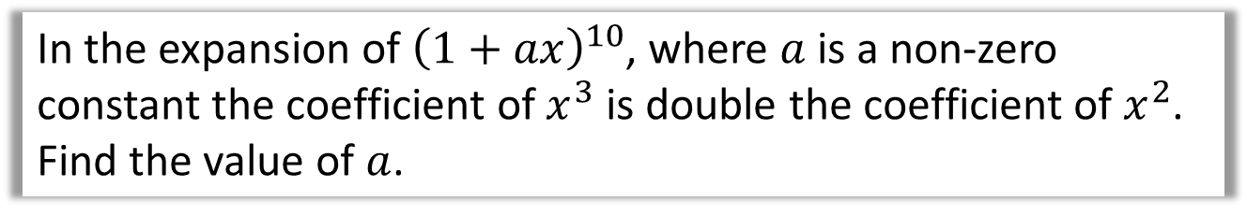
Test Your Understanding
In the expansion of ${\left(1+ax\right)}^{10}$, where $a$ is a non-zero constant the coefficient of $x^{3}$ is double the coefficient of $x^{2}$. Find the value of $a$.
?
$x^{2}$ term: $\left(\begin{matrix}10 \\ 2\end{matrix}\right)\left(1^{8}\right){\left(ax\right)}^{2}=45a^{2}x^{2}$
$x^{3}$ term: $\left(\begin{matrix}10 \\ 3\end{matrix}\right)\left(1^{7}\right){\left(ax\right)}^{3}=120a^{3}x^{3}$
$$∴120a^{3}=2\left(45a^{2}\right) \\ 120a^{3}=90a^{2} \\ 4a^{3}−3a^{2}=0 \\ a^{2}\left(4a−3\right)=0 \\ a=0 or a=\frac{3}{4}$$
But $a$ is non-zero, so $a=\frac{3}{4}$

Slide 5


Exercise 8.4
Pearson Pure Mathematics Year 1/AS
Pages 64
Extension
2
[STEP I 2013 Q6] By considering the coefficient of $x^{r}$ in the series for $\left(1+x\right){\left(1+x\right)}^{n}$, or otherwise, obtain the following relation between binomial coefficients:
$$\left(\begin{matrix}n \\ r\end{matrix}\right)+\left(\begin{matrix}n \\ r−1\end{matrix}\right)=\left(\begin{matrix}n+1 \\ r\end{matrix}\right)$$
Noting that $\left(1+x\right){\left(1+x\right)}^{n}={\left(1+x\right)}^{n+1}$, the $x^{r}$ term is $\left(\begin{matrix}n+1 \\ r\end{matrix}\right)x^{r}$.
But the $x^{r}$ term could be obtained either by 1 in the first bracket multiplied by $x^{r}$ term in the second, giving $1×\left(\begin{matrix}n \\ r\end{matrix}\right)x^{r}$, or the $x$ in the first bracket multiplied by the $x^{r−1}$ term in the second, $x×\left(\begin{matrix}n \\ r−1\end{matrix}\right)x^{r−1}=\left(\begin{matrix}n \\ r−1\end{matrix}\right)x^{r}$. Thus comparing coefficients: $$\left(\begin{matrix}n \\ r\end{matrix}\right)+\left(\begin{matrix}n \\ r−1\end{matrix}\right)=\left(\begin{matrix}n+1 \\ r\end{matrix}\right)$$
1
[MAT 2014 1G] Let $n$ be a positive integer. The coefficient of $x^{3}y^{5}$ in the expansion of ${\left(1+xy+y^{2}\right)}^{n}$ equals:
$n$
$2^{n}$
$\left(\begin{matrix}n \\ 3\end{matrix}\right)\left(\begin{matrix}n \\ 5\end{matrix}\right)$
$4\left(\begin{matrix}n \\ 4\end{matrix}\right)$
$\left(\begin{matrix}n \\ 8\end{matrix}\right)$
Try to imagine $n$ brackets written out. To get $x^{3}y^{5}$, we must have chosen $xy$ from 3 brackets, $y^{2}$ from one and 1 from the remaining brackets. That’s $\left(\begin{matrix}n \\ 3\end{matrix}\right)$ choices for the $xy$ term, and $n−3$ choices for the $y^{2}$ term.
Using the definition of the choose function, you can show that $4\left(\begin{matrix}n \\ 4\end{matrix}\right)=\left(n−3\right)\left(\begin{matrix}n \\ 3\end{matrix}\right)$
?
?

Slide 6
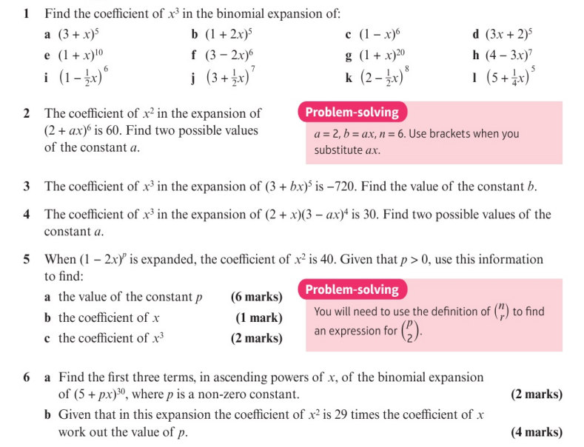
Homework Exercise

Slide 7
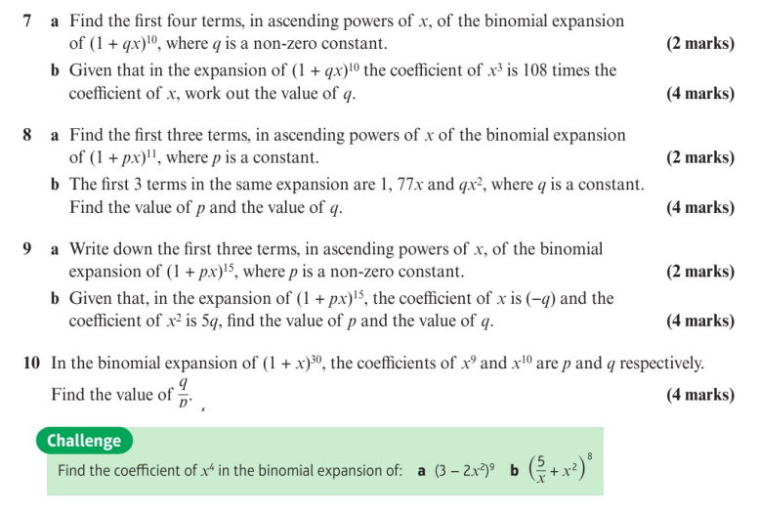
Homework Exercise

Slide 8
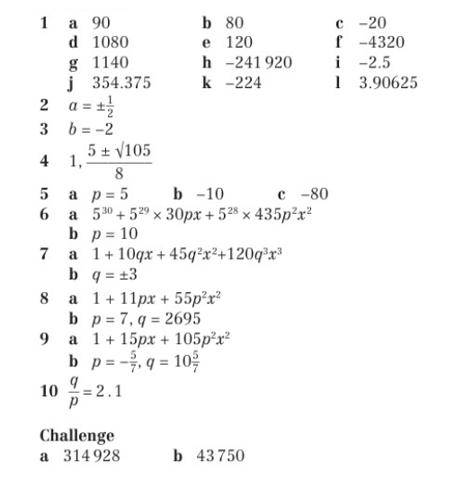
Homework Exercise

