Slide 1
P2 Chapter 3: Sequences and Series
Recurrence Relations

Slide 2
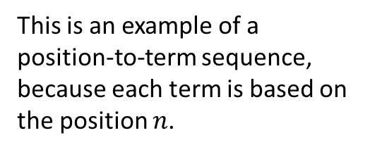
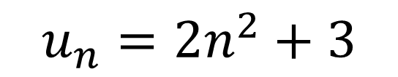
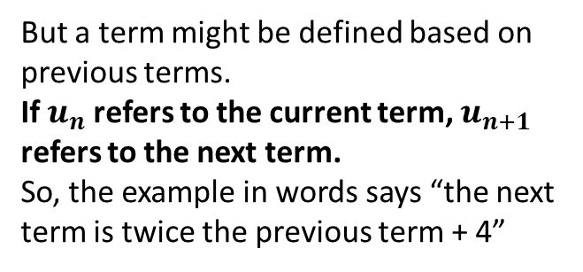
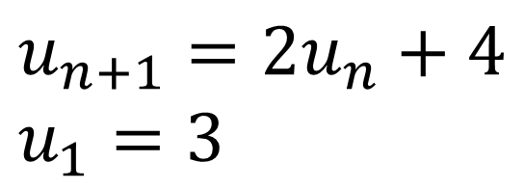
Recurrence Relations
This is an example of a position-to-term sequence, because each term is based on the position $n$.
$$u_{n}=2n^{2}+3$$
$$u_{n+1}=2u_{n}+4 \\ u_{1}=3$$
But a term might be defined based on previous terms.
If $u_{n}$ refers to the current term, $u_{n+1}$ refers to the next term.
So, the example in words says “the next term is twice the previous term + 4”
We need the first term because the recurrence relation alone is not enough to know what number the sequence starts at.
This is known as a term-to-term sequence, or more formally as a recurrence relation, as the sequence ‘recursively’ refers to itself.

Slide 3
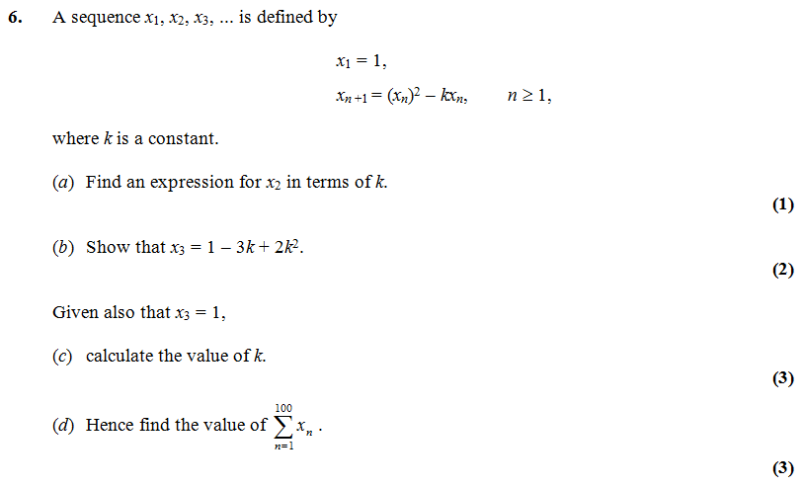
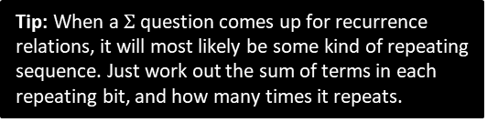

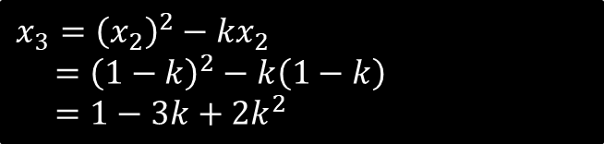


Example
Important Note: With recurrence relation questions, the the sequence will likely not be arithmetic nor geometric. So your previous $u_{n}$ and $S_{n}$ formulae do not apply.
Edexcel C1 May 2013 (R)
?
$$x_{2}={\left(x_{1}\right)}^{2}−kx_{1}=1−k$$
$$x_{3}={\left(x_{2}\right)}^{2}−kx_{2} \\ ={\left(1−k\right)}^{2}−k\left(1−k\right) \\ =1−3k+2k^{2}$$
?
$$k=\frac{3}{2}$$
?
?
$$=1+\left(−\frac{1}{2}\right)+1+\left(−\frac{1}{2}\right)+… \\ =50×\left(1−\frac{1}{2}\right)=25$$
Tip: When a $Σ$ question comes up for recurrence relations, it will most likely be some kind of repeating sequence. Just work out the sum of terms in each repeating bit, and how many times it repeats.

Slide 4
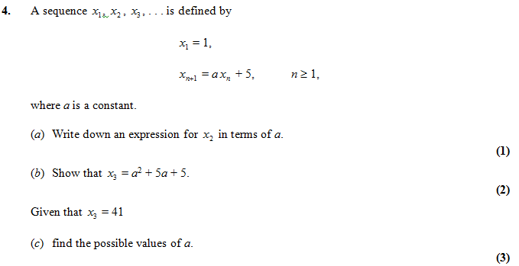



Test Your Understanding
Edexcel C1 Jan 2012
?
$$x_{2}=a+5$$
?
$$x_{3}=a\left(a+5\right)+5=…$$
?
$$a^{2}+5a+5=41 \\ a^{2}+5a−36=0 \\ \left(a+9\right)\left(a−4\right)=0 \\ a=−9 or 4$$

Slide 5
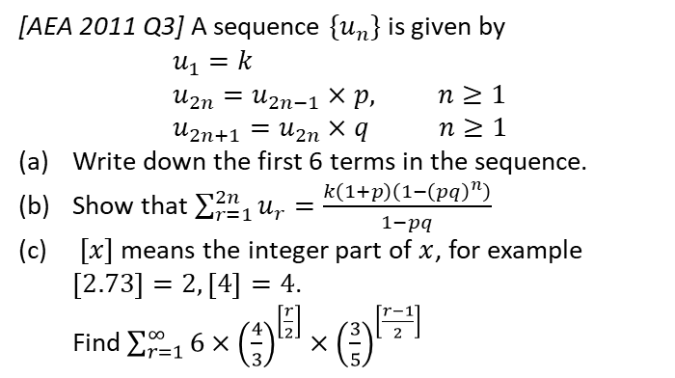
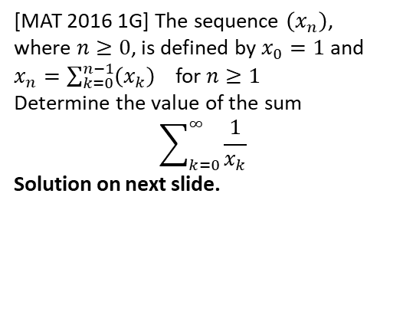
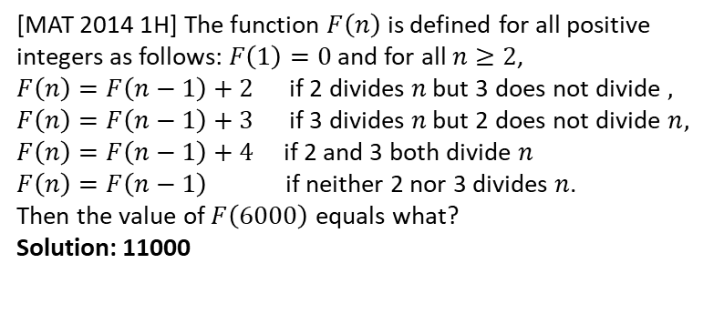
Exercise 3.7
Pearson Pure Mathematics Year 2/AS
Page 25
?
1
[AEA 2011 Q3] A sequence $\{u_{n}\}$ is given by
$$u_{1}=k \\ u_{2n}=u_{2n−1}×p, n≥1 \\ u_{2n+1}=u_{2n}×q n≥1$$
Write down the first 6 terms in the sequence.
Show that $\sum_{r=1}^{2n}{u_{r}}=\frac{k\left(1+p\right)\left(1−{\left(pq\right)}^{n}\right)}{1−pq}$
$[x]$ means the integer part of $x$, for example $\left[2.73\right]=2, \left[4\right]=4$.
Find $\sum_{r=1}^{∞}{6×{\left(\frac{4}{3}\right)}^{\left[\frac{r}{2}\right]}×{\left(\frac{3}{5}\right)}^{\left[\frac{r−1}{2}\right]}}$
2
[MAT 2014 1H] The function $F\left(n\right)$ is defined for all positive integers as follows: $F\left(1\right)=0$ and for all $n≥2$,
$F\left(n\right)=F\left(n−1\right)+2$ if 2 divides $n$ but 3 does not divide $,$
$F\left(n\right)=F\left(n−1\right)+3$ if 3 divides $n$ but 2 does not divide $n,$
$F\left(n\right)=F\left(n−1\right)+4$ if 2 and 3 both divide $n$
$F\left(n\right)=F\left(n−1\right)$ if neither 2 nor 3 divides $n$.
Then the value of $F\left(6000\right)$ equals what?
Solution: 11000
3
[MAT 2016 1G] The sequence $\left(x_{n}\right)$, where $n≥0$, is defined by $x_{0}=1$ and
$x_{n}=\sum_{k=0}^{n−1}{\left(x_{k}\right)}$ for $n≥1$
Determine the value of the sum
$$\sum_{k=0}^{∞}{\frac{1}{x_{k}}}$$
Solution on next slide.
?

Slide 6
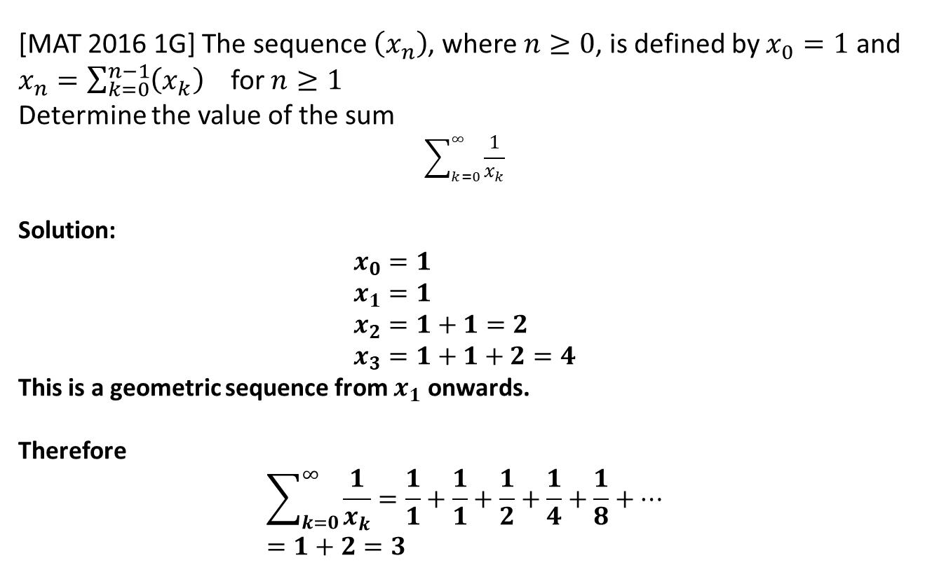
Solution to Extension Question 3
[MAT 2016 1G] The sequence $\left(x_{n}\right)$, where $n≥0$, is defined by $x_{0}=1$ and
$x_{n}=\sum_{k=0}^{n−1}{\left(x_{k}\right)}$ for $n≥1$
Determine the value of the sum
$$\sum_{k=0}^{∞}{\frac{1}{x_{k}}}$$
Solution:
$$x_{0}=1 \\ x_{1}=1 \\ x_{2}=1+1=2 \\ x_{3}=1+1+2=4$$
This is a geometric sequence from $x_{1}$ onwards.
Therefore
$$\sum_{k=0}^{∞}{\frac{1}{x_{k}}}=\frac{1}{1}+\frac{1}{1}+\frac{1}{2}+\frac{1}{4}+\frac{1}{8}+… \\ =1+2=3$$

Slide 7
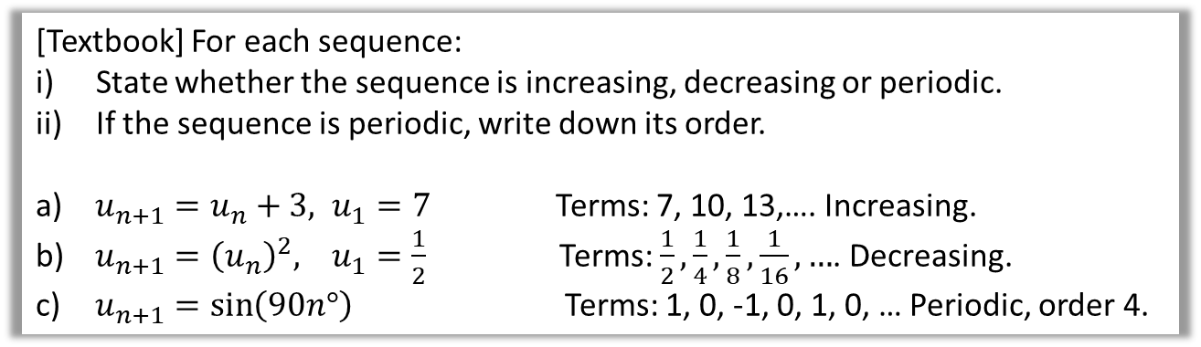
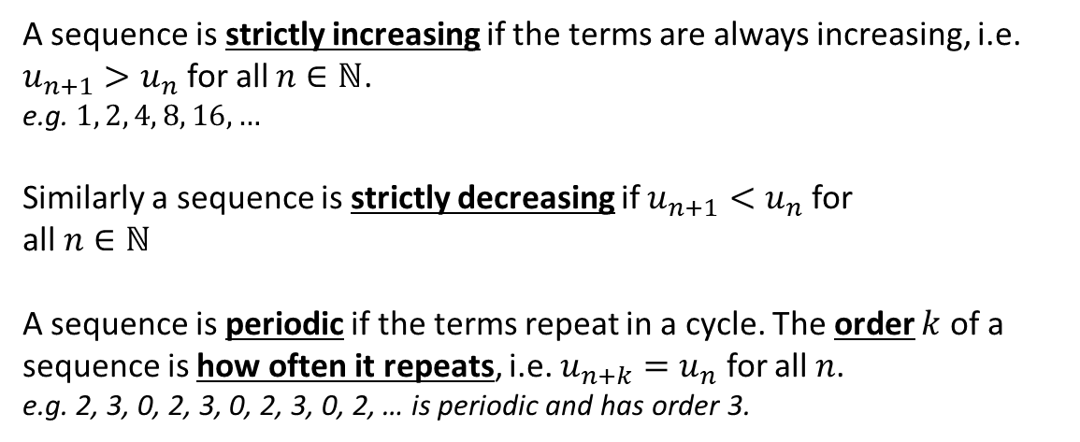
Increasing, decreasing and periodic sequences
A sequence is strictly increasing if the terms are always increasing, i.e.
$u_{n+1}>u_{n}$ for all $n∈ℕ$.
e.g. $1, 2, 4, 8, 16, …$
Similarly a sequence is strictly decreasing if $u_{n+1}<u_{n}$ for
all $n∈ℕ$
A sequence is periodic if the terms repeat in a cycle. The order $k$ of a sequence is how often it repeats, i.e. $u_{n+k}=u_{n}$ for all $n$.
e.g. 2, 3, 0, 2, 3, 0, 2, 3, 0, 2, … is periodic and has order 3.
Textbook Error: It uses the term ‘increasing’ when it means ‘strictly increasing’.
[Textbook] For each sequence:
State whether the sequence is increasing, decreasing or periodic.
If the sequence is periodic, write down its order.
$u_{n+1}=u_{n}+3, u_{1}=7$ Terms: 7, 10, 13,…. Increasing.
$u_{n+1}={\left(u_{n}\right)}^{2}, u_{1}=\frac{1}{2}$ Terms: $\frac{1}{2},\frac{1}{4},\frac{1}{8},\frac{1}{16},…$. Decreasing.
$u_{n+1}=\sin\left(90n°\right)$ Terms: 1, 0, -1, 0, 1, 0, … Periodic, order 4.
?
?
?

Slide 8
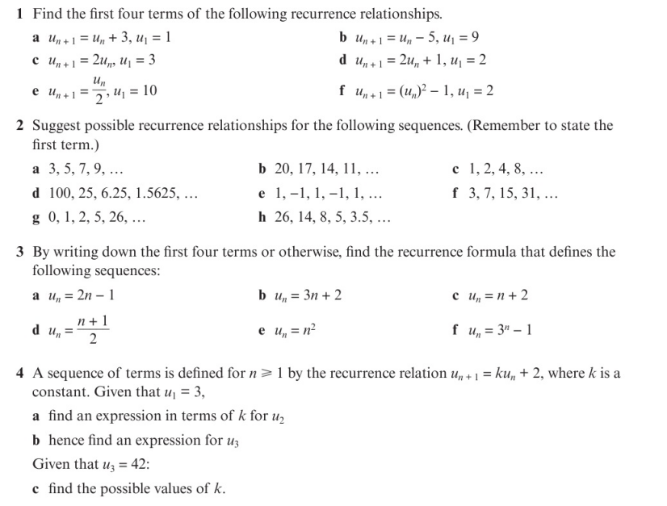
Homework Exercise

Slide 9
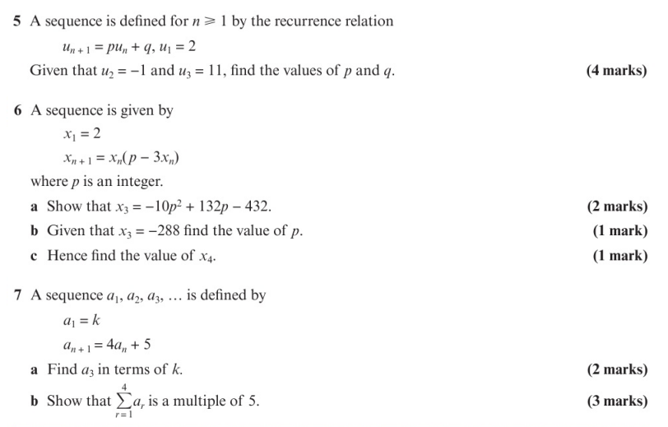
Homework Exercise

Slide 10
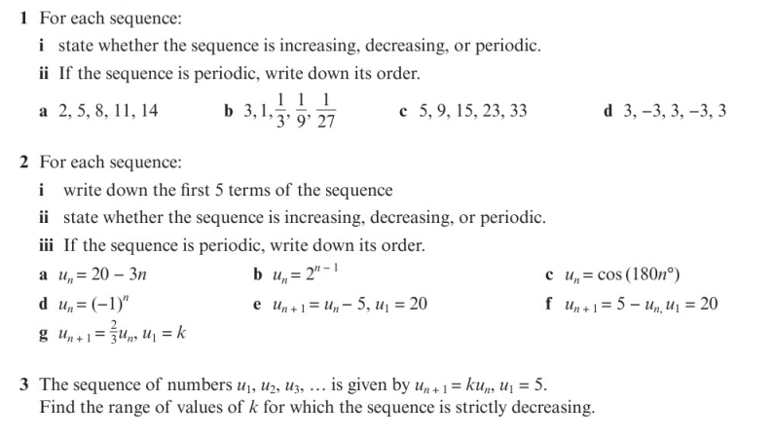
Homework Exercise

Slide 11
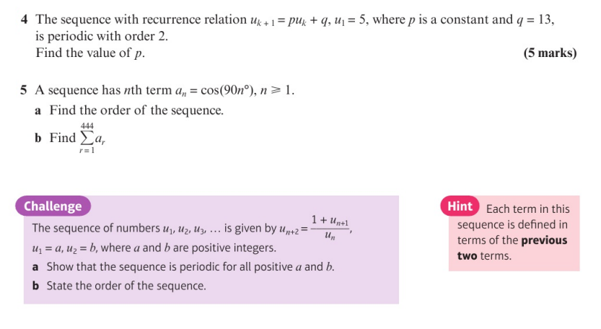
Homework Exercise

Slide 12
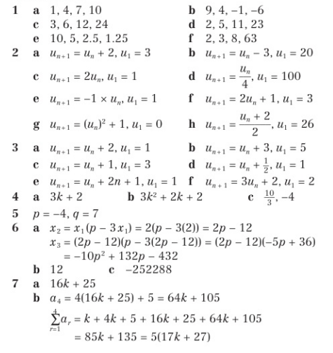
Homework Answers

Slide 13
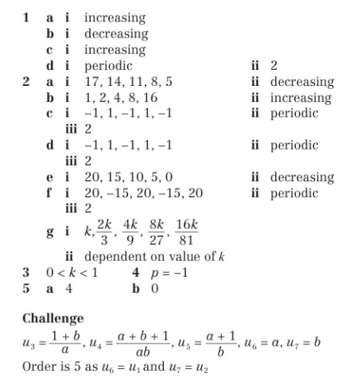
Homework Answers

