Slide 1
M2 Chapter 7: Application of Forces Modelling with Statics

Slide 2



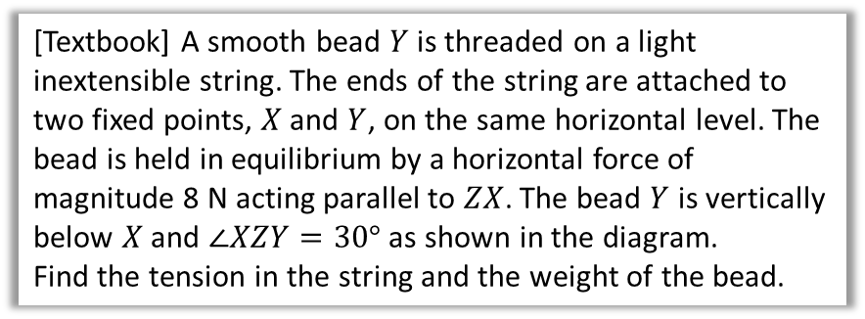

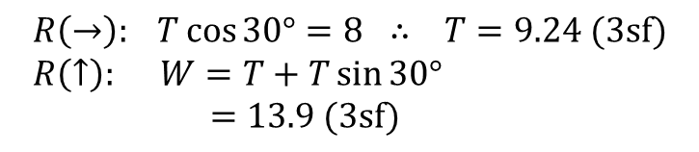




Modelling with Statics
We can apply this to problems involving tension, weight and pulleys.
[Textbook] A smooth bead $Y$ is threaded on a light inextensible string. The ends of the string are attached to two fixed points, $X$ and $Y$, on the same horizontal level. The bead is held in equilibrium by a horizontal force of magnitude 8 N acting parallel to $ZX$. The bead $Y$ is vertically below $X$ and $∠XZY=30°$ as shown in the diagram.
Find the tension in the string and the weight of the bead.
$$X$$
$$Z$$
$$30°$$
$$8 N$$
$$Y$$
? Force Diagram
As the bead is smooth, the two parts of the string can be considered as a single piece of string, and therefore the tension is the same throughout.
$$T N$$
$$T N$$
$$8 N$$
$$30°$$
?
$$R\left(→\right): T\cos{30°}=8 ∴ T=9.24 (3sf) \\ R\left(↑\right): W=T+T\sin{30°} \\ =13.9 (3sf)$$
$$W N$$
?

Slide 3





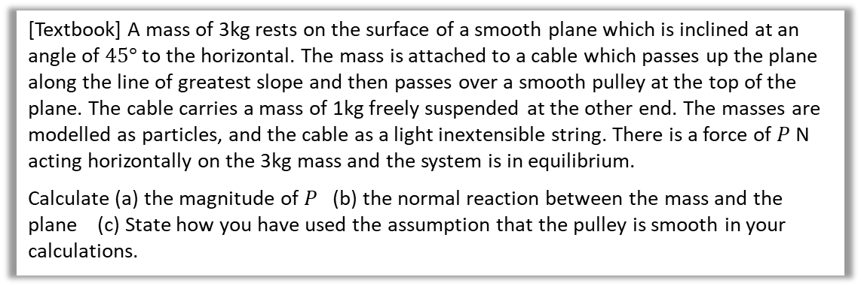







Further Example
[Textbook] A mass of 3kg rests on the surface of a smooth plane which is inclined at an angle of $45°$ to the horizontal. The mass is attached to a cable which passes up the plane along the line of greatest slope and then passes over a smooth pulley at the top of the plane. The cable carries a mass of 1kg freely suspended at the other end. The masses are modelled as particles, and the cable as a light inextensible string. There is a force of $P$ N acting horizontally on the 3kg mass and the system is in equilibrium.
Calculate (a) the magnitude of $P$ (b) the normal reaction between the mass and the plane (c) State how you have used the assumption that the pulley is smooth in your calculations.
? Force Diagram
a
For 1kg mass:
$$R\left(↑\right): T=g$$
For 3kg mass:
$$R\left(↗\right): T+P\cos{45°}=3g\sin{45°} \\ ∴P=\frac{3g\sin{45°}−g}{\cos{45°}}=3g−g\sqrt{2}=16 (2sf)$$
$$R\left(↖\right): R=3g\cos{45°}+P\sin{45°} \\ =6g\frac{\sqrt{2}}{2}−g=32 (2sf)$$
Pulley is smooth so tension in string will be same on both sides of the pulley.
$$R$$
?
$$T$$
$$P$$
$$T$$
$$P\sin{45}$$
$$45°$$
$$3g\cos{45}$$
?
$$P\cos{45}$$
$$3g$$
$$1g$$
$$45°$$
$$3g\sin{45}$$
b
?
c
?

Slide 4
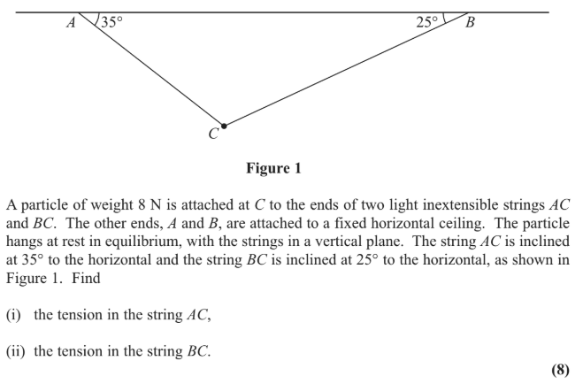
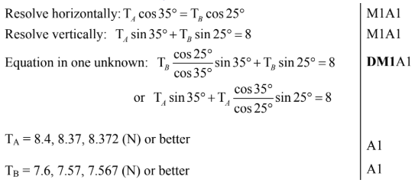
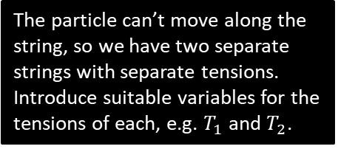
Test Your Understanding
Edexcel M1(Old) May 2013(R) Q2
The particle can’t move along the string, so we have two separate strings with separate tensions. Introduce suitable variables for the tensions of each, e.g. $T_{1}$ and $T_{2}$.
?

Slide 5
Exercise 7.2
Pearson Stats/Mechanics Year 2
Pages 57-58

Slide 6
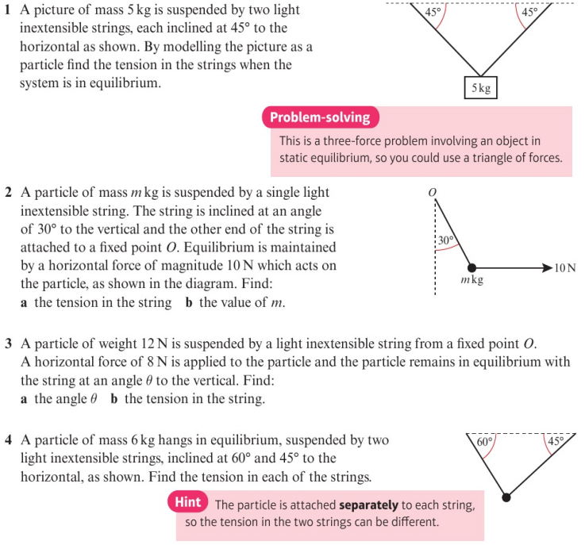
Homework Exercise

Slide 7
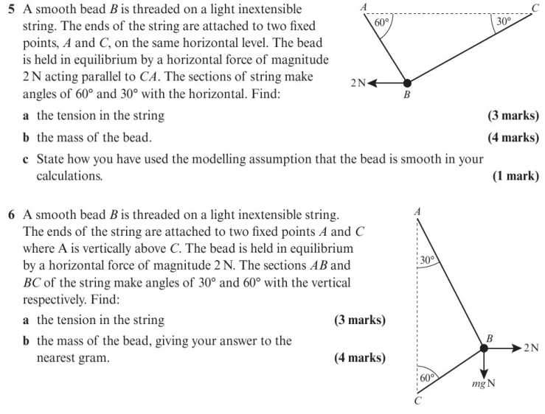
Homework Exercise

Slide 8
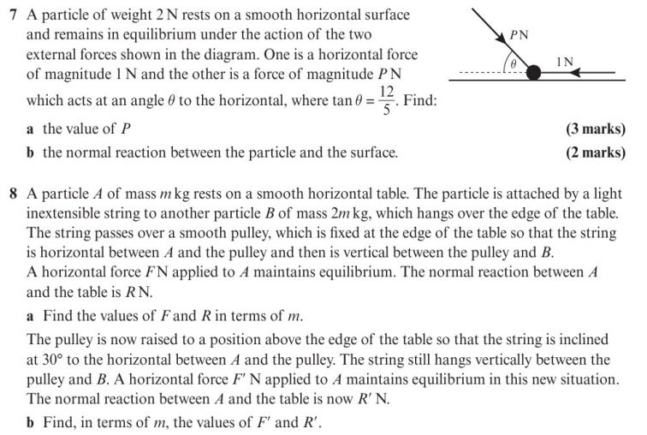
Homework Exercise

Slide 9
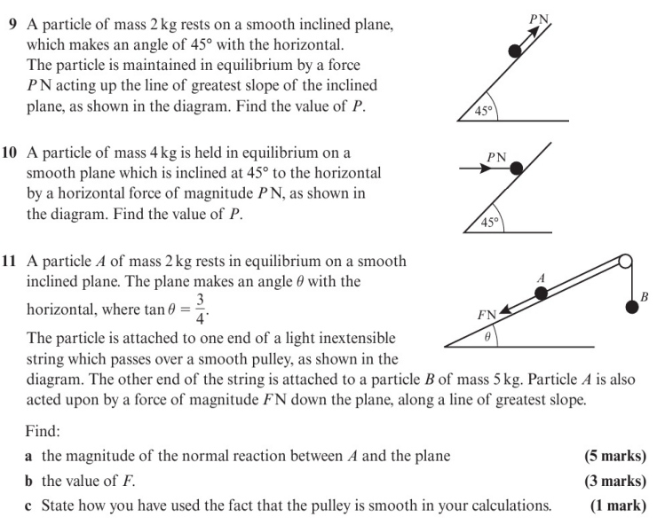
Homework Exercise

Slide 10
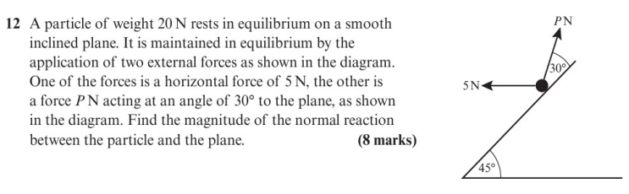
Homework Exercise

Slide 11
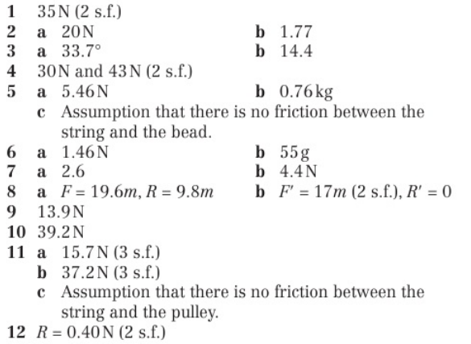
Homework Answers

