Slide 1
P1 Chapter 11: Vectors Vector Modelling

Slide 2



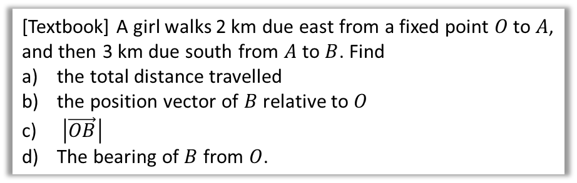




Example
[Textbook] A girl walks 2 km due east from a fixed point $O$ to $A$, and then 3 km due south from $A$ to $B$. Find
the total distance travelled
the position vector of $B$ relative to $O$
$\left|\vec{OB}\right|$
The bearing of $B$ from $O$.
N
$$2+3=5km \\ \vec{OB}=\left(\begin{matrix}2 \\ −3\end{matrix}\right) km$$
$\left|\vec{OB}\right|=\sqrt{2^{2}+3^{2}}=\sqrt{13}=3.61km$ (3sf)
$$90°+\tan^{−1}\left(\frac{−3}{2}\right)=146.3°$$
$$2$$
$$A$$
a
?
$$O$$
b
?
$$θ$$
$$3$$
?
c
d
?
$$B$$

Slide 3
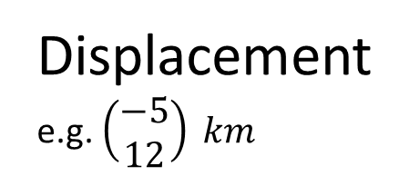

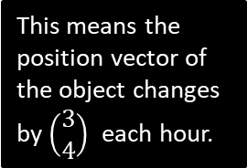
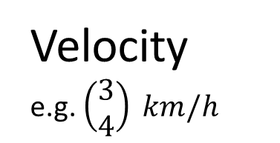

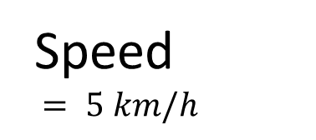

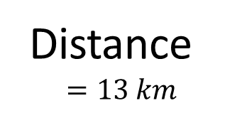
Modelling
In Mechanics, you will see certain things can be represented as a simple number (without direction), or as a vector (with direction):
Remember a ‘scalar’ just means a real number (in the context of vectors). It can be obtained using the magnitude of the vector.
Vector Quantity
Scalar Magnitude
Velocity
e.g. $\left(\begin{matrix}3 \\ 4\end{matrix}\right) km/h$
?
Speed
$= 5 km/h$
This means the position vector of the object changes by $\left(\begin{matrix}3 \\ 4\end{matrix}\right)$ each hour.
…which is equivalent to moving 5km each hour.
$$5$$
$$4$$
$$3$$
Displacement
e.g. $\left(\begin{matrix}−5 \\ 12\end{matrix}\right) km$
?
Distance
$$=13 km$$

Slide 4








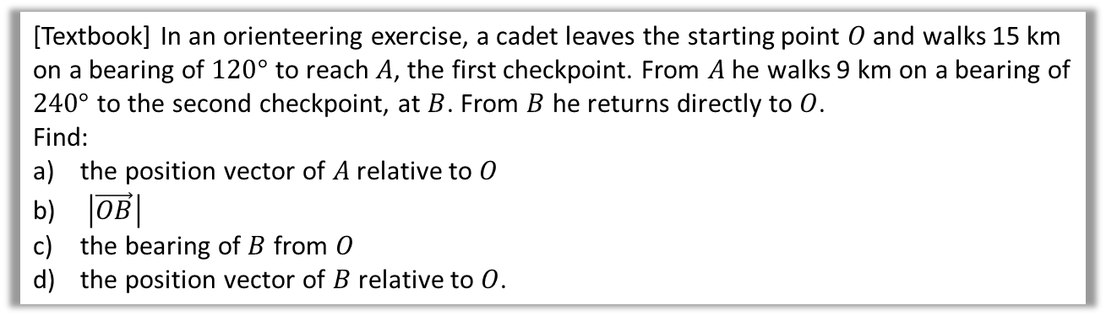




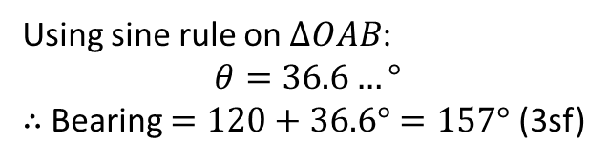


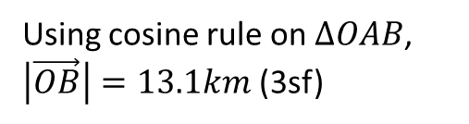






Further Example
[Textbook] In an orienteering exercise, a cadet leaves the starting point $O$ and walks 15 km on a bearing of $120°$ to reach $A$, the first checkpoint. From $A$ he walks 9 km on a bearing of $240°$ to the second checkpoint, at $B$. From $B$ he returns directly to $O$.
Find:
the position vector of $A$ relative to $O$
$\left|\vec{OB}\right|$
the bearing of $B$ from $O$
the position vector of $B$ relative to $O$.
Tips:
Draw a BIG diagram.
Remember bearings are measured clockwise from North.
N
?
N
b
Using cosine rule on $ΔOAB$, $\left|\vec{OB}\right|=13.1km$ (3sf)
?
a
$$120°$$
$$O$$
N
$$O$$
N
$$30°$$
$$30°$$
$$θ$$
$$60°$$
$$θ$$
$$15 km$$
$$A$$
$$15 km$$
$$A$$
$$60°$$
$$240°$$
$$240°$$
$$9 km$$
$$9 km$$
$$B$$
$$B$$
?
$$\vec{OA}=\left(\begin{matrix}15\cos{30°} \\ 15\sin{30°}\end{matrix}\right)=\left(\begin{matrix}13.0 \\ 7.5\end{matrix}\right) km$$
c
Using sine rule on $ΔOAB$:
$$θ=36.6…°$$ $∴$Bearing $=120+36.6°=157°$ (3sf)

Slide 5



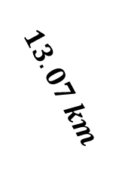


Further Example
[Textbook] In an orienteering exercise, a cadet leaves the starting point $O$ and walks 15 km on a bearing of $120°$ to reach $A$, the first checkpoint. From $A$ he walks 9 km on a bearing of $240°$ to the second checkpoint, at $B$. From $B$ he returns directly to $O$.
Find:
the position vector of $A$ relative to $O$
$\left|\vec{OB}\right|$
the bearing of $B$ from $O$
the position vector of $B$ relative to $O$.
N
d
?
$$120°$$
$$O$$
N
$$30°$$
$$\vec{OB}=\left(\begin{matrix}13.07\sin{23.41°} \\ −13.07\cos{23.41°}\end{matrix}\right)=\left(\begin{matrix}5.19 \\ −12.0\end{matrix}\right) km$$
$$36.59°$$
$$15 km$$
$$23.41°$$
$$A$$
$$13.07 km$$
$$9 km$$
$$B$$

Slide 6
Exercise 11.6
Pearson Pure Mathematics Year 1/AS
Pages 90-91

Slide 7
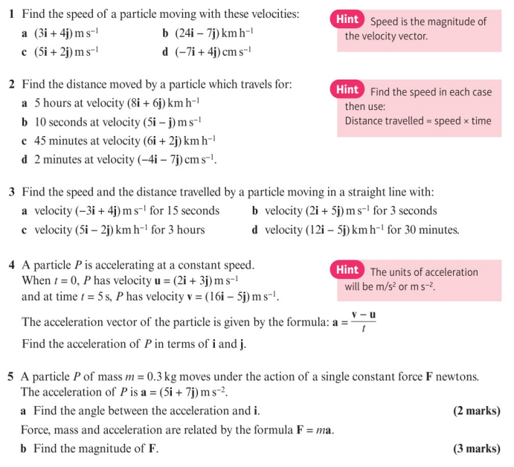
Homework Exercise

Slide 8
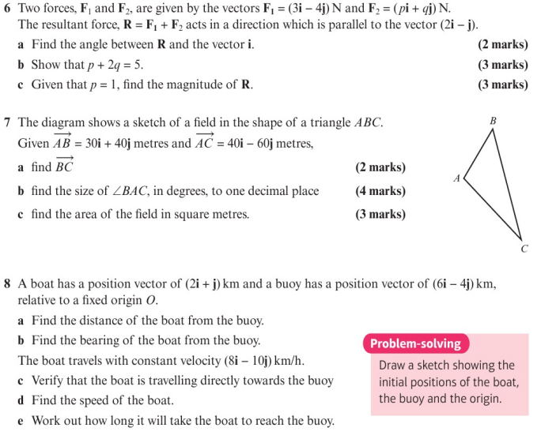
Homework Exercise

Slide 9
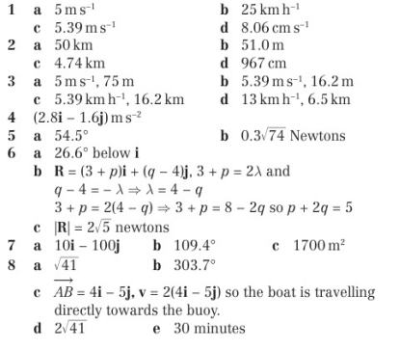
Homework Answers

