Slide 1
M1 Chapter 11: Variable Acceleration Calculus Proof of Suvat

Slide 2
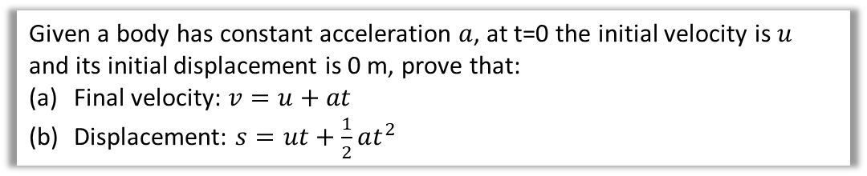
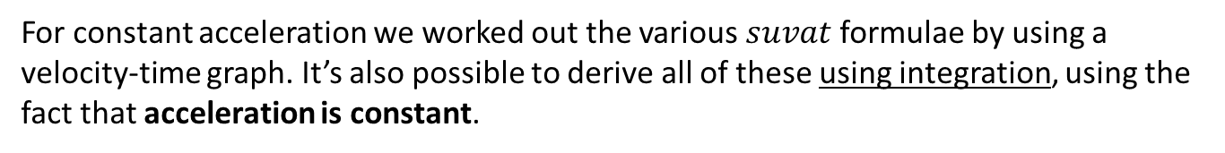
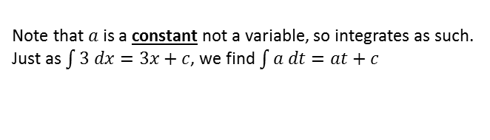
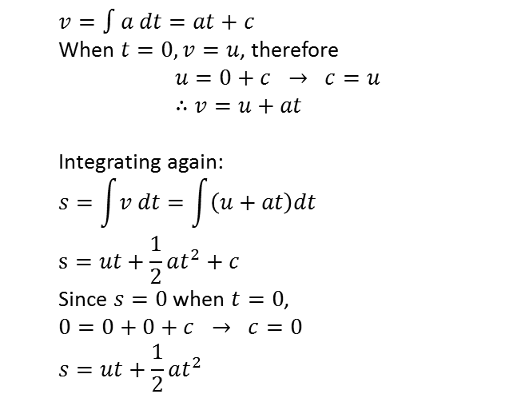
Constant acceleration formulae
For constant acceleration we worked out the various $suvat$ formulae by using a velocity-time graph. It’s also possible to derive all of these using integration, using the fact that acceleration is constant.
Given a body has constant acceleration $a$, at t=0 the initial velocity is $u$ and its initial displacement is 0 m, prove that:
Final velocity: $v=u+at$
Displacement: $s=ut+\frac{1}{2}at^{2}$
a
?
Note that $a$ is a constant not a variable, so integrates as such. Just as $\int{3 dx=3x+c}$, we find $\int{a dt}=at+c$
$$v=∫a dt=at+c$$
When $t=0, v=u$, therefore
$$u=0+c → c=u \\ ∴v=u+at$$
Integrating again:
$$s=\int{v dt}=\int{\left(u+at\right)dt} \\ s=ut+\frac{1}{2}at^{2}+c$$
Since $s=0$ when $t=0$,
$$0=0+0+c → c=0 \\ s=ut+\frac{1}{2}at^{2}$$
b
?
Again, because $u$ is fixed, we can treat it as a constant.

Slide 3
Exercise 11.5 Constant Acceleration Formulae
Pearson Stats/Mechanics Year 1
Pages 82-83

Slide 4
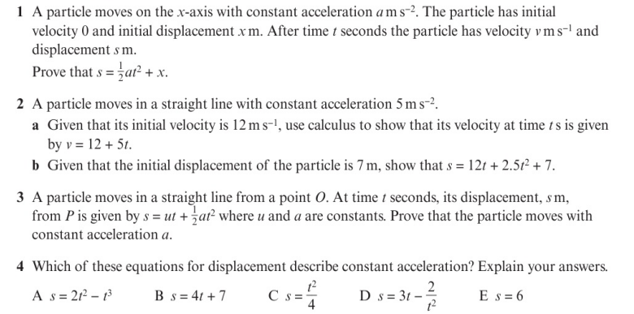
Homework Exercise

Slide 5
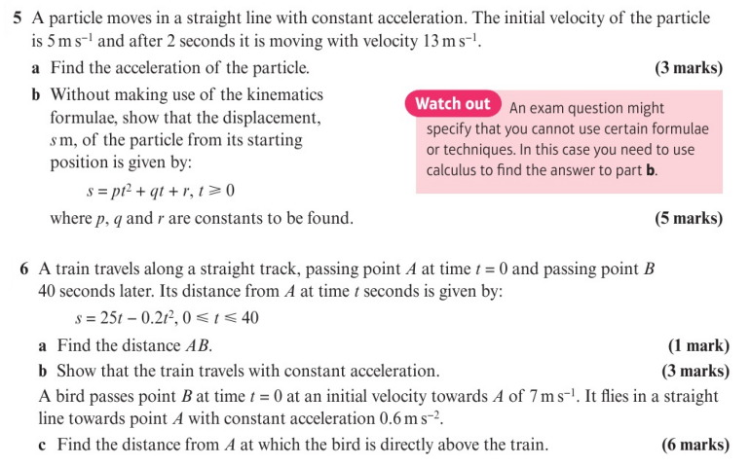
Homework Exercise

Slide 6
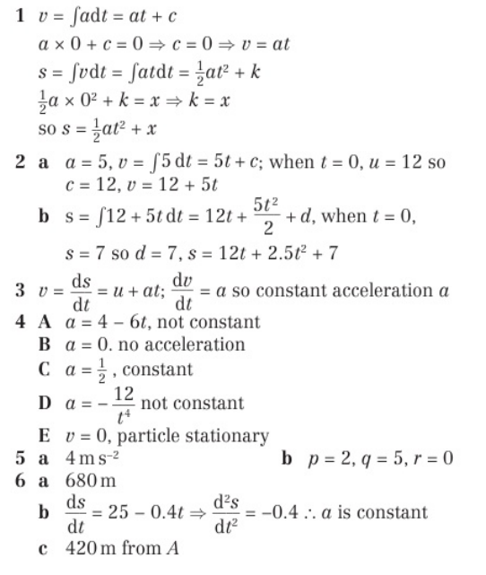
Homework Answers

