Slide 1
M2 Chapter 5: Inclined Planes Chapter Practice

Slide 2
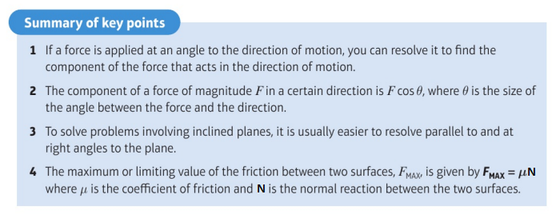
Key Points

Slide 3
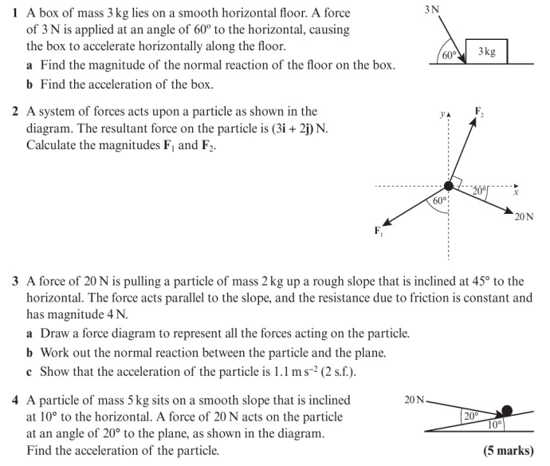
Chapter Exercises

Slide 4
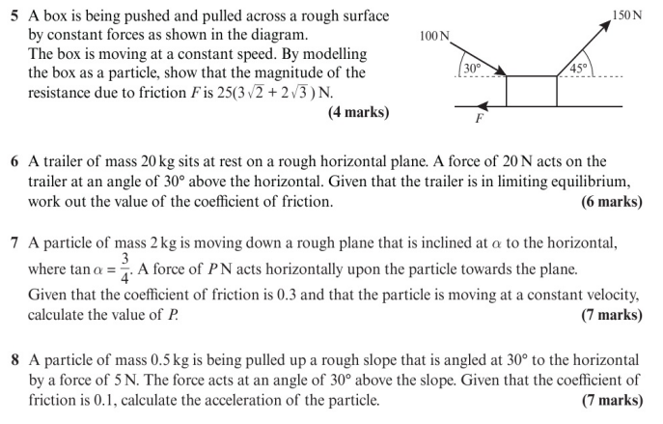
Chapter Exercises

Slide 5
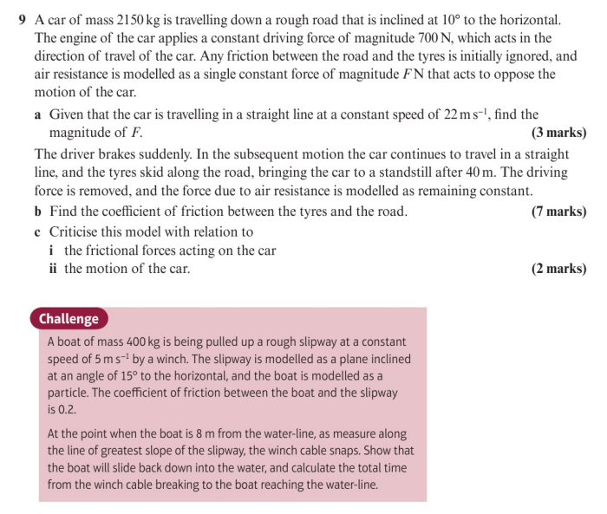
Chapter Exercises

Slide 6
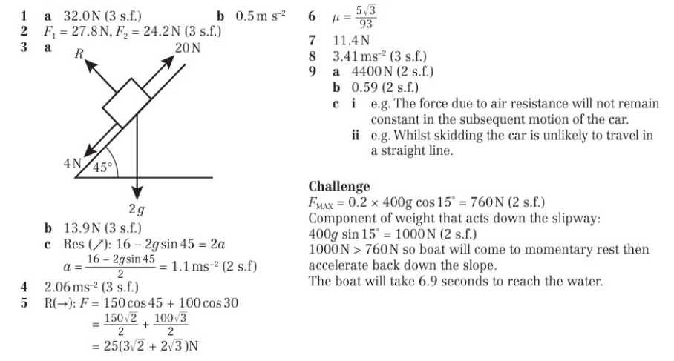
Chapter Answers

