Slide 1
P2 Chapter 11: 3D Vectors Applications to Mechanics

Slide 2
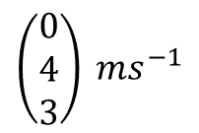
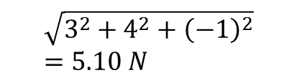

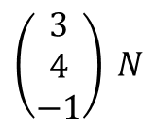
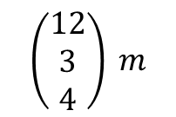

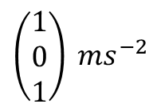

Application to Mechanics
Out of displacement, speed, acceleration, force, mass and time, all but mass and time are vectors. Clearly these can act in 3D space.
Vector
Scalar
$$\left(\begin{matrix}3 \\ 4 \\ −1\end{matrix}\right) N$$
?
Force
$$\sqrt{3^{2}+4^{2}+{\left(−1\right)}^{2}} \\ =5.10 N$$
$$\left(\begin{matrix}1 \\ 0 \\ 1\end{matrix}\right) ms^{−2}$$
?
Acceleration
$$1.41 ms^{−2}$$
$$\left(\begin{matrix}12 \\ 3 \\ 4\end{matrix}\right) m$$
?
Displacement
$$13 m$$
Distance
$$\left(\begin{matrix}0 \\ 4 \\ 3\end{matrix}\right) ms^{−1}$$
?
Velocity
$$5 m$$
Speed

Slide 3

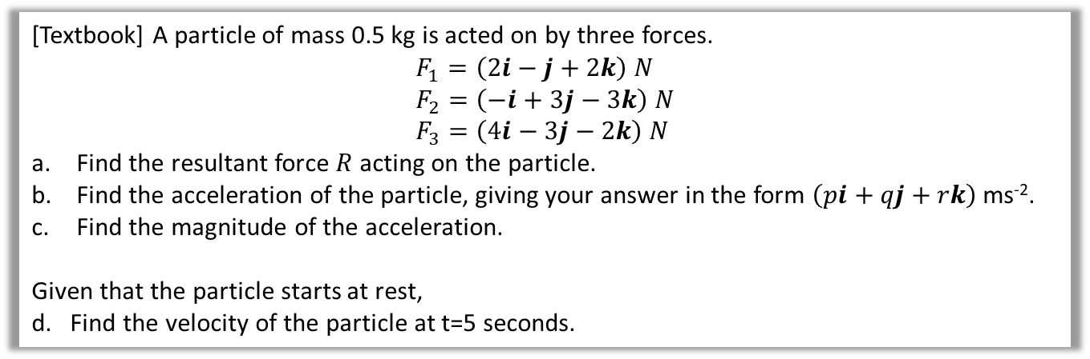
Example
[Textbook] A particle of mass 0.5 kg is acted on by three forces.
$$F_{1}=\left(2i−j+2k\right) N \\ F_{2}=\left(−i+3j−3k\right) N \\ F_{3}=\left(4i−3j−2k\right) N$$
Find the resultant force $R$ acting on the particle.
Find the acceleration of the particle, giving your answer in the form $\left(pi+qj+rk\right)$ ms⁻².
Find the magnitude of the acceleration.
Given that the particle starts at rest,
d. Find the velocity of the particle at t=5 seconds.
?
$\left(\begin{matrix}2 \\ −1 \\ 2\end{matrix}\right)+\left(\begin{matrix}−1 \\ 3 \\ −3\end{matrix}\right)+\left(\begin{matrix}4 \\ −3 \\ −2\end{matrix}\right)=\left(\begin{matrix}5 \\ −1 \\ −3\end{matrix}\right) N$
$F=ma$ $\left(\begin{matrix}5 \\ −1 \\ −3\end{matrix}\right)=0.5a ∴a=\left(\begin{matrix}10 \\ −2 \\ −6\end{matrix}\right) ms^{−2}$
$\left|a\right|=\sqrt{{10}^{2}+{\left(−2\right)}^{2}+{\left(−6\right)}^{2}}=\sqrt{140}$ ms⁻²
$a=\left(\begin{matrix}50 \\ −10 \\ −30\end{matrix}\right) ms^{−2}$
?
?
?

Slide 4
Exercise 12.4
Pearson Pure Mathematics Year 2/AS
Pages 108-109

Slide 5
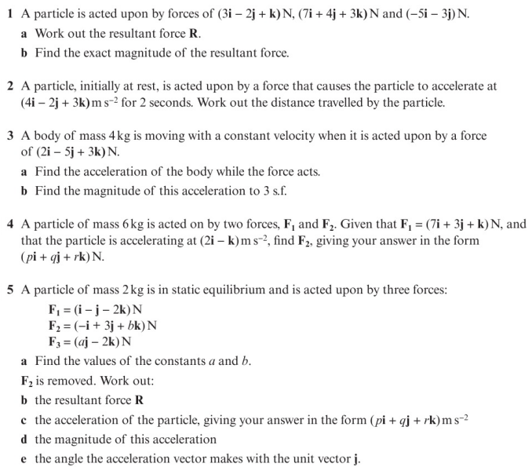
Homework Exercise

Slide 6
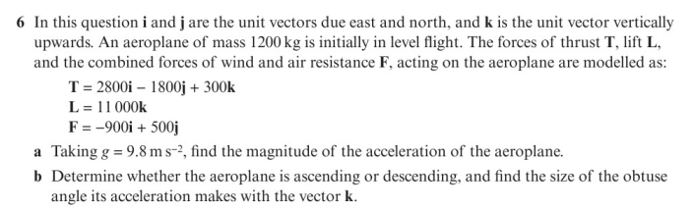
Homework Exercise

Slide 7
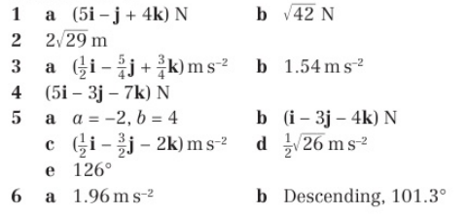
Homework Answers

