Slide 1
P2 Chapter 9: Differentiation The Chain Rule

Slide 2
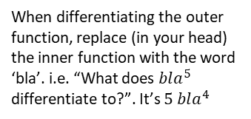
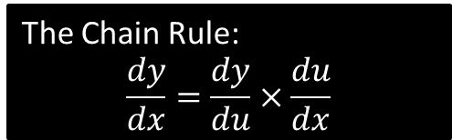
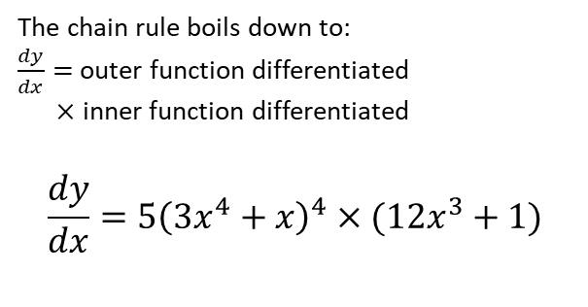



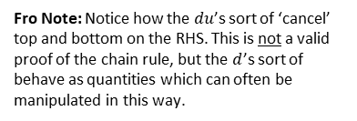
The Chain Rule
The chain rule allows us to differentiate a composite function, i.e. a function within a function.
$$y={\left(3x^{4}+x\right)}^{5}$$
The Chain Rule:
$$\frac{dy}{dx}=\frac{dy}{du}×\frac{du}{dx}$$
Fro Note: Notice how the $du$’s sort of ‘cancel’ top and bottom on the RHS. This is not a valid proof of the chain rule, but the $d$’s sort of behave as quantities which can often be manipulated in this way.
Doing it mentally in one go:
(aka the ‘bla method’)
Full Method:
?
Let $u=3x^{4}+x$
$$\frac{du}{dx}=12x^{3}+1$$
$$y=u^{5} \\ \frac{dy}{du}=5u^{4}=5{\left(3x^{4}+x\right)}^{4} \\ ∴\frac{dy}{dx}=\frac{dy}{du}×\frac{du}{dx} \\ =5{\left(3x^{4}+x\right)}^{4}\left(12x^{3}+1\right)$$
In the Chain Rule, $u$ represents the inner function.
The chain rule boils down to:
$\frac{dy}{dx}=$outer function differentiated
$×$ inner function differentiated
$$\frac{dy}{dx}=5{\left(3x^{4}+x\right)}^{4}×(12x^{3}+1)$$
This represents the ‘outer’ function.
?
?
When differentiating the outer function, replace (in your head) the inner function with the word ‘bla’. i.e. “What does $bla^{5}$ differentiate to?”. It’s $5 bla^{4}$
Now differentiate the inner function, i.e. the ‘bla’.

Slide 3
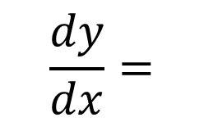


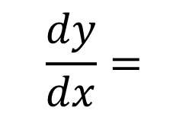
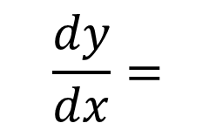
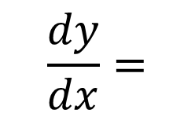












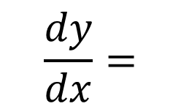









Further Practice
Outer Function Differentiated
Inner Function Differentiated
$$\frac{dy}{dx}=$$
?
?
$$y={\left(x^{2}+1\right)}^{3}$$
$$3{\left(x^{2}+1\right)}^{2}$$
$$×$$
$$2x$$
The outer function is “$bla^{3}$”
$$\frac{dy}{dx}=$$
$$\frac{1}{x}$$
$$y={\left(\ln{x}\right)}^{3}$$
?
$$×$$
?
$$3{\left(\ln{x}\right)}^{2}$$
The outer function is again “$bla^{3}$”
$$\frac{dy}{dx}=$$
?
$$\left(2x+1\right)$$
$$y=e^{x^{2}+x}$$
$$e^{x^{2}+x}$$
$$×$$
?
The outer function is “$e^{bla}$”
$$\frac{dy}{dx}=$$
$$y={\left(2^{x}+1\right)}^{2}$$
?
$$×$$
?
$$2(2^{x}+1)$$
$$2^{x}\ln{2}$$
$$\frac{dy}{dx}=$$
$$\frac{1}{\sin{x}}$$
?
$$y=\ln\left(\sin{x}\right)$$
$$×$$
?
$$\cos{x}$$

Slide 4
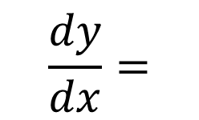
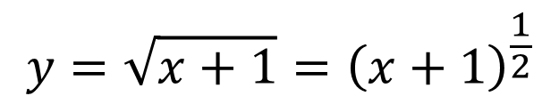


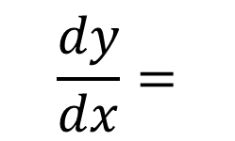










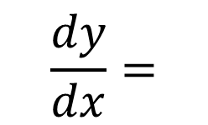




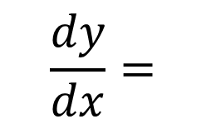


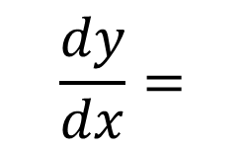


Yet Further Practice
Outer Function Differentiated
Inner Function Differentiated
$$\frac{dy}{dx}=$$
?
?
$$\cos{5x}$$
$$×$$
$$y=\sin{5x}$$
$$5$$
This is consistent with what we learned earlier in the chapter.
The outer function is “$\sin{bla}$”
?
$$\frac{dy}{dx}=$$
$$y=\sin^{2}{x}={\left(\sin{x}\right)}^{2}$$
?
$$×$$
?
$$2\sin{x}$$
$$\cos{x}$$
Fro Tip: When differentiating a trig function to a power, always rewrite using a bracket first.
$$y=\sqrt{x+1}={\left(x+1\right)}^{\frac{1}{2}}$$
$$\frac{dy}{dx}=$$
$$\frac{1}{2}{\left(x+1\right)}^{−\frac{1}{2}}$$
?
?
?
$$×$$
$$1$$
Here we had to use the Chain Rule twice!
?
$$\frac{dy}{dx}=$$
?
$$y=\cos^{3}{2x}={\left(\cos{2x}\right)}^{3}$$
?
$$3{\left(\cos{2x}\right)}^{2}$$
$$×$$
$$\left(−2\sin{2x}\right)$$
$$y=e^{e^{x}}$$
$$\frac{dy}{dx}=$$
?
?
$$e^{e^{x}}$$
$$×$$
$$e^{x}$$

Slide 5


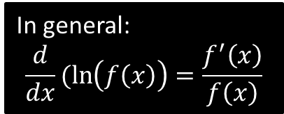


Test Your Understanding
C3 June 2011 Q1a
In general:
$$\frac{d}{dx}(\ln\left(f\left(x\right)\right)=\frac{f^{′}\left(x\right)}{f\left(x\right)}$$
?
$$\frac{dy}{dx}=\frac{1}{x^{2}+3x+5}×\left(2x+3\right)=\frac{2x+3}{x^{2}+3x+5}$$
[Textbook] Given that $y=\sqrt{5x^{2}+1}$, find $\frac{dy}{dx}$ at $\left(4,9\right)$
?
$$y={\left(5x^{2}+1\right)}^{\frac{1}{2}} \\ \frac{dy}{dx}=\frac{1}{2}{\left(5x^{2}+1\right)}^{−\frac{1}{2}}×10x$$
When $x=4$,
$$\frac{dy}{dx}=\frac{1}{2}{\left(5\left(4^{2}\right)+1\right)}^{−\frac{1}{2}}×10\left(4\right)=\frac{20}{9}$$

Slide 6
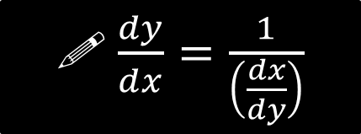

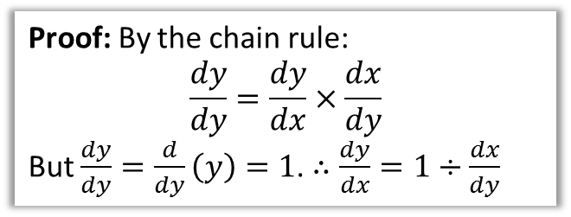
$$dx/dy$$
Proof: By the chain rule:
$$\frac{dy}{dy}=\frac{dy}{dx}×\frac{dx}{dy}$$
But $\frac{dy}{dy}=\frac{d}{dy}\left(y\right)=1$. $∴\frac{dy}{dx}=1÷\frac{dx}{dy}$
! $\frac{dy}{dx}=\frac{1}{\left(\frac{dx}{dy}\right)}$
Sometimes we might have $x$ in terms of $y$, but we want to find $\frac{dy}{dx}$.
Find $\frac{dy}{dx}$ when $x=2y^{2}+y$
$$\frac{dx}{dy}=4y+1 \\ \frac{dy}{dx}=\frac{1}{4y+1}$$
Find the gradient of $x={\left(1+2y\right)}^{3}$ when $y=1$
$$\frac{dx}{dy}=6{\left(1+2y\right)}^{2} → \frac{dy}{dx}=\frac{1}{6{\left(1+2y\right)}^{2}}$$
$$m=\frac{1}{6{\left(1+2\right)}^{2}}=\frac{1}{54}$$
?
?

Slide 7
Exercise 9.3
Pearson Pure Year 2
Page 71

Slide 8
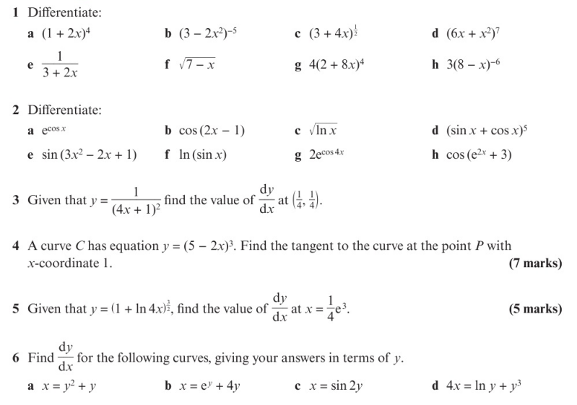
Homework Exercise

Slide 9
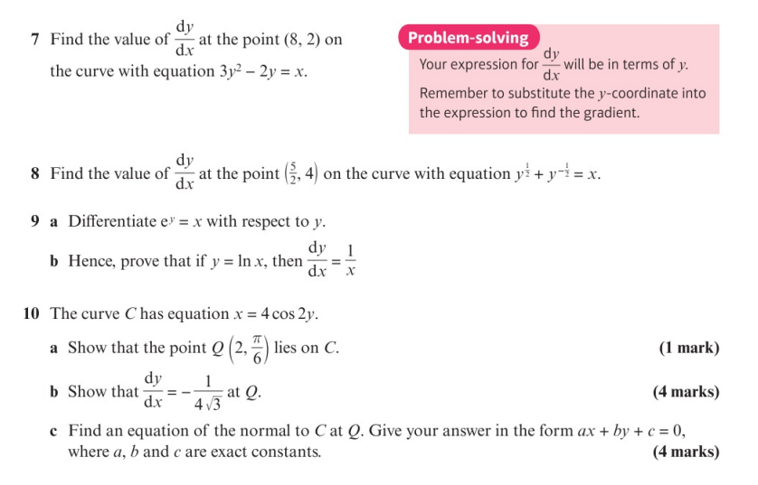
Homework Exercise

Slide 10
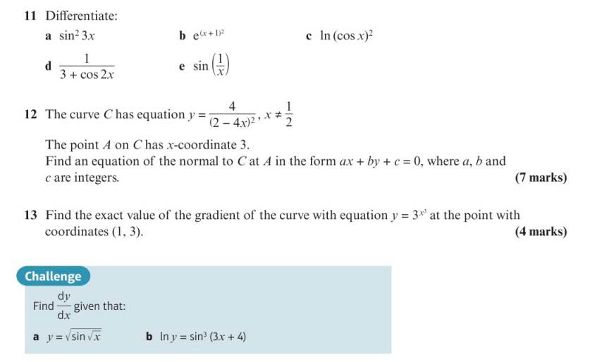
Homework Exercise

Slide 11
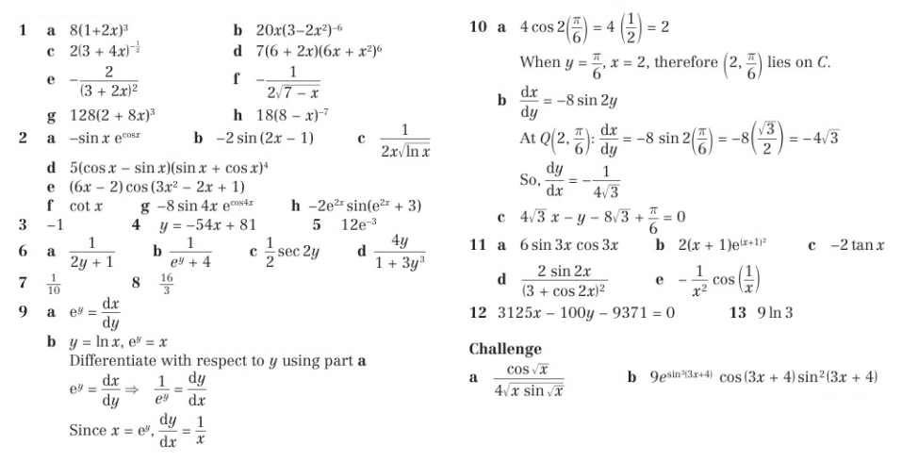
Homework Answers

