Slide 1
M2 Chapter 5: Inclined Planes Force Components

Slide 2

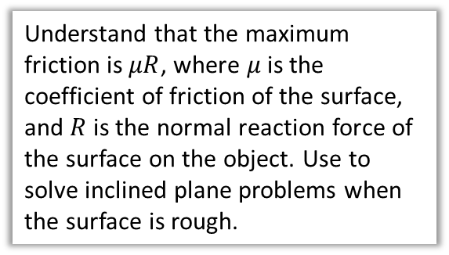

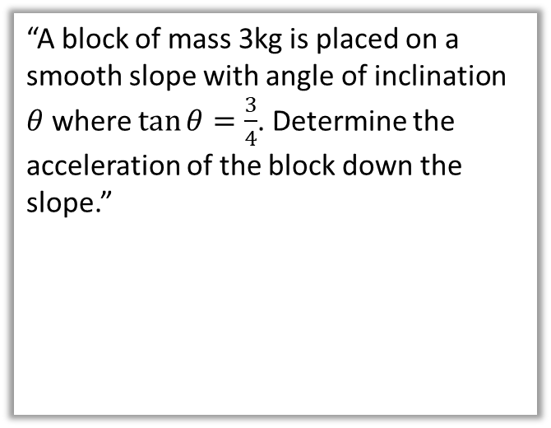





Overview
In Year 1 any frictional forces were stated. In this chapter, we will be able to calculate the frictional force using the normal reaction force acting on the object.
1:: Resolving components
2:: Inclined Planes
“Determine the magnitude and direction of the resultant force.”
“A block of mass 3kg is placed on a smooth slope with angle of inclination $θ$ where $\tan{θ}=\frac{3}{4}$. Determine the acceleration of the block down the slope.”
$5$N
$$30°$$
$2$N
$$R$$
3:: $F≤μR$
3kg
Understand that the maximum friction is $μR$, where $μ$ is the coefficient of friction of the surface, and $R$ is the normal reaction force of the surface on the object. Use to solve inclined plane problems when the surface is rough.
$$θ$$
$$3g$$

Slide 3
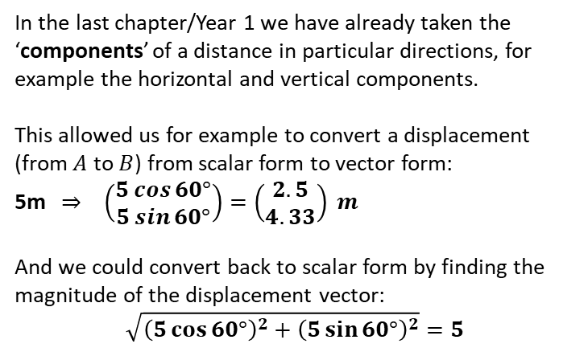




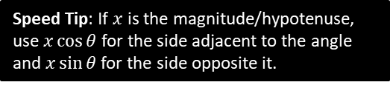




Resolving Forces
In the last chapter/Year 1 we have already taken the ‘components’ of a distance in particular directions, for example the horizontal and vertical components.
This allowed us for example to convert a displacement (from $A$ to $B$) from scalar form to vector form:
5m $⇒ \left(\begin{matrix}5\cos{60°} \\ 5\sin{60°}\end{matrix}\right)=\left(\begin{matrix}2.5 \\ 4.33\end{matrix}\right) m$
And we could convert back to scalar form by finding the magnitude of the displacement vector:
$$\sqrt{{\left(5\cos{60°}\right)}^{2}+{\left(5\sin{60°}\right)}^{2}}=5$$
$$B$$
5m
?
$$5\sin{60°}$$
$$60°$$
$$A$$
$$5\cos{60°}$$
?
Speed Tip: If $x$ is the magnitude/hypotenuse, use $x\cos{θ}$ for the side adjacent to the angle and $x\sin{θ}$ for the side opposite it.
7 N
$$60°$$
?
We can use exactly the same principle to find the components of a force, and convert between vector and scalar form.
$$7 cos 60° N$$
$$7 sin 60° N$$
?

Slide 4








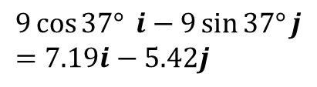




Quickfire Questions
Convert each force to the form $ai+bj$, where $i$ and $j$ are the positive $x$ and $y$ directions respectively.
1
$$8N$$
?
?
$$4\sqrt{3} i+4j$$
$$8\sin{30°}$$
3
$$30°$$
$$8\cos{30°}$$
?
$$37°$$
?
$$9\cos{37°} i−9\sin{37°}j \\ =7.19i−5.42j$$
2
$$9N$$
?
$$6\sin{45°}$$
$$6N$$
?
?
$$−3\sqrt{2} i+3\sqrt{2}j$$
$$45°$$
$$6\cos{45°}$$

Slide 5



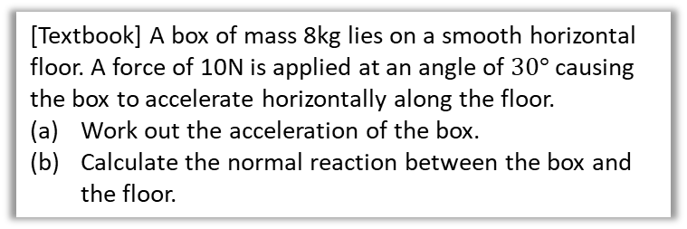


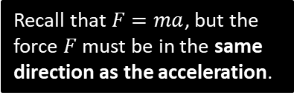


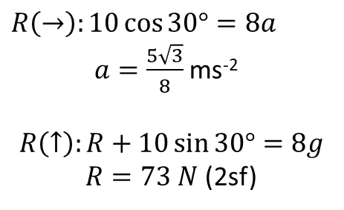
Applied Example
[Textbook] A box of mass 8kg lies on a smooth horizontal floor. A force of 10N is applied at an angle of $30°$ causing the box to accelerate horizontally along the floor.
Work out the acceleration of the box.
Calculate the normal reaction between the box and the floor.
$$10N$$
8 kg
$$30°$$
Recall that $F=ma$, but the force $F$ must be in the same direction as the acceleration.
Draw a clear force diagram, obviously!
? Diagram
$$R$$
$$10N$$
a
$R\left(→\right):10\cos{30°}=8a$ $a=\frac{5\sqrt{3}}{8}$ ms⁻²
$$R\left(↑\right):R+10\sin{30°}=8g$$ $R=73 N$ (2sf)
?
8 kg
$$30°$$
$$10\sin{30}$$
$$10\cos{30}$$
b
?
$$8g$$
HIGHLY RECOMMENDED Tips:
Use dotted lines for components of a force, to distinguish from solid lines for full forces.
Make sure the direction of your components is clear in the diagram, to ensure you get the sign right in calculations.
Write the values of your components in the diagram (as above).

Slide 6








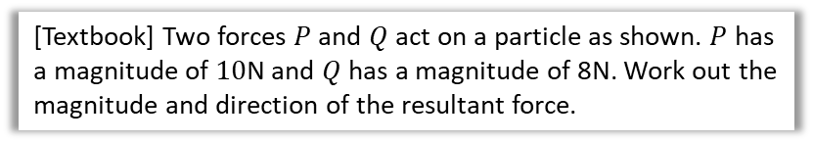











Combining Forces
$$P$$
[Textbook] Two forces $P$ and $Q$ act on a particle as shown. $P$ has a magnitude of $10$N and $Q$ has a magnitude of 8N. Work out the magnitude and direction of the resultant force.
$$45°$$
$$30°$$
Method 1: Finding total $x$ and $y$ components of force.
$$Q$$
Method 2: Using Triangle Law for vector addition.
?
Resultant force:
$$\left(\begin{matrix}10\cos{45°}+8\cos{30°} \\ 10\sin{45°}−8\sin{30°}\end{matrix}\right)=\left(\begin{matrix}13.999 \\ 3.071\end{matrix}\right)$$
Magnitude: $\sqrt{{13.999}^{2}+{3.071}^{2}}$ $$=14.3 N$$
?
$$R$$
We can avoid resolving components by drawing the force vectors in a chain, then finding the vector from the start to end point. The resultant vector (orange) geometrically represents the same of the vectors.
$$θ$$
$$10$$
$$30°$$
$$8$$
$$105°$$
$$45°$$
$$30°$$
Use cosine rule to get magnitude of $R$:
$$R^{2}=8^{2}+{10}^{2}−2×8×10×\cos\left(105°\right) \\ R=14.3 N$$
Use sine rule to get $θ$:
$$\frac{\sin\left(θ+30°\right)}{10}=\frac{\sin\left(105°\right)}{14.332} \\ \sin\left(θ+30°\right)=\frac{10\sin\left(105°\right)}{14.332} … \\ θ=12.4°$$
Do a quick sketch of the force vector to get the direction:
$$θ=\tan^{−1}\left(\frac{3.071}{13.999}\right)=12.4°$$
$$3.071$$
$$θ$$
$$13.999$$

Slide 7



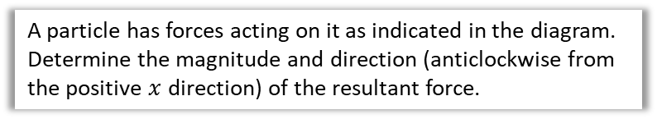





Test Your Understanding
$3$N
A particle has forces acting on it as indicated in the diagram. Determine the magnitude and direction (anticlockwise from the positive $x$ direction) of the resultant force.
$$25°$$
$$32°$$
?
Resultant force:
$$\left(\begin{matrix}4\cos{32°}−3\sin{25°} \\ 3\cos{25°}−4\sin{32°}\end{matrix}\right)=\left(\begin{matrix}2.1243 \\ 0.5992\end{matrix}\right)$$
Magnitude: $\sqrt{{2.1243}^{2}+{0.5992}^{2}}$ $$=2.21 N$$
Direction:
$θ=\tan^{−1}\left(\frac{0.5992}{2.1243}\right)$ $$=15.8°$$
$4$N
$$0.5992$$
$$θ$$
$$2.1243$$

Slide 8
Exercise 5.1
Pearson Stats/Mechanics Year 2
Pages 43-44

Slide 9
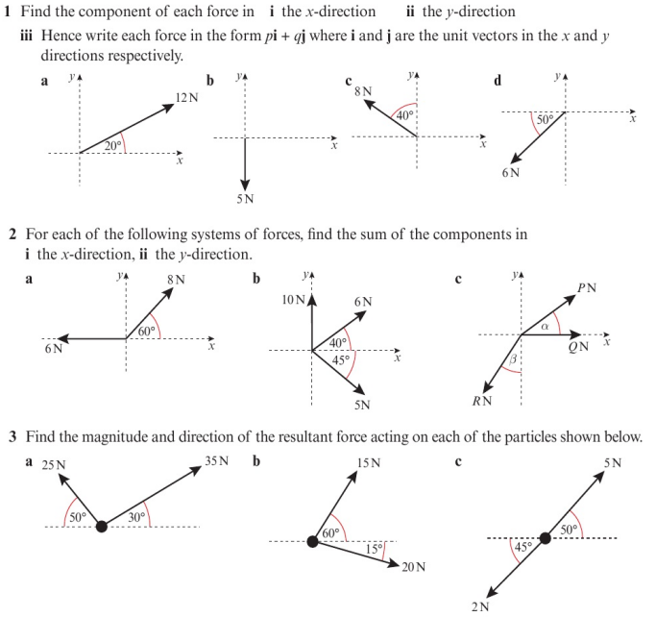
Homework Exercise

Slide 10
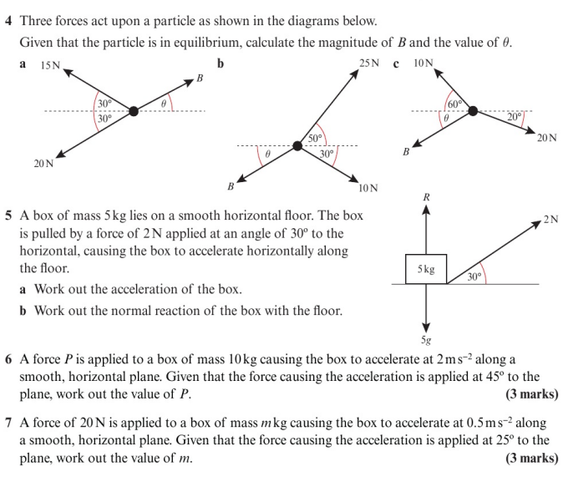
Homework Exercise

Slide 11
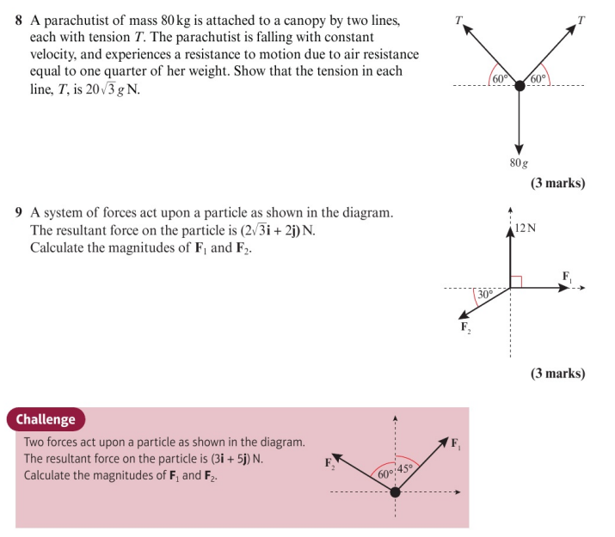
Homework Exercise

Slide 12
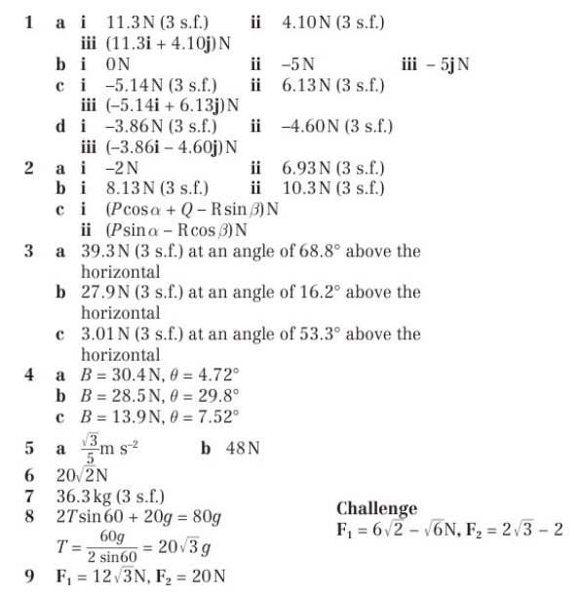
Homework Answers

