Slide 1
P2 Chapter 2: Graphing Functions
The Modulus Function

Slide 2

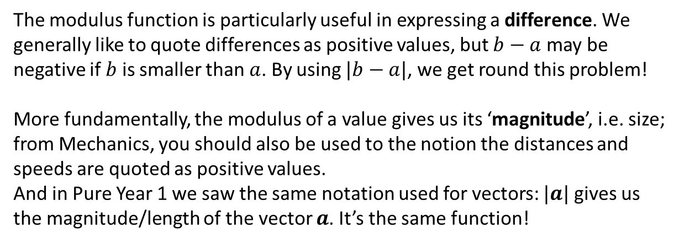

The Modulus Function
! The modulus of a number $a$, written $|a|$, is its non-negative numerical value.
e.g. $\left|6\right|=6$ and $\left|−7.1\right|=7.1$
$$b$$
$$a$$
1
2
3
4
5
6
7
8
The modulus function is particularly useful in expressing a difference. We generally like to quote differences as positive values, but $b−a$ may be negative if $b$ is smaller than $a$. By using $|b−a|$, we get round this problem!
More fundamentally, the modulus of a value gives us its ‘magnitude’, i.e. size; from Mechanics, you should also be used to the notion the distances and speeds are quoted as positive values.
And in Pure Year 1 we saw the same notation used for vectors: $|a|$ gives us the magnitude/length of the vector $a$. It’s the same function!

Slide 3
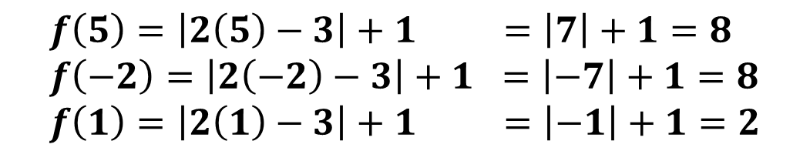
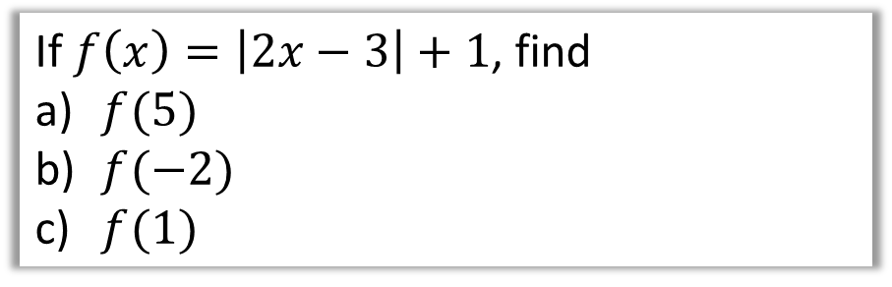
Examples
If $f\left(x\right)=\left|2x−3\right|+1$, find
$f(5)$
$f(−2)$
$f(1)$
?
$$f\left(5\right)=\left|2\left(5\right)−3\right|+1 =\left|7\right|+1=8 \\ f\left(−2\right)=\left|2\left(−2\right)−3\right|+1 =\left|−7\right|+1=8 \\ f\left(1\right)=\left|2\left(1\right)−3\right|+1 =\left|−1\right|+1=2$$

Slide 4



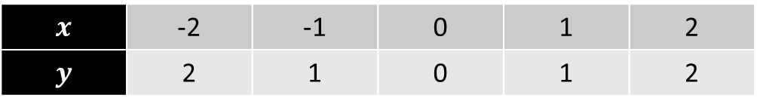



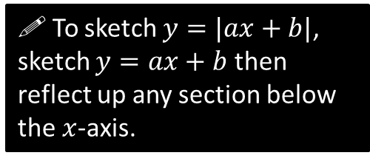
Modulus Graphs
$$y=|x|$$
$$x$$ | -2 | -1 | 0 | 1 | 2
$$y$$ | 2 | 1 | 0 | 1 | 2
?
?
?
?
?
$$(−2,2)$$
$$(2,2)$$
$$(−1,1)$$
$$(1,1)$$
$$(0,0)$$
! To sketch $y=|ax+b|$, sketch $y=ax+b$ then reflect up any section below the $x$-axis.

Slide 5









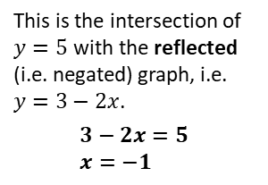
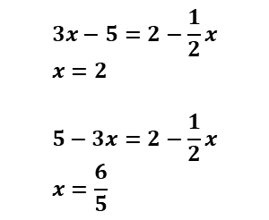




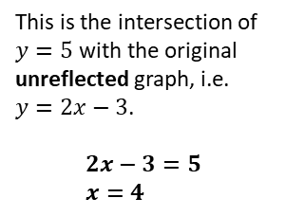






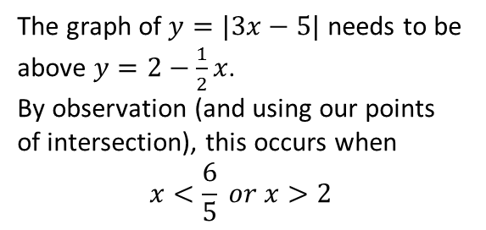
Modulus Graphs
Sketch $y=|2x−3|$
Solve $\left|2x−3\right|=5$
$$y$$
$$y$$
As you would have done in Pure Year 1, sketch a line for each side of the equation, so that we can use the points of intersection.
Fro Tip: I like to sketch the non-modulus graph first with a dotted line.
$$y=5$$
$$3$$
$$3$$
This is the intersection of $y=5$ with the original unreflected graph, i.e. $y=2x−3$.
$$2x−3=5 \\ x=4$$
$$x$$
$$x$$
$$\frac{3}{2}$$
This is the intersection of $y=5$ with the reflected (i.e. negated) graph, i.e. $y=3−2x$.
$$3−2x=5 \\ x=−1$$
$$\frac{3}{2}$$
$$−3$$
$$−3$$
Solve $\left|3x−5\right|=2−\frac{1}{2}x$
Solve $\left|3x−5\right|>2−\frac{1}{2}x$
$$y$$
The graph of $y=|3x−5|$ needs to be above $y=2−\frac{1}{2}x$.
By observation (and using our points of intersection), this occurs when
$$x<\frac{6}{5} or x>2$$
$$3x−5=2−\frac{1}{2}x \\ x=2$$
$$5−3x=2−\frac{1}{2}x \\ x=\frac{6}{5}$$
$$5$$
$$2$$
$$\frac{6}{5}$$
$$x$$
$$2$$

Slide 6




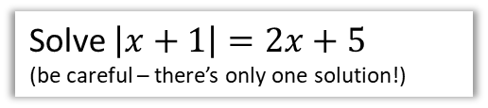




Test Your Understanding
Solve $\left|x+1\right|=2x+5$
(be careful – there’s only one solution!)
Solve $\left|4x−1\right|<2x$
?
?
$$y$$
$$y$$
$$5$$
$$1$$
$$1$$
$$x$$
$$x$$
$$\frac{1}{4}$$
We can see the line $y=2x+5$ only intersects with the reflected part of the modulus graph.
$$−x−1=2x+5 \\ 3x=−6 \\ x=−2$$
Determine ‘critical values’:
$$4x−1=2x \\ x=\frac{1}{2}$$
$$1−4x=2x \\ x=\frac{1}{6}$$
$$∴\frac{1}{6}<x<\frac{1}{2}$$

Slide 7
Exercise 2.1
Pearson Pure Mathematics Year 2/AS
Pages 6

Slide 8
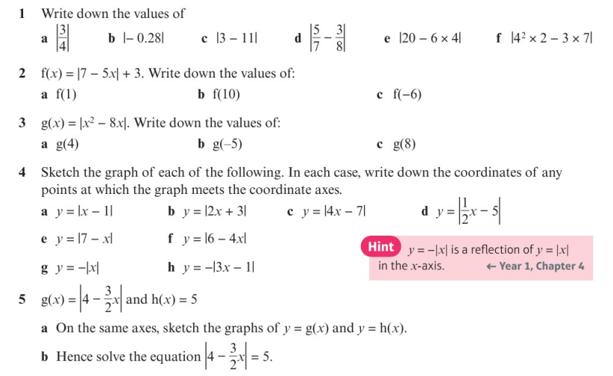
Homework Exercise

Slide 9
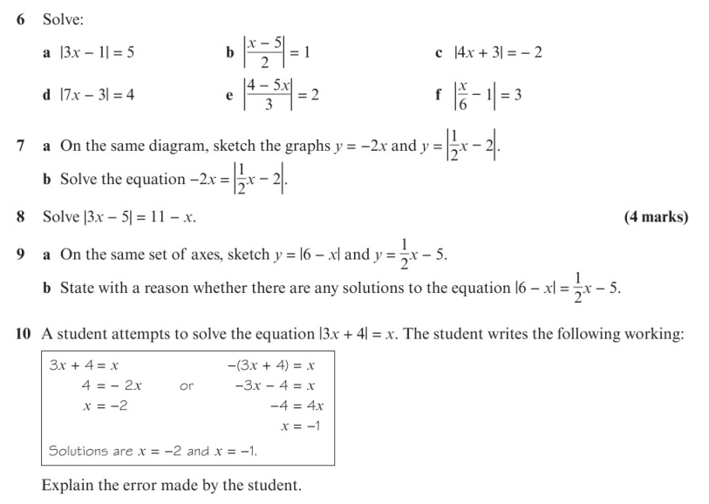
Homework Exercise

Slide 10
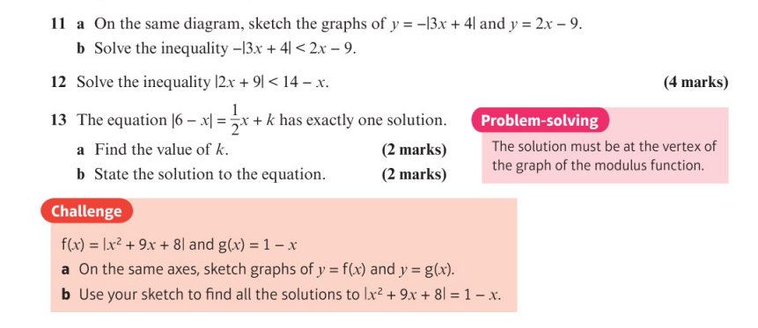
Homework Exercise

Slide 11
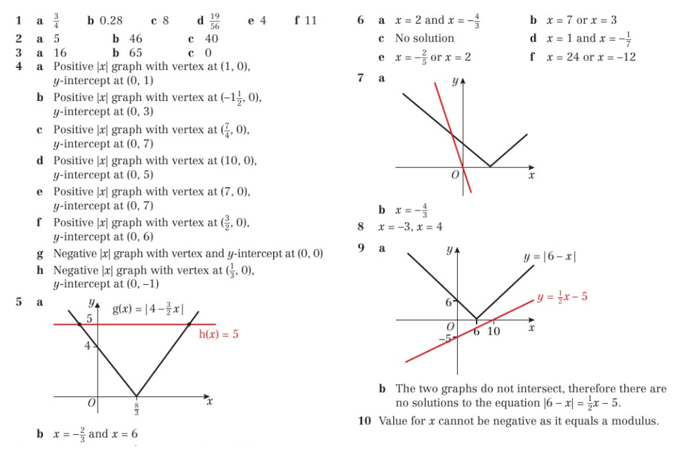
Homework Answers

Slide 12
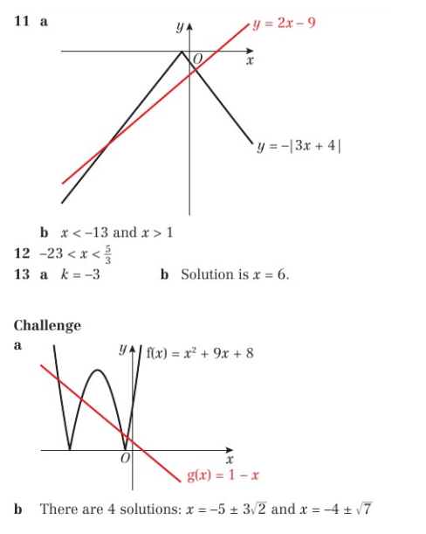
Homework Answers

