Slide 1
P2 Chapter 11: Integration The Trapezium Rule

Slide 2







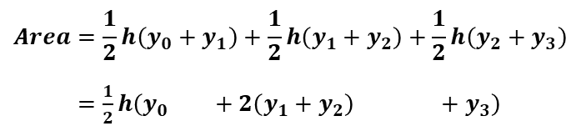
Skill #10: Trapezium Rule
Sometimes finding the exact area under the graph via integration is difficult. Students who have taken GCSE Maths may be familiar with the idea of approximating the area under a graph by dividing it into trapeziums of equal width.
$$y3$$
$$y2$$
$$y1$$
$$y0$$
$$Area=\frac{1}{2}h\left(y_{0}+y_{1}\right)+\frac{1}{2}h\left(y_{1}+y_{2}\right)+\frac{1}{2}h\left(y_{2}+y_{3}\right)$$
$=\frac{1}{2}h\left(y_{0 } +2\left(y_{1}+y_{2}\right) +y_{3}\right)$
?
$$h$$
$$h$$
$$h$$

Slide 3
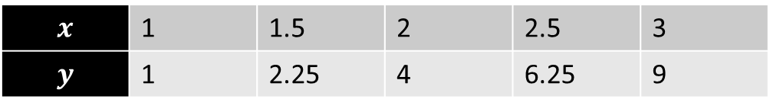

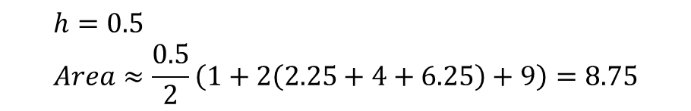
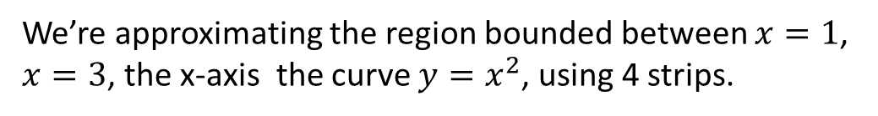
Trapezium Rule
In general: !
width of each trapezium
$$\int_{a}^{b}{y}dx≈\frac{h}{2}\left(y_{0}+2\left(y_{1}+…+y_{n−1}\right)+y_{n}\right)$$
Area under curve
is approximately
Example
We’re approximating the region bounded between $x=1$, $x=3$, the x-axis the curve $y=x^{2}$, using 4 strips.
Dividing a gap of 2 into 4 strips means each strip will be width 0.5
?
$$x$$ | 1 | 1.5 | 2 | 2.5 | 3
$$y$$ | 1 | 2.25 | 4 | 6.25 | 9
?
?
$$h=0.5 \\ Area≈\frac{0.5}{2}\left(1+2\left(2.25+4+6.25\right)+9\right)=8.75$$
?

Slide 4
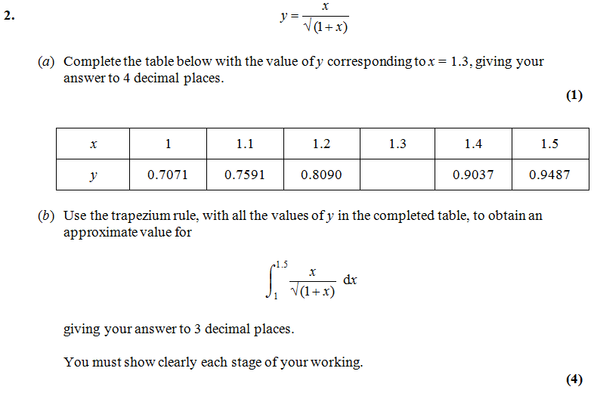
Trapezium Rule
Edexcel C2 May 2013 (R) Q2
Fro Tip: You can generate table with Casio calcs . $Mode→3 (Table)$. Use ‘Alpha’ button to key in X within the function. Press =
?
0.8571
$$Area≈\frac{0.1}{2}\left(0.7071+2\left(0.7591+0.8090+0.8571+0.9037\right)+0.9487\right)=0.416$$
?

Slide 5


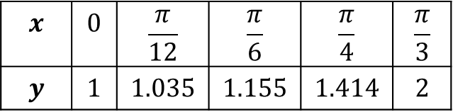
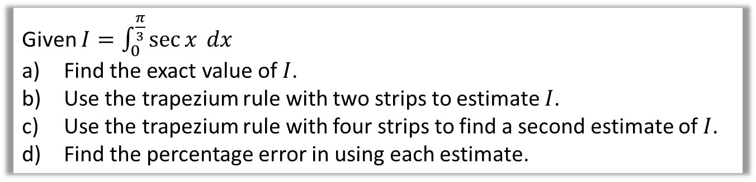
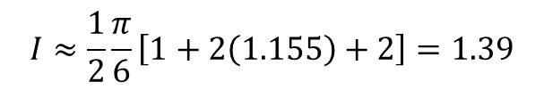
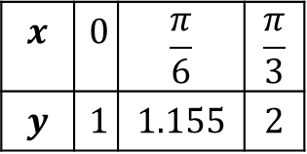
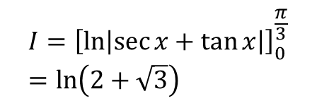
Further Example
Trapezium Rule: $\int_{a}^{b}{y dx}≈\frac{1}{2}h\left[y_{0}+2\left(y_{1}+…+y_{n−1}\right)+y_{n}\right]$
Q
Given $I=\int_{0}^{\frac{π}{3}}{\sec{x} dx}$
Find the exact value of $I$.
Use the trapezium rule with two strips to estimate $I$.
Use the trapezium rule with four strips to find a second estimate of $I$.
Find the percentage error in using each estimate.
a
$$I={\left[\ln\left|\sec{x}+\tan{x}\right|\right]}_{0}^{\frac{π}{3}} \\ =\ln\left(2+\sqrt{3}\right)$$
?
c
?
$$x$$ | $$0$$ | $$\frac{π}{12}$$ | $$\frac{π}{6}$$ | $$\frac{π}{4}$$ | $$\frac{π}{3}$$
$$y$$ | $$1$$ | $$1.035$$ | $$1.155$$ | $$1.414$$ | $$2$$
b
?
$$x$$ | $$0$$ | $$\frac{π}{6}$$ | $$\frac{π}{3}$$
$$y$$ | $$1$$ | $$1.155$$ | $$2$$
$$I≈\frac{1}{2}\frac{π}{12}\left[1+2\left(1.035+1.155+1.414\right)+2\right]=1.34$$
$$I≈\frac{1}{2}\frac{π}{6}\left[1+2\left(1.155\right)+2\right]=1.39$$
Error is 5.6% and 1.5%.
d
?

Slide 6
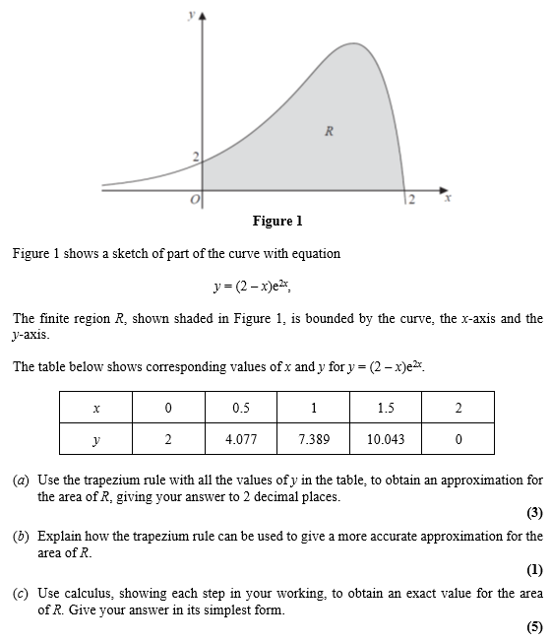

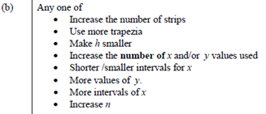
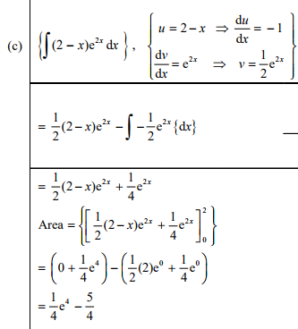
Test Your Understanding
Edexcel C4 June 2014(R) Q2
?
?
?

Slide 7
Exercise 11.9
Pearson Pure Mathematics Year 2
Pages 98-100

Slide 8
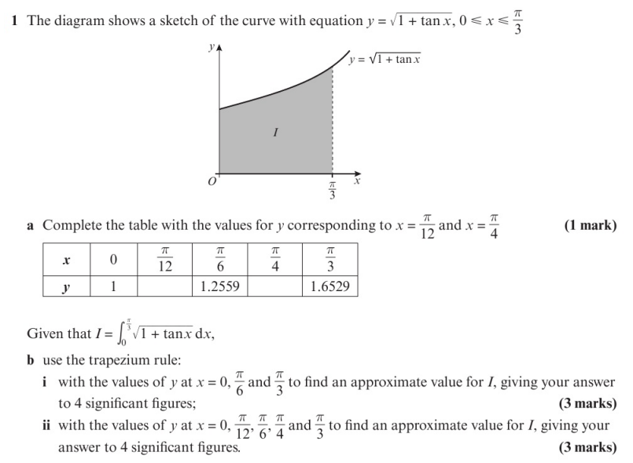
Homework Exercise

Slide 9
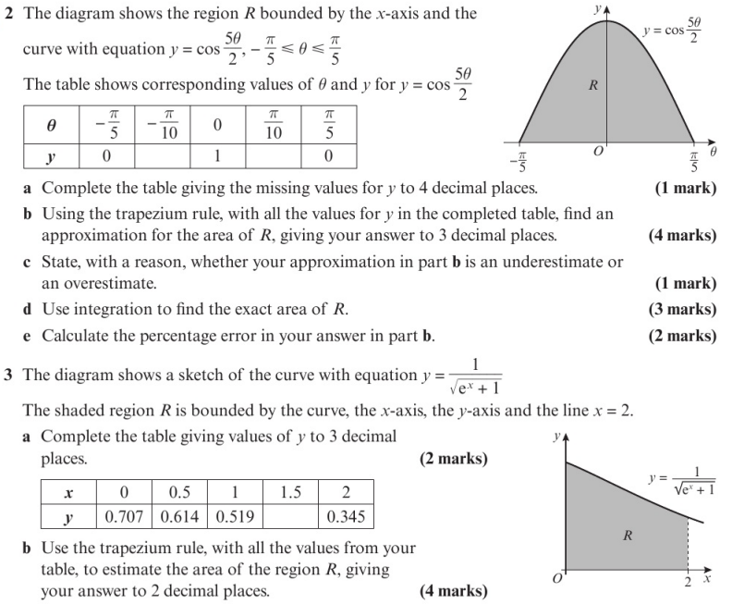
Homework Exercise

Slide 10
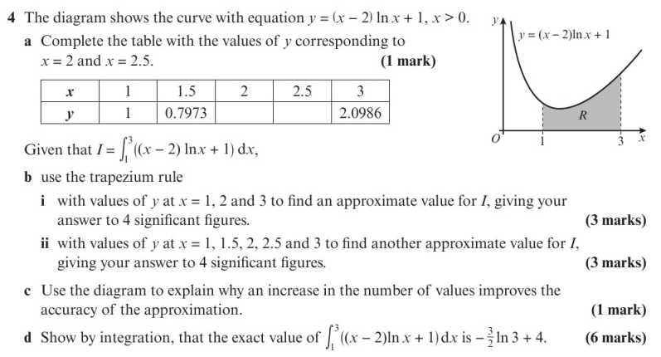
Homework Exercise

Slide 11
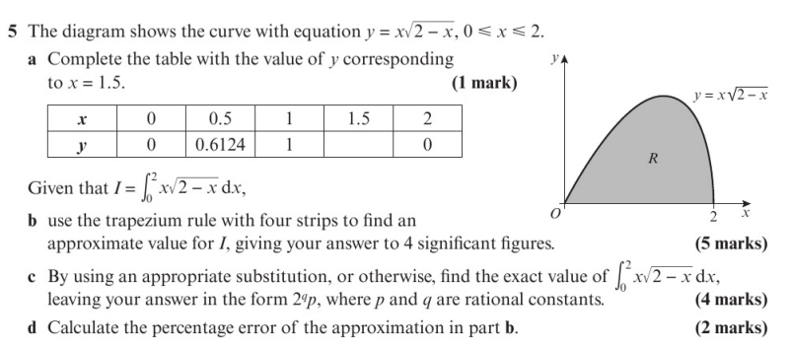
Homework Exercise

Slide 12
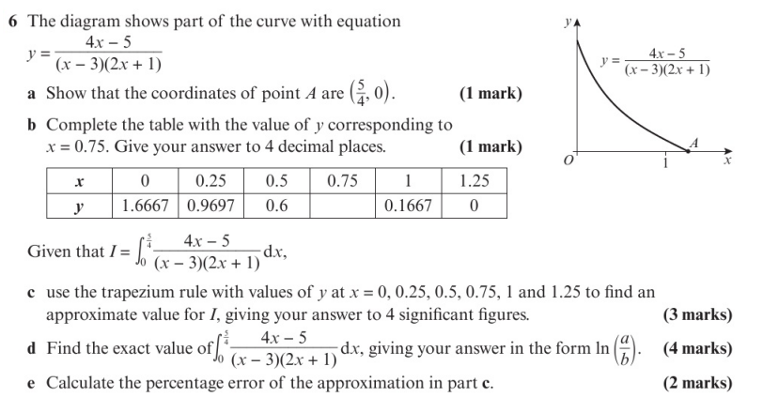
Homework Exercise

Slide 13
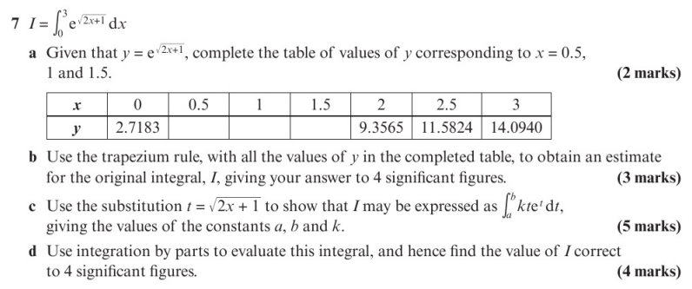
Homework Exercise

Slide 14
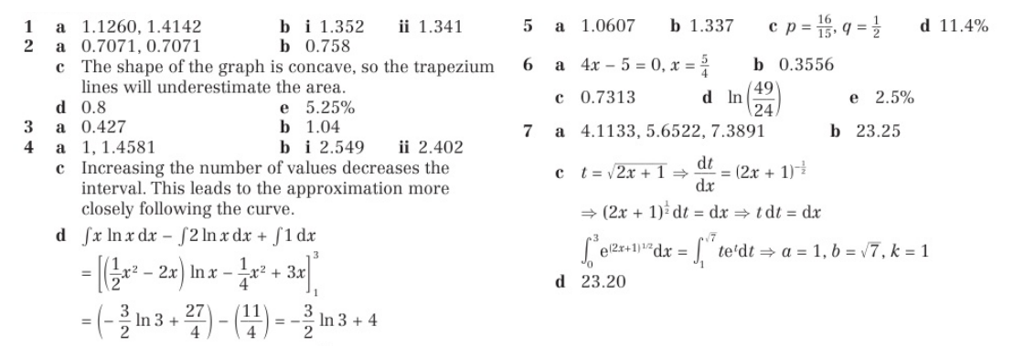
Homework Answers

