Slide 1
P2 Chapter 1: Algebra Techniques
Repeated Partial Fractions

Slide 2
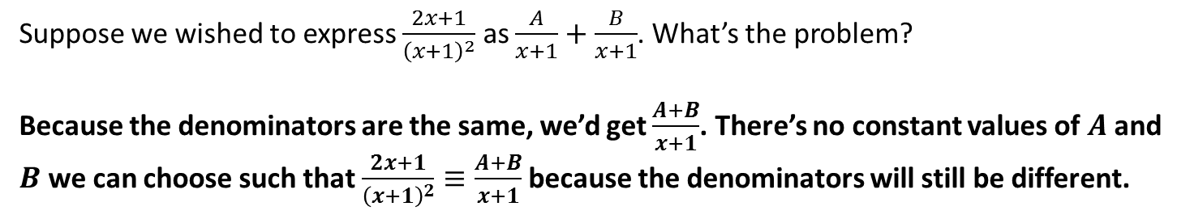

Repeated linear factors
Suppose we wished to express $\frac{2x+1}{{\left(x+1\right)}^{2}}$ as $\frac{A}{x+1}+\frac{B}{x+1}$. What’s the problem?
Because the denominators are the same, we’d get $\frac{A+B}{x+1}$. There’s no constant values of $A$ and $B$ we can choose such that $\frac{2x+1}{{\left(x+1\right)}^{2}}≡\frac{A+B}{x+1}$ because the denominators will still be different.
?
Q
Split $\frac{11x^{2}+14x+5}{{\left(x+1\right)}^{2}\left(2x+1\right)}$ into partial fractions.
The problem is resolved by having the factor both squared and non-squared (explanation of why we do this at the end of these slides).
$$\frac{11x^{2}+14x+5}{{\left(x+1\right)}^{2}\left(2x+1\right)}≡\frac{A}{x+1}+\frac{B}{{\left(x+1\right)}^{2}}+\frac{C}{2x+1}$$
?
$$11x^{2}+14x+5≡A\left(x+1\right)\left(2x+1\right)+B\left(2x+1\right)+C{\left(x+1\right)}^{2}$$
When $x=−1$: $2=−B → B=−2$
When $x=−\frac{1}{2}$: $\frac{3}{4}=\frac{1}{4}C → C=3$
At this point we could substitute something else (e.g. $x=1$) but it’s easier to equate $x^{2}$ terms.
$$11=2A+C \\ A=4$$

Slide 3
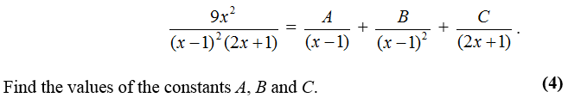
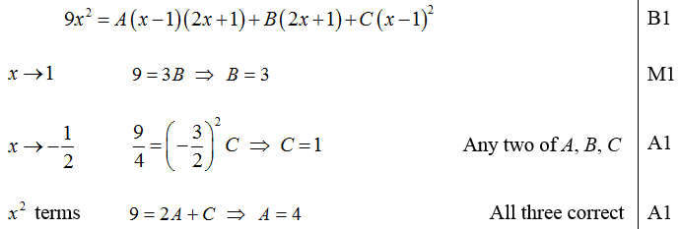
Test Your Understanding
C4 June 2011 Q1
?

Slide 4
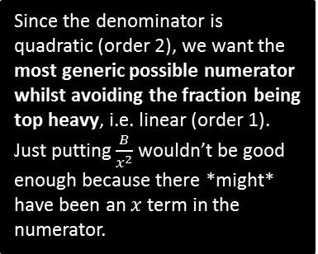
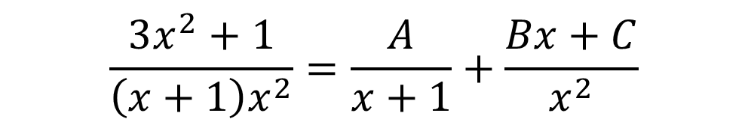
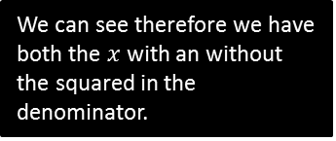
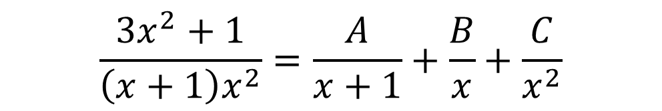
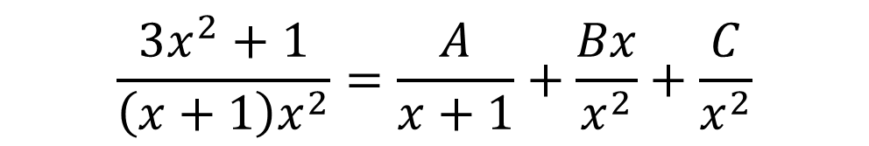
Informal proof of method for repeated factors
If a factor is repeated, why do have a partial fraction with the squared and one without?
When we split into partial fractions, we want each fraction to be non-top-heavy algebraic fractions – recall this means that the ‘order’ of the numerator has to be less than the order of the denominator. We assume the most generic non-top-heavy fraction possible, i.e. where the order of the numerator is one less than the denominator…
order 1
Since the denominator is quadratic (order 2), we want the most generic possible numerator whilst avoiding the fraction being top heavy, i.e. linear (order 1).
Just putting $\frac{B}{x^{2}}$ wouldn’t be good enough because there *might* have been an $x$ term in the numerator.
$$\frac{3x^{2}+1}{\left(x+1\right)x^{2}}=\frac{A}{x+1}+\frac{Bx+C}{x^{2}}$$
order 2
$$\frac{3x^{2}+1}{\left(x+1\right)x^{2}}=\frac{A}{x+1}+\frac{Bx}{x^{2}}+\frac{C}{x^{2}}$$
Split the fraction.
We can see therefore we have both the $x$ with an without the squared in the denominator.
$$\frac{3x^{2}+1}{\left(x+1\right)x^{2}}=\frac{A}{x+1}+\frac{B}{x}+\frac{C}{x^{2}}$$

Slide 5
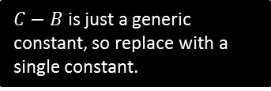
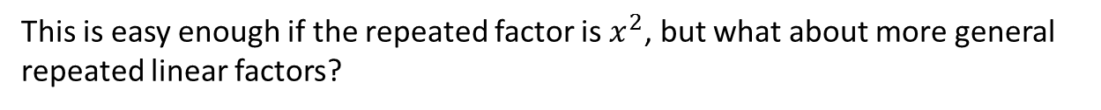
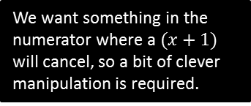

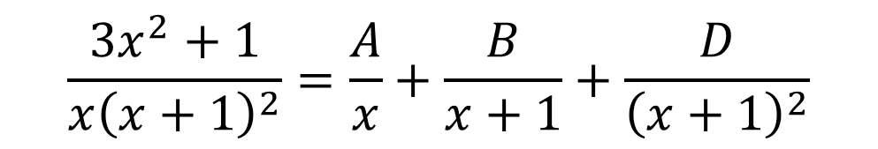
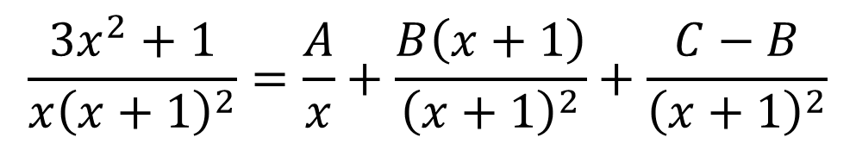
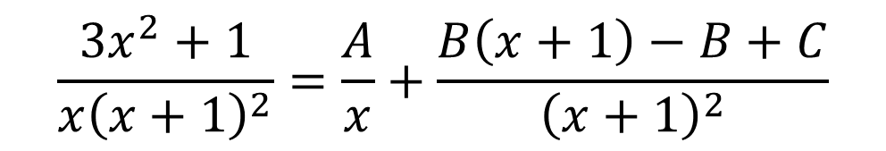
Informal proof of method for repeated factors
This is easy enough if the repeated factor is $x^{2}$, but what about more general repeated linear factors?
$$\frac{3x^{2}+1}{x{\left(x+1\right)}^{2}}=\frac{A}{x}+\frac{Bx+C}{{\left(x+1\right)}^{2}}$$
We want something in the numerator where a $(x+1)$ will cancel, so a bit of clever manipulation is required.
$$\frac{3x^{2}+1}{x{\left(x+1\right)}^{2}}=\frac{A}{x}+\frac{B\left(x+1\right)−B+C}{{\left(x+1\right)}^{2}}$$
Split the fraction as before.
$$\frac{3x^{2}+1}{x{\left(x+1\right)}^{2}}=\frac{A}{x}+\frac{B\left(x+1\right)}{{\left(x+1\right)}^{2}}+\frac{C−B}{{\left(x+1\right)}^{2}}$$
$$\frac{3x^{2}+1}{x{\left(x+1\right)}^{2}}=\frac{A}{x}+\frac{B}{x+1}+\frac{D}{{\left(x+1\right)}^{2}}$$
$C−B$ is just a generic constant, so replace with a single constant.

Slide 6
Exercise 1.4
Pearson Pure Mathematics Year 2/AS
Page 3

Slide 7
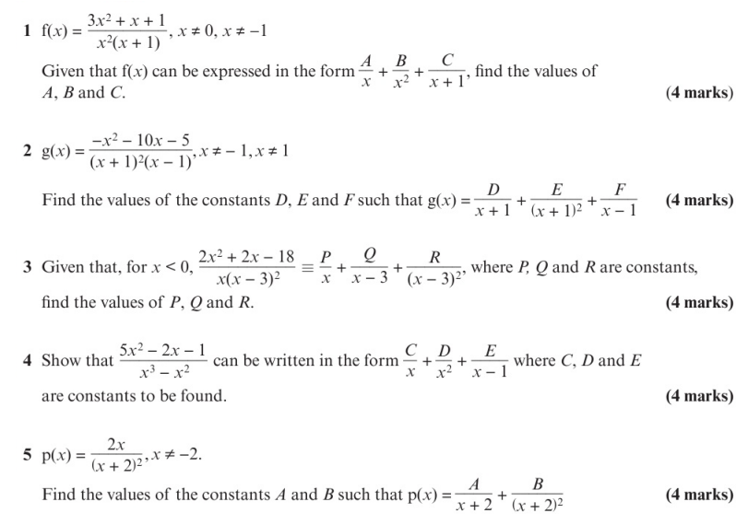
Homework Exercise

Slide 8
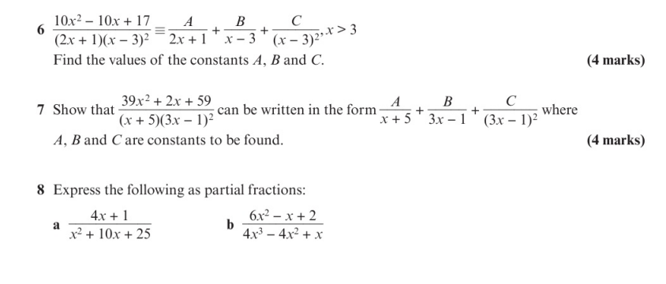
Homework Exercise

Slide 9
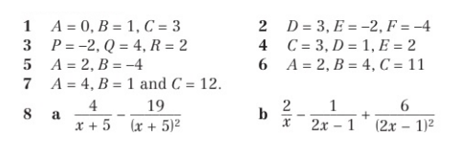
Homework Answers

