Slide 1
P1 Chapter 9: Trigonometric Ratios Sine Rule

Slide 2


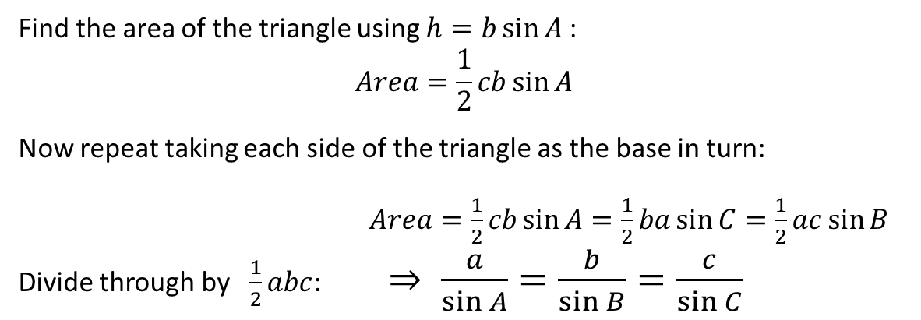

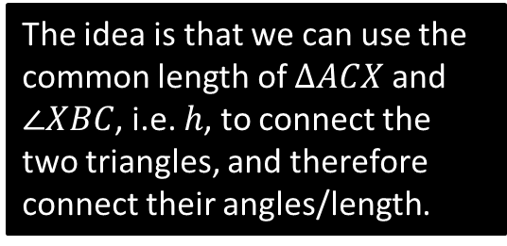





Proof of Sine Rule
$$C$$
The idea is that we can use the common length of $ΔACX$ and $∠XBC$, i.e. $h$, to connect the two triangles, and therefore connect their angles/length.
$$b$$
$$a$$
$$h$$
$$A$$
$$B$$
$$X$$
$$c$$
Find the area of the triangle using $h=b\sin{A}$:
$$Area=\frac{1}{2}cb\sin{A}$$
Now repeat taking each side of the triangle as the base in turn:
$Area=\frac{1}{2}cb\sin{A}=\frac{1}{2}ba\sin{C}=\frac{1}{2}ac\sin{B}$ Divide through by $\frac{1}{2}abc$: $⇒ \frac{a}{\sin{A}}=\frac{b}{\sin{B}}=\frac{c}{\sin{C}}$
?

Slide 3
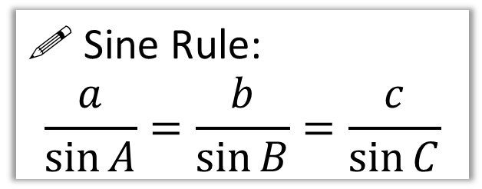
The Sine Rule
b
For this triangle, try calculating each side divided by the sin of its opposite angle. What do you notice in all three cases?
65°
c
5.02
A
10
85°
! Sine Rule:
$$\frac{a}{\sin{A}}=\frac{b}{\sin{B}}=\frac{c}{\sin{C}}$$
?
C
B
30°
9.10
a
You have | You want | Use
#1: Two angle-side opposite pairs | Missing angle or side in one pair | Sine rule

Slide 4
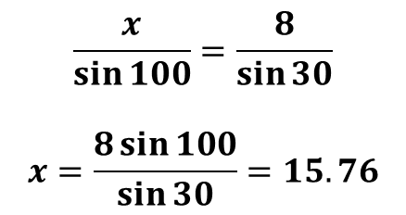
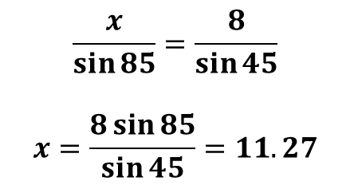
Examples
8
Q2
Q1
8
50°
85°
100°
15.76
45°
?
30°
11.27
?
$$\frac{x}{\sin{85}}=\frac{8}{\sin{45}}$$
$$x=\frac{8\sin{85}}{\sin{45}}=11.27$$
$$\frac{x}{\sin{100}}=\frac{8}{\sin{30}}$$
$$x=\frac{8\sin{100}}{\sin{30}}=15.76$$
You have | You want | Use
#1: Two angle-side opposite pairs | Missing angle or side in one pair | Sine rule

Slide 5
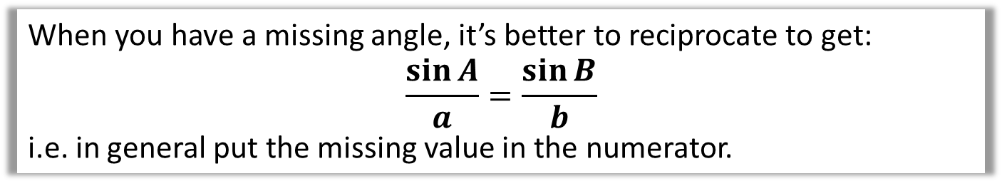
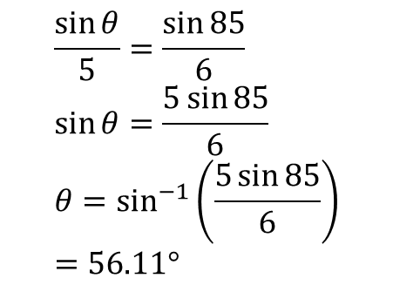
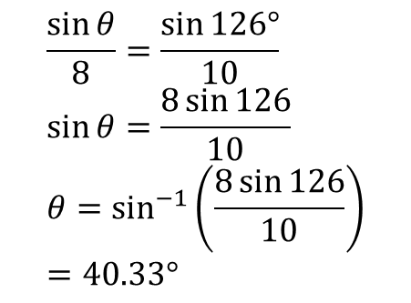
Examples
When you have a missing angle, it’s better to reciprocate to get:
$$\frac{\sin{A}}{a}=\frac{\sin{B}}{b}$$
i.e. in general put the missing value in the numerator.
5
Q3
Q4
8
126°
85°
40.33°
?
56.11°
6
10
?
$$\frac{\sin{θ}}{5}=\frac{\sin{85}}{6} \\ \sin{θ}=\frac{5\sin{85}}{6} \\ θ=\sin^{−1}\left(\frac{5\sin{85}}{6}\right) \\ =56.11°$$
$$\frac{\sin{θ}}{8}=\frac{\sin{126°}}{10} \\ \sin{θ}=\frac{8\sin{126}}{10} \\ θ=\sin^{−1}\left(\frac{8\sin{126}}{10}\right) \\ =40.33°$$

Slide 6
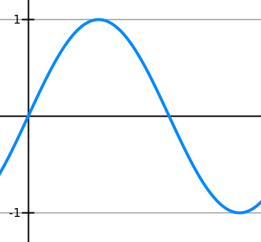
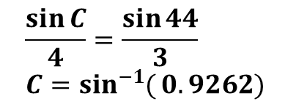

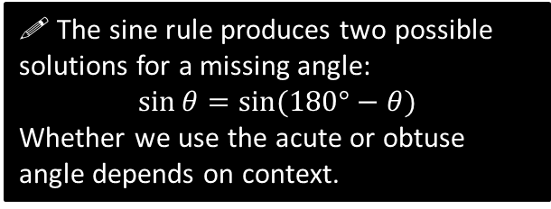

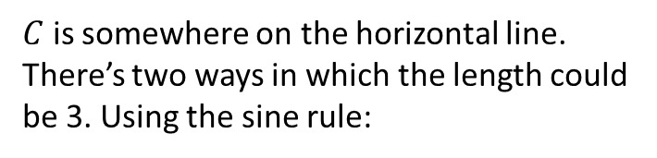




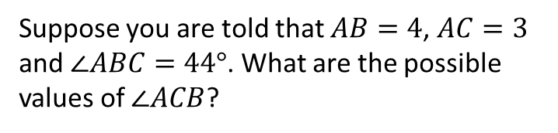
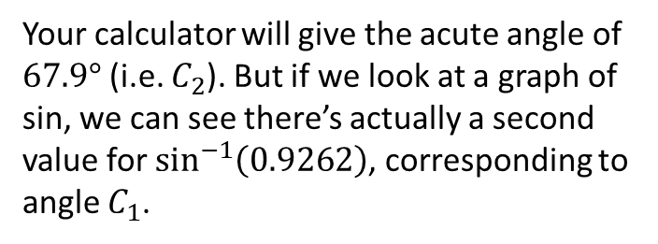





The ‘Ambiguous Case’
$$A$$
Suppose you are told that $AB=4$, $AC=3$ and $∠ABC=44°$. What are the possible values of $∠ACB$?
$C$ is somewhere on the horizontal line. There’s two ways in which the length could be 3. Using the sine rule:
$$4$$
$$3$$
$$3$$
$$\frac{\sin{C}}{4}=\frac{\sin{44}}{3} \\ C=\sin^{−1}{(}0.9262)$$
$$44°$$
Your calculator will give the acute angle of $67.9°$ (i.e. $C_{2}$). But if we look at a graph of sin, we can see there’s actually a second value for $\sin^{−1}\left(0.9262\right)$, corresponding to angle $C_{1}$.
$$B$$
$$C_{1}$$
$$C_{2}$$
0.9262
! The sine rule produces two possible solutions for a missing angle:
$$\sin{θ}=sin⁡(180°−θ)$$
Whether we use the acute or obtuse angle depends on context.
$$67.9°$$
$$112.1°$$
$$180°$$

Slide 7



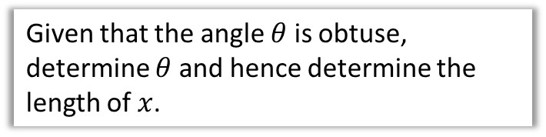

Test Your Understanding
Given that the angle $θ$ is obtuse, determine $θ$ and hence determine the length of $x$.
10
$$θ$$
5
?
$$20°$$
$$\frac{\sin{θ}}{10}=\frac{\sin{20°}}{5} \\ \sin^{−1}\left(\frac{10\sin{20°}}{5}\right)=43.1602° \\ ∴θ=180°−43.1602°=136.8398°$$
The other angle is:
$$180°−136.8398°−20°=23.1602°$$
Using sine rule again:
$$\frac{x}{\sin{23.1602°}}=\frac{5}{\sin{20°}}$$
$$x=5.75 (3sf)$$
$$x$$

Slide 8
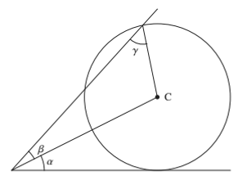
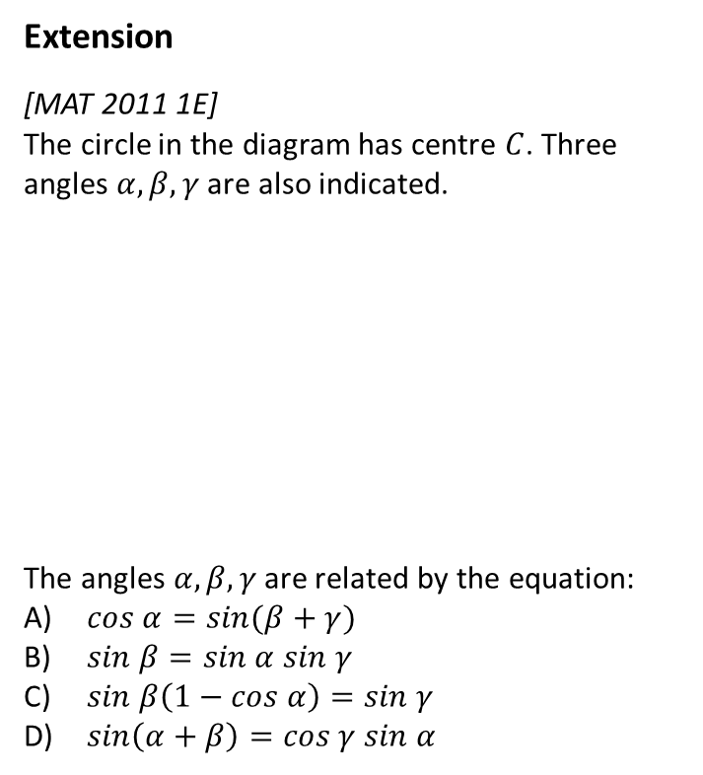


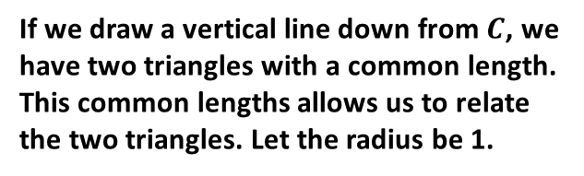
Exercise 9.2
Pearson Pure Mathematics Year 1/AS
Page 70
Extension
[MAT 2011 1E]
The circle in the diagram has centre $C$. Three angles $α, β, γ$ are also indicated.
The angles $α, β, γ$ are related by the equation:
$cos α=sin(β+γ)$
$sin β=sin α sin γ$
$sin β\left(1−cos α\right)=sin γ$
$sin\left(α+β\right)=cos γ sin α$
?
If we draw a vertical line down from $C$, we have two triangles with a common length. This common lengths allows us to relate the two triangles. Let the radius be 1.
1
1
$$x$$
1
Using bottom triangle:
$$1=x\sin{α → x=\frac{1}{\sin{α}}}$$
Using sine rule on top:
$$\frac{x}{\sin{γ}}=\frac{1}{\sin{β}}$$
Substituting in $x$ from the first equation, and rearranging, we obtain (B).

Slide 9
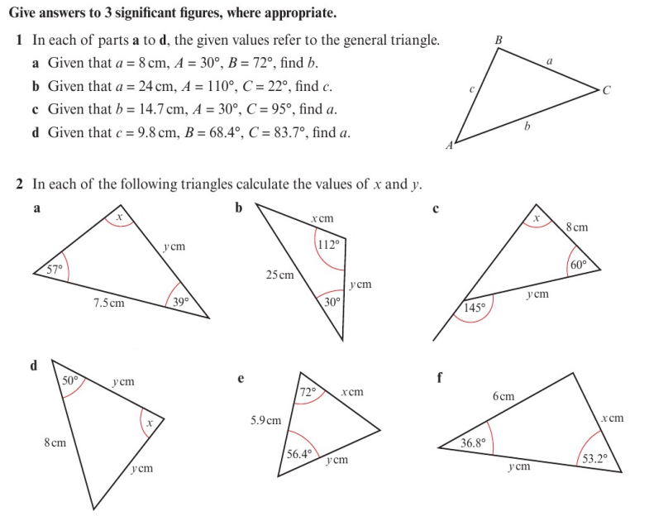
Homework Exercise

Slide 10
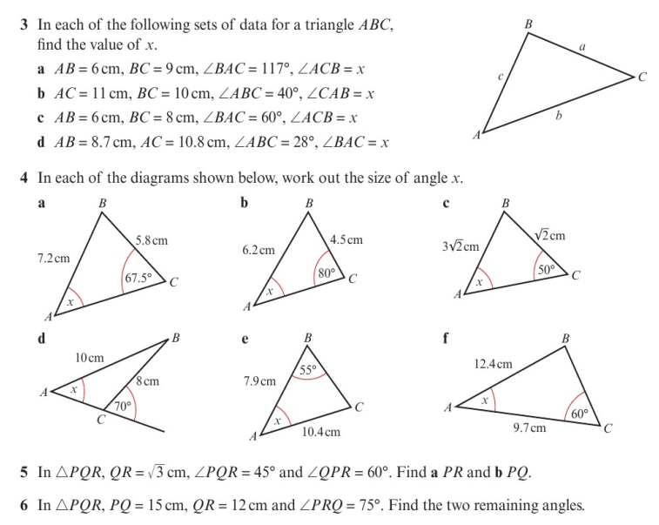
Homework Exercise

Slide 11
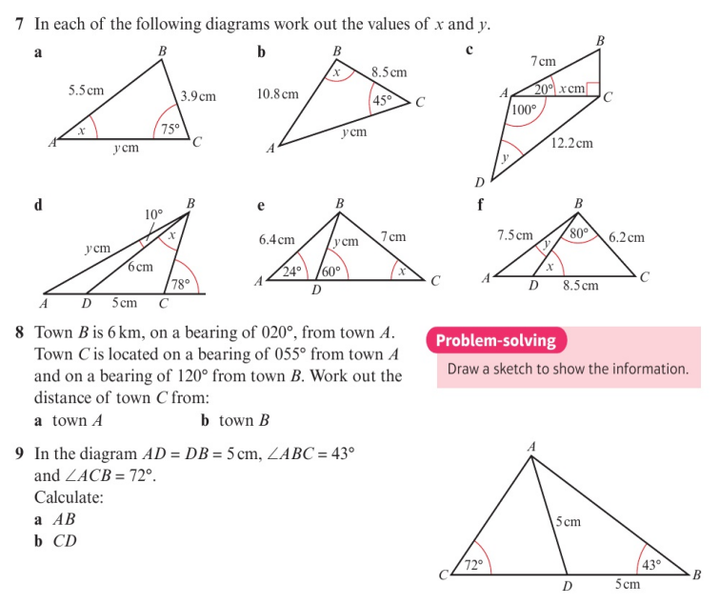
Homework Exercise

Slide 12
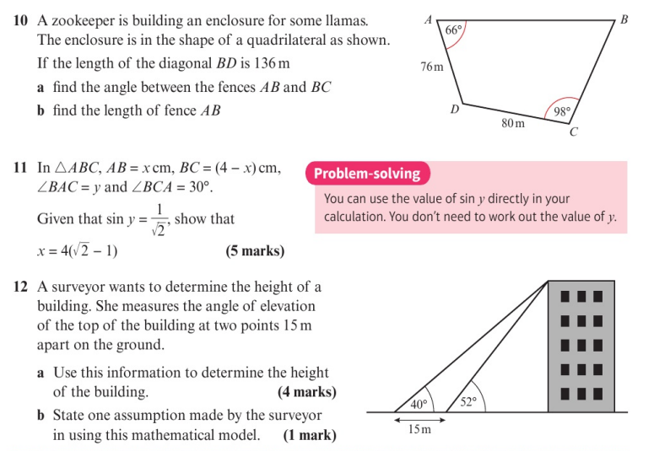
Homework Exercise

Slide 13
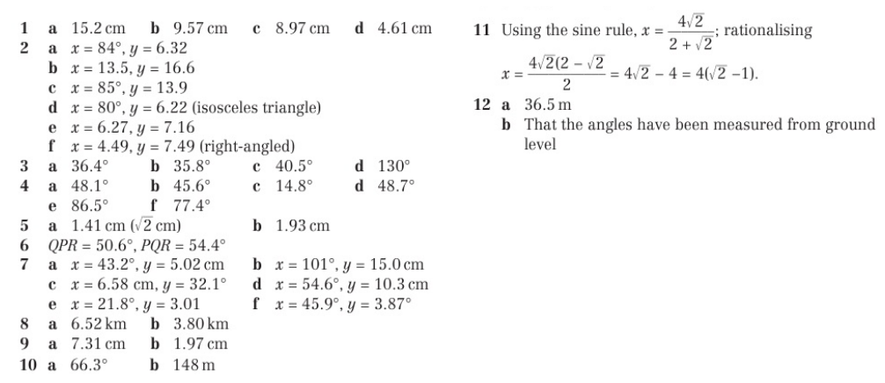
Homework Answers

