Slide 1
M2 Chapter 4: Moments Resultant Moments

Slide 2














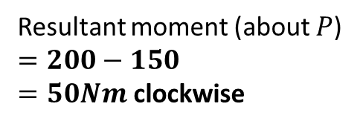







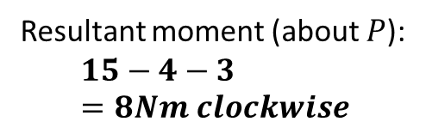
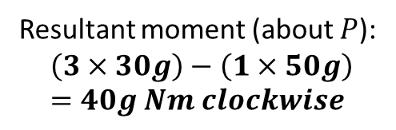
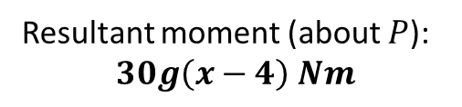
Resultant moments
If we have multiple coplanar forces, we can also find the overall moment by adding them – just treat one of the directions (clockwise or anticlockwise) as negative. This is similar to finding resultant force.
$$5N$$
$$3N$$
$$20N$$
2
1
$$P$$
$$2m$$
$$1m$$
$$1m$$
$$10m$$
$$10N$$
Resultant moment (about $P$):
$$15−4−3=8Nm clockwise$$
$$15m$$
$$4N$$
?
$$P$$
Resultant moment (about $P$)
$$=200−150$$ $=50Nm$ clockwise
3
$$1m$$
$$3m$$
?
(Rod is light)
$$m=50kg$$
$$m=30kg$$
$$5N$$
$$P$$
Resultant moment (about $P$):
$$\left(3×30g\right)−\left(1×50g\right)=40g Nm clockwise$$
$$x$$
?
4
$$4m$$
$$m=30kg$$
Resultant moment (about $P$):
$$30g\left(x−4\right) Nm$$
$$P$$
?

Slide 3




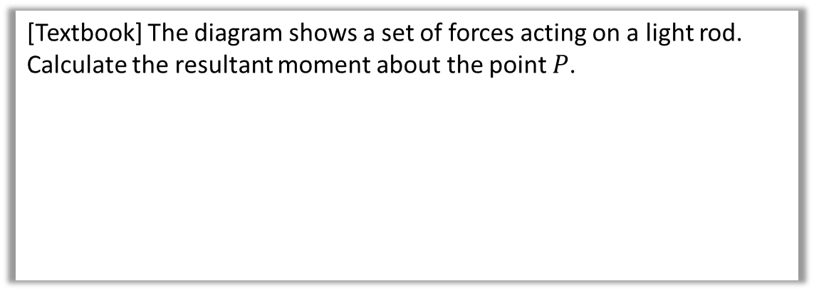

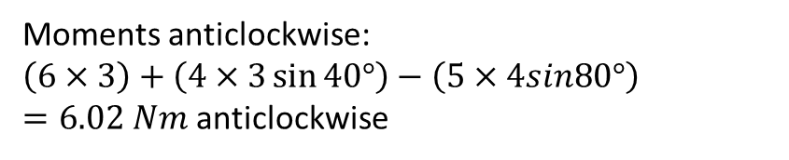




Angled examples
[Textbook] The diagram shows a set of forces acting on a light rod. Calculate the resultant moment about the point $P$.
$$5N$$
$$4N$$
Always start by drawing in perpendicular distances.
$$80°$$
$$40°$$
$3$m
$$P$$
$3$m
Click to sketch perpendicular distances
$1$m
$$6N$$
Moments anticlockwise:
$\left(6×3\right)+\left(4×3\sin{40°}\right)−\left(5×4sin80°\right)$ $=6.02 Nm$ anticlockwise
?

Slide 4



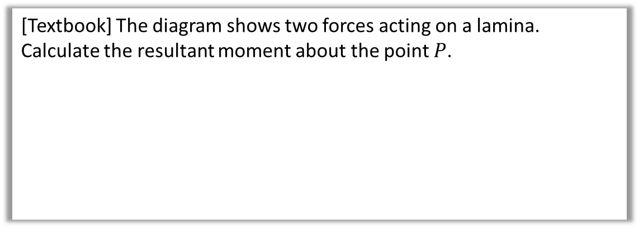



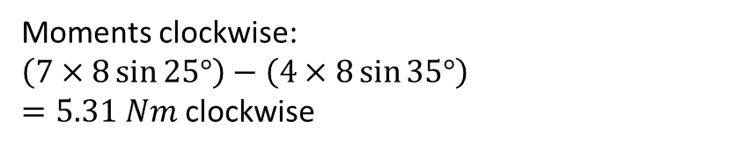
Test Your Understanding
[Textbook] The diagram shows two forces acting on a lamina.
Calculate the resultant moment about the point $P$.
$7$ N
$$25°$$
$8$ m
$$P$$
$$35°$$
$4$ N
Click to sketch perpendicular distances
Moments clockwise:
$\left(7×8\sin{25°}\right)−\left(4×8\sin{35°}\right)$ $=5.31 Nm$ clockwise
?

Slide 5
Exercise 4.2
Pearson Stats/Mechanics Year 2
Page 34-35

Slide 6
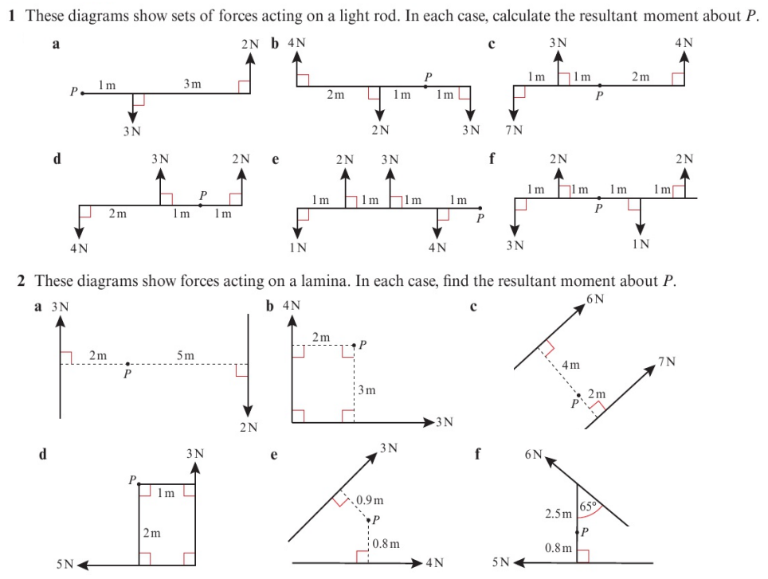
Homework Exercise

Slide 7
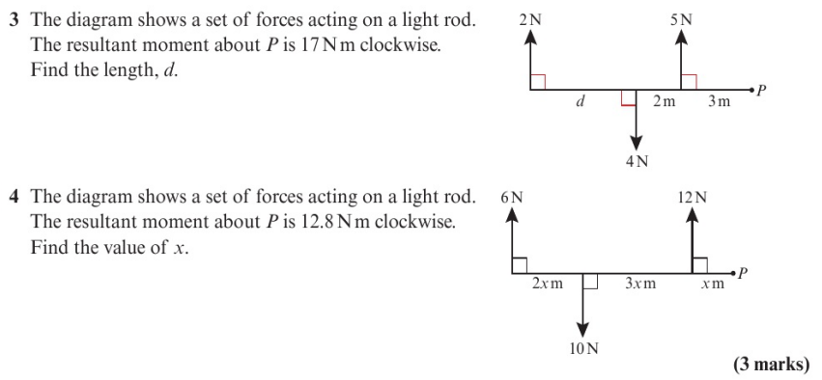
Homework Exercise

Slide 8
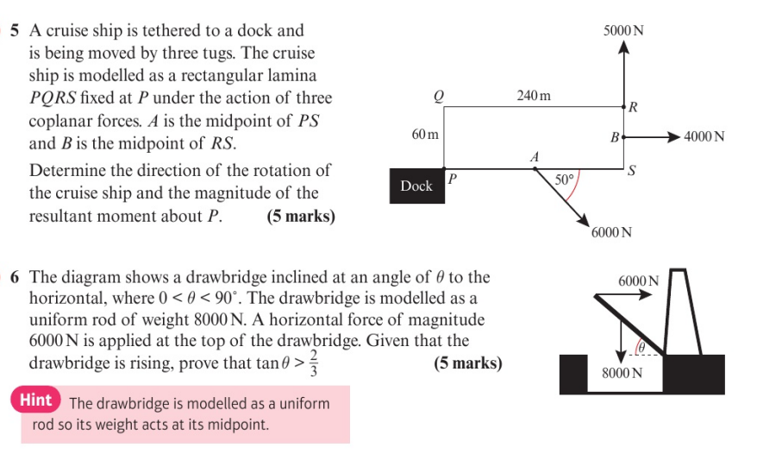
Homework Exercise

Slide 9
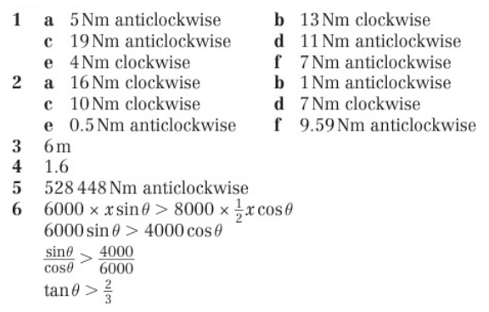
Homework Answers

