Slide 1
P2 Chapter 10: Numerical Methods Modelling Applications

Slide 2

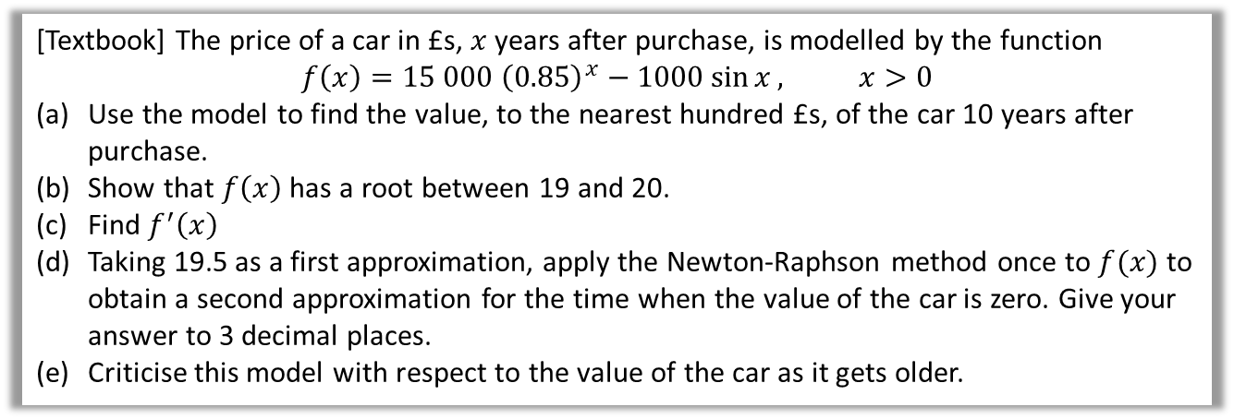
Application to Modelling
[Textbook] The price of a car in £s, $x$ years after purchase, is modelled by the function
$$f\left(x\right)=15 000 {\left(0.85\right)}^{x}−1000\sin{x}, x>0$$
Use the model to find the value, to the nearest hundred £s, of the car 10 years after purchase.
Show that $f\left(x\right)$ has a root between 19 and 20.
Find $f^{′}\left(x\right)$
Taking 19.5 as a first approximation, apply the Newton-Raphson method once to $f(x)$ to obtain a second approximation for the time when the value of the car is zero. Give your answer to 3 decimal places.
Criticise this model with respect to the value of the car as it gets older.
a
$$f\left(10\right)=3497.13$$
$$→£3500$$
$$f\left(19\right)=543.11>0 \\ f\left(20\right)=−331.55<0$$
There is a change of sign between 19 and 20, so that is a root in the interval $19<x<20$
$$f^{′}\left(x\right)=\left(15 000\right){\left(0.85\right)}^{x}\left(\ln{0.85}\right)−1000\cos{x} \\ f\left(19.5\right)=25.0693… \\ f^{′}\left(19.5\right)=−898.3009… \\ x_{1}=x_{0}−\frac{f\left(x_{0}\right)}{f^{′}\left(x_{0}\right)}=19.528$$
?
In reality, the car can never have a negative value so this model is not reasonable for cars that are approximately 20 or more years old.
d
?
b
?
c
?

Slide 3
Exercise 10.4
Pearson Pure Mathematics Year 2/AS
Page 86

Slide 4
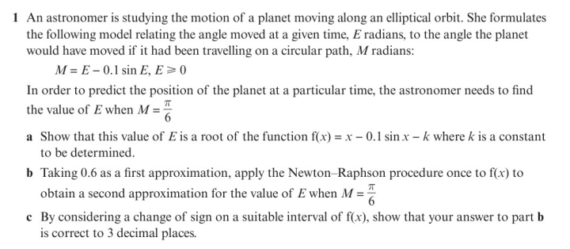
Homework Exercise

Slide 5
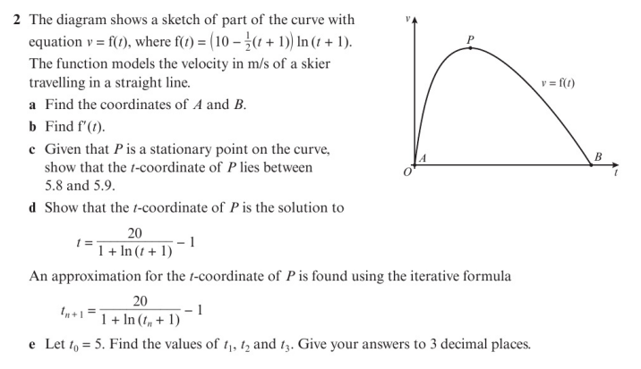
Homework Exercise

Slide 6
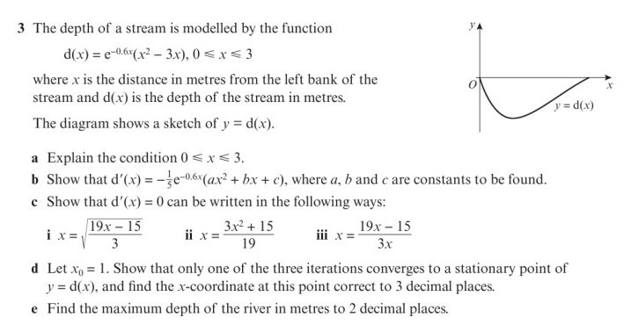
Homework Exercise

Slide 7
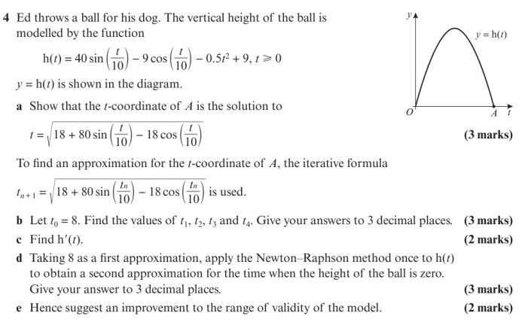
Homework Exercise

Slide 8
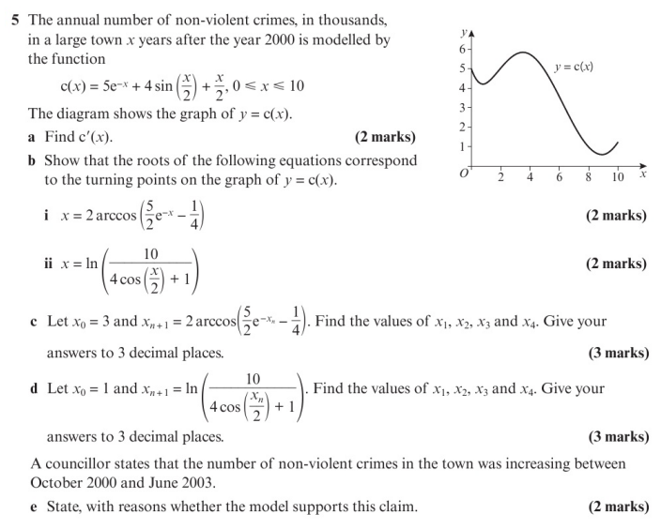
Homework Exercise

Slide 9
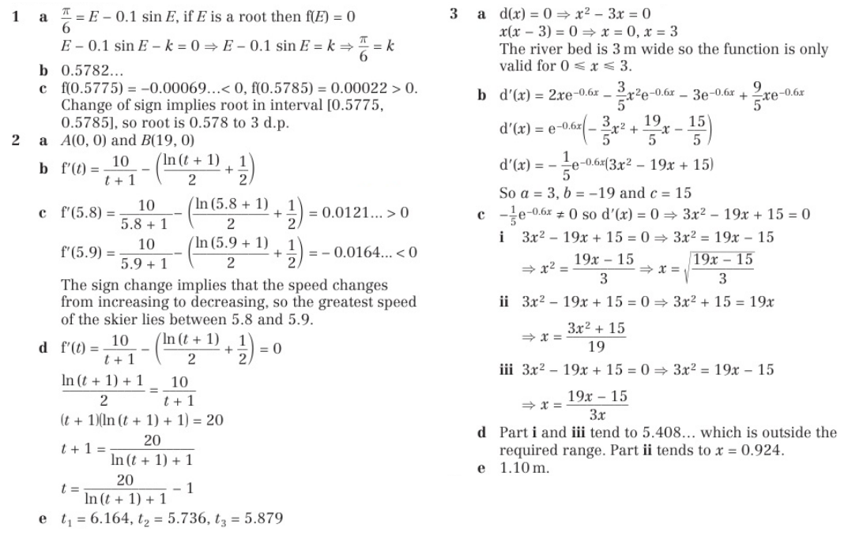
Homework Answers

Slide 10
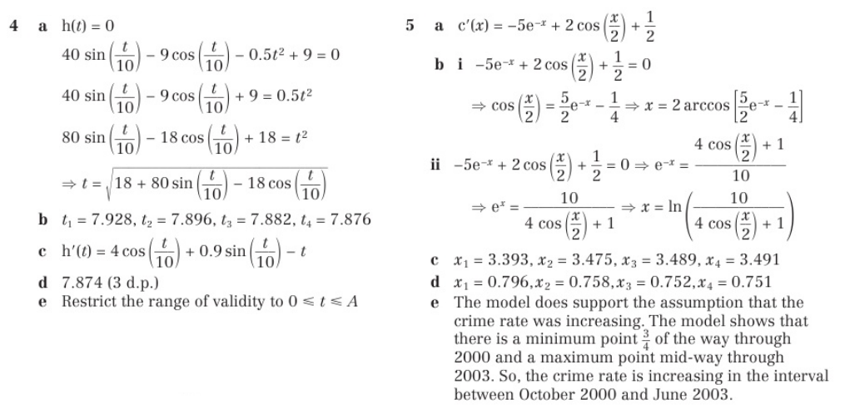
Homework Answers

