Slide 1
P2 Chapter 3: Sequences and Series
Modelling with Series

Slide 2

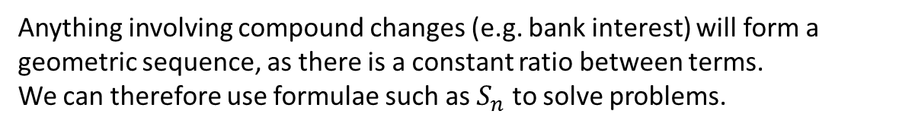

Modelling
Anything involving compound changes (e.g. bank interest) will form a geometric sequence, as there is a constant ratio between terms.
We can therefore use formulae such as $S_{n}$ to solve problems.
[Textbook] Bruce starts a new company. In year 1 his profits will be £20 000. He predicts his profits to increase by £5000 each year, so that his profits in year 2 are modelled to be £25 000, in year 3, £30 000 and so on. He predicts this will continue until he reaches annual profits of £100 000. He then models his annual profits to remain at £100 000.
Calculate the profits for Bruce’s business in the first 20 years.
State one reason why this may not be a suitable model.
Bruce’s financial advisor says the yearly profits are likely to increase by 5% per annum. Using this model, calculate the profits for Bruce’s business in the first 20 years.
a
The sequence is arithmetic up until £100 000, but stops increasing thereafter. We need to know the position of this term.
$$a=20 000, d=5000$$
$$u_{n}=a+\left(n−1\right)d → 100000=20000+\left(n−1\right)d \\ ∴n=17$$
First find sum of first 17 terms (where sequence is arithmetic):
$$S_{17}=\frac{17}{2}(2\left(20000\right)+16\left(5000\right)+1 020 000 \\ ∴S_{20}=1 020 000+3\left(100 000\right)=1 320 000$$
? a
b
? b
It is unlikely that Bruce’s profits will increase by exactly the same amount each year.
$$a=20 000 r=1.05 \\ S_{20}=\frac{20000\left({1.05}^{20}−1\right)}{1.05−1} \\ =£ 661 319.08$$
c
? c

Slide 3

Geometric Modelling Example
[Textbook] A piece of A4 paper is folded in half repeatedly. The thickness of the A4 paper is 0.5 mm.
Work out the thickness of the paper after four folds.
Work out the thickness of the paper after 20 folds.
State one reason why this might be an unrealistic model.
a
$$a=0.5 mm, r=2$$
After 4 folds:
$$u_{5}=0.5×2^{4}=8 mm$$
After 20 folds
$$u_{21}=0.5×2^{20}=524 288 mm$$
It is impossible to fold the paper that many times so the model is unrealistic.
?
b
?
c
?

Slide 4
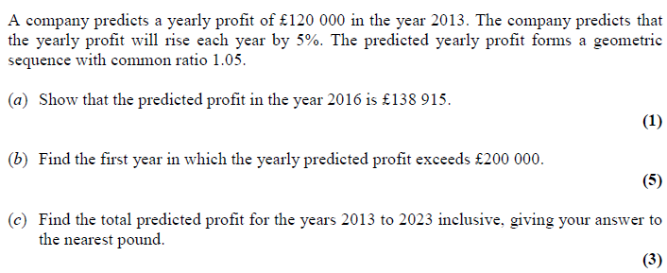
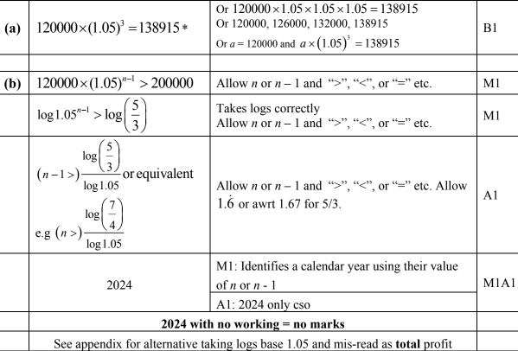

Test Your Understanding
Edexcel C2 Jan 2013 Q3
? a
? c
? b

Slide 5
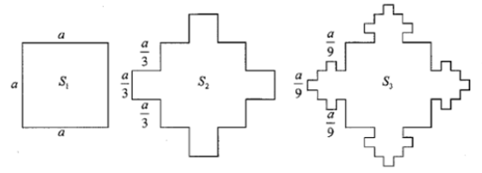
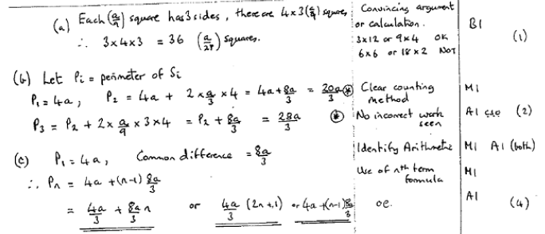
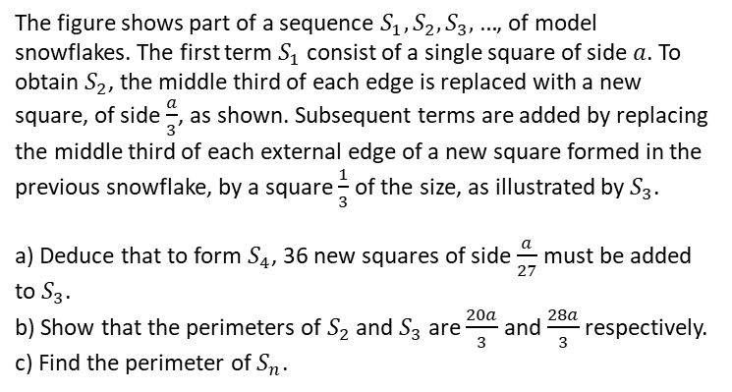
Exercise 3.8
Pearson Pure Mathematics Year 2/AS
Page 26
Extension
The figure shows part of a sequence $S_{1}, S_{2}, S_{3},…$, of model snowflakes. The first term $S_{1}$ consist of a single square of side $a$. To obtain $S_{2}$, the middle third of each edge is replaced with a new square, of side $\frac{a}{3}$, as shown. Subsequent terms are added by replacing the middle third of each external edge of a new square formed in the previous snowflake, by a square $\frac{1}{3}$ of the size, as illustrated by $S_{3}$.
a) Deduce that to form $S_{4}$, 36 new squares of side $\frac{a}{27}$ must be added to $S_{3}$.
b) Show that the perimeters of $S_{2}$ and $S_{3}$ are $\frac{20a}{3}$ and $\frac{28a}{3}$ respectively.
c) Find the perimeter of $S_{n}$.
1
[AEA 2007 Q5]
?

Slide 6
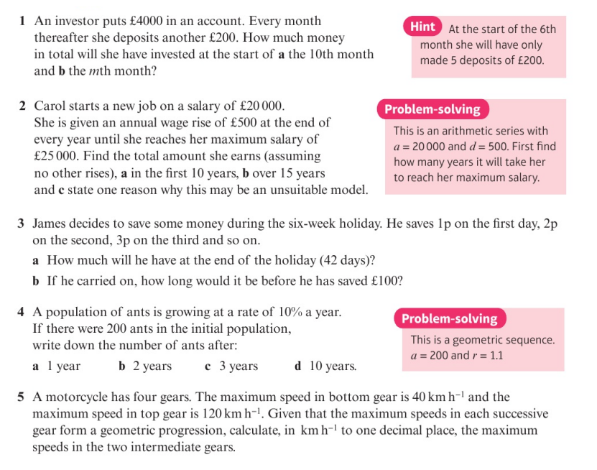
Homework Exercise

Slide 7
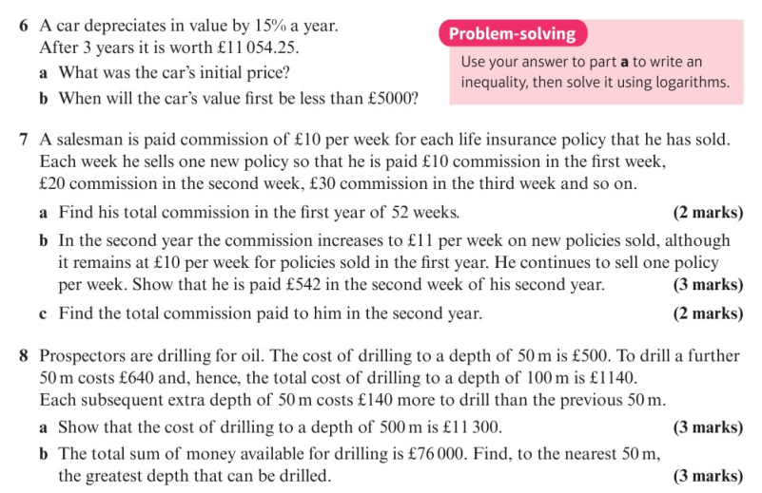
Homework Exercise

Slide 8
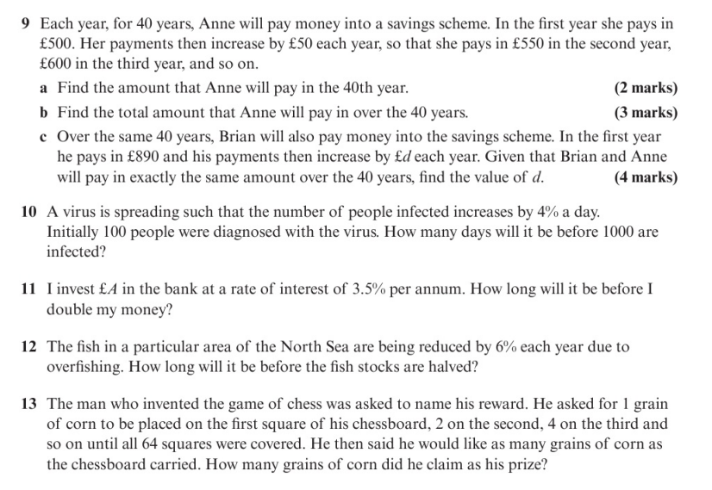
Homework Exercise

Slide 9
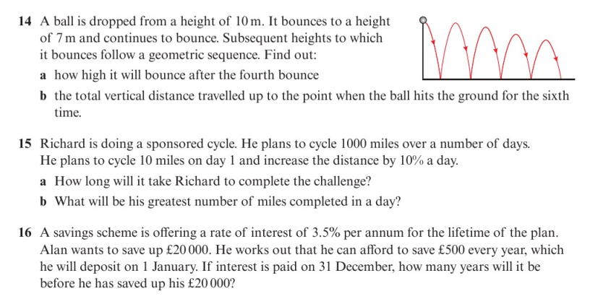
Homework Exercise

Slide 10
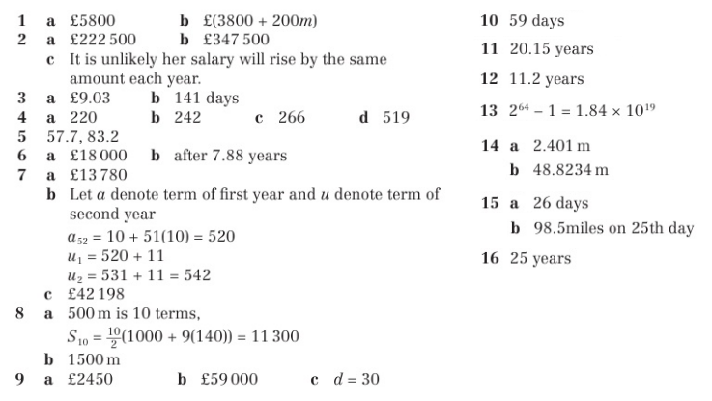
Homework Answers

