Slide 1
M1 Chapter 10: Forces and Motion Force Vectors

Slide 2

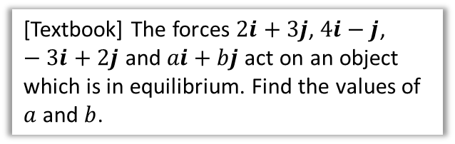



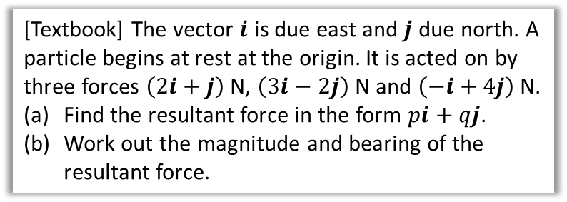

Forces as Vectors
Forces have direction, and therefore we can naturally write them as vectors, either in $i$-$j$ notation or as column vectors.
! You can find the resultant of two or more forces given as vectors by adding the vectors.
[Textbook] The vector $i$ is due east and $j$ due north. A particle begins at rest at the origin. It is acted on by three forces $\left(2i+j\right)$ N, $\left(3i−2j\right)$ N and $\left(−i+4j\right)$ N.
Find the resultant force in the form $pi+qj$.
Work out the magnitude and bearing of the resultant force.
[Textbook] The forces $2i+3j$, $4i−j$, $−3i+2j$ and $ai+bj$ act on an object which is in equilibrium. Find the values of $a$ and $b$.
?
$$\left(\begin{matrix}2 \\ 3\end{matrix}\right)+\left(\begin{matrix}4 \\ −1\end{matrix}\right)+\left(\begin{matrix}−3 \\ 2\end{matrix}\right)+\left(\begin{matrix}a \\ b\end{matrix}\right) \\ =\left(\begin{matrix}3+a \\ 4+b\end{matrix}\right)=\left(\begin{matrix}0 \\ 0\end{matrix}\right)$$
$$∴a=−3, b=−4$$
$$\left(\begin{matrix}2 \\ 1\end{matrix}\right)+\left(\begin{matrix}3 \\ −2\end{matrix}\right)+\left(\begin{matrix}−1 \\ 4\end{matrix}\right)=\left(\begin{matrix}4 \\ 3\end{matrix}\right)=4i+3j$$
If in equilibrium, resultant force is 0.
a
?
b
The magnitude of the force is the magnitude of the vector:
$$\left|\left(\begin{matrix}4 \\ 3\end{matrix}\right)\right|=\sqrt{4^{2}+3^{2}}=5 N$$
$$θ=\tan^{−1}\left(\frac{3}{4}\right)=36.9°$$
$∴$ Bearing $=90−36.9=053.1°$
?
3
$$θ$$
4

Slide 3
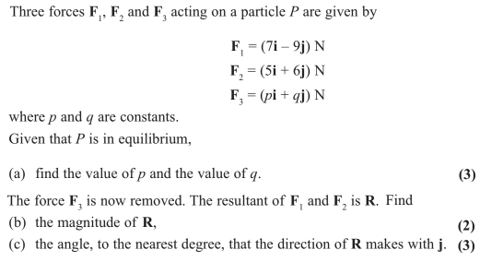
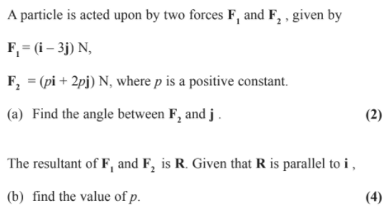
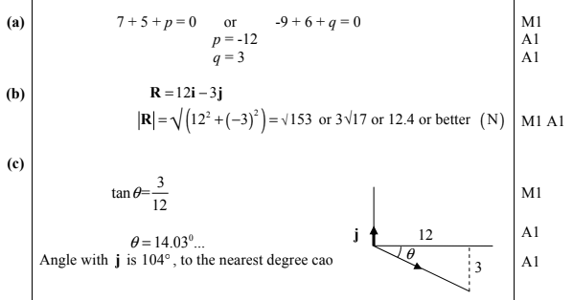
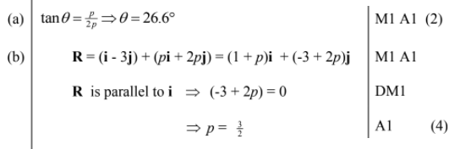
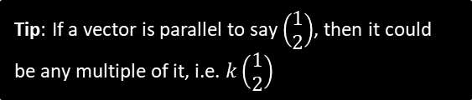
Test Your Understanding
Edexcel M1 Jan 2012 Q3
Edexcel M1 May 2009 Q2
Tip: If a vector is parallel to say $\left(\begin{matrix}1 \\ 2\end{matrix}\right)$, then it could be any multiple of it, i.e. $k\left(\begin{matrix}1 \\ 2\end{matrix}\right)$
?
?
?
?
?

Slide 4
Classwork Exercise 10.2
Pearson Stats/Mechanics Year 1 Exercise Book
Page 68

Slide 5

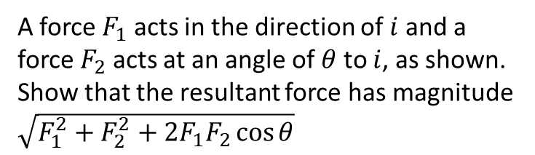



Extension
A force $F_{1}$ acts in the direction of $i$ and a force $F_{2}$ acts at an angle of $θ$ to $i$, as shown.
Show that the resultant force has magnitude $\sqrt{F_{1}^{2}+F_{2}^{2}+2F_{1}F_{2}\cos{θ}}$
$$F_{2}$$
$$θ$$
$$F_{1}$$
Force vector: $\left(\begin{matrix}F_{1}+F_{2}\cos{θ} \\ F_{2}\sin{θ}\end{matrix}\right)$
Magnitude:
$$\sqrt{{\left(F_{1}+F_{2}cosθ\right)}^{2}+F_{2}^{2}\sin^{2}{θ}} \\ =\sqrt{F_{1}^{2}+2F_{1}F_{2}\cos{θ}+F_{2}^{2}\cos^{2}{θ}+F_{2}^{2}\sin^{2}{θ}} \\ =\sqrt{F_{1}^{2}+2F_{1}F_{2}\cos{θ}+F_{2}^{2}\left(\cos^{2}{θ}+\sin^{2}{θ}\right)} \\ =\sqrt{F_{1}^{2}+F_{2}^{2}+2F_{1}F_{2}\cos{θ}}$$
?

Slide 6
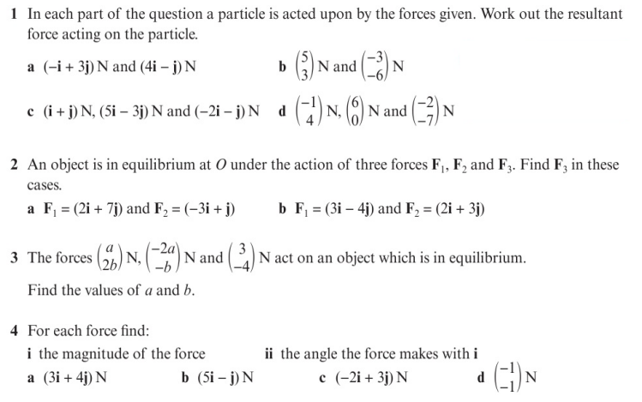
Homework Exercise

Slide 7
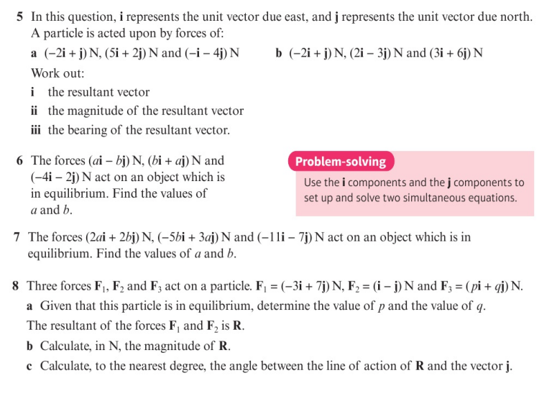
Homework Exercise

Slide 8
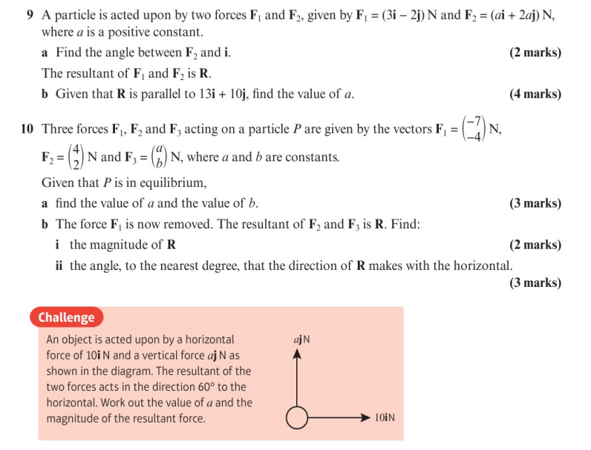
Homework Exercise

Slide 9
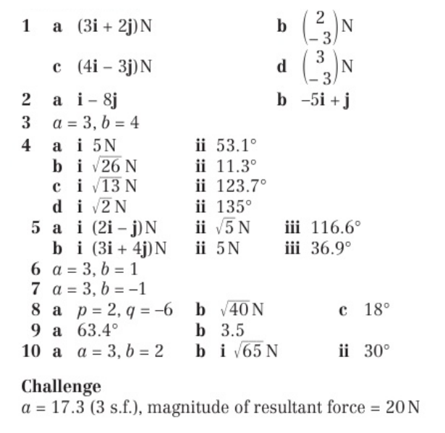
Homework Answers

