Slide 1
P2 Chapter 1: Algebra Techniques
Proof by Contradiction

Slide 2
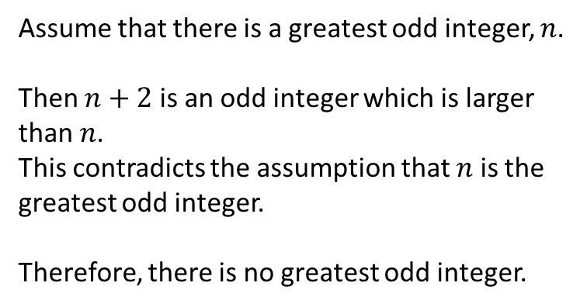
Proof By Contradiction
! To prove a statement is true by contradiction:
Assume that the statement is in fact false.
Prove that this would lead to a contradiction.
Therefore we were wrong in assuming the statement was false, and therefore it must be true.
Prove that there is no greatest odd integer.
? Assumption
Assume that there is a greatest odd integer, $n$.
Then $n+2$ is an odd integer which is larger than $n$.
This contradicts the assumption that $n$ is the greatest odd integer.
Therefore, there is no greatest odd integer.
How to structure/word proof:
“Assume that [negation of statement].”
[Reasoning followed by…] “This contradicts the assumption that…” or “This is a contradiction”.
“Therefore [restate original statement].”
? Show contradiction
? Conclusion

Slide 3
Negating the original statement
The first part of a proof by contradiction requires you to negate the original statement.
What is the negation of each of these statements? (Click to choose)
“There are infinitely many prime numbers.”
“All Popes are Catholic.”
“If it is raining, my garden is wet.”
“There are infinitely many non-prime (i.e. composite) numbers.”
“There exists a Pope who is not Catholic.”
“It is not raining and my garden is dry.”
“There are finitely many prime numbers.”
“No Popes are Catholic.”
“It is not raining and my garden is wet.”
“There are finitely many non-composite numbers.”
“Harry Potter is the Pope.”
“It is raining and my garden is not wet.”
Comments: The negation of “all are” isn’t “none are”. So the negation of “everyone likes green” wouldn’t be “no one likes green”, but: “not everyone likes green”. Do not confuse a ‘negation’ with the ‘opposite’.
Comments: If you have a conditional statement like “If A then B”, then the negation is “A and not B”, i.e. the condition is true, but the conclusion is false/negated.

Slide 4

More Examples
Prove by contradiction that if $n^{2}$ is even, then $n$ must be even.
? Assumption
Assume there exists a number $n$ such that $n^{2}$ is even, but $n$ is not even.
$n$ is odd therefore $n=2k+1$ for some integer $k$.
$$n^{2}={\left(2k+1\right)}^{2}=4k^{2}+4k+1 \\ =2\left(2k^{2}+2k\right)+1$$
which is odd.
This contradicts the assumption that $n^{2}$ is even.
Therefore if $n^{2}$ is even then $n$ must be even.
Remember the negation of “if A then B” is “A and not B”.
? Show contradiction
? Conclusion

Slide 5
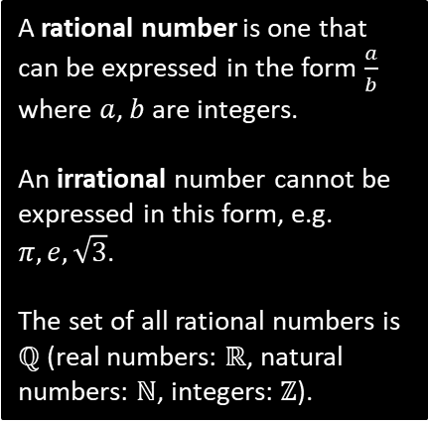
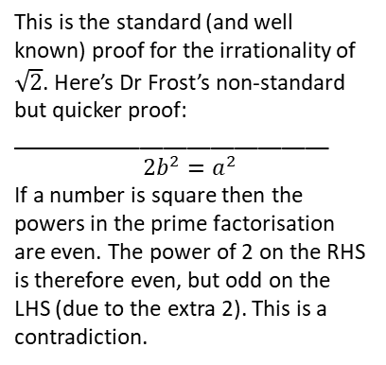

More Examples
Prove by contradiction that $\sqrt{2}$ is an irrational number.
? Assumption
Assume that $\sqrt{2}$ is a rational number.
Then $\sqrt{2}=\frac{a}{b}$, where $a$ and $b$ are integers and $\frac{a}{b}$ is a fraction in its simplest form.
$$∴2=\frac{a^{2}}{b^{2}} ⇒ 2b^{2}=a^{2}$$
Since LHS is even, $a^{2}$ is even, and therefore $a$ is even.
Therefore let $a=2k$ where $k$ is an integer.
$$2b^{2}={\left(2k\right)}^{2}=4k^{2} \\ b^{2}=2k^{2}$$
Since RHS is even, $b^{2}$ is even, and therefore $b$ is even.
But then $a$ and $b$ are both even, contradicting that $\frac{a}{b}$ is a fraction in its simplest form.
Therefore $\sqrt{2}$ is irrational.
A rational number is one that can be expressed in the form $\frac{a}{b}$ where $a$, $b$ are integers.
An irrational number cannot be expressed in this form, e.g. $π, e, \sqrt{3}$.
The set of all rational numbers is $ℚ$ (real numbers: $ℝ$, natural numbers: $ℕ$, integers: $ℤ$).
? Show contradiction
This is the standard (and well known) proof for the irrationality of $\sqrt{2}$. Here’s Dr Frost’s non-standard but quicker proof:
___________________________
$$2b^{2}=a^{2}$$
If a number is square then the powers in the prime factorisation are even. The power of 2 on the RHS is therefore even, but odd on the LHS (due to the extra 2). This is a contradiction.
? Conclusion

Slide 6

More Examples
Prove by contradiction that there are infinitely many prime numbers.
? Assumption
This proof is courtesy of Euclid, and is one of the earliest known proofs.
Assume that there is a finite number of prime numbers.
Therefore we can list all the prime numbers:
$$p_{1}, p_{2}, p_{3},…,p_{n}$$
Consider the number:
$$N=(p_{1}×p_{2}×…×p_{n})+1$$
When you divide $N$ by any of $p_{1}$, $p_{2}, …,p_{n}$, the remainder will always be 1.
Therefore $N$ is not divisible by any of these primes.
Therefore $N$ must itself be prime, or its prime factorisation contains only primes not in our original list.
This contradicts the assumption that $p_{1}, p_{2},…,p_{n}$ contained the list of all prime numbers.
Therefore, there are an infinite number of primes.
? Show contradiction
? Conclusion

Slide 7
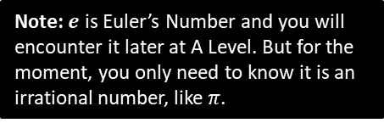
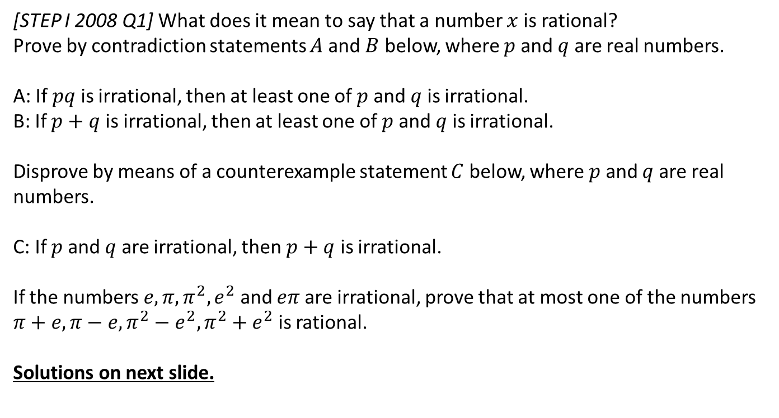
Exercise 1.1
Pearson Pure Mathematics Year 2/AS
Page 1
Extension
[STEP I 2008 Q1] What does it mean to say that a number $x$ is rational?
Prove by contradiction statements $A$ and $B$ below, where $p$ and $q$ are real numbers.
A: If $pq$ is irrational, then at least one of $p$ and $q$ is irrational.
B: If $p+q$ is irrational, then at least one of $p$ and $q$ is irrational.
Disprove by means of a counterexample statement $C$ below, where $p$ and $q$ are real numbers.
C: If $p$ and $q$ are irrational, then $p+q$ is irrational.
If the numbers $e,π,π^{2}, e^{2}$ and $eπ$ are irrational, prove that at most one of the numbers $π+e, π−e, π^{2}−e^{2}, π^{2}+e^{2}$ is rational.
Solutions on next slide.
Note: $e$ is Euler’s Number and you will encounter it later at A Level. But for the moment, you only need to know it is an irrational number, like $π$.

Slide 8
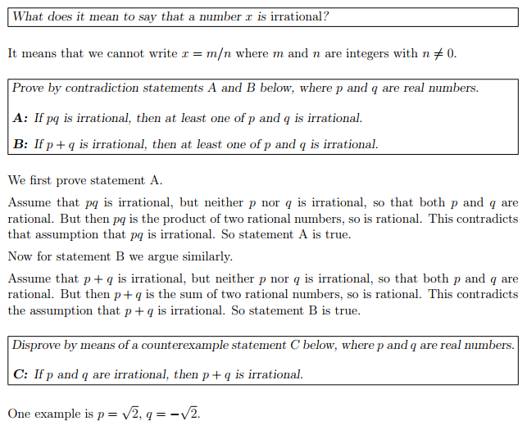
Solution to Extension Problem
?
?
?

Slide 9
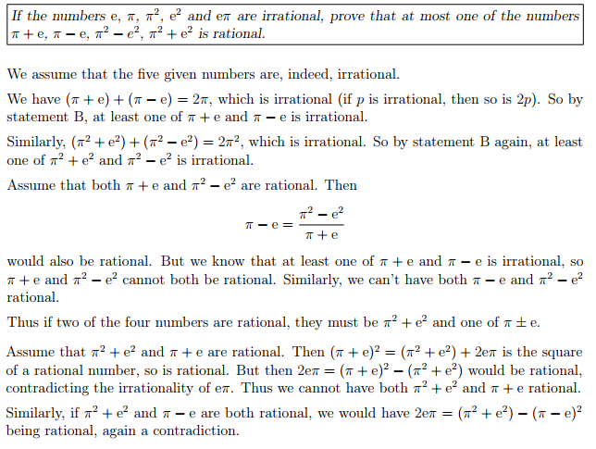

Solution to Extension Problem
?
Fun Fact: No mathematician has yet managed to prove that $π+e$ or $π−e$ is irrational.

Slide 10
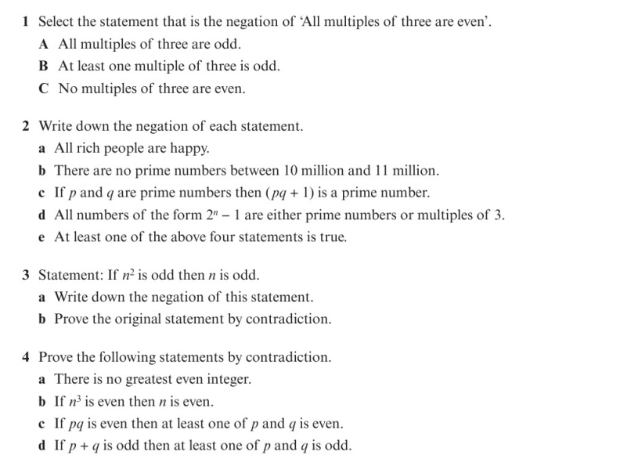
Homework Exercise

Slide 11
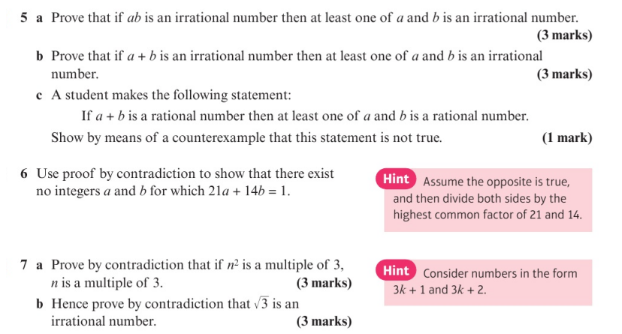
Homework Exercise

Slide 12
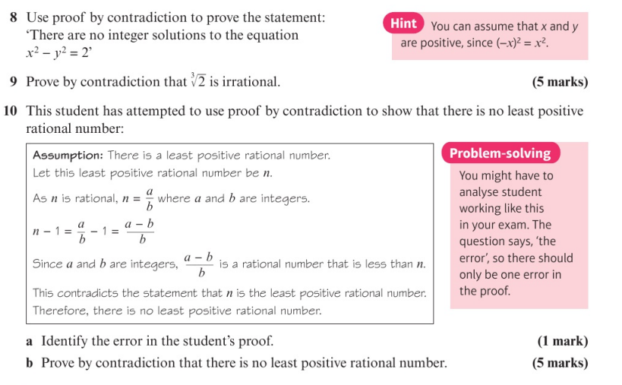
Homework Exercise

Slide 13
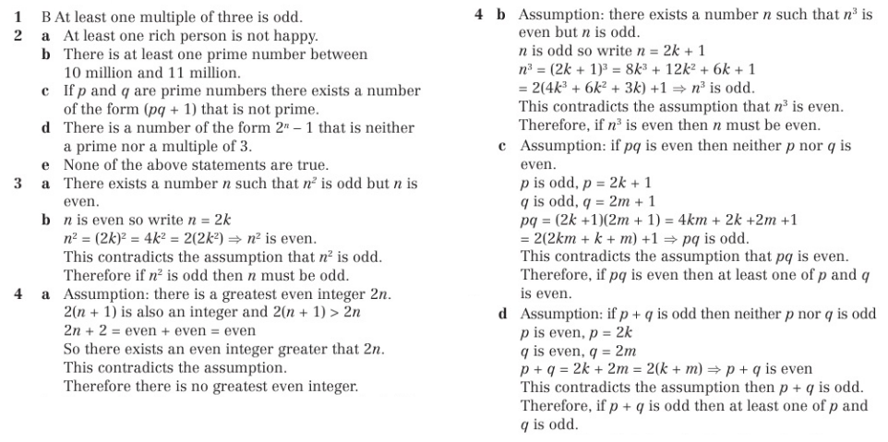
Homework Answers

Slide 14
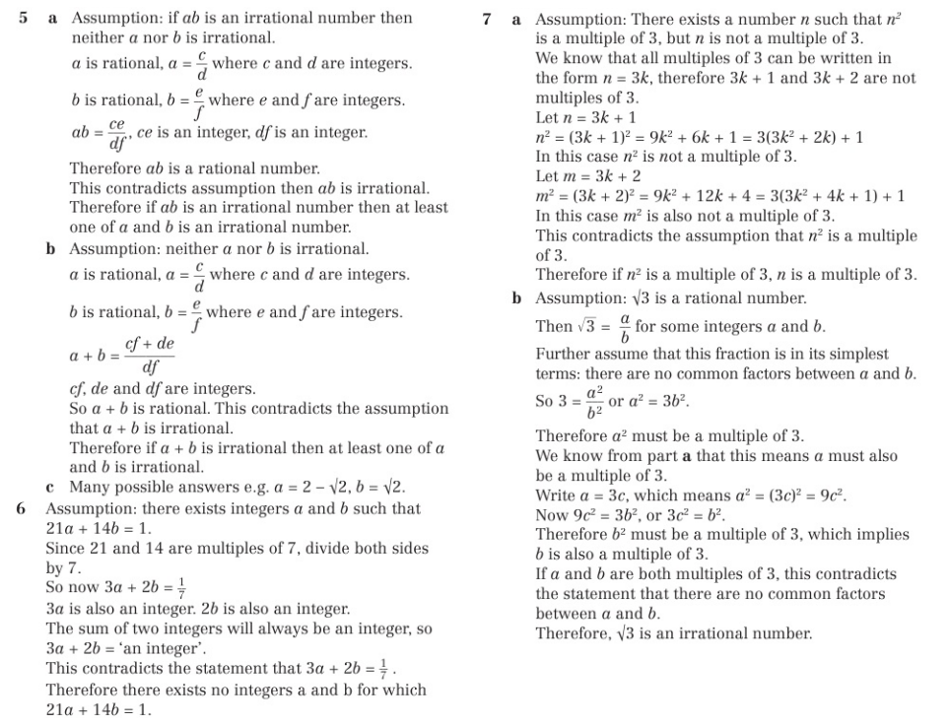
Homework Answers

Slide 15
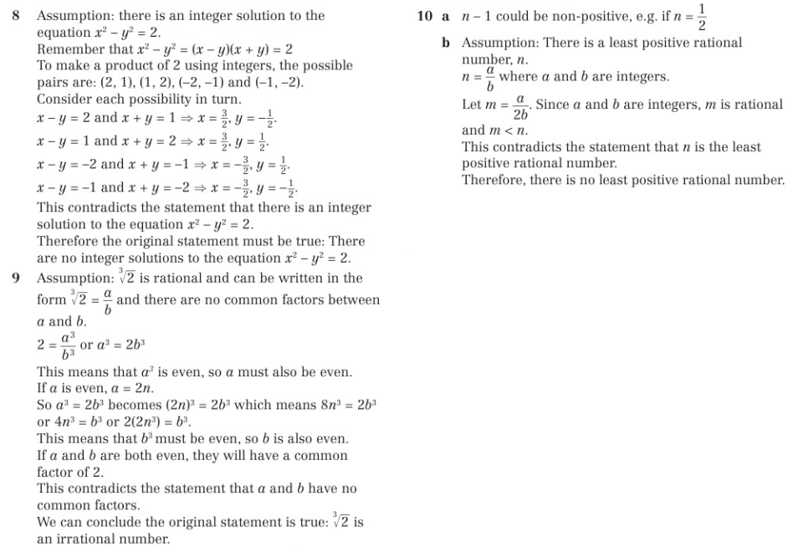
Homework Answers

