Slide 1
P1 Chapter 13: Integration
Negative Areas

Slide 2

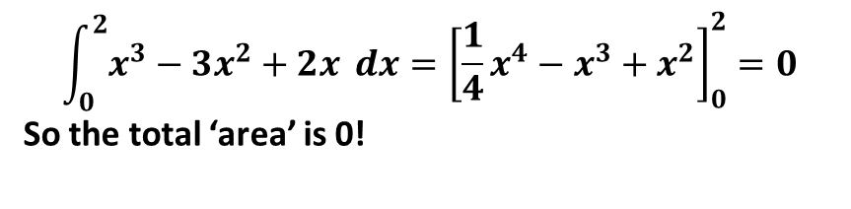

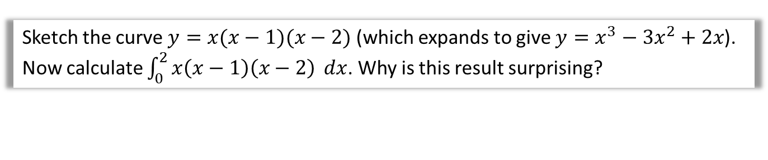

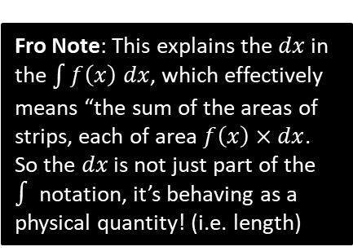

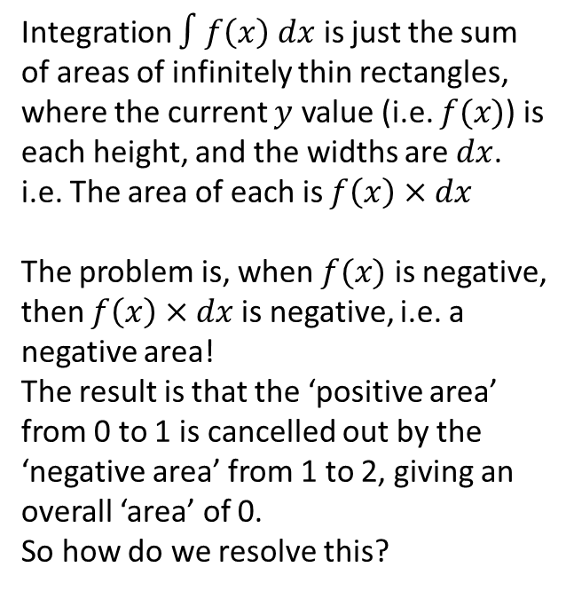


‘Negative Areas’
Sketch the curve $y=x(x−1)(x−2)$ (which expands to give $y=x^{3}−3x^{2}+2x$).
Now calculate $\int_{0}^{2}{x\left(x−1\right)\left(x−2\right)} dx$. Why is this result surprising?
?
$$y$$
$$\int_{0}^{2}{x^{3}−3x^{2}+2x} dx={\left[\frac{1}{4}x^{4}−x^{3}+x^{2}\right]}_{0}^{2}=0$$
So the total ‘area’ is 0!
$$f(x)$$
Integration $∫f\left(x\right) dx$ is just the sum of areas of infinitely thin rectangles, where the current $y$ value (i.e. $f(x)$) is each height, and the widths are $dx$.
i.e. The area of each is $f\left(x\right)×dx$
The problem is, when $f(x)$ is negative, then $f\left(x\right)×dx$ is negative, i.e. a negative area!
The result is that the ‘positive area’ from 0 to 1 is cancelled out by the ‘negative area’ from 1 to 2, giving an overall ‘area’ of 0.
So how do we resolve this?
$$x$$
$$dx$$
$$1$$
$$2$$
Fro Note: This explains the $dx$ in the $\int{f\left(x\right) dx}$, which effectively means “the sum of the areas of strips, each of area $f\left(x\right)×dx$. So the $dx$ is not just part of the $∫$ notation, it’s behaving as a physical quantity! (i.e. length)

Slide 3


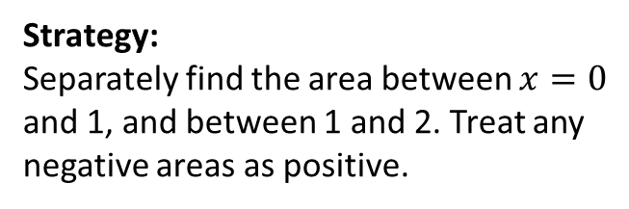



Example
Find the total area bound between the curve $y=x(x−1)(x−2)$ and the $x$-axis.
$$y$$
Strategy:
Separately find the area between $x=0$ and 1, and between 1 and 2. Treat any negative areas as positive.
?
$$x$$
$$1$$
$$2$$
$$x\left(x−1\right)\left(x−2\right)=x^{3}−3x^{2}+2x$$
$$\int_{0}^{1}{x^{3}−3x^{2}+2x} dx={\left[\frac{1}{4}x^{4}−x^{3}+x^{2}\right]}_{0}^{1}=\frac{1}{4} \\ \int_{1}^{2}{x^{3}−3x^{2}+2x} dx={\left[\frac{1}{4}x^{4}−x^{3}+x^{2}\right]}_{0}^{2}=−\frac{1}{4}$$
Treating both as positive:
$$Area=\frac{1}{4}+\frac{1}{4}=\frac{1}{2}$$
? Solution

Slide 4
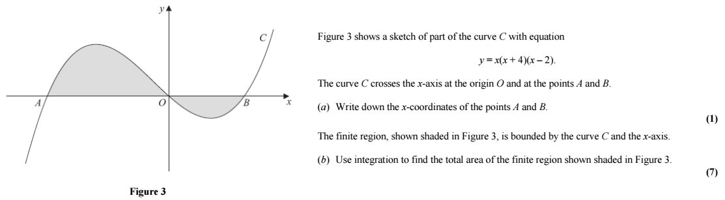
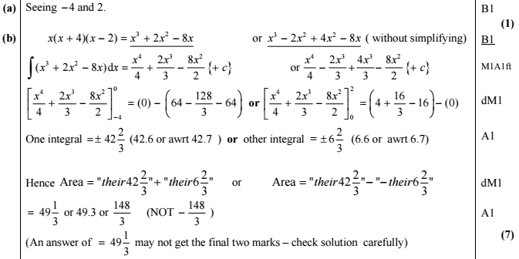
Test Your Understanding
Edexcel C2 May 2013 Q6
?
?

Slide 5

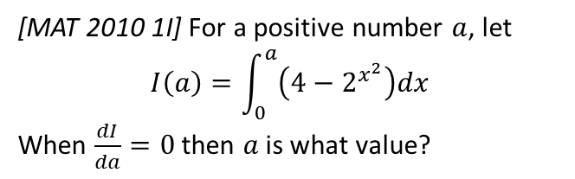



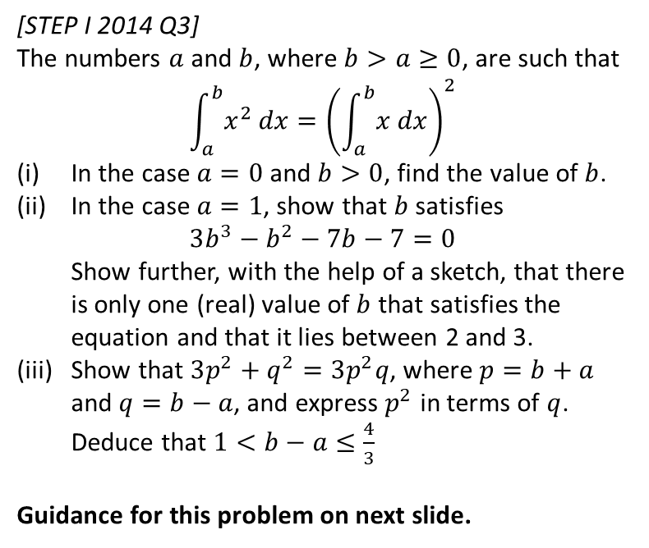


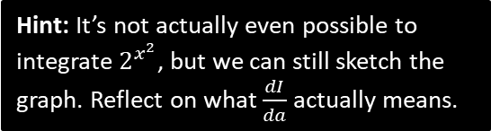

Exercise 13.6
Pearson Pure Mathematics Year 1/AS
Page 108
Hint: It’s not actually even possible to integrate $2^{x^{2}}$, but we can still sketch the graph. Reflect on what $\frac{dI}{da}$ actually means.
Extension
1
[MAT 2010 1I] For a positive number $a$, let
$$I\left(a\right)=\int_{0}^{a}{\left(4−2^{x^{2}}\right)dx}$$
When $\frac{dI}{da}=0$ then $a$ is what value?
2
[STEP I 2014 Q3]
The numbers $a$ and $b$, where $b>a≥0$, are such that
$$\int_{a}^{b}{x^{2} dx}={\left(\int_{a}^{b}{x dx}\right)}^{2}$$
In the case $a=0$ and $b>0$, find the value of $b$.
In the case $a=1$, show that $b$ satisfies
$3b^{3}−b^{2}−7b−7=0$
Show further, with the help of a sketch, that there is only one (real) value of $b$ that satisfies the equation and that it lies between 2 and 3.
Show that $3p^{2}+q^{2}=3p^{2}q$, where $p=b+a$ and $q=b−a$, and express $p^{2}$ in terms of $q$. Deduce that $1<b−a≤\frac{4}{3}$
Guidance for this problem on next slide.
?
$$y$$
$I\left(a\right)$ represents the area from $x=0$ up to $a$.
$$I\left(a\right)$$
$$y=4−2^{x^{2}}$$
$$x$$
$$a$$
$\frac{dI}{da}$ represents the rate of change of area as $a$ increases. Thus if $\frac{dI}{da}=0$, the area is not changing. This must happen at the $x$-intercept of the graph, because once the curve goes negative, the total area will start to decrease.
$$4−2^{x^{2}}=0 → x=\sqrt{2}$$
The answer is $a=\sqrt{2}$.

Slide 6
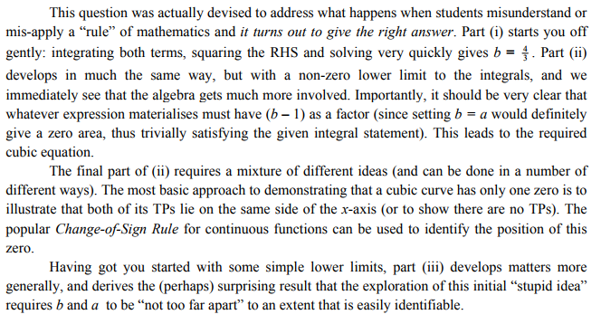
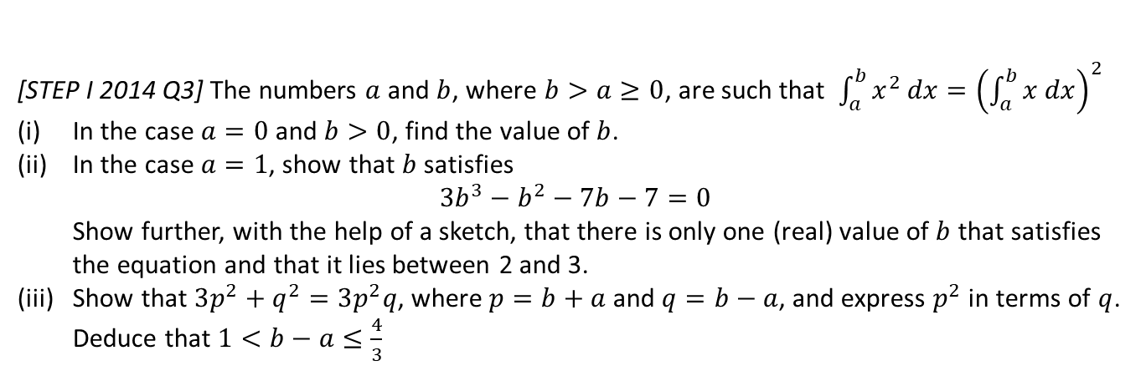
Guidance for Extension Problem 2
[STEP I 2014 Q3] The numbers $a$ and $b$, where $b>a≥0$, are such that $\int_{a}^{b}{x^{2} dx}={\left(\int_{a}^{b}{x dx}\right)}^{2}$
In the case $a=0$ and $b>0$, find the value of $b$.
In the case $a=1$, show that $b$ satisfies
$3b^{3}−b^{2}−7b−7=0$
Show further, with the help of a sketch, that there is only one (real) value of $b$ that satisfies the equation and that it lies between 2 and 3.
Show that $3p^{2}+q^{2}=3p^{2}q$, where $p=b+a$ and $q=b−a$, and express $p^{2}$ in terms of $q$. Deduce that $1<b−a≤\frac{4}{3}$

Slide 7
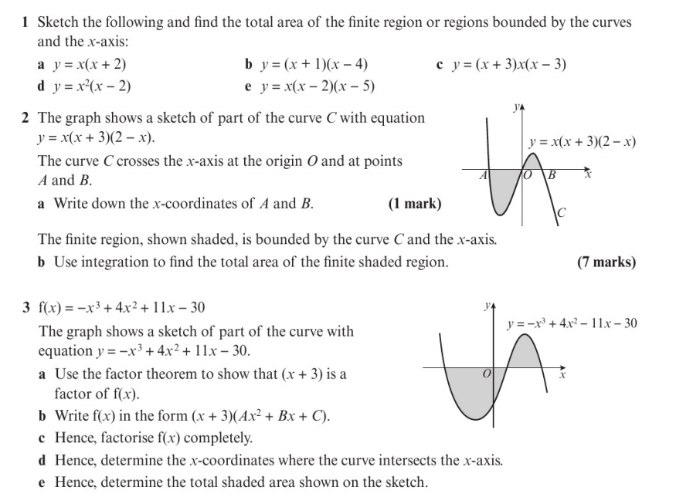
Homework Exercise

Slide 8
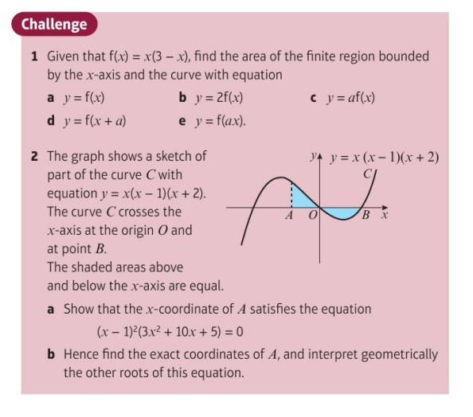
Homework Exercise

Slide 9
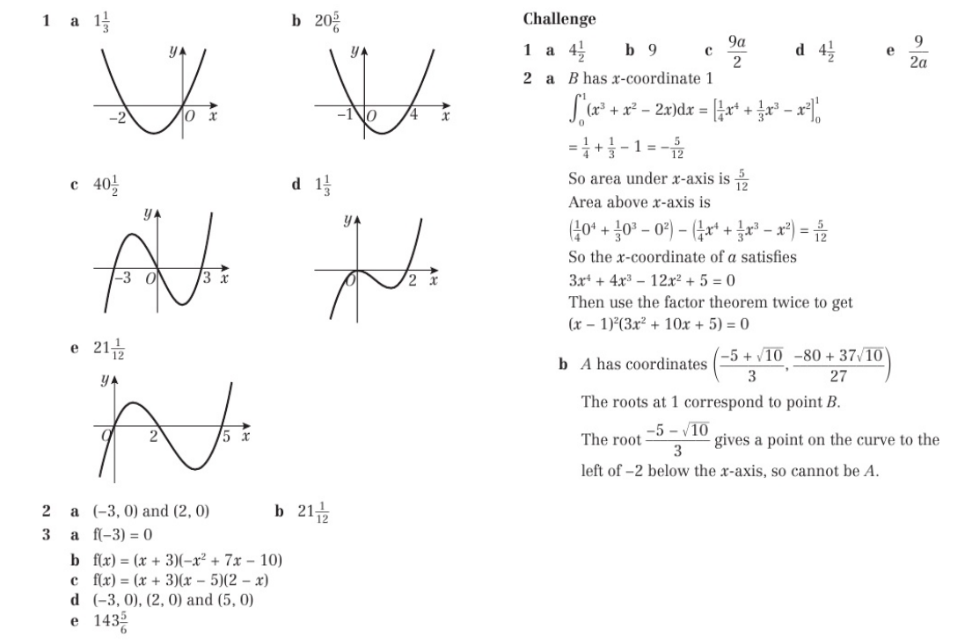
Homework Answers

