Slide 1
P1 Chapter 9: Trigonometric Ratios Cosine Rule

Slide 2
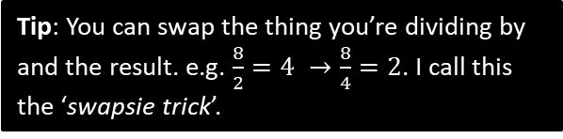

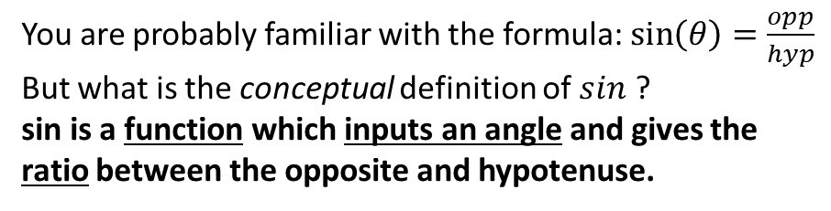









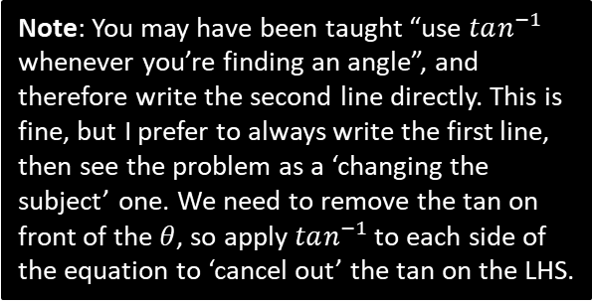
RECAP :: Right-Angled Trigonometry
You are probably familiar with the formula: $\sin\left(θ\right)=\frac{opp}{hyp}$
But what is the conceptual definition of $sin$ ?
sin is a function which inputs an angle and gives the ratio between the opposite and hypotenuse.
hyp
opp
?
$$θ$$
adj
Remember that a ratio just means the ‘relative size’ between quantities (in this case lengths). For this reason, sin/cos/tan are known as “trigonometric ratios”.
Find $x$.
Tip: You can swap the thing you’re dividing by and the result. e.g. $\frac{8}{2}=4 →\frac{8}{4}=2$. I call this the ‘swapsie trick’.
4
?
$$\cos\left(20\right)=\frac{4}{x} \\ x=\frac{4}{\cos\left(20\right)}=11.7 (3sf)$$
$$20°$$
$$x$$
Note: You may have been taught “use $tan^{−1}$ whenever you’re finding an angle”, and therefore write the second line directly. This is fine, but I prefer to always write the first line, then see the problem as a ‘changing the subject’ one. We need to remove the tan on front of the $θ$, so apply $tan^{−1}$ to each side of the equation to ‘cancel out’ the tan on the LHS.
$$5$$
Find $θ$.
$$\tan\left(θ\right)=\frac{5}{3} \\ θ=\tan^{−1}\left(\frac{5}{3}\right)=59.0°$$
$$3$$
?
$$θ$$

Slide 3









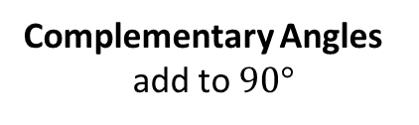







Just for your interest…
Have you ever wondered why “cosine” contains the word “sine”?
$$a$$
$$a$$
$$b$$
$$b$$
$$a$$
$$b$$
Supplementary Angles
add to $180°$
Complementary Angles
add to $90°$
Therefore these angles are complementary.
i.e. The cosine of an angle is the sine of the complementary angle.
Hence cosine = COMPLEMENTARY SINE
?
$$\cos\left(50\right)=\frac{x}{h}$$
$$h$$
$$50°$$
$$x$$
?
$$\sin\left(40\right)=\frac{x}{h}$$
$$40°$$
$$y$$
$$∴\cos\left(50\right)=\sin\left(40\right)$$

Slide 4
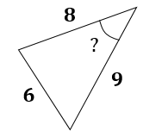
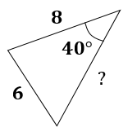
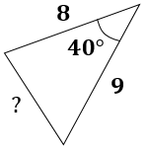
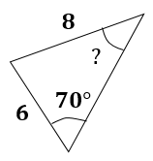
OVERVIEW: Finding missing sides and angles
When triangles are not right-angled, we can no longer use simple trigonometric ratios, and must use the cosine and sine rules.
You have | You want | Use
#1: Two angle-side opposite pairs | Missing angle or side in one pair | Sine rule
#2 Two sides known and a missing side opposite a known angle | Remaining side | Cosine rule
#3 All three sides | An angle | Cosine rule
#4 Two sides known and a missing side not opposite known angle | Remaining side | Sine rule twice
?
?
?
?

Slide 5
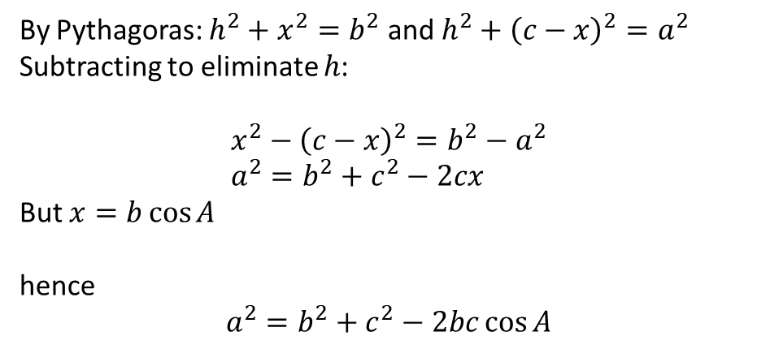

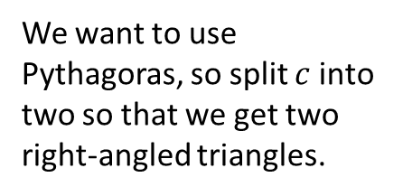





Proof of Cosine Rule
We want to use Pythagoras, so split $c$ into two so that we get two right-angled triangles.
$$b$$
$$a$$
$$h$$
$$A$$
$$c−x$$
$$x$$
By Pythagoras: $h^{2}+x^{2}=b^{2}$ and $h^{2}+{\left(c−x\right)}^{2}=a^{2}$
Subtracting to eliminate $h$:
$$x^{2}−{\left(c−x\right)}^{2}=b^{2}−a^{2} \\ a^{2}=b^{2}+c^{2}−2cx$$
But $x=b\cos{A}$
hence
?

Slide 6




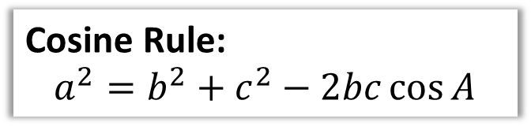





Cosine Rule
We use the cosine rule whenever we have three sides (and an angle) involved.
Proof at end of PowerPoint.
$$b$$
Cosine Rule:
$$a^{2}=b^{2}+c^{2}−2bc\cos{A}$$
$$15$$
$$A$$
The only angle in formula is $A$, so label angle in diagram $A$, label opposite side $a$, and so on ($b$ and $c$ can go either way).
$$x^{2}={15}^{2}+{12}^{2}−\left(2×15×12×\cos{115}\right) \\ x^{2}=521.14257… \\ x=22.83$$
$$115°$$
How are sides labelled ?
$$a$$
$$c$$
$$x$$
$$12$$
Calculation?

Slide 7





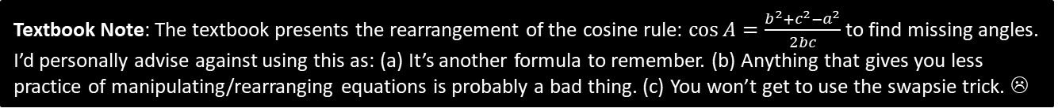

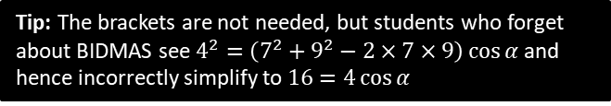
Dealing with Missing Angles
You have | You want | Use
All three sides | An angle | Cosine rule
$$a^{2}=b^{2}+c^{2}−2bc\cos{A}$$
$$7$$
Tip: The brackets are not needed, but students who forget about BIDMAS see $4^{2}=\left(7^{2}+9^{2}−2×7×9\right)\cos{α}$ and hence incorrectly simplify to $16=4\cos{α}$
$$α$$
$$4$$
?
Label sides then substitute into formula.
$$9$$
$$4^{2}=7^{2}+9^{2}−\left(2×7×9×\cos{α}\right) \\ 16=130−126\cos{α} \\ 126\cos{α}=130−16 \\ \cos{α}=\frac{114}{126} \\ α=\cos^{−1}\left(\frac{114}{126}\right)=25.2°$$
?
Simplify each bit of formula.
?
Rearrange (I use ‘subtraction swapsie trick’ to swap thing you’re subtracting and result)
?
Textbook Note: The textbook presents the rearrangement of the cosine rule: $\cos{A}=\frac{b^{2}+c^{2}−a^{2}}{2bc}$ to find missing angles. I’d personally advise against using this as: (a) It’s another formula to remember. (b) Anything that gives you less practice of manipulating/rearranging equations is probably a bad thing. (c) You won’t get to use the swapsie trick. ☹

Slide 8


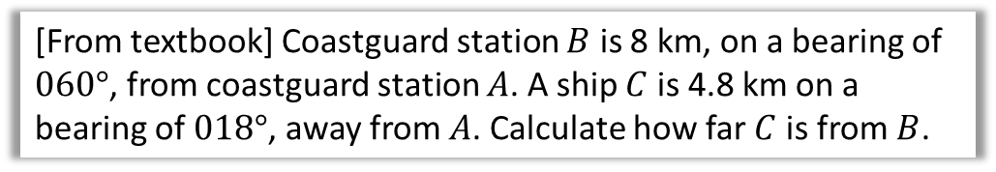



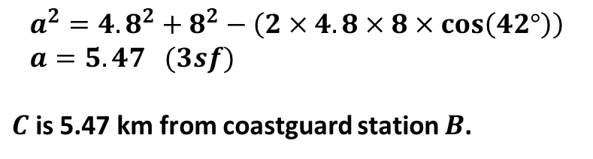










Harder Ones
Determine the value of $x$.
?
$${\left(2x−1\right)}^{2}=x^{2}+{\left(x+8\right)}^{2}−2x\left(x+8\right)\cos{60°} \\ 4x^{2}−4x+1=x^{2}+x^{2}+16x+64−x^{2}−8x \\ 3x^{2}−12x−63=0 \\ x^{2}−4x−21=0 \\ \left(x+3\right)\left(x−7\right)=0 \\ ∴x=7$$
$$x$$
$$2x−1$$
$$60°$$
$$x+8$$
[From textbook] Coastguard station $B$ is 8 km, on a bearing of $060°$, from coastguard station $A$. A ship $C$ is 4.8 km on a bearing of $018°$, away from $A$. Calculate how far $C$ is from $B$.
?
$$N$$
$$C$$
$$a km$$
$$B$$
$$a^{2}={4.8}^{2}+8^{2}−\left(2×4.8×8×\cos\left(42°\right)\right) \\ a=5.47 (3sf)$$
$C$ is 5.47 km from coastguard station $B$.
$$4.8km$$
$$18°$$
$$60°$$
$$8 km$$
$$A$$

Slide 9















Test Your Understanding
1
$$x$$
3
$$2x−3$$
$$5$$
$$70°$$
$$2x−2$$
$$6$$
$$3$$
2
$$60°$$
$$x$$
$$x=6.36°$$
?
$$θ$$
$$8$$
?
$$10$$
$$x=5$$
$$θ=124.2°$$
?
Fro Note: You will get an obtuse angle whenever you inverse cos a negative value.

Slide 10
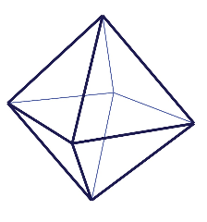
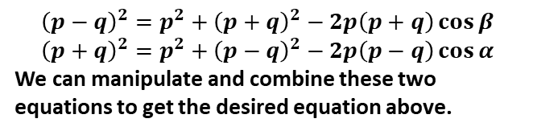


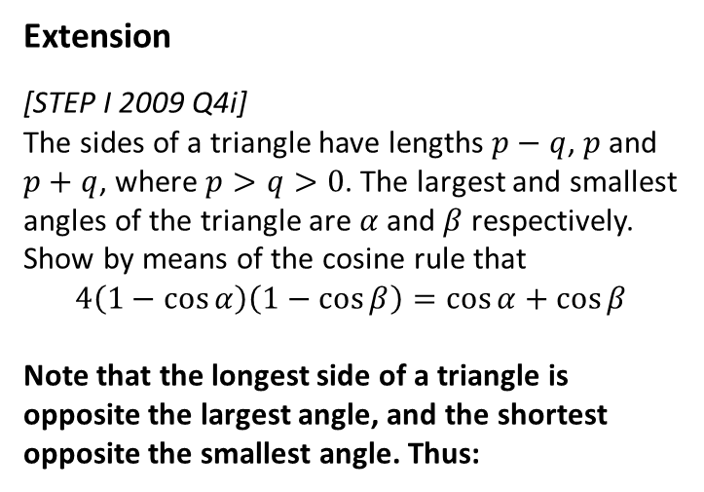



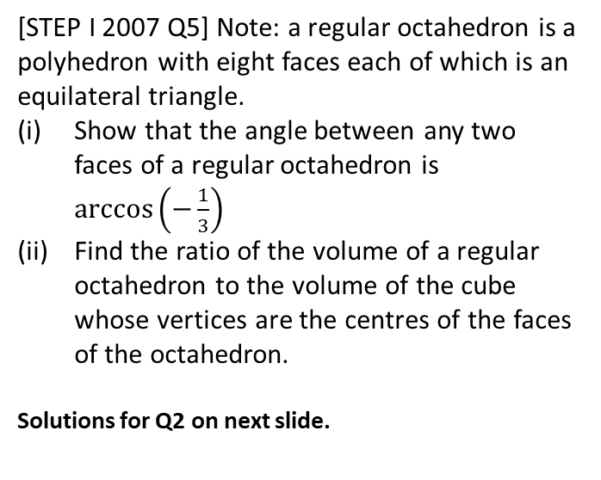
Exercise 9A
Pearson Pure Mathematics Year 1/AS
Pages 177-179
Extension
[STEP I 2009 Q4i]
The sides of a triangle have lengths $p−q$, $p$ and $p+q$, where $p>q>0$. The largest and smallest angles of the triangle are $α$ and $β$ respectively. Show by means of the cosine rule that
$$4\left(1−\cos{α}\right)\left(1−\cos{β}\right)=\cos{α+\cos{β}}$$
Note that the longest side of a triangle is opposite the largest angle, and the shortest opposite the smallest angle. Thus:
2
[STEP I 2007 Q5] Note: a regular octahedron is a polyhedron with eight faces each of which is an equilateral triangle.
Show that the angle between any two faces of a regular octahedron is $\arccos\left(−\frac{1}{3}\right)$
Find the ratio of the volume of a regular octahedron to the volume of the cube whose vertices are the centres of the faces of the octahedron.
Solutions for Q2 on next slide.
1
?
$$p$$
$$p−q$$
$$α$$
$$β$$
$$p+q$$
$${\left(p−q\right)}^{2}=p^{2}+{\left(p+q\right)}^{2}−2p\left(p+q\right)\cos{β} \\ {\left(p+q\right)}^{2}=p^{2}+{\left(p−q\right)}^{2}−2p\left(p−q\right)\cos{α}$$
We can manipulate and combine these two equations to get the desired equation above.

Slide 11
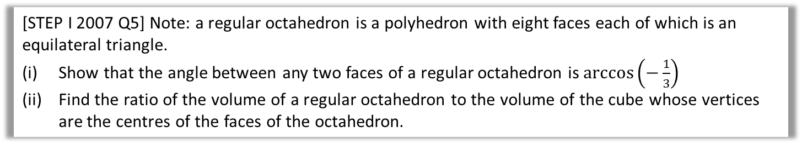

Solutions to Extension Question 2
[STEP I 2007 Q5] Note: a regular octahedron is a polyhedron with eight faces each of which is an equilateral triangle.
Show that the angle between any two faces of a regular octahedron is $\arccos\left(−\frac{1}{3}\right)$
Find the ratio of the volume of a regular octahedron to the volume of the cube whose vertices are the centres of the faces of the octahedron.
(Official solutions) Big, clear diagram essential!
Let the side length of the octahedron be $2k$. Then sloping “height” of a triangular face is $k\sqrt{3}$. Also, the vertical height of the whole octahedron is $2k\sqrt{2}$. Therefore, by the cosine rule, $8k^{2}=3k^{2}+3k^{2}−2\left(k\sqrt{3}\right)\left(k\sqrt{3}\right)\cos{A}$ Hence $A=arcos\left(−\frac{2k^{2}}{6k^{2}}\right)=\arccos\left(−\frac{1}{3}\right)$
The centre of each face is on any median of the equilateral triangle that is the face, and the centre is two-thirds of the way along the median from any vertex. This is a quotable fact, but can be worked out from a diagram, using the fact that the centre of an equilateral triangle is equidistant from the three vertices: the centre divides the median in the ratio $1:\cos{60°}$. The feet of the two medians from the apex of the octahedron in two adjacent triangles are $k\sqrt{2}$ apart. Therefore, by similarity, adjacent centres of the triangular faces are $\frac{2}{3}×k\sqrt{2}$ apart. Therefore, the volume of the cube (whose vertices are the centres of the faces) is ${\left(\frac{2}{3}×k\sqrt{2}\right)}^{3}=\frac{16k^{3}\sqrt{2}}{27}$ and the volume of the octahedron is $2×\frac{4k^{2}×k\sqrt{2}}{3}=\frac{8k^{3}\sqrt{2}}{3}$. Hence the ratio of the volume of the octahedron to the volume of the cube is $9:2$.
?
?

Slide 12
Exercise 9.1
Pearson Pure Mathematics Year 1/AS
Page 68

Slide 13
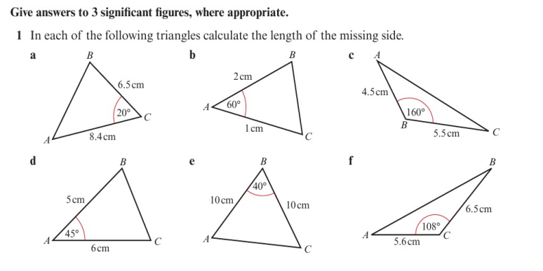
Homework Exercise

Slide 14
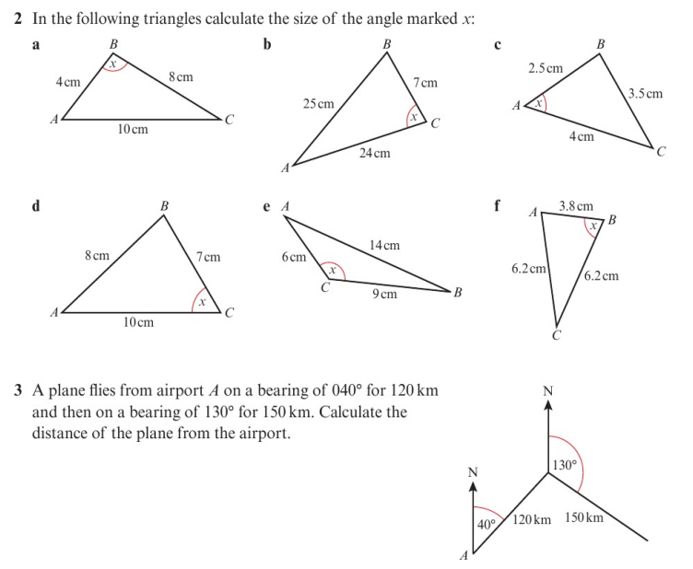
Homework Exercise

Slide 15
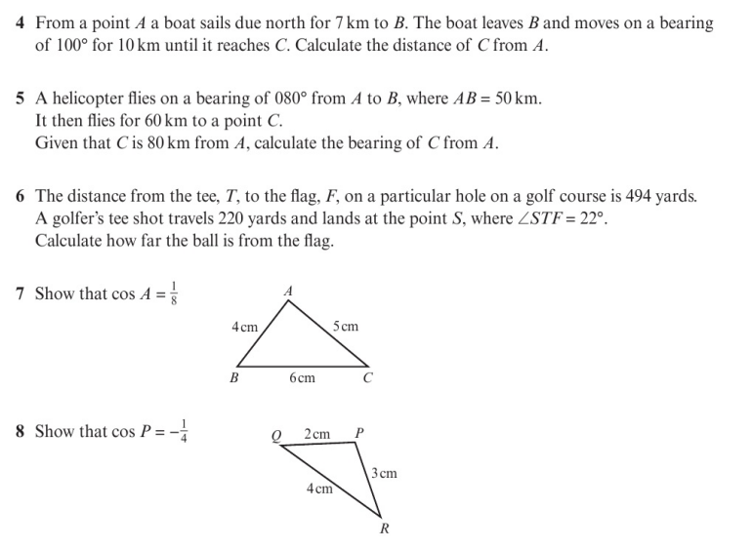
Homework Exercise

Slide 16
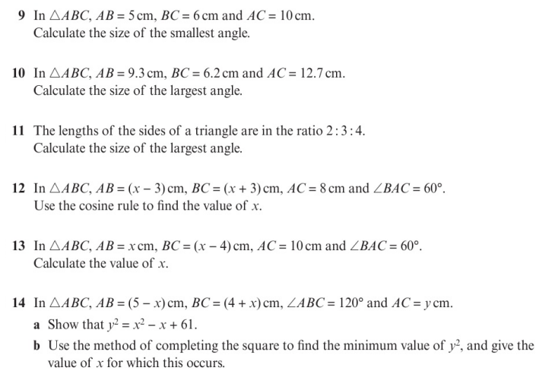
Homework Exercise

Slide 17
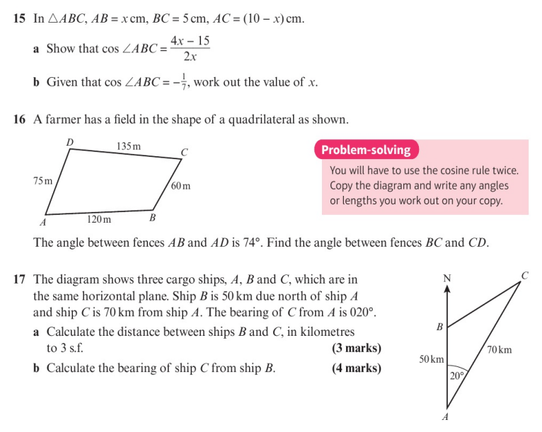
Homework Exercise

Slide 18
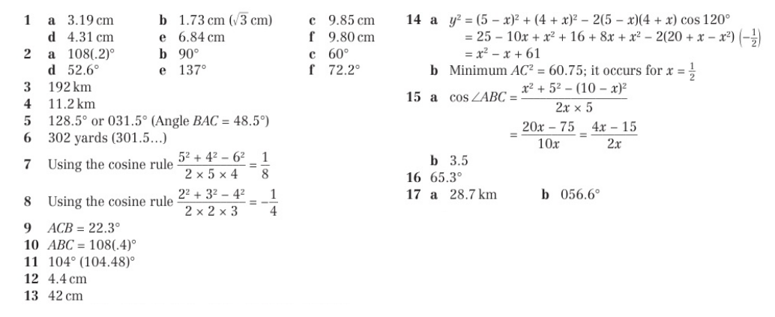
Homework Answers

