Slide 1
P1 Chapter 4: Transforming Graphs Reciprocal Graphs

Slide 2
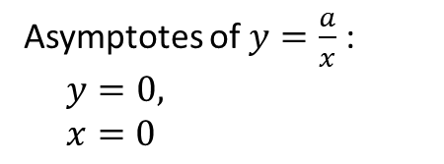

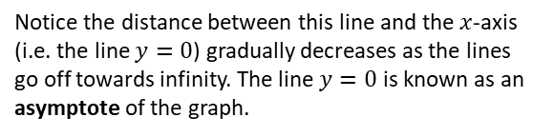




GCSE RECAP :: Reciprocal Graphs
Sketch $y=\frac{1}{x}$
Sketch $y=−\frac{3}{x}$
?
?
$$y$$
$$y$$
Fro Note: The scaling caused by the 3 isn’t observable for this graph in isolation because the axes have no scale. This will only be observation for multiple graphs on the same axes.
$$x$$
$$x$$
Notice the distance between this line and the $x$-axis (i.e. the line $y=0$) gradually decreases as the lines go off towards infinity. The line $y=0$ is known as an asymptote of the graph.
! An asymptote is a line which the graph approaches but never reaches.
Asymptotes of $y=\frac{a}{x}$ :
$y=0,$
$x=0$
?

Slide 3


Reciprocal Graphs
This is new to the A Level 2017 syllabus.
Sketch $y=\frac{3}{x^{2}}$
Sketch $y=−\frac{4}{x^{2}}$
?
?
$$y$$
$$y$$
$$x$$
$$x$$
Hint: Note that anything squared will always be at least zero.

Slide 4

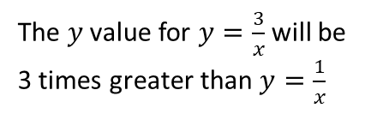



Reciprocal Graphs
On the same axes, sketch $y=\frac{1}{x}$ and $y=\frac{3}{x}$
?
$$y$$
$$y=\frac{3}{x}$$
The $y$ value for $y=\frac{3}{x}$ will be 3 times greater than $y=\frac{1}{x}$
$$y=\frac{1}{x}$$
$$x$$

Slide 5
Exercise 4.3
Pearson Pure Mathematics Year 1/AS
Page 28

Slide 6
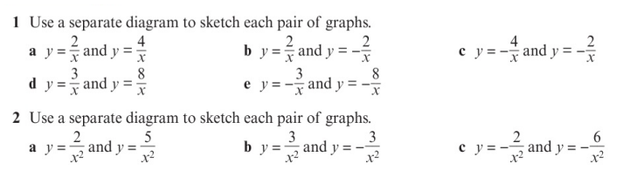
Homework Exercise

Slide 7
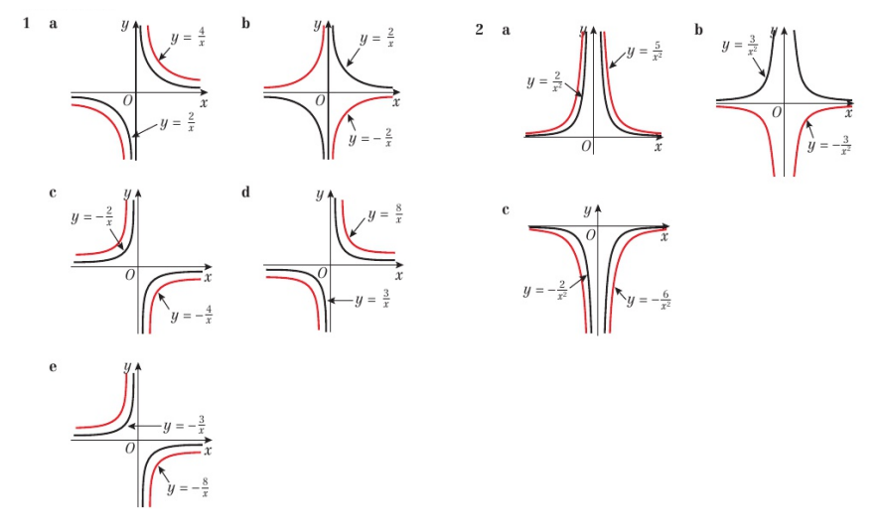
Homework Answers

