Slide 1
P2 Chapter 2: Graphing Functions
Combining Transformations

Slide 2


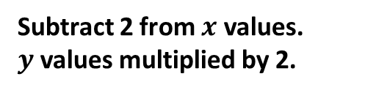


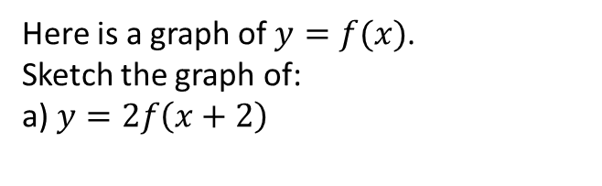













Combining Transformations
RECAP:
Affects which axis?
What we expect or opposite?
Change inside $f( )$
?
$$x$$
?
Opposite
$$y$$
Change outside $f( )$
?
?
What we expect
There is nothing new here relative to Year 1, except that you might have to do more than one transformation…
?
Here is a graph of $y=f(x)$.
Sketch the graph of:
a) $y=2f\left(x+2\right)$
Subtract 2 from $x$ values.
$y$ values multiplied by 2.
$$y$$
$$y=f(x)$$
$$y$$
Start with the points you have coordinates of first!
$$B\left(6,4\right)$$
$$y=f(x)$$
$$\left(5,8\right)$$
$$x$$
$$B\left(6,4\right)$$
$$O$$
$$x$$
$$A\left(2,−1\right)$$
$$O$$
$$A\left(2,−1\right)$$
$$\left(0,−2\right)$$

Slide 3
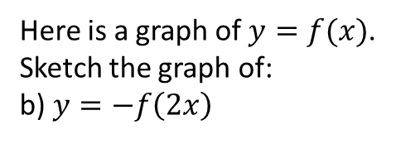



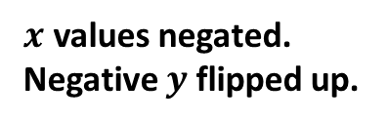














Combining Transformations
$$y$$
Here is a graph of $y=f(x)$.
Sketch the graph of:
b) $y=−f\left(2x\right)$
? b
Halve $x$ values.
$y$ values negated.
$$y=f(x)$$
$$y$$
$$B\left(6,4\right)$$
$$y=f(x)$$
$$x$$
$$O$$
$$\left(1,1\right)$$
$$A\left(2,−1\right)$$
$$x$$
$$O$$
c) $y=\left|f\left(−x\right)\right|$
$$\left(3,−4\right)$$
$$y$$
? c
$$B\left(−6,4\right)$$
$$A\left(−2,1\right)$$
$$y=f(x)$$
$x$ values negated.
Negative $y$ flipped up.
$$x$$
$$O$$

Slide 4
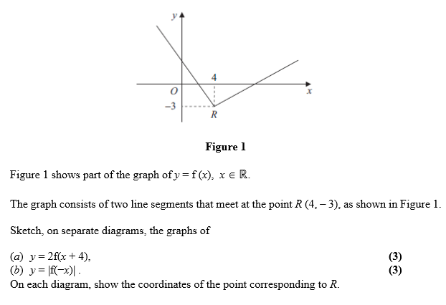
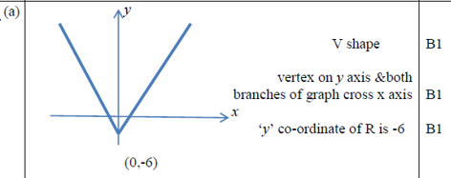
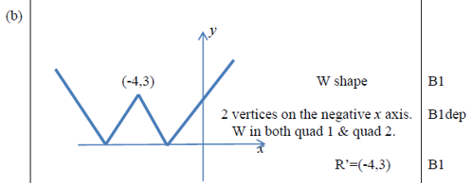
Test Your Understanding
C4 June 2011 Q3
? a
? b

Slide 5

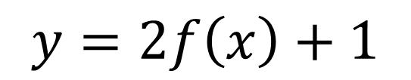



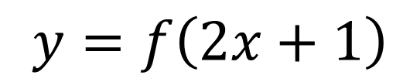

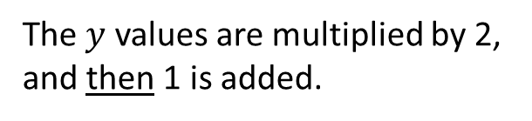

What if two $x$ changes or two $y$ changes?
$$y=2f\left(x\right)+1$$
Sketch $y=\ln\left(1−2x\right)$
Inverse of $1−2x$ is $\frac{1−x}{2}=−\frac{1}{2}x+\frac{1}{2}$
So multiply $x$ values by $−\frac{1}{2}$ and then add $\frac{1}{2}$.
?
The $y$ values are multiplied by 2, and then 1 is added.
?
$$y=f\left(2x+1\right)$$
You will not get multiple $x$ transformations in your exam, but theoretically…
The easiest way is the think of the inverse function of $2x+1$, i.e. $\frac{x−1}{2}$.
This gives us the changes to the $x$ values, and in the correct order! In this case, we would -1 from the $x$ values (translation 1 left) and then halve the $x$ values (stretch on $x$-axis of scale factor $\frac{1}{2}$)
Original asymptote was $x=0$.
$$\left(0×−\frac{1}{2}\right)+\frac{1}{2}=\frac{1}{2}$$
So new asymptote is $x=\frac{1}{2}$
$$y$$
$$x=\frac{1}{2}$$
?
$$x$$

Slide 6
Exercise 2.6
Pearson Pure Mathematics Year 2/AS
Page 12

Slide 7
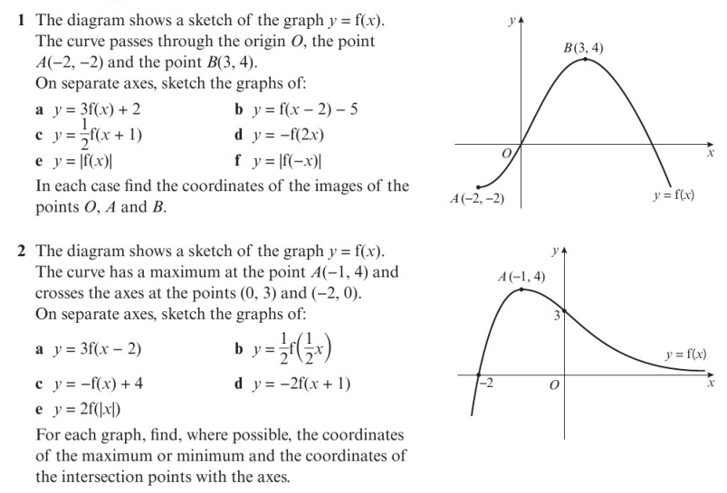
Homework Exercise

Slide 8
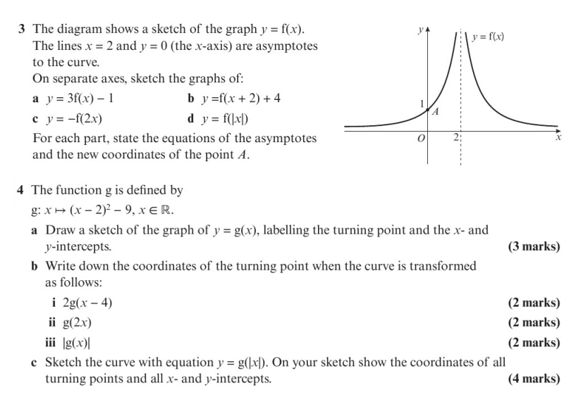
Homework Exercise

Slide 9
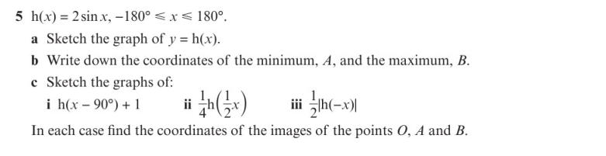
Homework Exercise

Slide 10
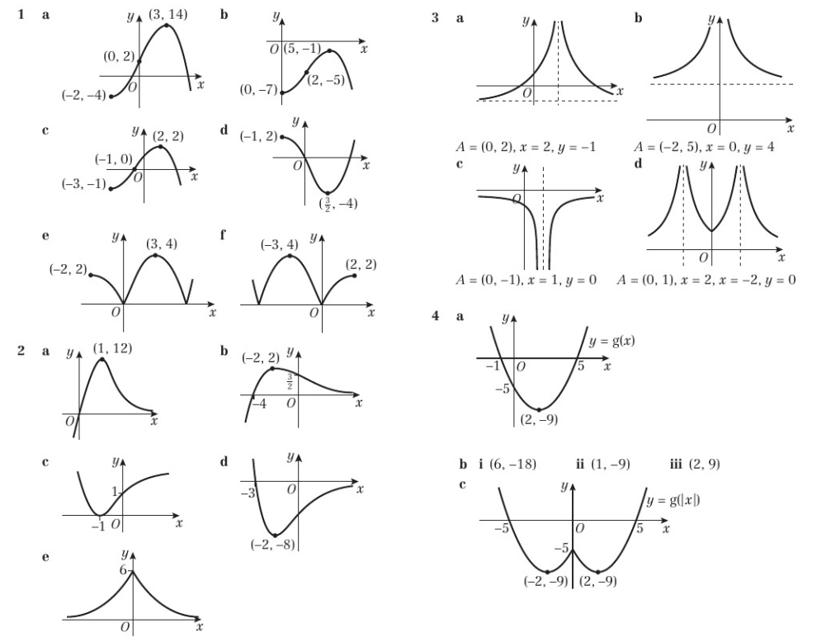
Homework Answers

Slide 11
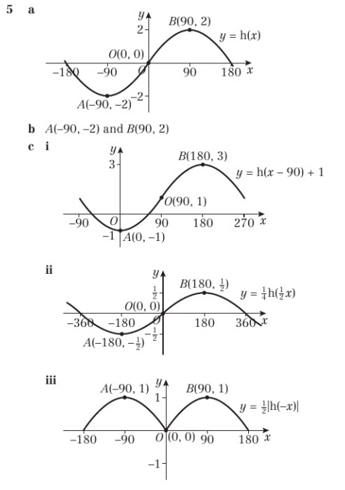
Homework Answers

