Slide 1
P2 Chapter 6: CoAngle Trigonometry
Arc Functions

Slide 2





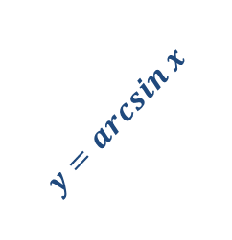




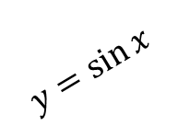


Inverse Trig Functions
You need to know how to sketch $y=\arcsin{x}, y=\arccos{x}$, $y=\arctan{x}$.
(Yes, you could be asked in an exam!)
$$y$$
We have to restrict the domain of $\sin{x}$ to $−\frac{π}{2}≤x<\frac{π}{2}$ before we can find the inverse. Why?
Because only one-to-one functions have an inverse. By restricting the domain it is now one-to-one.
$$\frac{π}{2}$$
?
$$1$$
$$y=arcsin x$$
$$x$$
$$−\frac{π}{2}$$
$$−1$$
$$1$$
$$\frac{π}{2}$$
$$y=\sin{x}$$
$$−1$$
$$−\frac{π}{2}$$

Slide 3
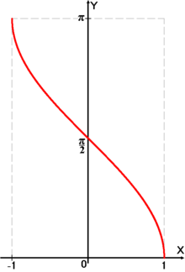
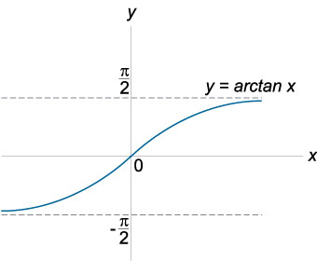


Inverse Trig Functions
$$y=\arccos{x}$$
$$y=\arctan{x}$$
?
?
Note that this graph has asymptotes.

Slide 4

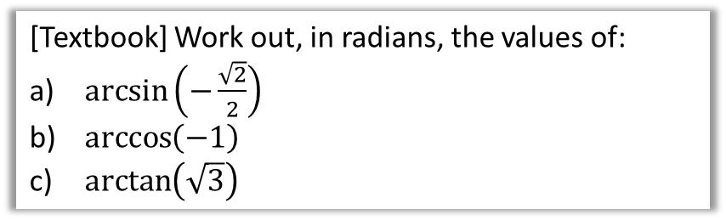

Evaluating inverse trig functions
[Textbook] Work out, in radians, the values of:
$\arcsin\left(−\frac{\sqrt{2}}{2}\right)$
$\arccos\left(−1\right)$
$\arctan\left(\sqrt{3}\right)$
You can simply use the $\sin^{−1}{x}$, $\cos^{−1}{x}$ and $\tan^{−1}{x}$ buttons on your calculator.
If you don’t have a calculator, just use the $sin,cos,tan$ graphs backwards.
?
$$\arcsin\left(−\frac{\sqrt{2}}{2}\right)=−\frac{π}{4} \\ \arccos\left(−1\right)=π \\ \arctan\left(\sqrt{3}\right)=\frac{π}{3}$$
?
?

Slide 5
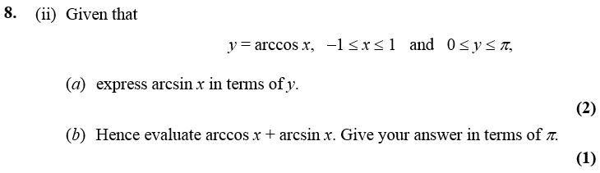

One Final Problem…
Edexcel C3 Jan 2007
?
Fewer than 10% of candidates got this part right.
$$y=\arccos{x} \\ x=\cos{y}=sin\left(\frac{π}{2}−y\right) \\ \arcsin{x=\frac{π}{2}−y}$$
$$\arccos{x+\arcsin{x}} \\ =y+\frac{π}{2}−y=\frac{π}{2}$$

Slide 6
Exercise 6.5
Pearson Pure Mathematics Year 2/AS
Page 46

Slide 7
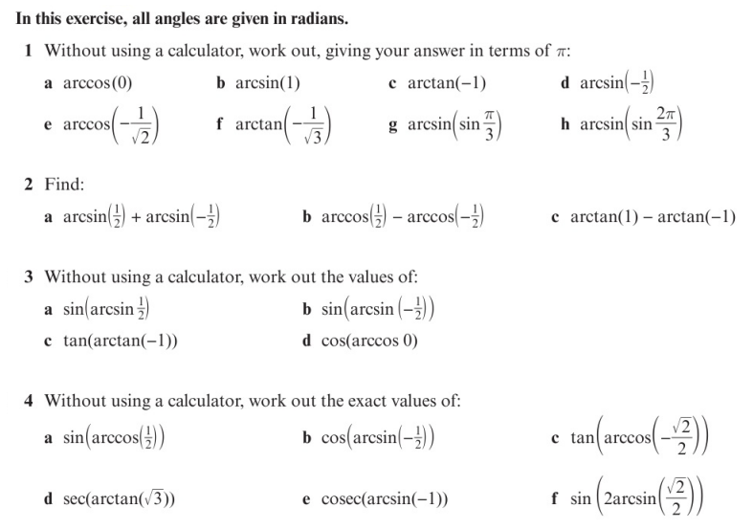
Homework Exercise

Slide 8
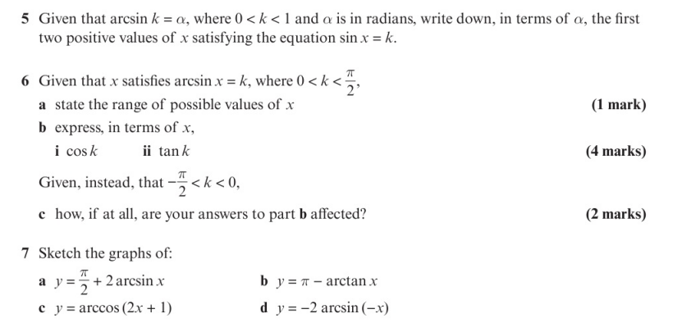
Homework Exercise

Slide 9
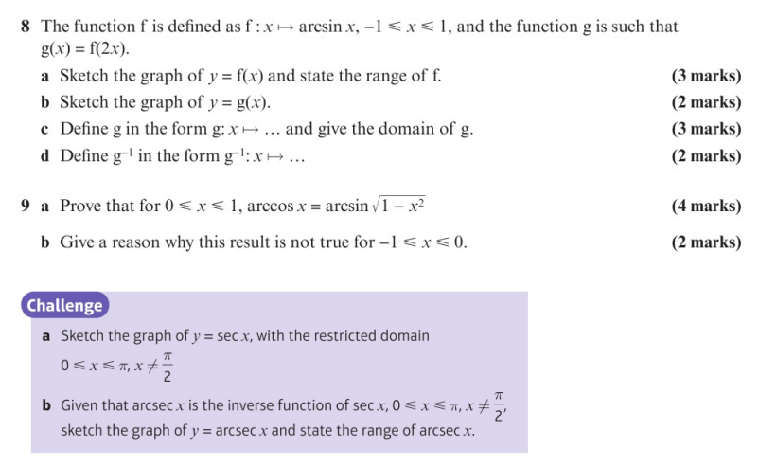
Homework Exercise

Slide 10
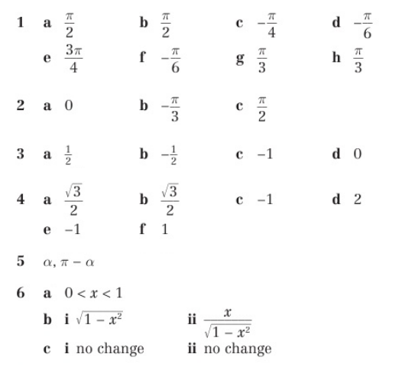
Homework Answers

Slide 11
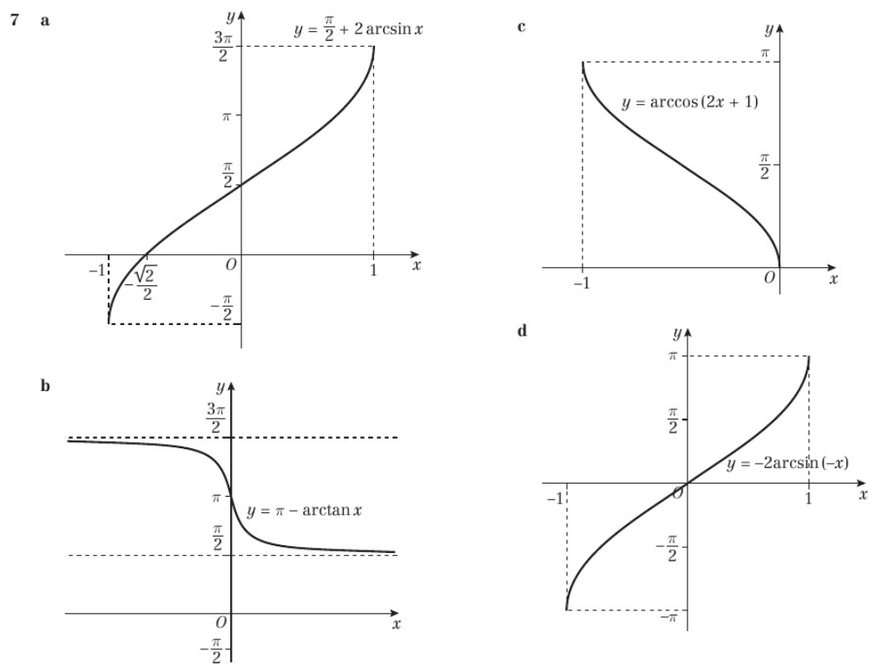
Chapter Answers

Slide 12
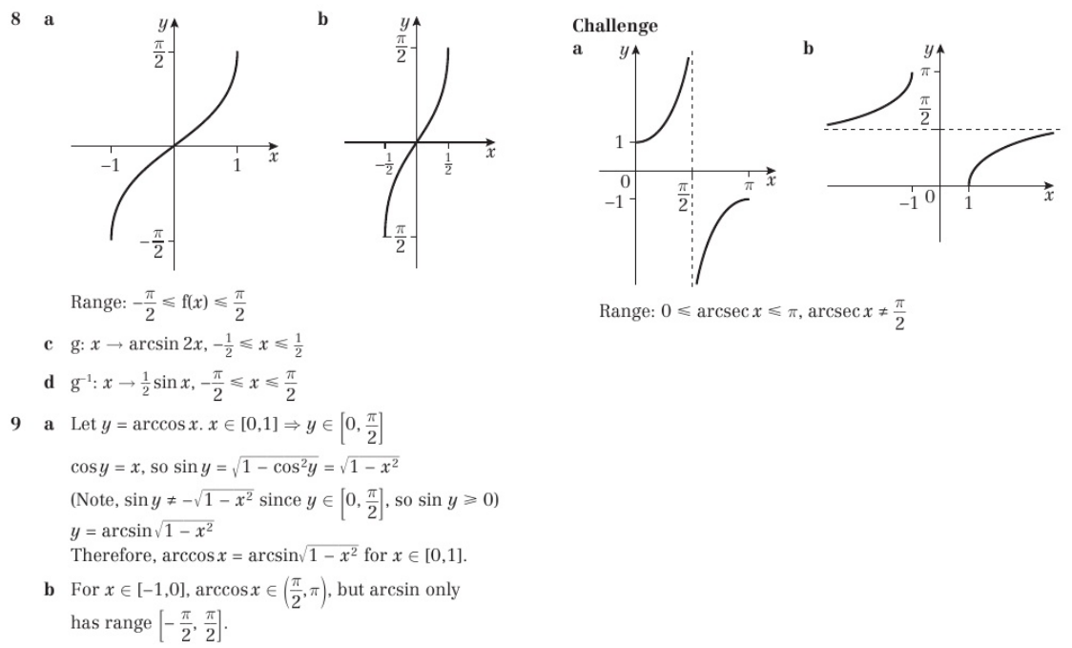
Chapter Answers

