Slide 1
P1 Chapter 12: Differentiation
Modelling with Derivatives

Slide 2



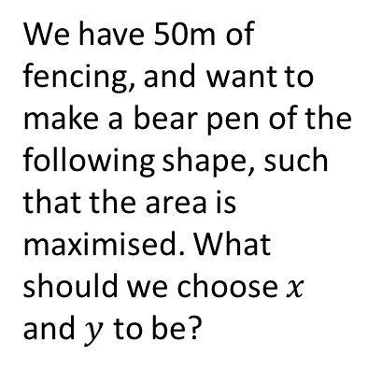
Optimisation Problems/Modelling
We have a sheet of A4 paper, which we want to fold into a cuboid. What height should we choose for the cuboid in order to maximise the volume?
$$h$$
These are examples of optimisation problems: we’re trying to maximise/minimise some quantity by choosing an appropriate value of a variable that we can control.
We have 50m of fencing, and want to make a bear pen of the following shape, such that the area is maximised. What should we choose $x$ and $y$ to be?
$$x$$
$$y$$

Slide 3
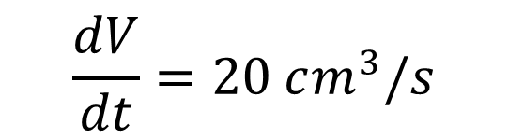
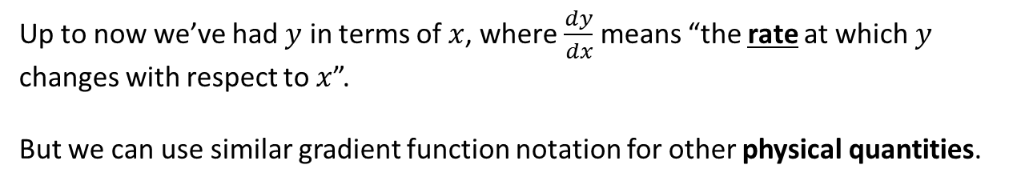
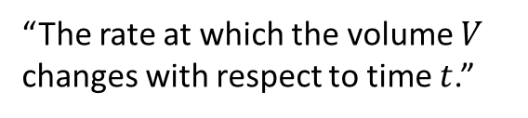
‘Rate of change’
Up to now we’ve had $y$ in terms of $x$, where $\frac{dy}{dx}$ means “the rate at which $y$ changes with respect to $x$”.
But we can use similar gradient function notation for other physical quantities.
Real Life Maths!
A sewage container fills at a rate of 20 cm³ per second.
How could we use appropriate notation to represent this?
$$\frac{dV}{dt}=20 cm^{3}/s$$
“The rate at which the volume $V$ changes with respect to time $t$.”

Slide 4
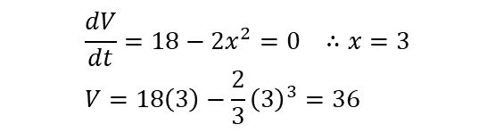



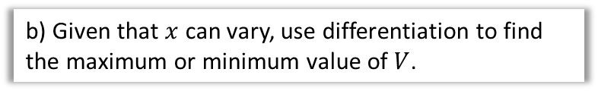
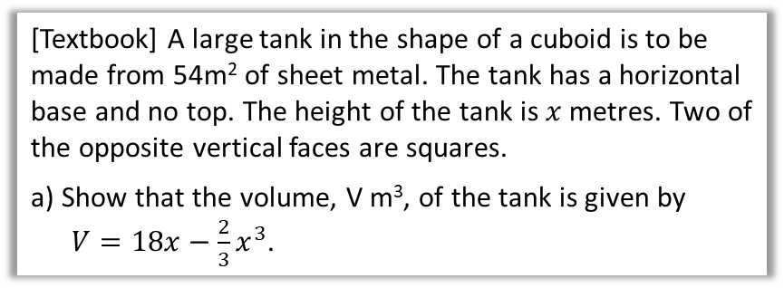

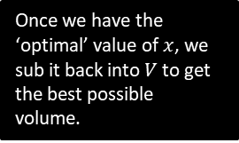
Example Optimisation Problem
Optimisation problems in an exam usually follow the following pattern:
There are 2 variables involved (you may have to introduce one yourself), typically lengths.
There are expressions for two different physical quantities:
  One is a constraint, e.g. “the surface area is 20cm²”.
  The other we wish to maximise/minimise, e.g. “we wish to maximise the volume”.
We use the constraint to eliminate one of the variables in the latter equation, so that it is then just in terms of one variable, and we can then use differentiation to find the turning point.
[Textbook] A large tank in the shape of a cuboid is to be made from 54m² of sheet metal. The tank has a horizontal base and no top. The height of the tank is $x$ metres. Two of the opposite vertical faces are squares.
a) Show that the volume, V m³, of the tank is given by
$V=18x−\frac{2}{3}x^{3}$.
$$x$$
$$x$$
$$y$$
$$2x^{2}+3xy=54 \\ V=x^{2}y$$
But we want $V$ just in terms of $x$:
$$y=\frac{54−2x^{2}}{3x} → V=x^{2}\left(\frac{54−2x^{2}}{3x}\right)$$
$$V=\frac{54x^{2}−2x^{4}}{3x}=18x−\frac{2}{3}x^{3}$$
These are the two equations mentioned in the guidance: one for surface area and one volume.
?
We need to introduce a second variable ourselves so that we can find expressions for the surface area and volume.
Once we have the ‘optimal’ value of $x$, we sub it back into $V$ to get the best possible volume.
?
b) Given that $x$ can vary, use differentiation to find the maximum or minimum value of $V$.
$$\frac{dV}{dt}=18−2x^{2}=0 ∴x=3 \\ V=18\left(3\right)−\frac{2}{3}{\left(3\right)}^{3}=36$$

Slide 5
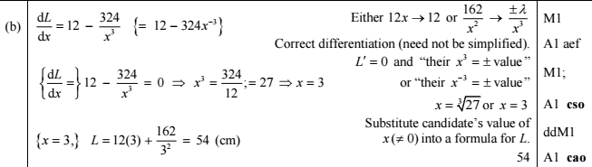
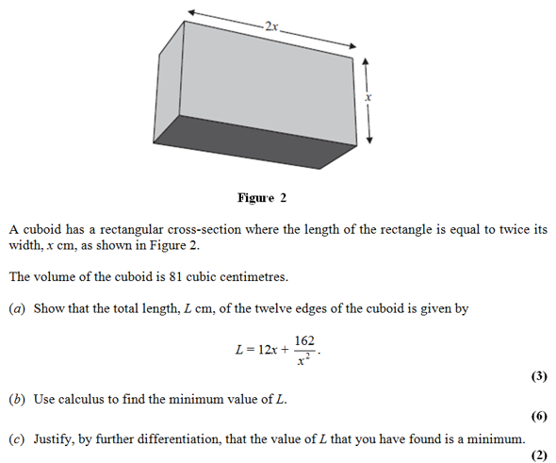

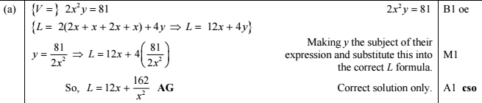
Test Your Understanding
Edexcel C2 May 2011 Q8
? b
? c
? a

Slide 6

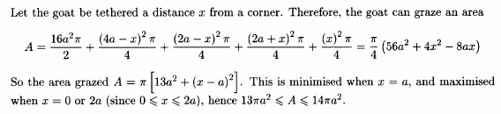
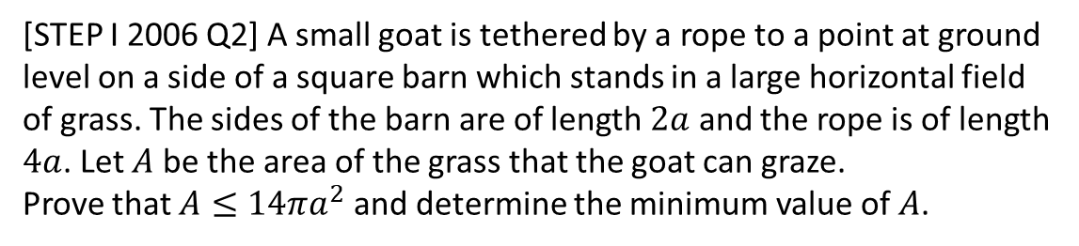
Exercise 12.11
Pearson Pure Mathematics Year 1/AS
Page 101
Extension
1
[STEP I 2006 Q2] A small goat is tethered by a rope to a point at ground level on a side of a square barn which stands in a large horizontal field of grass. The sides of the barn are of length $2a$ and the rope is of length $4a$. Let $A$ be the area of the grass that the goat can graze.
Prove that $A≤14πa^{2}$ and determine the minimum value of $A$.
?

Slide 7
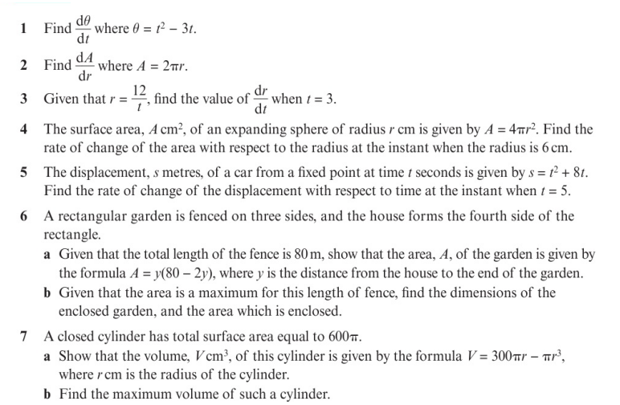
Homework Exercise

Slide 8
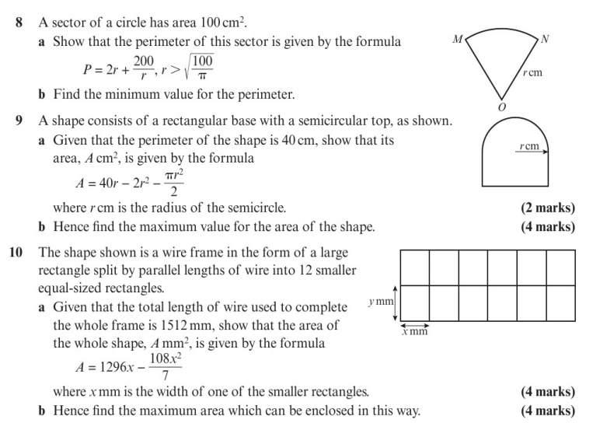
Homework Exercise

Slide 9
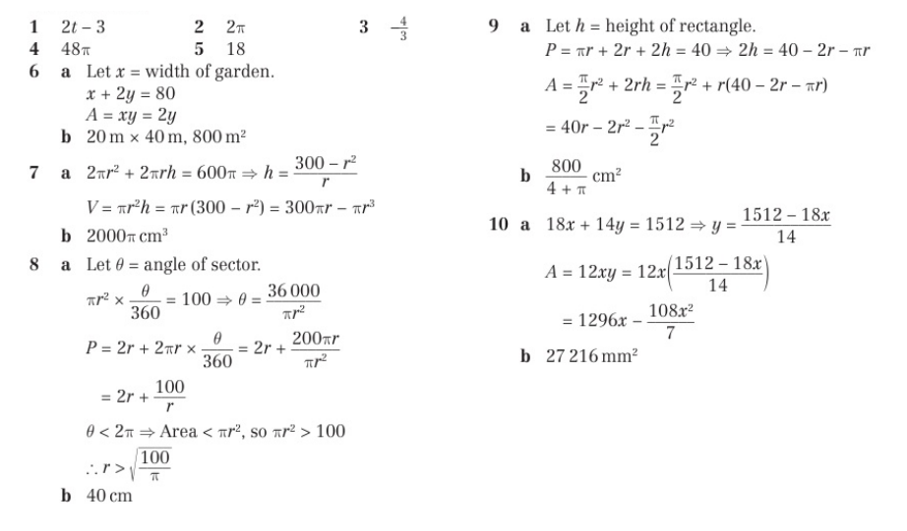
Homework Answers

