Slide 1
P1 Chapter 1: Algebra Fractional Indices

Slide 2

Negative and Fractional Indices
$$a^{0}=1 \\ a^{\frac{1}{m}}=\sqrt[m]{a} \\ a^{\frac{n}{m}}={\left(\sqrt[m]{a}\right)}^{n} \\ a^{−m}=\frac{1}{a^{m}}$$
Note: $\sqrt{9}$ only means the positive square root of 9, i.e. 3 not -3.
Otherwise, what would be the point of the $±$ in the quadratic formula before the $\sqrt{b^{2}−4ac}$?
Prove that $x^{\frac{1}{2}}=\sqrt{x}$
Evaluate ${27}^{−\frac{1}{3}}$
Evaluate ${32}^{\frac{2}{5}}$
?
?
?
$$x^{\frac{1}{2}}×x^{\frac{1}{2}}=x^{1}$$
But $\sqrt{x}×\sqrt{x}=x$
$$∴x^{\frac{1}{2}}=\sqrt{x}$$
$$=\frac{1}{{27}^{\frac{1}{3}}}=\frac{1}{3}$$
$$=2^{2}=4$$
Simplify ${\left(\frac{1}{9}x^{6}y\right)}^{\frac{1}{2}}$
Evaluate ${\left(\frac{27}{8}\right)}^{−\frac{2}{3}}$
If $b=\frac{1}{9}a^{2}$, determine $3b^{−2}$ in the form $kb^{n}$ where $k,n$ are constants.
?
$$={\left(\frac{8}{27}\right)}^{\frac{2}{3}}={\left(\frac{2}{3}\right)}^{2}=\frac{4}{9}$$
$$=\frac{1}{3}x^{3}y^{\frac{1}{2}}$$
?
?
$$3b^{−2}=3{\left(\frac{1}{9}a^{2}\right)}^{−2} \\ =3\left(81a^{−4}\right)=243a^{−4}$$

Slide 3
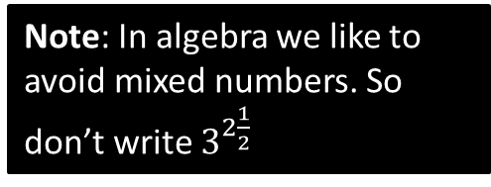
Writing a surd using indices
If $9\sqrt{3}=3^{k}$, determine the value of $k$.
The key here is to write everything as powers with a consistent base, in this case, 3.
?
$$9\sqrt{3}=9×\sqrt{3} \\ =3^{2}×3^{\frac{1}{2}} \\ =3^{\frac{5}{2}}$$
$$∴k=\frac{5}{2}$$
Note: In algebra we like to avoid mixed numbers. So don’t write $3^{2\frac{1}{2} }$

Slide 4
Further Examples
[Edexcel IGCSE May14-4H] Given that
$${\left(2^{\frac{1}{2}}\right)}^{n}=\frac{2^{x}}{8^{y}}$$
Express $n$ in terms of $x$ and $y$.
[Edexcel IAL C12 Jan 2019 Q2c] Given that $y=2^{x}$, express the following in terms of $y$.
$$\frac{1}{4^{2x−3}}$$
Write your expression in its simplest form.
?
?
$$2^{\frac{1}{2}n}=\frac{2^{x}}{{\left(2^{3}\right)}^{y}} \\ =\frac{2^{x}}{2^{3y}}=2^{x−3y} \\ ∴\frac{1}{2}n=x−3y \\ n=2x−6y$$
$$\frac{1}{4^{2x−3}}=4^{−(2x−3)}=4^{−2x+3} \\ ={\left(2^{2}\right)}^{−2x+3} \\ =2^{−4x+6} \\ =2^{−4x}×2^{6} \\ ={\left(2^{x}\right)}^{−4}×64 \\ =64y^{−4} or \frac{64}{y^{4}}$$
Write 8 as a power of 2 (putting a bracket around it), for consistency of base with the other powers.

Slide 5
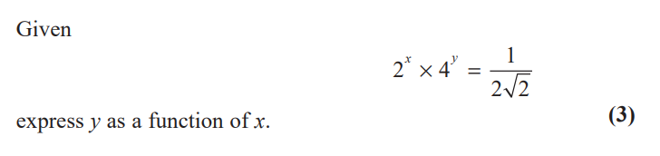
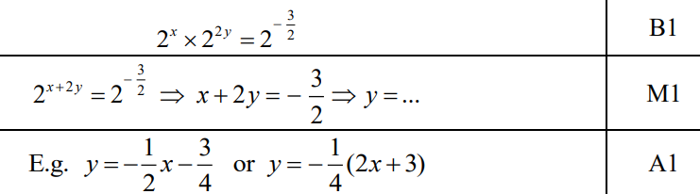
Test Your Understanding
Edexcel Paper 2 – May 2019
?

Slide 6
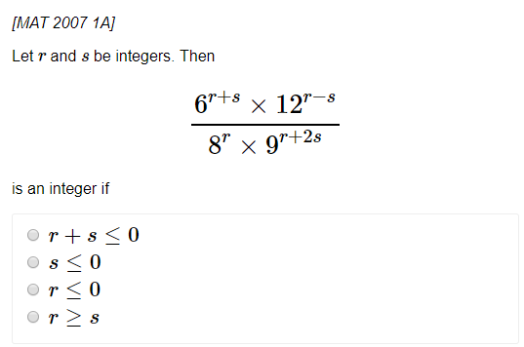
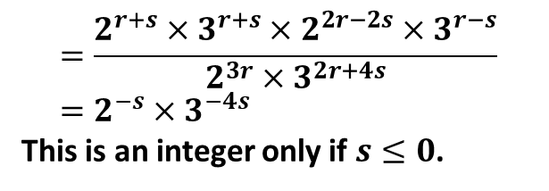
Exercise 1.4
Pearson Pure Mathematics Year 1/AS
Page 3
?
$$=\frac{2^{r+s}×3^{r+s}×2^{2r−2s}×3^{r−s}}{2^{3r}×3^{2r+4s}} \\ =2^{−s}×3^{−4s}$$
This is an integer only if $s≤0$.

Slide 7
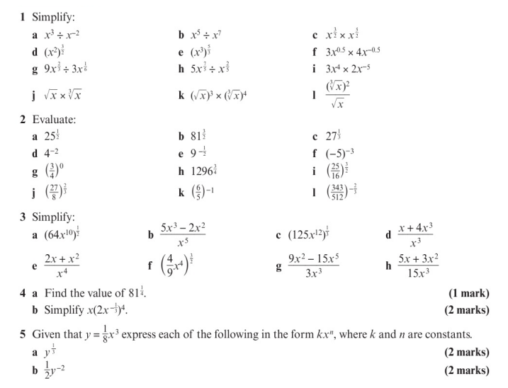
Homework Exercise

Slide 8
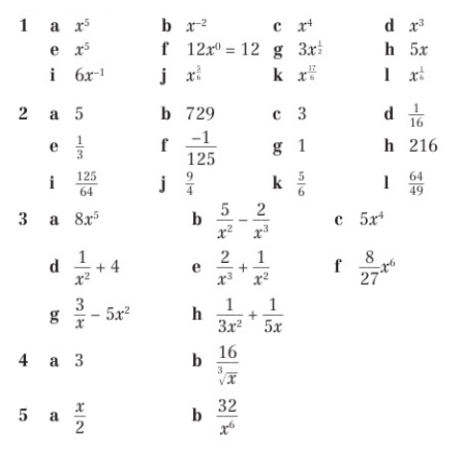
Homework Answers

