Slide 1
Stats1 Chapter 7: Hypothesis Testing Two Tailed Tests

Slide 2

Two-Tailed Tests
We have already seen that if we’re interest in bias ‘either way’, we have two tails, and therefore have to split the critical region by halving the significance level at each end.
Over a long period of time it has been found that in Enrico’s restaurant the ratio of non-veg to veg meals is 2 to 1. In Manuel’s restaurant in a random sample of 10 people ordering meals, 1 ordered a vegetarian meal. Using a 5% level of significance, test whether or not the proportion of people eating veg meals in Manuel’s restaurant is different to that in Enrico’s restaurant.
?
Proportion eating veg meals at Enrico’s is $\frac{1}{3}$
Let $p$ be the proportion of people at Manuel’s that order veg.
Let $X$ be number of people eating veg meals.
$$H_{0}:p=\frac{1}{3} H_{1}:p≠\frac{1}{3}$$
If $H_{0}$ true then $X\sim B\left(10,\frac{1}{3}\right)$
$$P\left(X≤1\right)=P\left(X=0\right)+P\left(X=1\right) \\ =0.104 (3sf)$$
$0.104>0.025$ therefore insufficient evidence to reject $H_{0}$.
There is no evidence that proportion of veg meals at Manuel’s restaurant is different to Enrico’s.
Half significance as 2 tailed.
Conclusion and what it means in context.

Slide 3
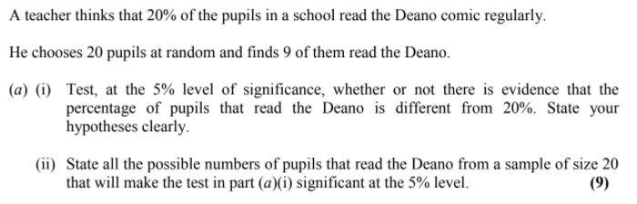
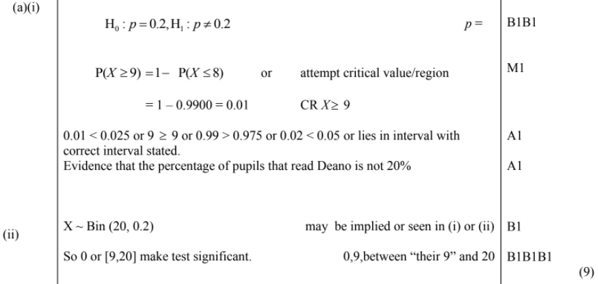
Test Your Understanding
Edexcel S2 Jan 2006 Q7a
?
?

Slide 4
Exercise 7.4
Pearson Applied Year 1/AS
Pages 48-49

Slide 5
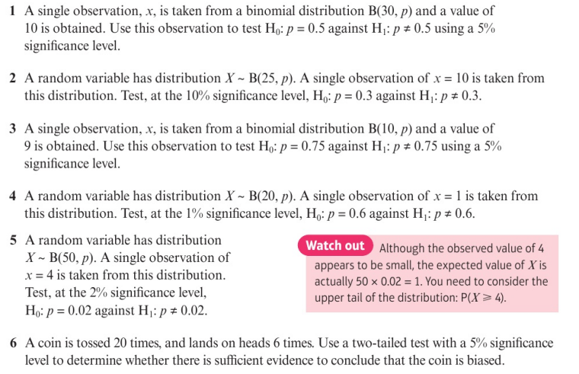
Homework Exercise

Slide 6
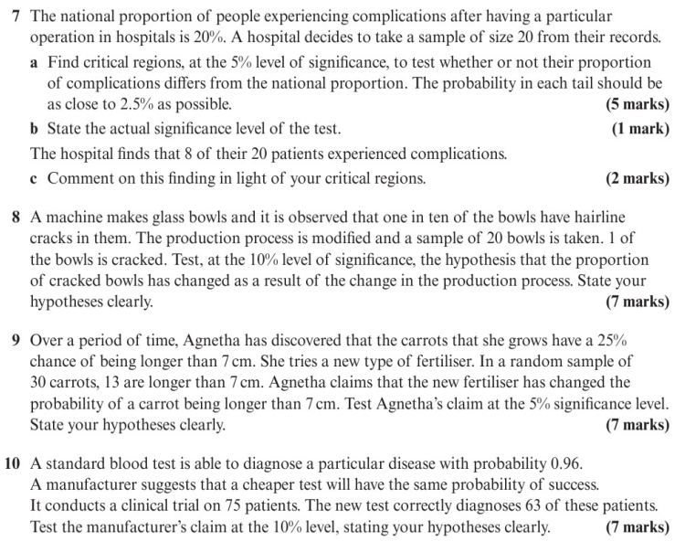
Homework Exercise

Slide 7
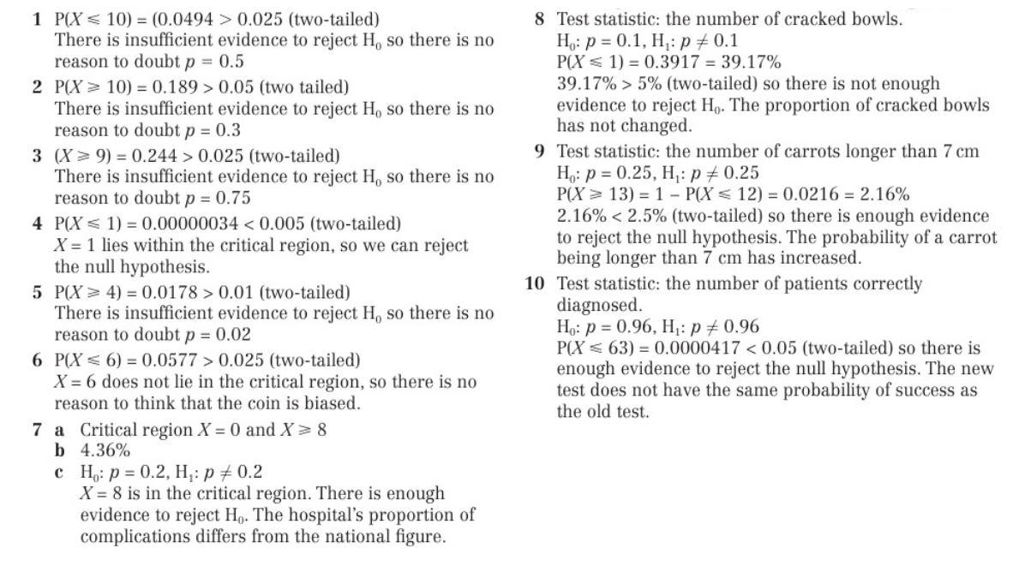
Homework Answers

