Slide 1
M2 Chapter 7: Application of Forces Inclined Plane Dynamics

Slide 2





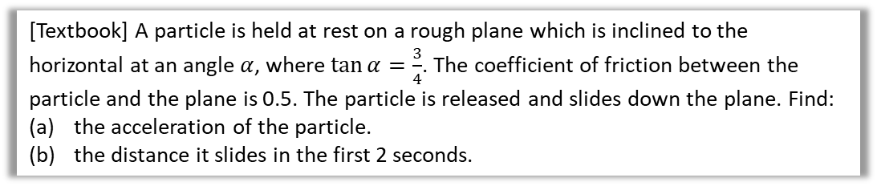








Particles moving on a rough plane
We’ve previously considered particles moving on smooth planes.
And particles in equilibrium (and not moving) on rough planes.
So let’s consider particles moving on rough planes!
[Textbook] A particle is held at rest on a rough plane which is inclined to the horizontal at an angle $α$, where $\tan{α}=\frac{3}{4}$. The coefficient of friction between the particle and the plane is 0.5. The particle is released and slides down the plane. Find:
the acceleration of the particle.
the distance it slides in the first 2 seconds.
? Diagram
If $\tan{α=\frac{3}{4}}$ then $\sin{α}=\frac{3}{5}$ and $\cos{α=\frac{4}{5}}$
$$R\left(↖\right): N=mg\cos{α} \\ N=\frac{4}{5}mg \\ R\left(↙\right): mg\sin{α}−μN=ma \\ \frac{3}{4}mg−\frac{2}{5}mg=ma \\ a=0.2g=2.0 ms^{−2}$$
$$s=?,u=0, v= ,a=0.2g, t=2 \\ s=ut+\frac{1}{2}at^{2}=3.9 (3sf)$$
? a
5
$$a$$
$$5$$
3
$$N$$
$$3$$
$$α$$
$$μN$$
4
$$4$$
$$mg\sin{α}$$
$$mg\cos{α}$$
$$mg$$
$$α$$
$$α$$
? b

Slide 3
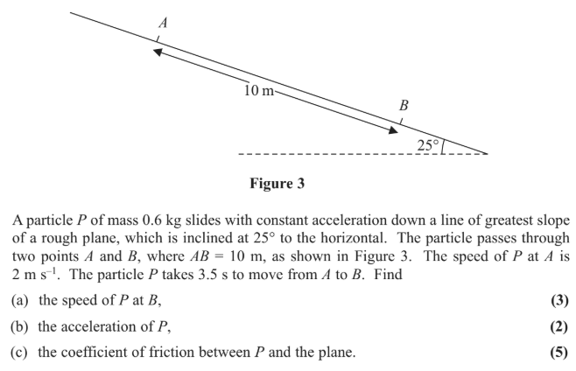
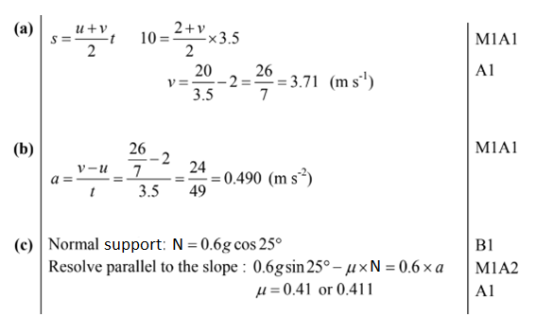
Test Your Understanding
Edexcel M1(Old) May 2013(R) Q5
?
?
?

Slide 4
Exercise 7.5
Pearson Stats/Mechanics Year 2
Pages 62-63

Slide 5
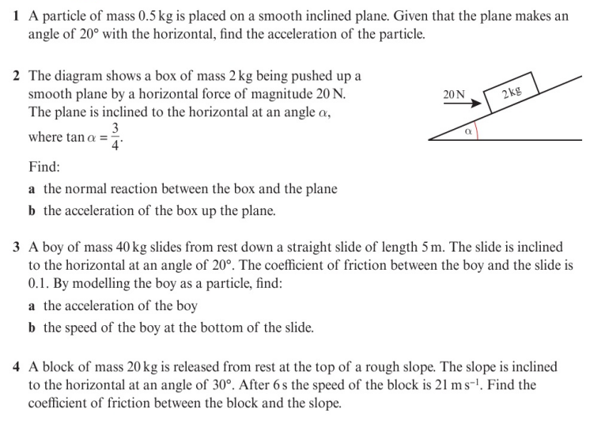
Homework Exercise

Slide 6
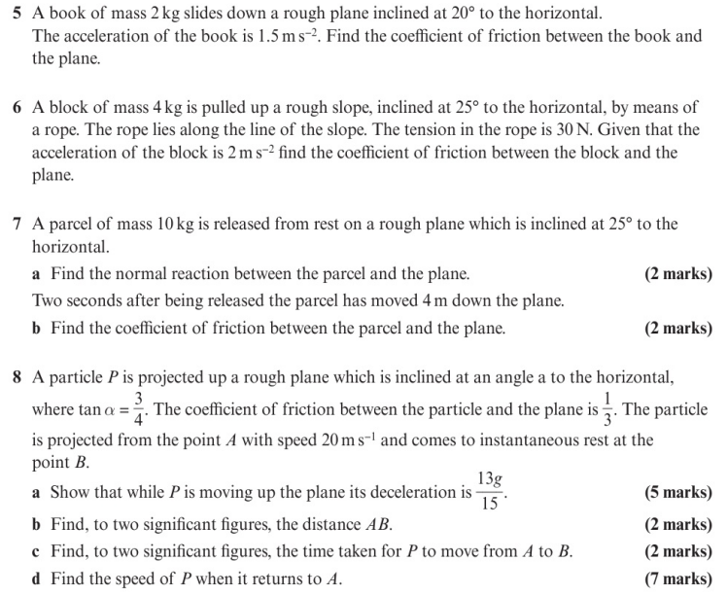
Homework Exercise

Slide 7
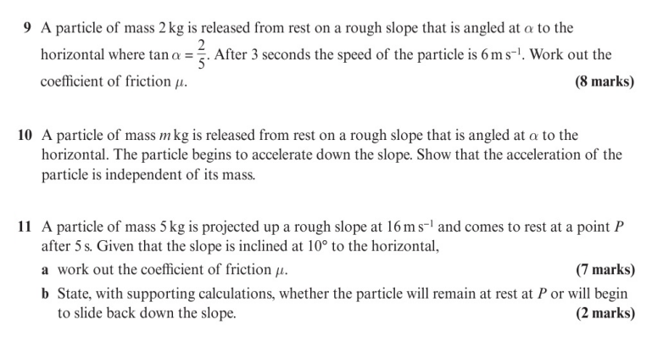
Homework Exercise

Slide 8
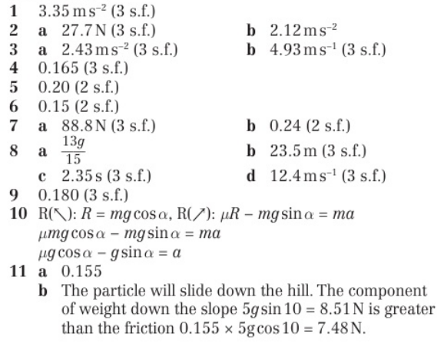
Homework Answers

