Slide 1
P2 Chapter 11: Integration Using Trigonometric Identities

Slide 2
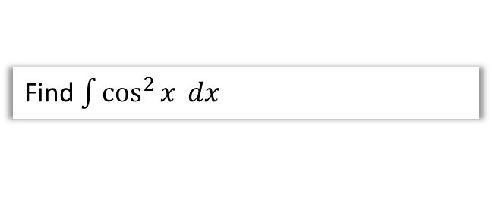

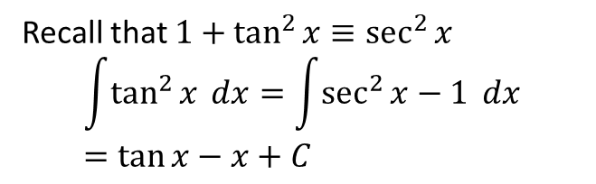



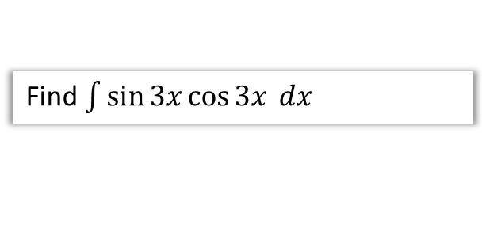

SKILL #3: Integrating using Trig Identities
Some expressions, such as $\sin^{2}{x}$ and $\sin{x}\cos{x}$ can’t be integrated directly, but we can use one of our trig identities to replace it with an expression we can easily integrate.
Q
Find $\int{\sin^{2}{x} dx}$
Q
Find $\int{\sin{3x}\cos{3x} dx}$
?
?
Do you know a trig identity involving $\sin^{2}{x}$?
$$\cos{2x}=1−2\sin^{2}{x} \\ \sin^{2}{x}=\frac{1}{2}−\frac{1}{2}\cos{2x} \\ \int{\sin^{2}{x} dx}=\frac{1}{2}x−\frac{1}{4}\sin{2x}$$
$$\sin{6x≡2\sin{3x}\cos{3x}} \\ \sin{3x}\cos{3x}=\frac{1}{2}\sin{6x}$$
$$\int{\sin{3x}\cos{3x} dx}=−\frac{1}{12}\cos{6x}+C$$
Q
Find $\int{\cos^{2}{x} dx}$
Q
Find $\int{\tan^{2}{x} dx}$
Recall that $1+\tan^{2}{x}≡\sec^{2}{x}$
$$\int{\tan^{2}{x} dx}=\int{\sec^{2}{x}−1} dx \\ =\tan{x}−x+C$$
?
?
$$\cos{2x}=2\cos^{2}{x}−1 \\ \cos^{2}{x}=\frac{1}{2}+\frac{1}{2}\cos{2x} \\ \int{\cos^{2}{x} dx}=\frac{1}{2}x+\frac{1}{4}\sin{2x}$$

Slide 3



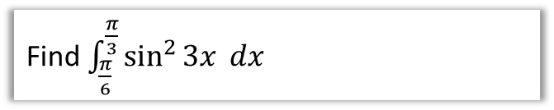
Check Your Understanding
Q
Find $\int{{\left(\sec{x}+\tan{x}\right)}^{2} dx}$
?
$$\int{{\left(\sec{x}+\tan{x}\right)}^{2} dx} \\ =\int{\sec^{2}{x}+2\sec{x}\tan{x}+\tan^{2}{x} dx} \\ =\tan{x}+2\sec{x}+\tan{x}−x+C \\ =2\tan{x}−2\sec{x}−x+C$$
Q
Find $\int_{\frac{π}{6}}^{\frac{π}{3}}{\sin^{2}{3x}} dx$
?
$$\cos{6x}=1−2\sin^{2}{3x} \\ ∴\sin^{2}{3x}=\frac{1}{2}−\frac{1}{2}\cos{6x}$$
$$\int_{\frac{π}{6}}^{\frac{π}{3}}{\sin^{2}{3x}} dx=\int_{\frac{π}{6}}^{\frac{π}{3}}{\frac{1}{2}−\frac{1}{2}cos6x} dx \\ ={\left[\frac{1}{2}x−\frac{1}{12}sin6x\right]}_{\frac{π}{6}}^{\frac{π}{3}} \\ =\left(\frac{π}{6}−\frac{1}{12}\sin{2π}\right)−\left(\frac{π}{12}−\sin{π}\right) \\ =\frac{π}{12}$$

Slide 4
Exercise 11.3
Pearson Pure Year 2
Page 92

Slide 5
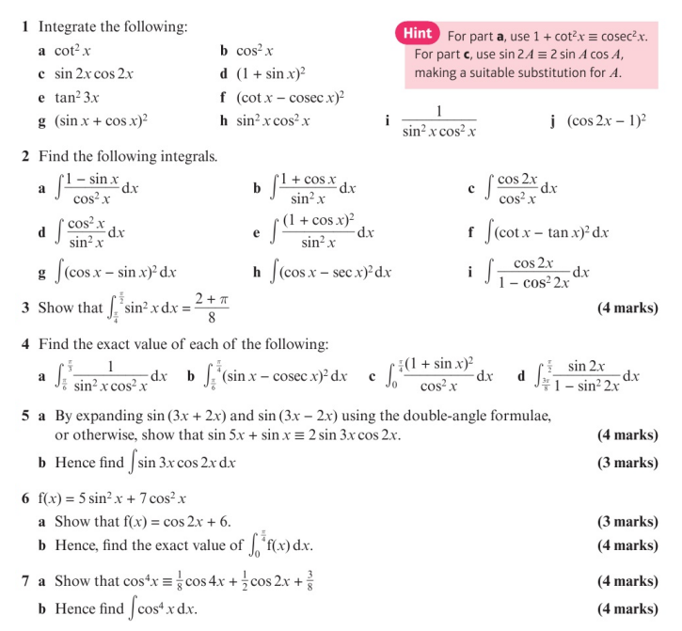
Homework Exercise

Slide 6
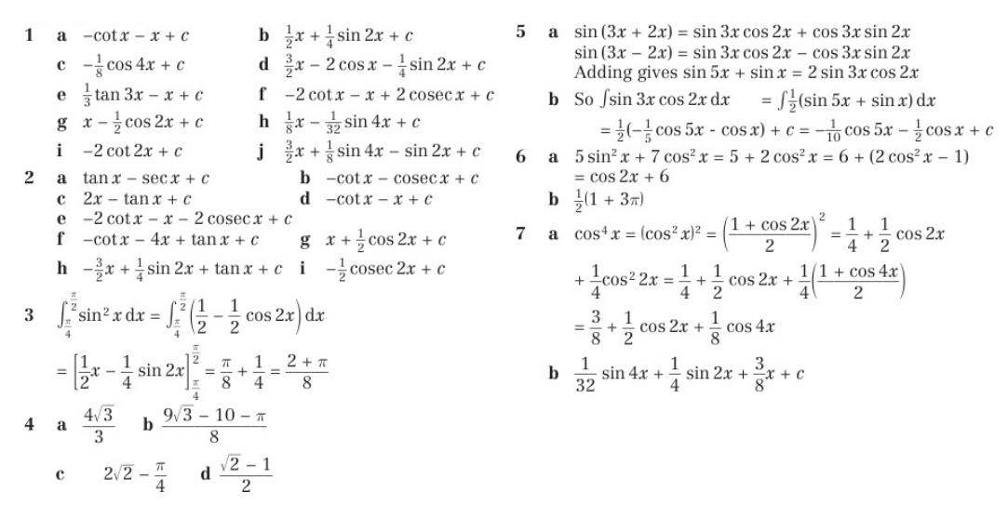
Homework Answers

