Slide 1
Stats Yr2 Chapter 2: Probability Theory Probability Formulae

Slide 2
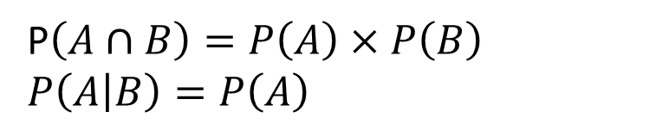
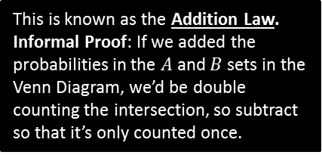
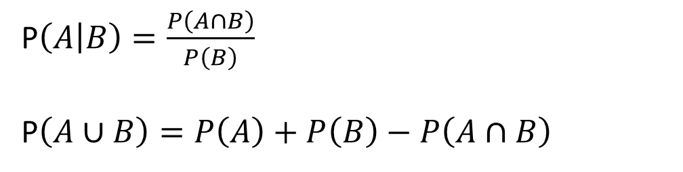
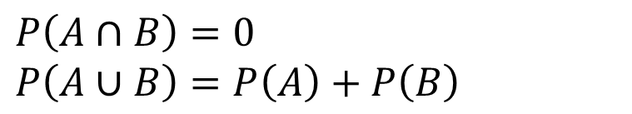
Full Laws of Probability
!
If events $A$ and $B$ are independent.
?
P$\left(A∩B\right)=P\left(A\right)×P\left(B\right)$
$P\left(A | B\right)=P\left(A\right)$
?
If events $A$ and $B$ are mutually exclusive:
?
$P\left(A∩B\right)=0$
$P\left(A∪B\right)=P\left(A\right)+P\left(B\right)$
?
In general:
We first encountered this in the previous section.
?
P$\left(A | B\right)=\frac{P\left(A∩B\right)}{P\left(B\right)}$
P$\left(A∪B\right)=P\left(A\right)+P\left(B\right)−P\left(A∩B\right)$
This is known as the Addition Law.
Informal Proof: If we added the probabilities in the $A$ and $B$ sets in the Venn Diagram, we’d be double counting the intersection, so subtract so that it’s only counted once.
?

Slide 3
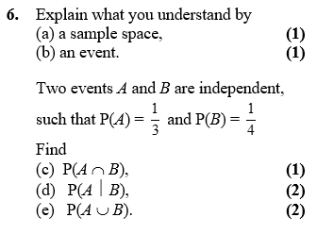
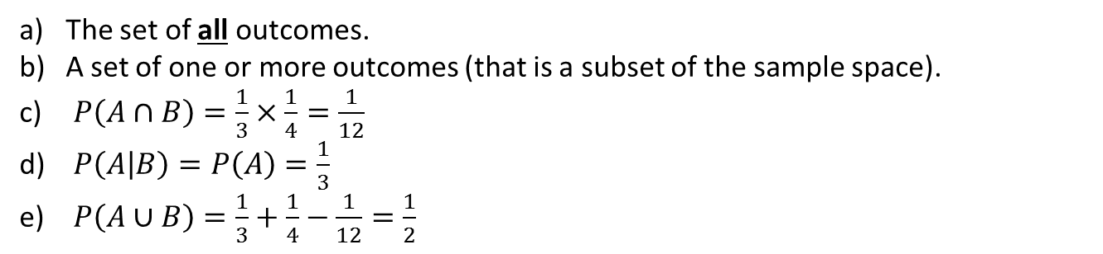
Example
Edexcel S1
?
The set of all outcomes.
A set of one or more outcomes (that is a subset of the sample space).
$P\left(A∩B\right)=\frac{1}{3}×\frac{1}{4}=\frac{1}{12}$
$P\left(A | B\right)=P\left(A\right)=\frac{1}{3}$
$P\left(A∪B\right)=\frac{1}{3}+\frac{1}{4}−\frac{1}{12}=\frac{1}{2}$
?
?
?
?

Slide 4
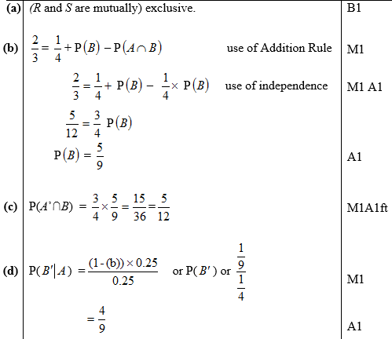
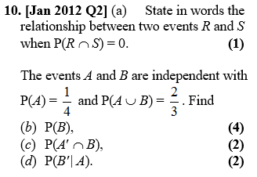

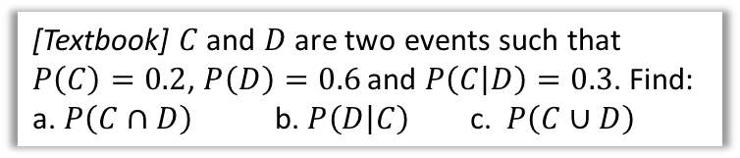
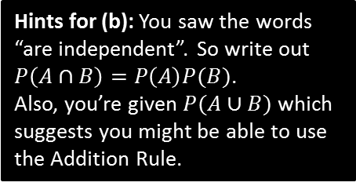
Further Examples
Hints for (b): You saw the words “are independent”. So write out $P\left(A∩B\right)=P\left(A\right)P(B)$.
Also, you’re given $P(A∪B)$ which suggests you might be able to use the Addition Rule.
[Textbook] $C$ and $D$ are two events such that $P\left(C\right)=0.2$, $P\left(D\right)=0.6$ and $P\left(C | D\right)=0.3$. Find:
a. $P\left(C∩D\right)$ b. $P\left(D | C\right)$ c. $P\left(C∪D\right)$
? a
$$P\left(C | D\right)=\frac{P\left(C∩D\right)}{P\left(D\right)} → 0.3=\frac{P\left(C∩D\right)}{0.6} \\ P\left(C∩D\right)=0.18$$
$$P\left(D | C\right)=\frac{P\left(C∩D\right)}{P\left(C\right)}=\frac{0.18}{0.2}=0.9$$
$$P\left(C∪D\right)=P\left(C\right)+P\left(D\right)−P\left(C∩D\right) \\ =0.2+0.6−0.18=0.62$$
?
? b
?
? c
?
?

Slide 5
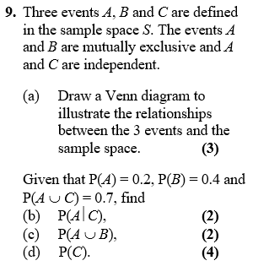





Test Your Understanding
Edexcel S1
a)
?
$$ξ$$
$$C$$
$$A$$
$$B$$
b) $P\left(A | C\right)=P\left(A\right)=0.2$
c) $P\left(A∪B\right)=P\left(A\right)+P\left(B\right)=0.6$
d) $P\left(A∪C\right)=P\left(A\right)+P\left(C\right)−P\left(A∩C\right)$ $$0.7=0.2+P\left(C\right)−0.2P\left(C\right) \\ 0.5=0.8P\left(C\right) \\ P\left(C\right)=\frac{5}{8}$$
?
?
?

Slide 6

SUPER IMPORTANT TIPS
If I were to identify two tips that will possible help you the most in probability questions:
If you see the words ‘given that’, Immediately write out the law for conditional probability.
Example: “Given Bob walks to school, find the probability that he’s not late…”
?
First thing you should write: $P\left(L^{′} | W\right)=\frac{P\left(L^{′}∩W\right)}{P\left(W\right)}=…$
If you see the words ‘are independent’, Immediately write out the laws for independence.
(Even before you’ve finished reading the question!)
Example: “$A$ is independent from $B$…”
?
First thing you should write: $P\left(A∩B\right)=P\left(A\right)P\left(B\right)$ $$P\left(A | B\right)=P(A)$$
If you’re stuck on a question where you have to find a probability given others, it’s probably because you’ve failed to take into account that two events are independent or mutually exclusive, or you need to use the conditional probability or additional law.

Slide 7
Exercise 2.4
Pearson Stats/Mechanics Year 2
Pages 15-17

Slide 8
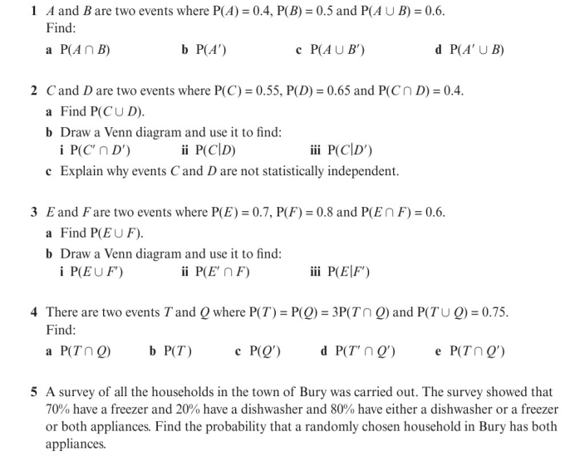
Homework Exercise

Slide 9
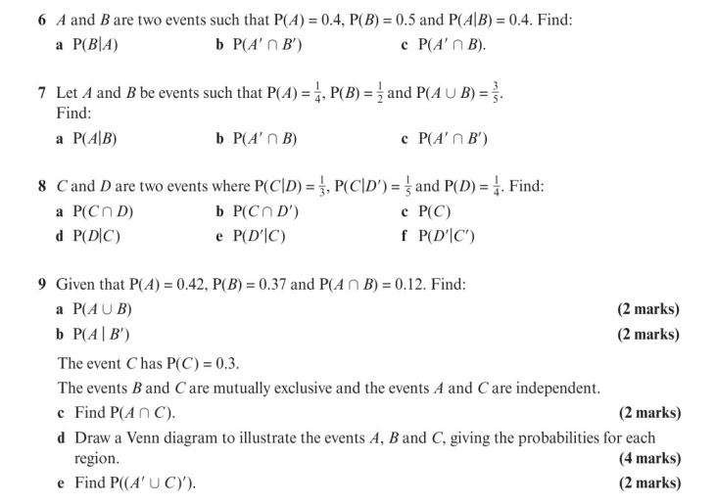
Homework Exercise

Slide 10
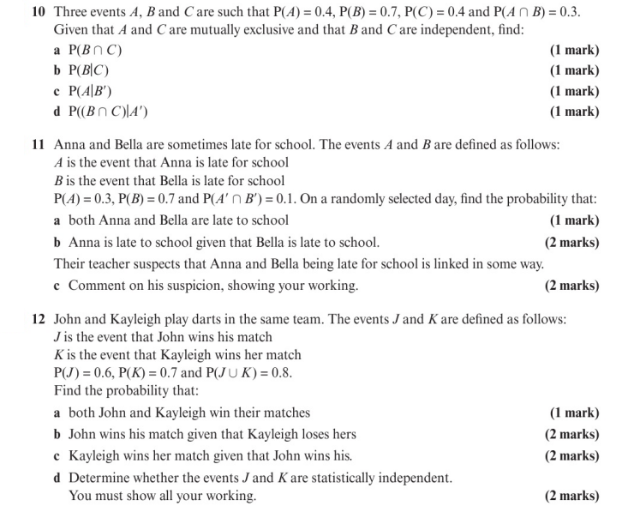
Homework Exercise

Slide 11
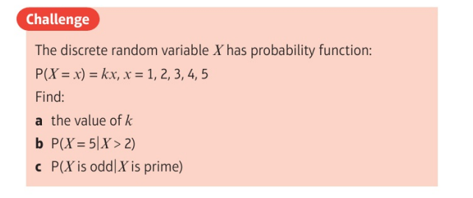
Homework Exercise

Slide 12
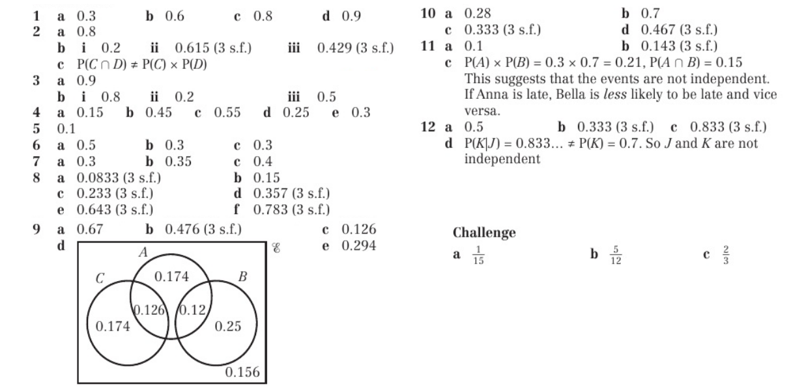
Homework Answers

