Slide 1
P2 Chapter 2: Graphing Functions
Inverse Functions

Slide 2
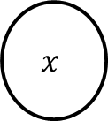


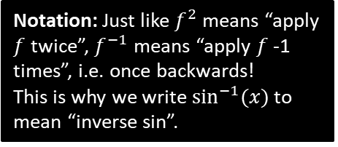


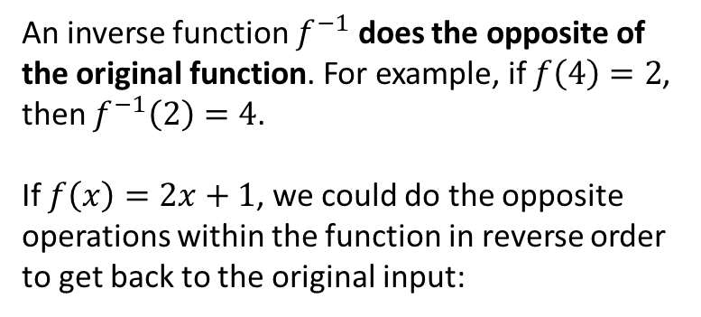



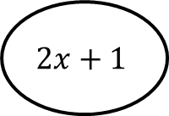

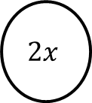

Inverse Functions
$$f$$
An inverse function $f^{−1}$ does the opposite of the original function. For example, if $f\left(4\right)=2$, then $f^{−1}\left(2\right)=4$.
If $f\left(x\right)=2x+1$, we could do the opposite operations within the function in reverse order to get back to the original input:
$$x$$
$$y$$
$$f^{−1}$$
Notation: Just like $f^{2}$ means “apply $f$ twice”, $f^{−1}$ means “apply $f$ -1 times”, i.e. once backwards!
This is why we write $\sin^{−1}{(x)}$ to mean “inverse sin”.
$$×2$$
$$+1$$
$$x$$
$$2x$$
$$2x+1$$
$$−1$$
$$÷2$$
Thus $f^{−1}\left(x\right)=\frac{x−1}{2}$
This has appeared in exams before.
Explain why the function must be one-to-one for an inverse function to exist:
If the mapping was many-to-one, then the inverse mapping would be one-to-many. But this is not a function!
?

Slide 3






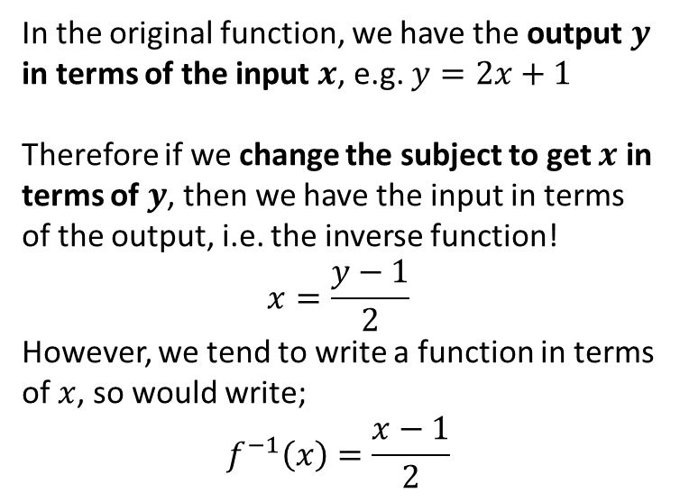




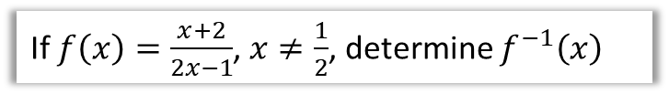
More on Inverse Functions
$$f$$
In the original function, we have the output $y$ in terms of the input $x$, e.g. $y=2x+1$
Therefore if we change the subject to get $x$ in terms of $y$, then we have the input in terms of the output, i.e. the inverse function!
$$x=\frac{y−1}{2}$$
However, we tend to write a function in terms of $x$, so would write;
$$f^{−1}\left(x\right)=\frac{x−1}{2}$$
$$x$$
$$y$$
$$f^{−1}$$
If $f\left(x\right)=3−4x$, find $f^{−1}(x)$
If $f\left(x\right)=\frac{x+2}{2x−1}$, $x≠\frac{1}{2}$, determine $f^{−1}\left(x\right)$
?
$$y=\frac{x+2}{2x−1} \\ y\left(2x−1\right)=x+2 \\ 2xy−y=x+2 2xy−x=y+2 \\ x\left(2y−1\right)=y+2 \\ x=\frac{y+2}{2y−1} \\ f^{−1}\left(x\right)=\frac{x+2}{2x−1}$$
$$y=3−4x \\ 4x=3−y \\ x=\frac{3−y}{4} \\ f^{−1}\left(x\right)=\frac{3−x}{4}$$
Use $y$ instead of $f\left(x\right)$ for convenience.
?
Make $x$ the subject.
Replace $y$’s with $x$ at end.

Slide 4
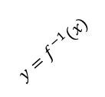

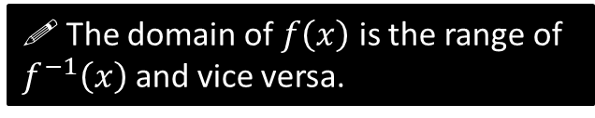



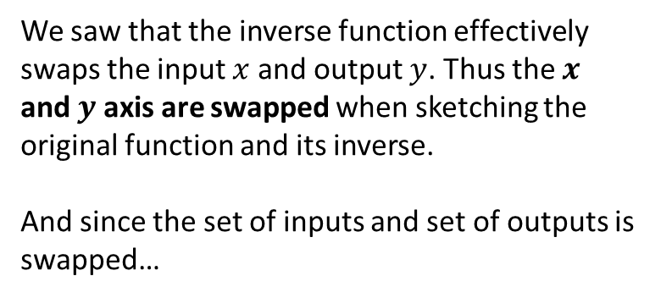




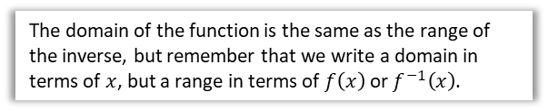


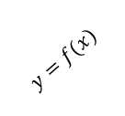
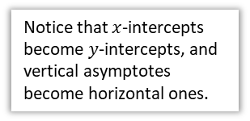
Graphing an Inverse Function
Notice that $x$-intercepts become $y$-intercepts, and vertical asymptotes become horizontal ones.
We saw that the inverse function effectively swaps the input $x$ and output $y$. Thus the $x$ and $y$ axis are swapped when sketching the original function and its inverse.
And since the set of inputs and set of outputs is swapped…
$$y$$
$$x=1$$
$$y=f^{−1}(x)$$
$$y=f(x)$$
$$2$$
$$y=1$$
! The domain of $f\left(x\right)$ is the range of $f^{−1}\left(x\right)$ and vice versa.
$$x$$
$$2$$
$$y=x$$
$y=f(x)$ and $y=f^{−1}\left(x\right)$ have the line $y=x$ as a line of symmetry.
Domain of $f$:
$$x>1$$
Range of $f^{−1}$:
$$f^{−1}\left(x\right)>1$$
?
?
The domain of the function is the same as the range of the inverse, but remember that we write a domain in terms of $x$, but a range in terms of $f\left(x\right)$ or $f^{−1}\left(x\right)$.

Slide 5



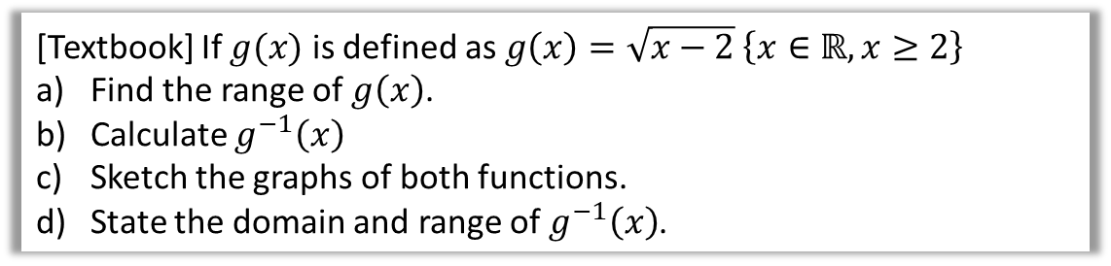





Example
[Textbook] If $g(x)$ is defined as $g\left(x\right)=\sqrt{x−2} \left\{x∈ℝ,x≥2\right\}$
Find the range of $g\left(x\right)$.
Calculate $g^{−1}\left(x\right)$
Sketch the graphs of both functions.
State the domain and range of $g^{−1}\left(x\right)$.
$$y$$
?
c
?
d
Domain of $g^{−1}\left(x\right)$ is range of $g(x)$ and range of $g^{−1}\left(x\right)$ the domain of $g(x)$.
Domain:
$$x≥0$$
Range:
$$f^{−1}\left(x\right)≥2$$
a
?
$$f\left(x\right)≥0$$
Start with $y=\sqrt{x−2}$ and make $x$ the subject, before swapping $y$ and $x$.
$$y=\sqrt{x−2}$$
$$x=y^{2}+2$$
$$g^{−1}\left(x\right)=x^{2}+2$$
$$y=g^{−1}(x)$$
b
?
$$2$$
$$y=g(x)$$
$$x$$
$$2$$

Slide 6



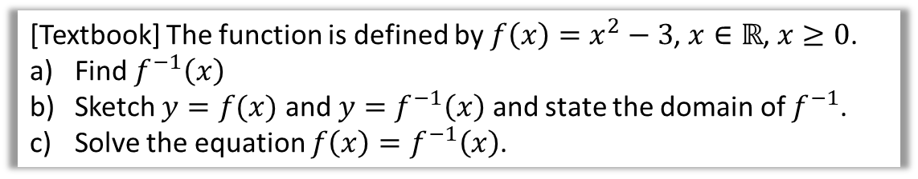






Further Example
[Textbook] The function is defined by $f\left(x\right)=x^{2}−3$, $x∈ℝ$, $x≥0$.
Find $f^{−1}\left(x\right)$
Sketch $y=f(x)$ and $y=f^{−1}\left(x\right)$ and state the domain of $f^{−1}$.
Solve the equation $f\left(x\right)=f^{−1}\left(x\right)$.
$$y=x^{2}−3 \\ x=\sqrt{y+3} \\ f^{−1}\left(x\right)=\sqrt{x+3}$$
If the function is equal to its inverse, it must lie on the line $y=x$, i.e. $f\left(x\right)=x$:
$$x^{2}−x=3 \\ x^{2}−x−3=0 \\ x=\frac{1±\sqrt{1+12}}{2} \\ =\frac{1+\sqrt{13}}{2}$$
a
?
c
?
b
$$y$$
?
$$y=f\left(x\right)$$
$$y=x$$
$$3$$
$$y=f^{−1}\left(x\right)$$
Note: There was once an exam question based on this principle.
$$3$$
$$x$$
From graph, we can see we only want positive solution.

Slide 7
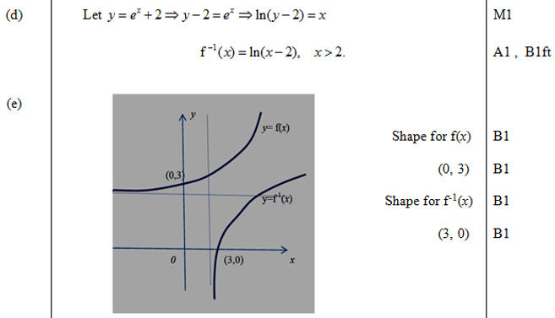
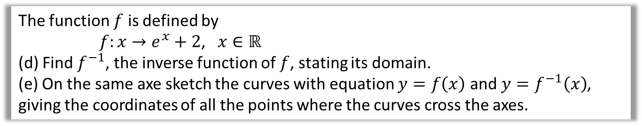
Test Your Understanding
Edexcel C4 June 2012 Q6
The function $f$ is defined by
$f:x→e^{x}+2$, $x∈ℝ$
(d) Find $f^{−1}$, the inverse function of $f$, stating its domain.
(e) On the same axe sketch the curves with equation $y=f\left(x\right)$ and $y=f^{−1}\left(x\right)$, giving the coordinates of all the points where the curves cross the axes.
?
?

Slide 8
Exercise 2.4
Pearson Pure Mathematics Year 2/AS
Pages 9

Slide 9
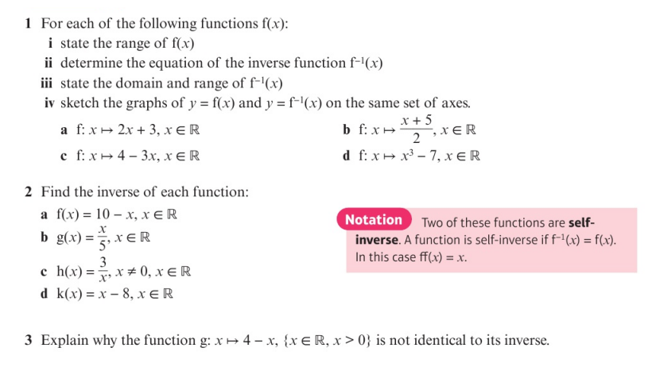
Homework Exercise

Slide 10
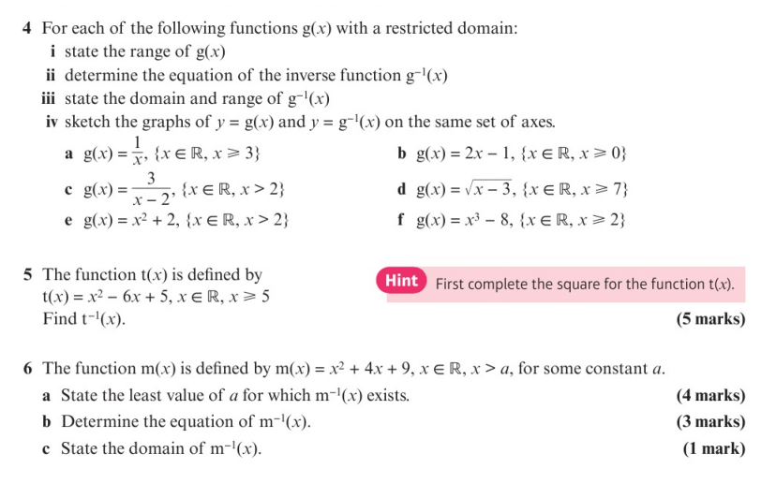
Homework Exercise

Slide 11
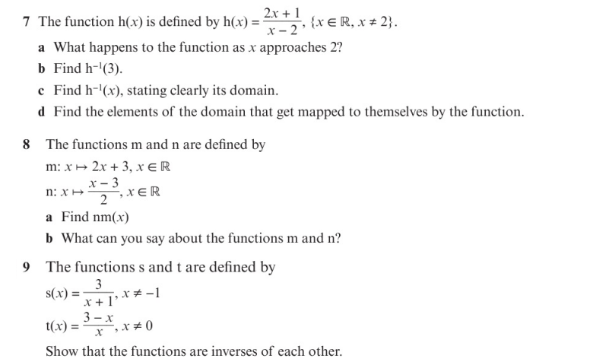
Homework Exercise

Slide 12
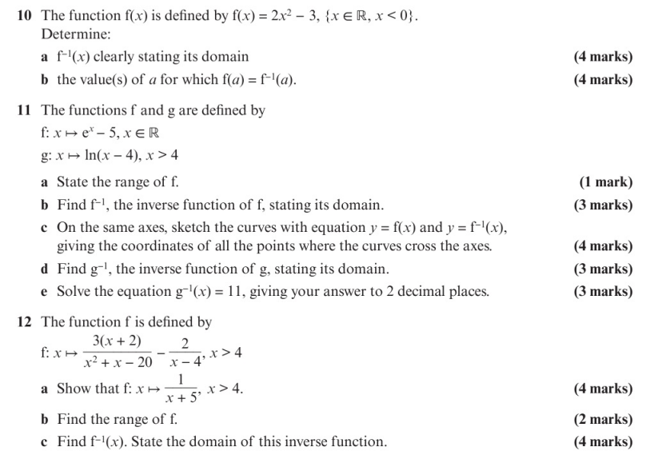
Homework Exercise

Slide 13
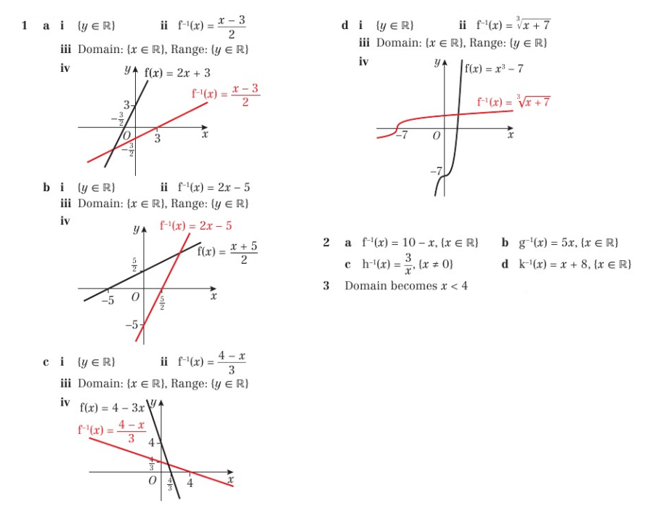
Homework Answers

Slide 14
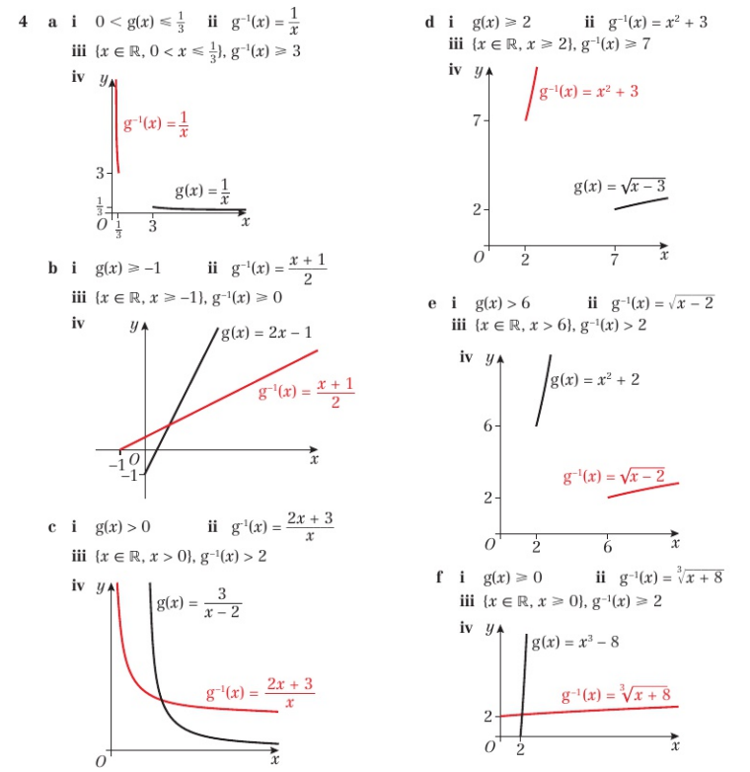
Homework Answers

Slide 15
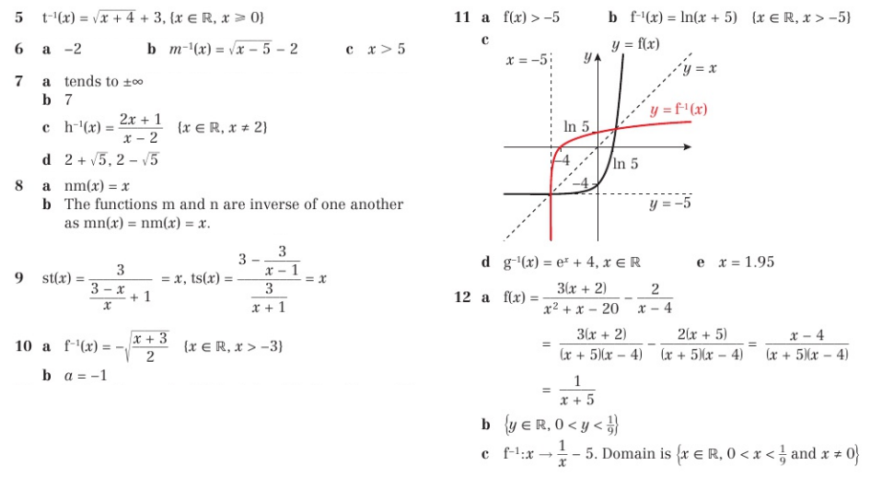
Homework Answers

