Slide 1
P2 Chapter 9: Differentiation The Quotient Rule

Slide 2
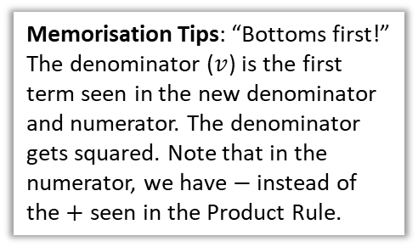

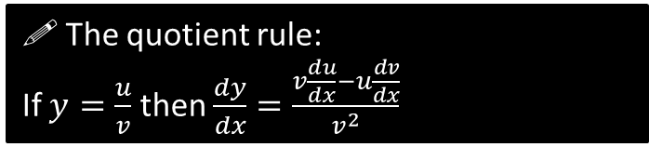
The Quotient Rule
Just as we use the ‘product rule’ to differentiate a ‘product’, we use the ‘quotient rule’ to differentiate a ‘quotient’ (i.e. division).
?
$$y=\frac{u}{v}=uv^{−1} \\ \frac{dy}{dx}=−uv^{−2}\frac{dv}{dx}+\frac{du}{dx}v^{−1} \\ =v^{−2}\left(v\frac{du}{dx}−u\frac{dv}{dx}\right) \\ =\frac{v\frac{du}{dx}−u\frac{dv}{dx}}{v^{2}}$$
?
?
?
! The quotient rule:
If $y=\frac{u}{v}$ then $\frac{dy}{dx}=\frac{v\frac{du}{dx}−u\frac{dv}{dx}}{v^{2}}$
Memorisation Tips: “Bottoms first!” The denominator ($v$) is the first term seen in the new denominator and numerator. The denominator gets squared. Note that in the numerator, we have $−$ instead of the $+$ seen in the Product Rule.

Slide 3



Examples
[Textbook] If $y=\frac{x}{2x+5}$, find $\frac{dy}{dx}$
$$u=x v=2x+5 \\ \frac{du}{dx}=1 \frac{dv}{dx}=2 \\ \frac{dy}{dx}=\frac{1\left(2x+5\right)−2x}{{\left(2x+5\right)}^{2}}=\frac{5}{{\left(2x+5\right)}^{2}}$$
?
Layout just like you would with the Product Rule.
[Textbook] Find the stationary point of $y=\frac{\sin{x}}{e^{2x}}$ , $0<x<π$
?
$$u=\sin{x}, v=e^{2x} \\ \frac{du}{dx}=\cos{x}, \frac{dv}{dx}=2e^{2x} \\ \frac{dy}{dx}=\frac{e^{2x}\cos{x}−2\sin{x} \left(e^{2x}\right)}{e^{4x}}=0$$
$$e^{2x}\cos{x}−2\sin{x}\left(e^{2x}\right)=0 \\ e^{2x}\left(\cos{x}−2\sin{x}\right)=0 \\ e^{2x}≠0 ∴\cos{x}=2\sin{x} \\ \tan{x}=\frac{1}{2} → x=0.464 \left(3sf\right) \\ y=\frac{\sin\left(0.464\right)}{e^{2×0.464}}=0.177 (3sf)$$
Whenever you have “fraction = 0”, you can just multiply through by denominator.
As per advice earlier this chapter, try to factorise whenever you have 0 on one side.
As per trig chapter, divide by $\cos{x}$ whenever you have a mix of $\sin{x}$ and $\cos{x}$.

Slide 4

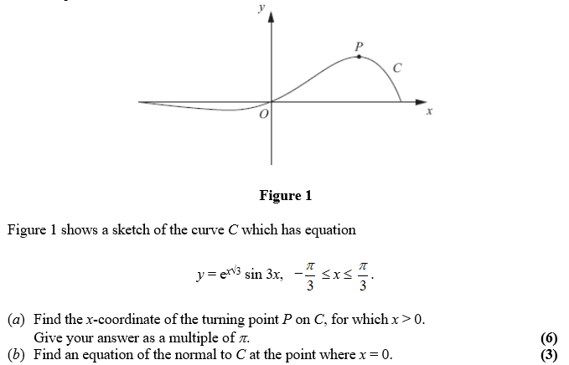
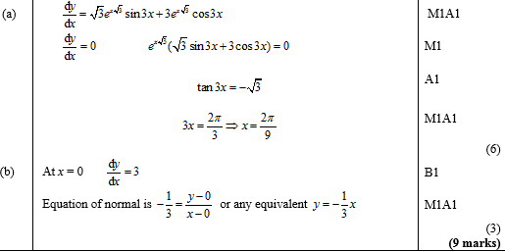
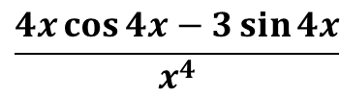
Test Your Understanding
Edexcel C3 Jan 2012 Q1a
?
$$\frac{4x\cos{4x}−3\sin{4x}}{x^{4}}$$
Edexcel C3 June 2012 Q3
?

Slide 5
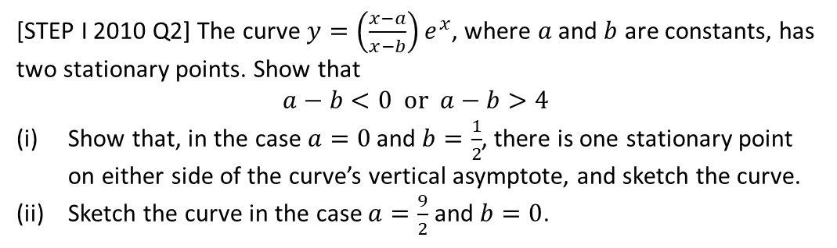
Exercise 9.5
Pearson Pure Year 2
Page 73
Extension
[STEP I 2010 Q2] The curve $y=\left(\frac{x−a}{x−b}\right)e^{x}$, where $a$ and $b$ are constants, has two stationary points. Show that
$$a−b<0 or a−b>4$$
Show that, in the case $a=0$ and $b=\frac{1}{2}$, there is one stationary point on either side of the curve’s vertical asymptote, and sketch the curve.
Sketch the curve in the case $a=\frac{9}{2}$ and $b=0$.

Slide 6
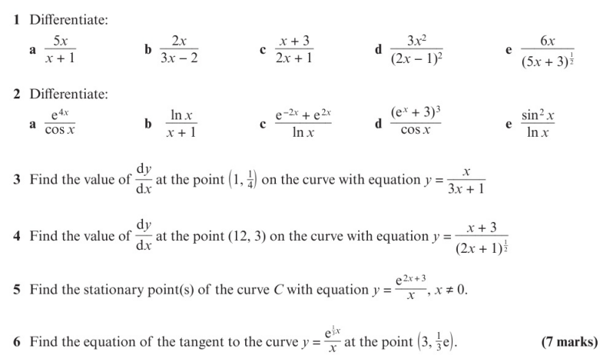
Homework Exercise

Slide 7
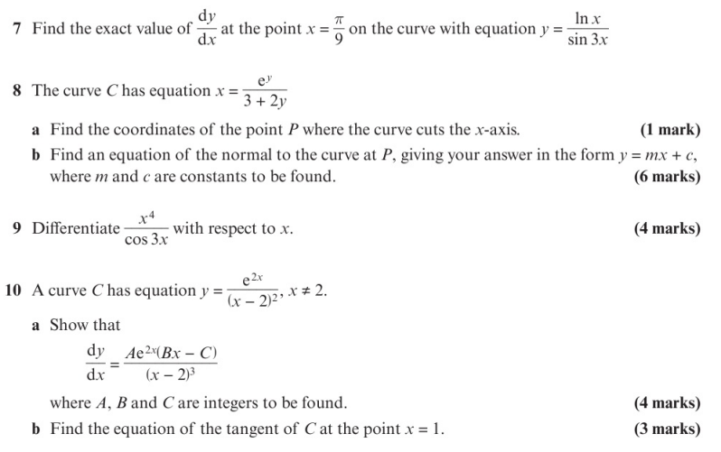
Homework Exercise

Slide 8
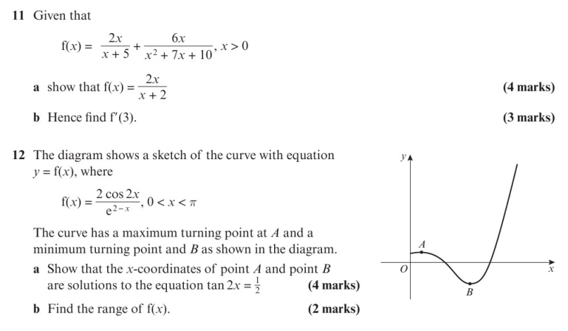
Homework Exercise

Slide 9
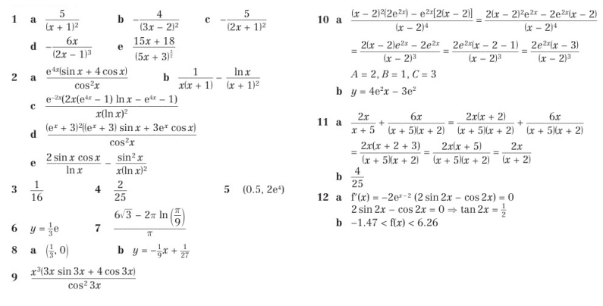
Homework Answers

