Slide 1
P2 Chapter 11: Integration Using Reverse Chain Rule

Slide 2

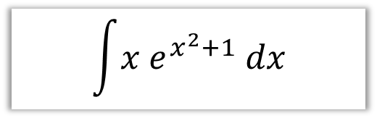
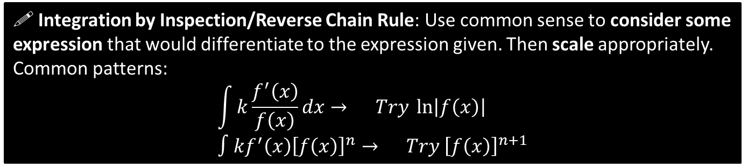

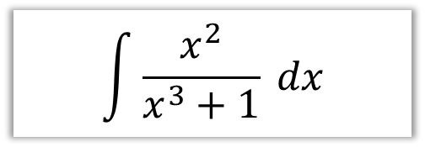
SKILL #4: Reverse Chain Rule
! Integration by Inspection/Reverse Chain Rule: Use common sense to consider some expression that would differentiate to the expression given. Then scale appropriately.
Common patterns:
$$\int{k\frac{f^{′}\left(x\right)}{f\left(x\right)}dx}→ Try \ln\left|f\left(x\right)\right| \\ ∫kf^{′}\left(x\right){\left[f\left(x\right)\right]}^{n}→ Try {\left[f\left(x\right)\right]}^{n+1}$$
In words: “If the bottom of a fraction differentiates to give the top (forgetting scaling), try ln of the bottom”.
$$\int{\frac{x^{2}}{x^{3}+1} dx}$$
$$\int{x e^{x^{2}+1} dx}$$
?
?
Consider $y=ln⁡|x^{3}+1|$
$$\frac{dy}{dx}=\frac{3x^{2}}{x^{3}+1}$$
Therefore:
$$\int{\frac{x^{2}}{x^{3}+1} dx} \\ =\frac{1}{3}ln\left|x^{3}+1\right|+C$$
Consider $y=e^{x^{2}+1}$
$$\frac{dy}{dx}=2x e^{x^{2}+1}$$
Therefore:
$$\int{x e^{x^{2}+1}dx}=\frac{1}{2}e^{x^{2}+1}+C$$

Slide 3
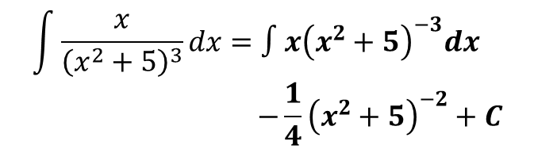
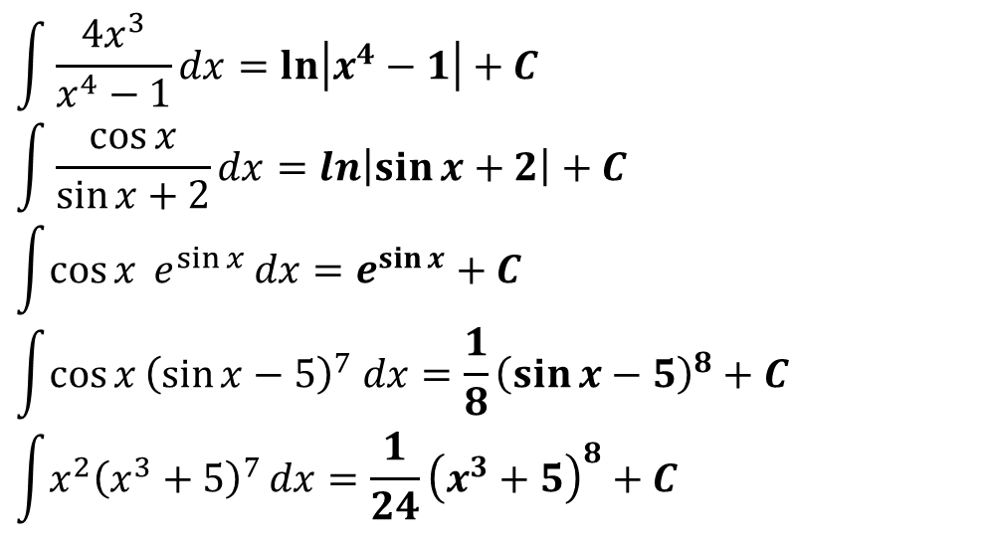
Quickfire
In your head !
$$\int{\frac{4x^{3}}{x^{4}−1}dx}=\ln\left|x^{4}−1\right|+C \\ \int{\frac{\cos{x}}{\sin{x}+2}dx}=\ln\left|\sin{x}+2\right|+C \\ \int{\cos{x} e^{\sin{x}}}dx=e^{\sin{x}}+C \\ \int{\cos{x}{\left(\sin{x}−5\right)}^{7} dx}=\frac{1}{8}{\left(\sin{x}−5\right)}^{8}+C \\ \int{x^{2}{\left(x^{3}+5\right)}^{7}}dx=\frac{1}{24}{\left(x^{3}+5\right)}^{8}+C$$
?
?
?
?
?
Not in your head !?
$$\int{\frac{x}{{\left(x^{2}+5\right)}^{3}}dx}=∫x{\left(x^{2}+5\right)}^{−3}dx \\ −\frac{1}{4}{\left(x^{2}+5\right)}^{−2}+C$$
?

Slide 4
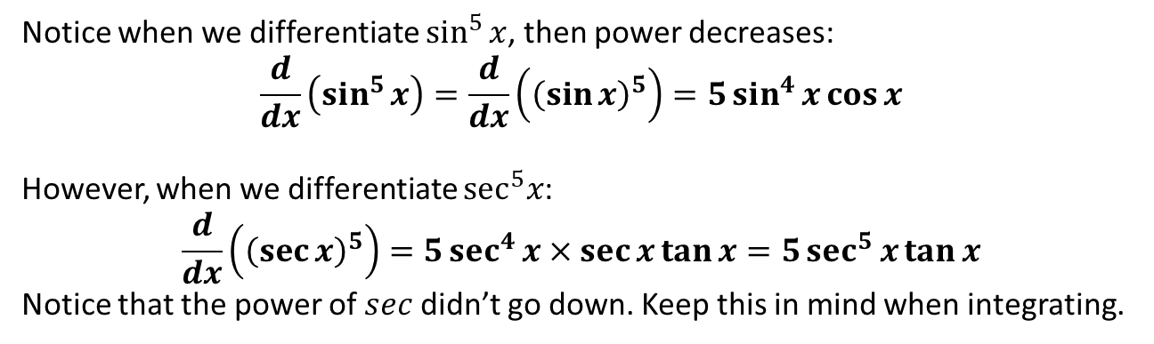

$\sin^{n}{x}\cos{x}$ vs $\sec^{n}{x}\tan{x}$
Notice when we differentiate $\sin^{5}{x}$, then power decreases:
$$\frac{d}{dx}\left(\sin^{5}{x}\right)=\frac{d}{dx}\left({\left(\sin{x}\right)}^{5}\right)=5\sin^{4}{x}\cos{x}$$
However, when we differentiate $\sec^{5}x$:
$$\frac{d}{dx}\left({\left(\sec{x}\right)}^{5}\right)=5\sec^{4}{x}×\sec{x}\tan{x}=5\sec^{5}{x}\tan{x}$$
Notice that the power of $sec$ didn’t go down. Keep this in mind when integrating.
?
?
$$\int{\sec^{4}{x}\tan{x}} dx$$
Consider $y=\sec^{4}{x}$
$$\frac{dy}{dx}=4\sec^{3}{x}×\sec{x}\tan{x}=4\sec^{4}{x}\tan{x}$$
$$∴ \int{\sec^{4}{x}\tan{x}} dx=\frac{1}{4}\sec^{4}{x}+C$$
?

Slide 5
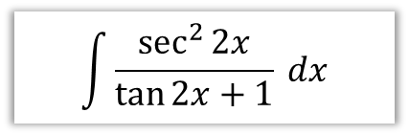


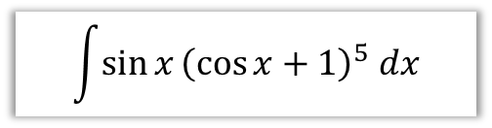

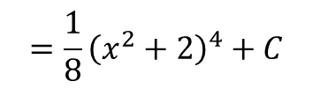

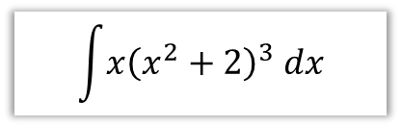

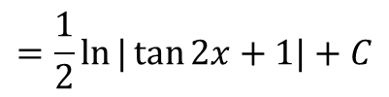
Test Your Understanding
$$\int{\sin{x}{\left(\cos{x}+1\right)}^{5} dx}$$
$$\int{\frac{cosec^{2}x}{{\left(2+\cot{x}\right)}^{3}}dx}$$
?
?
Consider $y={\left(\cos{x}+1\right)}^{6}$
$$\frac{dy}{dx}=−6\sin{x}{\left(\cos{x}+1\right)}^{5}$$
Therefore:
$$\int{\sin{x}{\left(\cos{x}+1\right)}^{5} dx} \\ =−\frac{1}{6}{\left(\cos{x}+1\right)}^{6}+C$$
Consider $y={\left(2+\cot{x}\right)}^{−2}$
$$\frac{dy}{dx}=−2{\left(2+\cot{x}\right)}^{−3}×−cosec^{2}x \\ =2cosec^{2}x{\left(2+\cot{x}\right)}^{−3}$$
Thus $\int{\frac{cosec^{2}x}{{\left(2+\cot{x}\right)}^{3}}dx}=\frac{1}{2}{\left(2+\cot{x}\right)}^{−2}+C$
$$\int{\frac{\sec^{2}{2x}}{\tan{2x}+1} dx}$$
$$\int{x{\left(x^{2}+2\right)}^{3} dx}$$
$$\int{5\tan{x}\sec^{2}{x} dx}$$
?
?
?
$$={\frac{1}{8}\left(x^{2}+2\right)}^{4}+C$$
Try $y=\sec^{2}{x}$
$$\frac{dy}{dx}=2\sec{x}×\sec{x}\tan{x} \\ =2\sec^{2}{x}\tan{x}$$
$$∴\int{5\tan{x}\sec^{2}{x} dx}=\frac{5}{2}\sec^{2}{x}+C$$
$$=\frac{1}{2}ln{|\tan{2x}+1|}+C$$

Slide 6
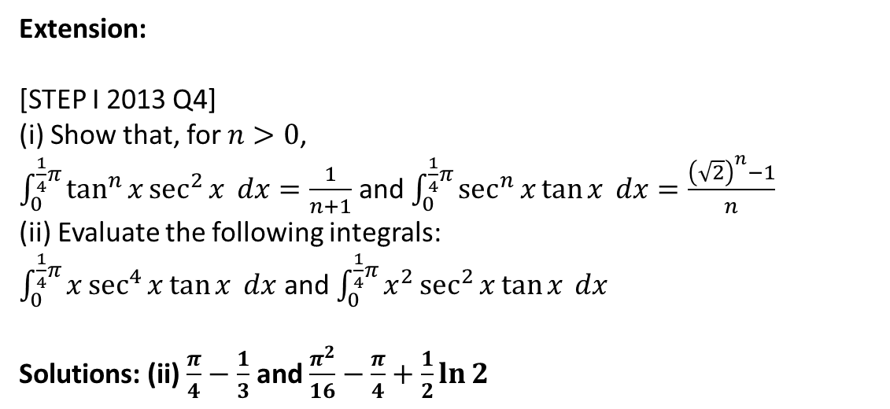
Exercise 11.4
Pearson Pure Year 2
Page 93
Extension:
[STEP I 2013 Q4]
(i) Show that, for $n>0$,
$\int_{0}^{\frac{1}{4}π}{\tan^{n}{x}\sec^{2}{x} dx}=\frac{1}{n+1}$ and $\int_{0}^{\frac{1}{4}π}{\sec^{n}{x}\tan{x}} dx=\frac{{\left(\sqrt{2}\right)}^{n}−1}{n}$
(ii) Evaluate the following integrals:
$\int_{0}^{\frac{1}{4}π}{x\sec^{4}{x}\tan{x} dx}$ and $\int_{0}^{\frac{1}{4}π}{x^{2}\sec^{2}{x}\tan{x}} dx$
Solutions: (ii) $\frac{π}{4}−\frac{1}{3}$ and $\frac{π^{2}}{16}−\frac{π}{4}+\frac{1}{2}\ln{2}$
?

Slide 7
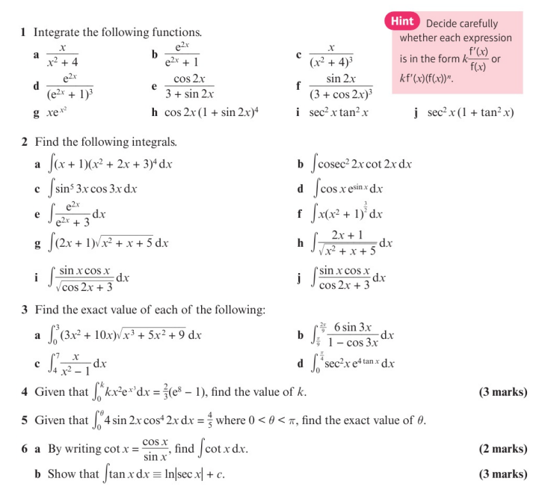
Homework Exercise

Slide 8
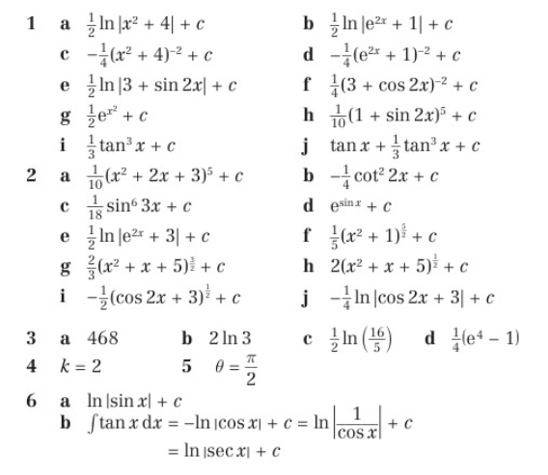
Homework Answers

