Slide 1
P1 Chapter 7: Algebraic Methods The Factor Theorem

Slide 2
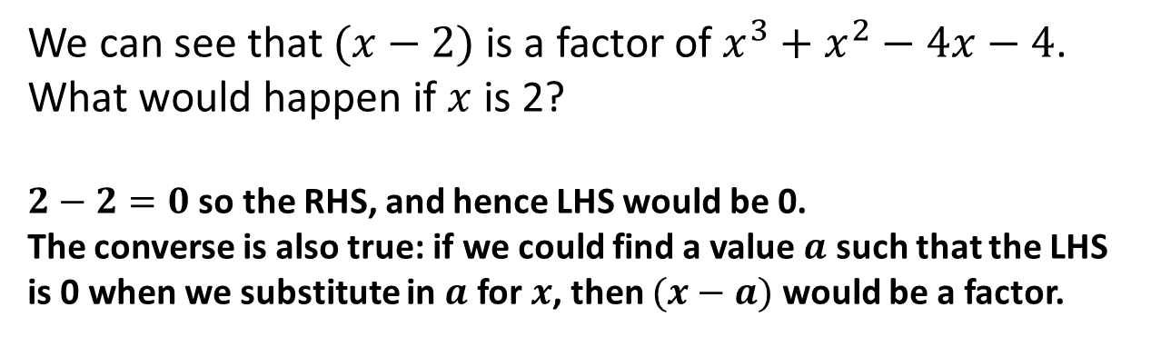
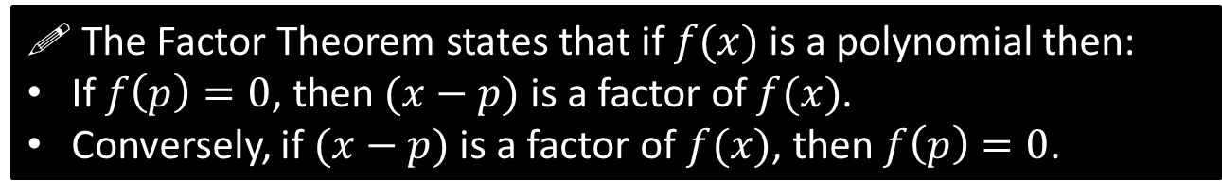
The Factor Theorem
$$x^{3}+x^{2}−4x−4=\left(x−2\right)\left(x^{2}+3x+2\right)$$
We can see that $(x−2)$ is a factor of $x^{3}+x^{2}−4x−4$.
What would happen if $x$ is 2?
$2−2=0$ so the RHS, and hence LHS would be 0.
The converse is also true: if we could find a value $a$ such that the LHS is 0 when we substitute in $a$ for $x$, then $(x−a)$ would be a factor.
?
! The Factor Theorem states that if $f(x)$ is a polynomial then:
If $f\left(p\right)=0$, then $(x−p)$ is a factor of $f(x)$.
Conversely, if $(x−p)$ is a factor of $f(x)$, then $f\left(p\right)=0$.

Slide 3

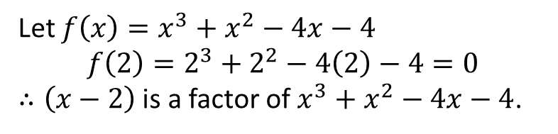

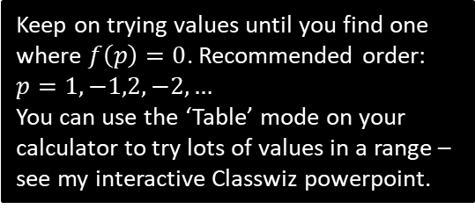
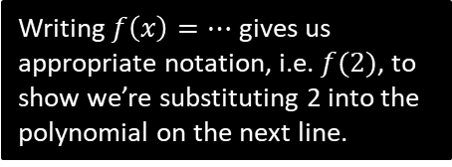
Examples (in textbook)
Show that $(x−2)$ is a factor of $x^{3}+x^{2}−4x−4$.
?
Let $f\left(x\right)=x^{3}+x^{2}−4x−4$
$$f\left(2\right)=2^{3}+2^{2}−4\left(2\right)−4=0$$
$∴\left(x−2\right)$ is a factor of $x^{3}+x^{2}−4x−4$.
Writing $f\left(x\right)=…$ gives us appropriate notation, i.e. $f(2)$, to show we’re substituting 2 into the polynomial on the next line.
Fully factorise $2x^{3}+x^{2}−18x−9$.
?
Keep on trying values until you find one where $f\left(p\right)=0$. Recommended order: $p=1,−1,2,−2,…$
You can use the ‘Table’ mode on your calculator to try lots of values in a range – see my interactive Classwiz powerpoint.
Let $f\left(x\right)=2x^{3}+x^{2}−18x−9$
$$f\left(1\right)=2{\left(1\right)}^{3}+1^{2}−18\left(1\right)−9=−24 \\ f\left(−1\right)=2{\left(−1\right)}^{3}+{\left(−1\right)}^{2}+18\left(−1\right)−9=24 \\ …$$ $f\left(3\right)=0 ∴ (x−3)$ is a factor.
Using algebraic division we find that:
$$2x^{3}+x^{2}−18x−9=\left(x−3\right)\left(2x^{2}+7x+3\right) \\ =(x−3)(2x+1)(x+3)$$
Fro Tip: If you consider that:
$$2x^{3}+x^{2}−18x−9=\left(x−3\right)\left(ax^{2}+bx+c\right)$$
it’s clear, by considering the expansion of the RHS, that $a=2$ and $c=3$. We can determine $b$ by considering for example the $x$ terms in the expansion. This is much faster than algebraic division.

Slide 4



Using Factor Theorem to find unknown coefficients
Given that $2x+1$ is a factor of $6x^{3}+ax^{2}+1$, determine the value of $a$.
?
Fro Side Notes:
Choose the value of $x$ to substitute that makes the divisor/factor 0.
So if $2x+1=0$, then $x=−\frac{1}{2}$, thus find $f\left(−\frac{1}{2}\right)$.
This even works when you’re dividing by non-linear factors, e.g. $\frac{1}{x}+1$, but at A Level they will always be of the form $ax+b$.
$$f\left(x\right)=6x^{3}+ax^{2}+1 \\ f\left(−\frac{1}{2}\right)=6{\left(−\frac{1}{2}\right)}^{3}+a{\left(−\frac{1}{2}\right)}^{2}+1 \\ =−\frac{3}{4}+\frac{1}{4}a+1=0 \\ \frac{1}{4}a=−\frac{1}{4} \\ a=−1$$

Slide 5
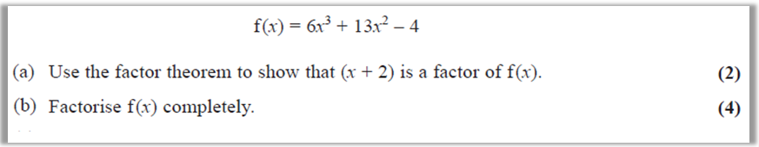
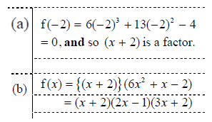
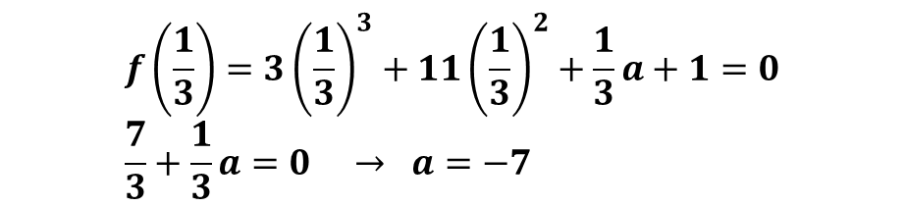

Test Your Understanding
Edexcel C2 May 2016 Q2
?
Given that $3x−1$ is a factor of $3x^{3}+11x^{2}+ax+1$, determine the value of $a$.
$$f\left(\frac{1}{3}\right)=3{\left(\frac{1}{3}\right)}^{3}+11{\left(\frac{1}{3}\right)}^{2}+\frac{1}{3}a+1=0 \\ \frac{7}{3}+\frac{1}{3}a=0 → a=−7$$
?

Slide 6
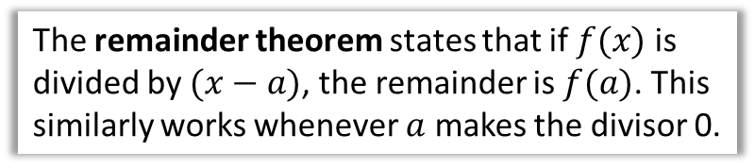
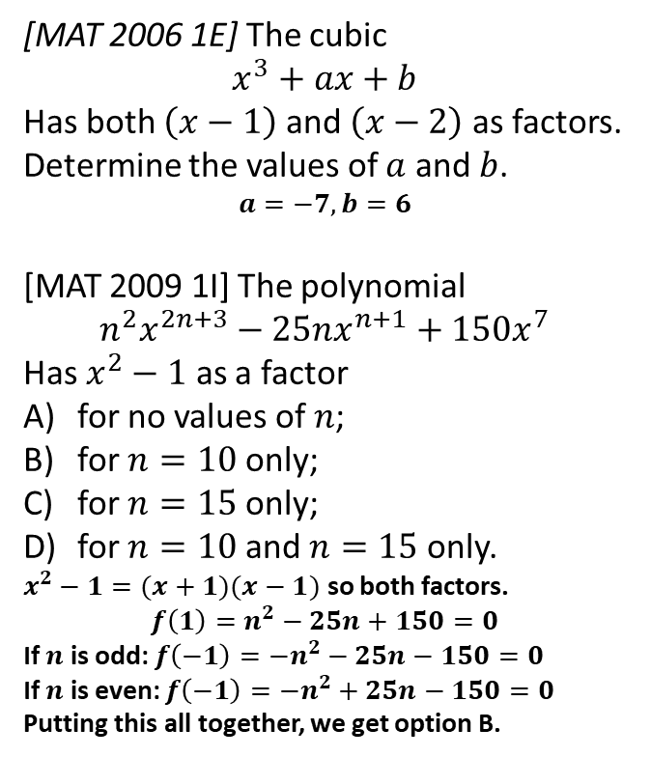

Exercise 7.1
Pearson Pure Mathematics Year 1/AS
Pages 56
Extension
The remainder theorem states that if $f(x)$ is divided by $(x−a)$, the remainder is $f(a)$. This similarly works whenever $a$ makes the divisor 0.
1
[MAT 2006 1E] The cubic
$$x^{3}+ax+b$$
Has both $\left(x−1\right)$ and $\left(x−2\right)$ as factors. Determine the values of $a$ and $b$.
$$a=−7, b=6$$
[MAT 2009 1I] The polynomial
$$n^{2}x^{2n+3}−25nx^{n+1}+150x^{7}$$
Has $x^{2}−1$ as a factor
for no values of $n$;
for $n=10$ only;
for $n=15$ only;
for $n=10$ and $n=15$ only.
$x^{2}−1=(x+1)(x−1)$ so both factors.
$$f\left(1\right)=n^{2}−25n+150=0$$
If $n$ is odd: $f\left(−1\right)=−n^{2}−25n−150=0$
If $n$ is even: $f\left(−1\right)=−n^{2}+25n−150=0$
Putting this all together, we get option B.
3
[MAT 2013 1G] Let $n≥2$ be an integer and $p_{n}\left(x\right)$ be the polynomial
$$p_{n}\left(x\right)=\left(x−1\right)+\left(x−2\right)+…+(x−n)$$
What is the remainder, in terms of $n$, when $p_{n}\left(x\right)$ is divided by $p_{n−1}\left(x\right)$?
$$p_{n}\left(x\right)=nx−\frac{1}{2}n\left(n+1\right) \\ p_{n−1}\left(x\right)=\left(n−1\right)x+\frac{1}{2}n\left(n−1\right)$$
We need to make the divisor 0:
$$\left(n−1\right)\left(x+\frac{1}{2}n\right)=0 → x=−\frac{n}{2}$$ Remainder:
$$p_{n}\left(−\frac{n}{2}\right)=n\left(−\frac{n}{2}\right)−\frac{1}{2}n\left(n+1\right)=−\frac{1}{2}n$$
?
2
?
?

Slide 7
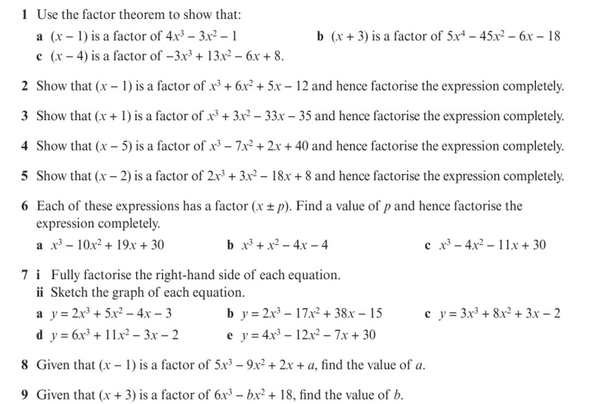
Homework Exercise

Slide 8
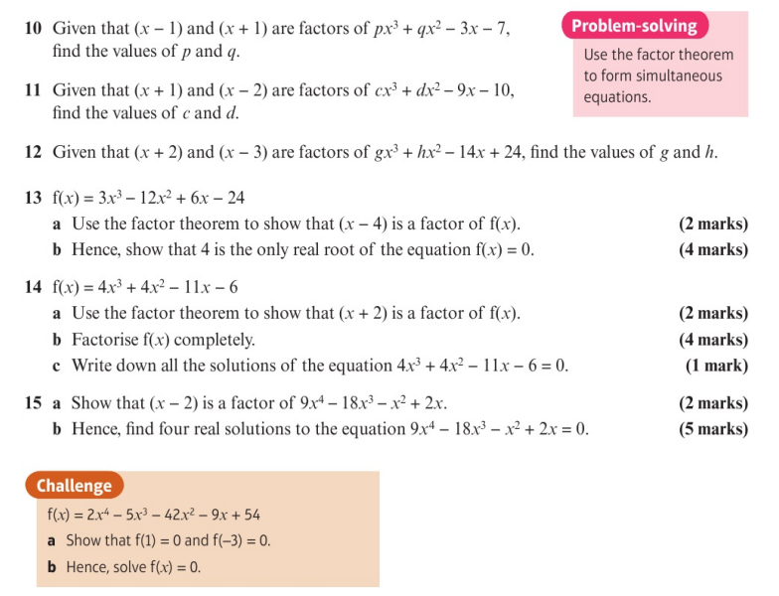
Homework Exercise

Slide 9
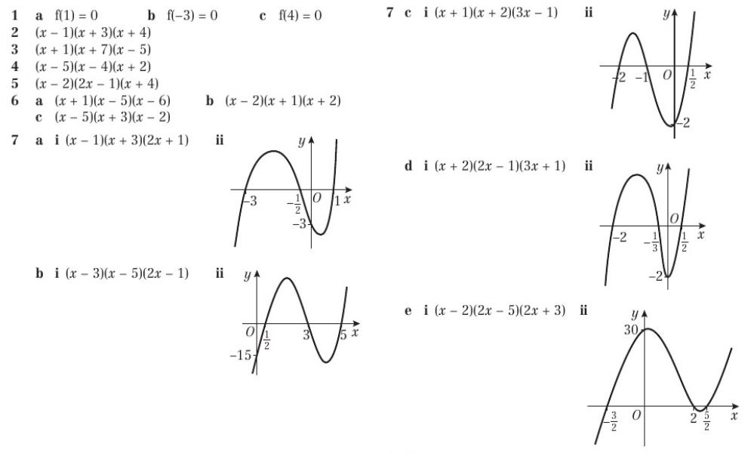
Homework Answers

Slide 10
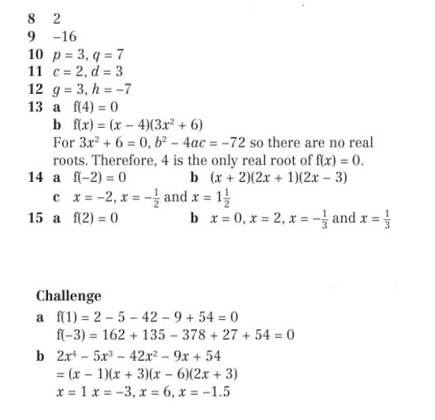
Homework Answers

