Slide 1
P2 Chapter 6: CoAngle Trigonometry
CoAngle Functions

Slide 2
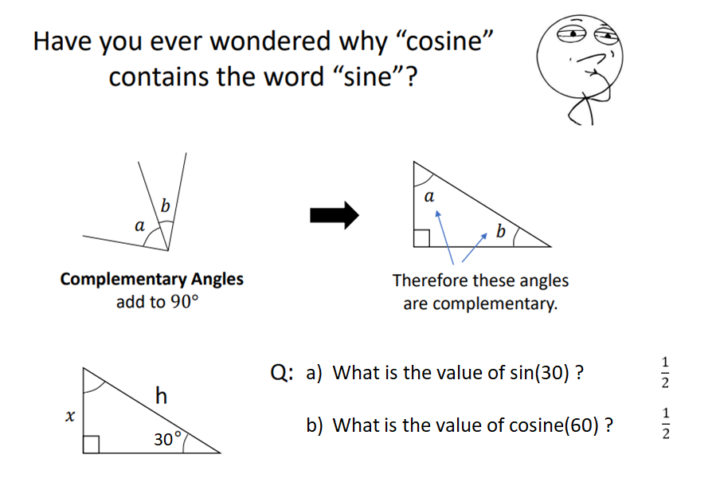
Co-angles
?
?

Slide 3







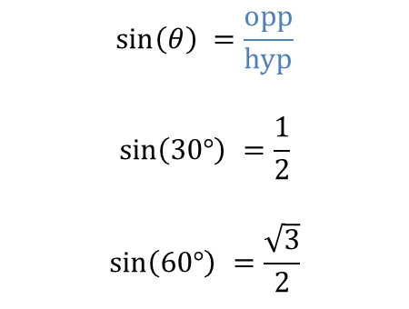
Co-Sine
cosine $\left(θ\right)$ = sin$\left(90−θ\right)$.
(co-angle)
$$\sin\left(θ\right) =\frac{opp}{hyp}$$
$$\sin\left(30°\right) =\frac{1}{2}$$
$$\sin\left(60°\right) =\frac{\sqrt{3}}{2}$$
$$\operatorname{cosine}\left(30°\right) = \sin\left(60°\right)=\frac{\sqrt{3}}{2}$$
$$\operatorname{cosine}\left(60°\right)= \sin\left(30°\right)= \frac{1}{2}$$
?
$$30°$$
$$2$$
$$\sqrt{3}$$
?
$$60°$$
$$1$$

Slide 4




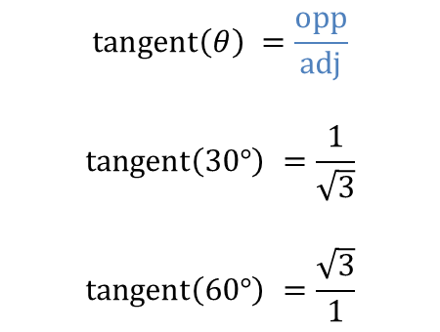

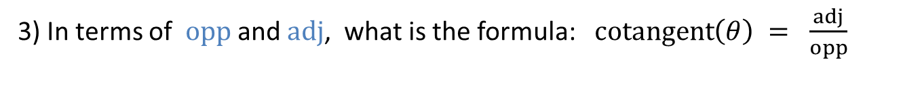

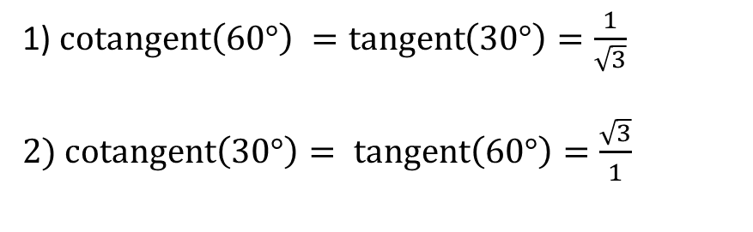
Co-Tangent
cotangent$\left(θ\right)$ = tangent $\left(90−θ\right)$.
(co-angle)
$$\operatorname{tangent}\left(θ\right) =\frac{opp}{adj}$$
$$\operatorname{tangent}\left(30°\right) =\frac{1}{\sqrt{3}}$$
$$\operatorname{tangent}\left(60°\right) =\frac{\sqrt{3}}{1}$$
$$30°$$
$$2$$
$$\sqrt{3}$$
?
1) $\operatorname{cotangent}\left(60°\right) =\operatorname{tangent}\left(30°\right)=\frac{1}{\sqrt{3}}$
2) $\operatorname{cotangent}\left(30°\right)= \operatorname{tangent}\left(60°\right)=\frac{\sqrt{3}}{1}$
$$60°$$
?
$$1$$
?
3) In terms of $opp$ and $adj$, what is the formula: $\operatorname{cotangent}\left(θ\right) = \frac{adj}{opp}$
?
4) What is the formula relating cotangent to tangent: $\cot\left(x\right)=\frac{1}{\tan\left(x\right)}$

Slide 5










Secant and The Unit Circle
Draw a tangent on the unit circle and extend the radius out to the tangent.
This extended line is known as the secant and makes the hypotenuse of a larger similar triangle with the tangent as the opposite length.
$$y$$
$$secant$$
$$1$$
$$y$$
$$tangent$$
$$θ$$
$$x$$
$$x$$
$$θ$$
$$radius=1$$
?
Write $\cos\left(θ\right)$with the secant as a hypotenuse: $\cos\left(θ\right)=\frac{1}{secant}$
2) Make $\sec\left(θ\right)≡secant$ the subject of the formula: $\sec\left(θ\right)=\frac{1}{cos}$
?

Slide 6
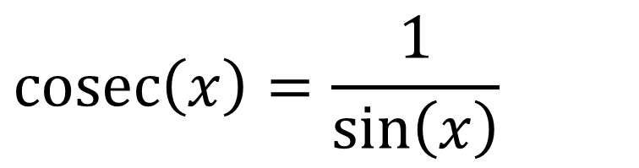
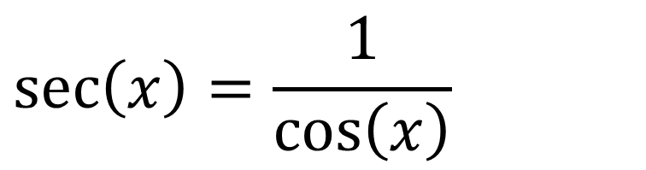
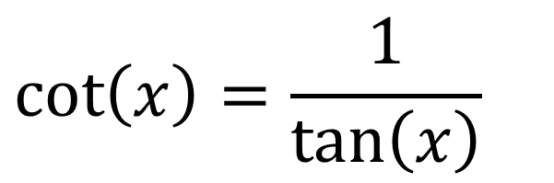
Reciprocal Trigonometric Functions
!
Summary to learn:
$$\sec\left(x\right)=\frac{1}{\cos\left(x\right)}$$
Short for “secant”
Pronounced “sehk” in shortened form or “sea-Kant” in full.
$$\operatorname{cosec}\left(x\right)=\frac{1}{\sin\left(x\right)}$$
There is also a “cosec” to go with sine
Short for “cosecant”
$$\cot\left(x\right)=\frac{1}{\tan\left(x\right)}$$
Short for “cotangent”
In shortened form, rhymes with “pot”.

Slide 7
Calculations
Calculate these exact values:
?
$$\cot{\frac{π}{4}}=\frac{1}{\tan{\frac{π}{4}}}=\frac{1}{1}=1 \\ \sec{\frac{π}{4}=\frac{1}{\cos{\frac{π}{4}}}=\frac{1}{\frac{1}{\sqrt{2}}}=\sqrt{2}}$$
$$\operatorname{cosec}{\frac{π}{3}}=\frac{1}{\sin{\frac{π}{3}}}=\frac{2}{\sqrt{3}}$$
$$\cot{\frac{π}{6}}=\sqrt{3}$$
$$\operatorname{cosec}{\frac{5π}{6}}=\operatorname{cosec}{\frac{π}{6}}=2$$
$$\cot{\frac{π}{3}}=\sqrt{3}$$
$$\sec{\frac{π}{6}}=\frac{2}{\sqrt{3}}$$
$$\operatorname{cosec}{\frac{π}{2}}=1$$
$$\sec{\frac{5π}{3}}=sec\frac{π}{3}=2$$
?
?
?
?
?
?
?
?

Slide 8
Exercise 6.1
Pearson Pure Mathematics Year 2/AS
Pages 1

Slide 9
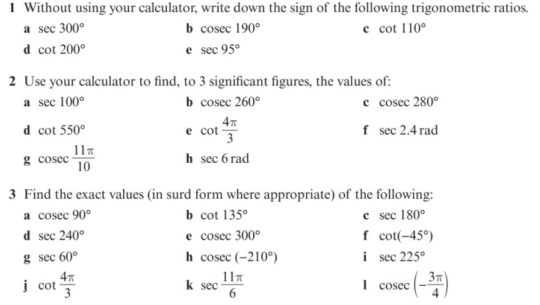
Homework Exercise

Slide 10
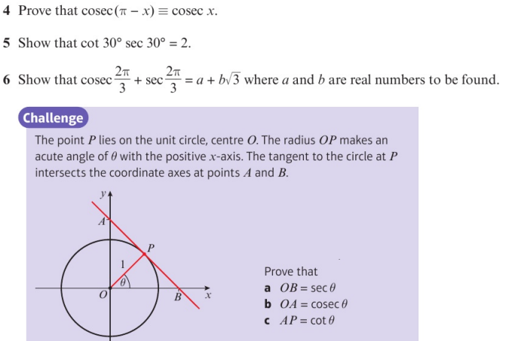
Homework Exercise

Slide 11
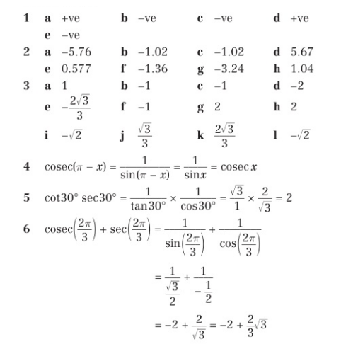
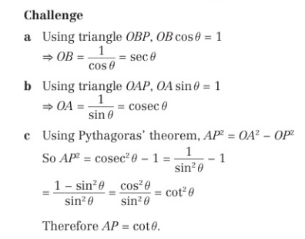
Homework Answers

