Slide 1
P2 Chapter 11: Integration Reverse Product Rule (aka By Parts)

Slide 2



SKILL #6: Integration by Parts
$$\int{x\cos{x} dx}=?$$
Just as the Product Rule was used to differentiate the product of two expressions, we can often use ‘Integration by Parts’ to integrate a product.
! To integrate by parts:
$$\int{u\frac{dv}{dx}}dx=uv−\int{v\frac{du}{dx} dx}$$
The Product Rule:
$$\frac{d}{dx}\left(uv\right)=v\frac{du}{dx}+u\frac{dv}{dx}$$
On the right-hand-side, both $v\frac{du}{dx}$ and $u\frac{dv}{dx}$ are the product of two expressions. So if we made either the subject, we could use $u\frac{dv}{dx}$ say to represent $x\cos{x}$ in the example.
Rearranging:
$$u\frac{dv}{dx}=\frac{d}{dx}\left(uv\right)−v\frac{du}{dx}$$
Integrating both sides with respect to $x$, we get the desired formula.
Proof ?
(not needed for exam)

Slide 3

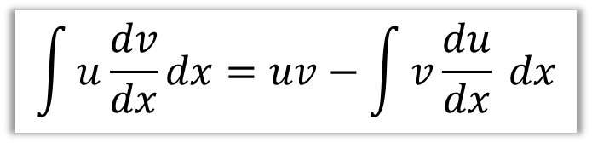
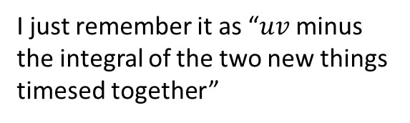
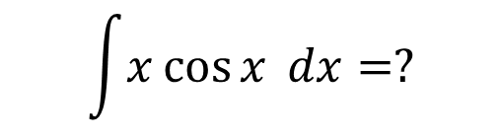
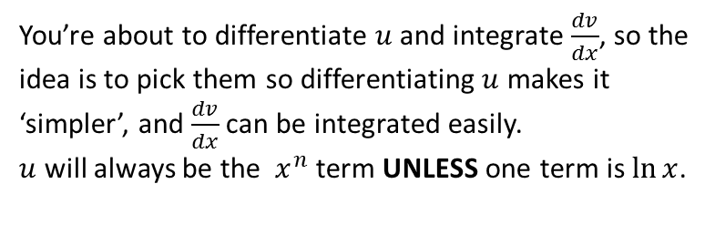
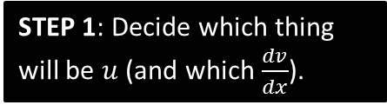

SKILL #6: Integration by Parts
$$\int{x\cos{x} dx}=?$$
$$\int{u\frac{dv}{dx}}dx=uv−\int{v\frac{du}{dx} dx}$$
?
$$u=x \frac{dv}{dx}=\cos{x}$$
$$\frac{du}{dx}=1 v=\sin{x}$$
$$\int{x\cos{x} dx}=x\sin{x}−\int{1\sin{x} dx} \\ =x\sin{x}+\cos{x}+C$$
STEP 1: Decide which thing will be $u$ (and which $\frac{dv}{dx}$).
You’re about to differentiate $u$ and integrate $\frac{dv}{dx}$, so the idea is to pick them so differentiating $u$ makes it ‘simpler’, and $\frac{dv}{dx}$ can be integrated easily.
$u$ will always be the $x^{n}$ term UNLESS one term is $\ln{x}$.
?
STEP 2: Find $\frac{du}{dx}$ and $v$.
?
STEP 3: Use the formula.
I just remember it as “$uv$ minus the integral of the two new things timesed together”

Slide 4

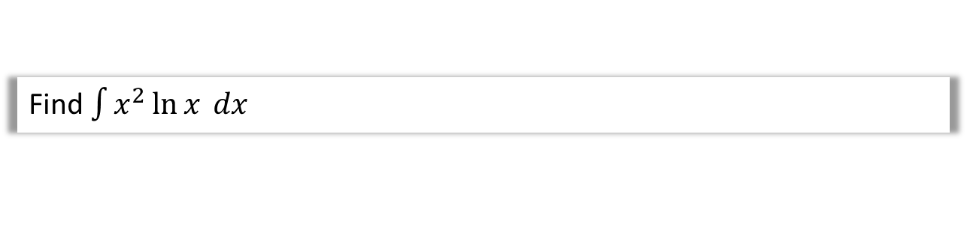
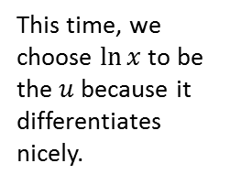

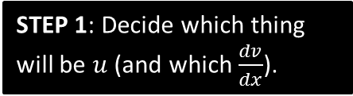
Another Example
Q
Find $\int{x^{2}\ln{x} dx}$
?
$$u=\ln{x} \frac{dv}{dx}=x^{2}$$
$$\frac{du}{dx}=\frac{1}{x} v=\frac{1}{3}x^{3}$$
$$\int{x^{2}\ln{x} dx}=\frac{1}{3}x^{3}\ln{x}−\int{\frac{1}{3}x^{2} dx} \\ =\frac{1}{3}x^{3}\ln{x}−\frac{1}{9}x^{3}+C$$
STEP 1: Decide which thing will be $u$ (and which $\frac{dv}{dx}$).
This time, we choose $\ln{x}$ to be the $u$ because it differentiates nicely.
STEP 2: Find $\frac{du}{dx}$ and $v$.
STEP 3: Use the formula.

Slide 5



IBP twice! 😐
Q
Find $\int{x^{2}e^{x} dx}$
?
$$u=x^{2} \frac{dv}{dx}=e^{x} \\ \frac{du}{dx}=2x v=e^{x} \\ \int{x^{2}e^{x} dx}=x^{2}e^{x}−\int{2xe^{x} dx}$$
We have to apply IBP again!
$$u=2x \frac{dv}{dx}=e^{x} \\ \frac{du}{dx}=2 v=e^{x}$$
$$\int{2xe^{x} dx}=2xe^{x}−\int{2e^{x}}dx \\ =2xe^{x}−2e^{x}$$
Therefore
$$\int{x^{2}e^{x} dx}=x^{2}e^{x}−\left(2xe^{x}−2xe^{x}\right)+C \\ =x^{2}e^{x}−2xe^{x}+2e^{x}+C$$
Fro Tip: I tend to write out my working for any second integral completely separately, and then put the result back into the original integral later.

Slide 6

Test Your Understanding
Q
Find $\int{x^{2}\sin{x} dx}$
?
$$=2x\sin{x}−x^{2}\cos{x}+2\cos{x}+C$$

Slide 7
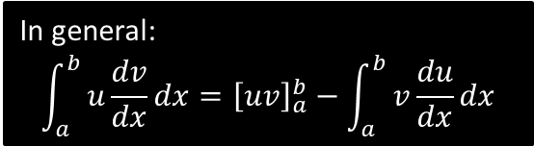


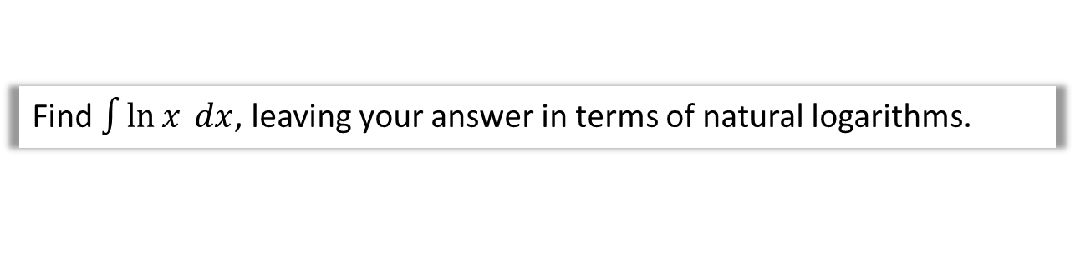
Integrating $\ln{x}$ and definite integration
Q
Find $\int{\ln{x} dx}$, leaving your answer in terms of natural logarithms.
?
$$u=\ln{x} \frac{dv}{dx}=1 \\ \frac{du}{dx}=\frac{1}{x} v=x \\ \int{\ln{x} dx}=x\ln{x}−\int{1 dx} \\ =x\ln{x}−x+C$$
Q
Find $\int_{1}^{2}{\ln{x}dx}$, leaving your answer in terms of natural logarithms.
?
$$\int_{1}^{2}{\ln{x}dx}={\left[x\ln{x}−x\right]}_{1}^{2}=2\ln{2}−1$$
If we were doing it from scratch:
$$u=\ln{x} \frac{dv}{dx}=1 \\ \frac{du}{dx}=\frac{1}{x} v=x \\ \int_{1}^{2}{\ln{x}dx}={\left[x\ln{x}\right]}_{1}^{2}−\int_{1}^{2}{1 dx} \\ =2\ln{2 }−1\ln{1}−{\left[x\right]}_{1}^{2} \\ =2\ln{2 −(2−1)}=2\ln{2}−1$$
In general:
$$\int_{a}^{b}{u\frac{dv}{dx}dx}={\left[uv\right]}_{a}^{b}−\int_{a}^{b}{v\frac{du}{dx}dx}$$

Slide 8

Test Your Understanding
Q
Find $\int_{0}^{\frac{π}{2}}{x\sin{x} dx}$
?
$$u=x \frac{dv}{dx}=\sin{x} \\ \frac{du}{dx}=1 v=−\cos{x} \\ \int{x\sin{x} dx}=−x\cos{x}−\int{−\cos{x} dx} \\ =−x\cos{x}+\int{\cos{x} dx} \\ =−x\cos{x}+\sin{x} dx \\ ∴ \int_{0}^{\frac{π}{2}}{x\sin{x} dx}={\left[−x\cos{x}+\sin{x}\right]}_{0}^{\frac{π}{2}} \\ =\left(−\frac{π}{2}\cos{\frac{π}{2}}+\sin{\frac{π}{2}}\right)−\left(0+\sin{0}\right) \\ =1$$

Slide 9
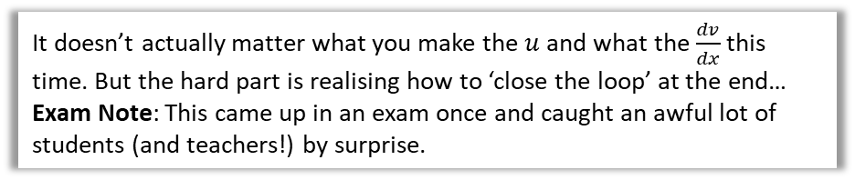
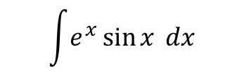
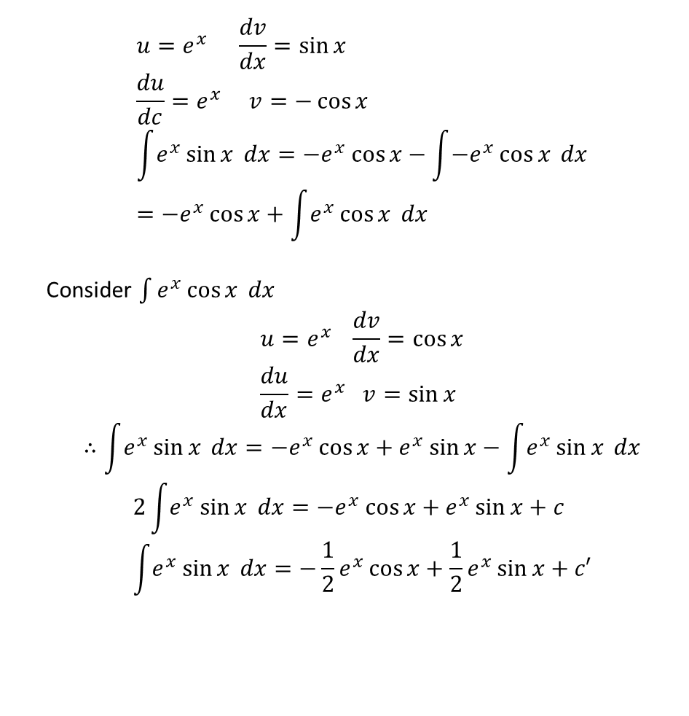
One final unusual one…
It doesn’t actually matter what you make the $u$ and what the $\frac{dv}{dx}$ this time. But the hard part is realising how to ‘close the loop’ at the end…
Exam Note: This came up in an exam once and caught an awful lot of students (and teachers!) by surprise.
$$\int{e^{x}\sin{x} dx}$$
$$u=e^{x} \frac{dv}{dx}=\sin{x} \\ \frac{du}{dc}=e^{x} v=−\cos{x} \\ \int{e^{x}\sin{x} dx}=−e^{x}\cos{x}−\int{−e^{x}\cos{x} dx} \\ =−e^{x}\cos{x}+\int{e^{x}\cos{x} dx}$$
Consider $\int{e^{x}\cos{x} dx}$
$$u=e^{x} \frac{dv}{dx}=\cos{x} \\ \frac{du}{dx}=e^{x} v=\sin{x}$$
$$∴\int{e^{x}\sin{x} dx}=−e^{x}\cos{x}+e^{x}\sin{x}−\int{e^{x}\sin{x} dx}$$
$$2\int{e^{x}}\sin{x} dx=−e^{x}\cos{x}+e^{x}\sin{x}+c \\ \int{e^{x}}\sin{x} dx=−\frac{1}{2}e^{x}\cos{x}+\frac{1}{2}e^{x}\sin{x}+c′$$
?
This is the surprising bit! Because we ended up with the original expression, we can ‘collect’ these integrals together!

Slide 10
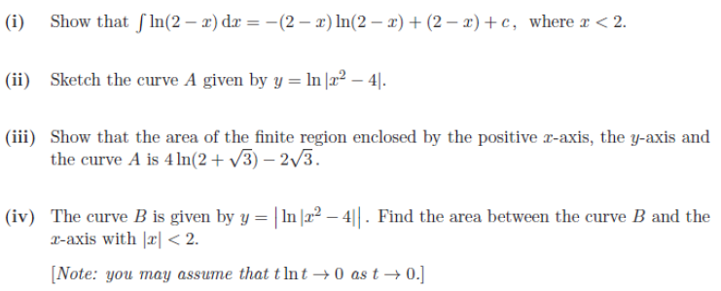
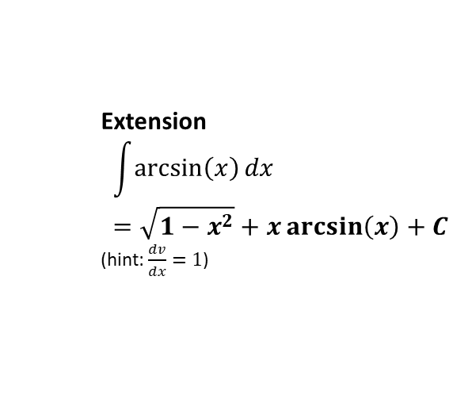
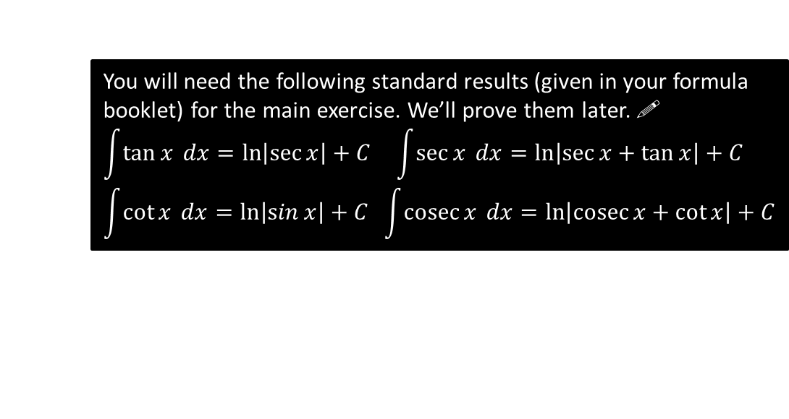
Exercise 11.6
Pearson Pure Year 2
Page 94
Extension
$$\int{\arcsin\left(x\right)dx}=\sqrt{1−x^{2}}+x\arcsin\left(x\right)+C$$
(hint: $\frac{dv}{dx}=1$)
[STEP I 2014 Q2]
?
You will need the following standard results (given in your formula booklet) for the main exercise. We’ll prove them later. !
$$\int{\tan{x} dx}=\ln\left|\sec{x}\right|+C \int{\sec{x} dx}=\ln\left|\sec{x+\tan{x}}\right|+C \\ \int{\cot{x} dx}=\ln\left|\sin{x}\right|+C \int{\operatorname{cosec}{x} dx}=\ln\left|\operatorname{cosec}{x+\cot{x}}\right|+C$$

Slide 11
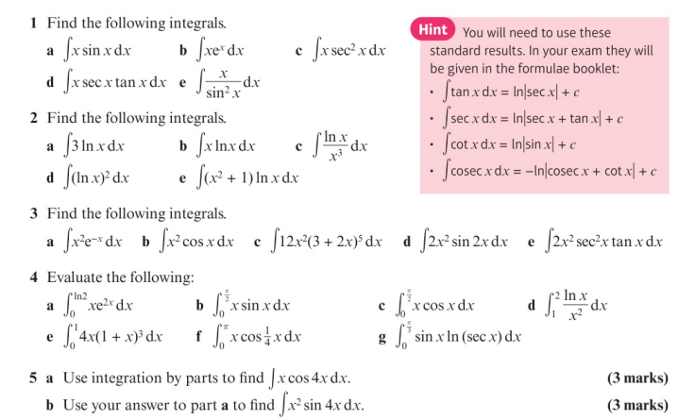
Homework Exercise

Slide 12
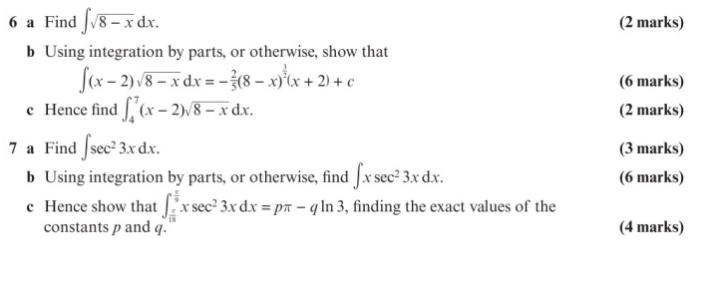
Homework Exercise

Slide 13
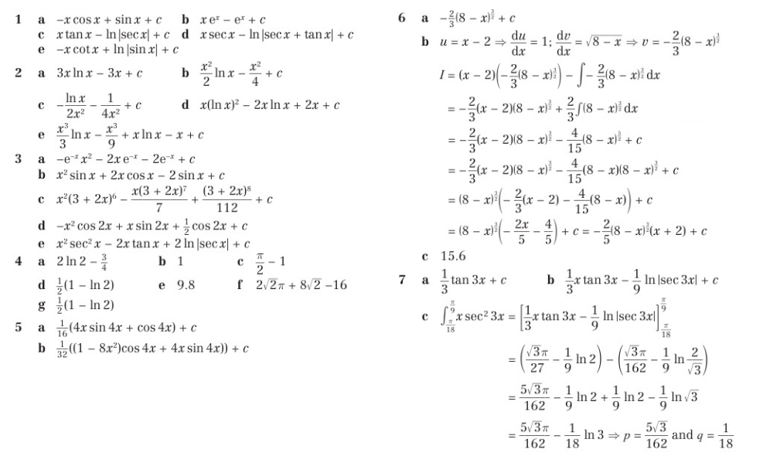
Homework Answers

