Slide 1
M2 Chapter 6: Projectiles Horizontal Vertical Components

Slide 2
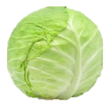





Components of velocity
Just as we split forces into its horizontal and vertical components, in order to consider forces in the horizontal and vertical directions respectively, we can do exactly the same with velocity!
When the object is at its highest point:
The vertical velocity is 0.
?
We know that the scalar form of velocity is speed, and thus we just find the magnitude of the velocity vector:
?
$20$ ms⁻¹
$20\sin{70°}$ ms⁻¹
$$70°$$
?
$$\left(\begin{matrix}12 \\ 5\end{matrix}\right) ms^{−1} \\ ⇒\sqrt{{12}^{2}+5^{2}} \\ =13 ms^{−1}$$
$20\cos{70°}$ ms⁻¹
?
Click for Tomanimation

Slide 3


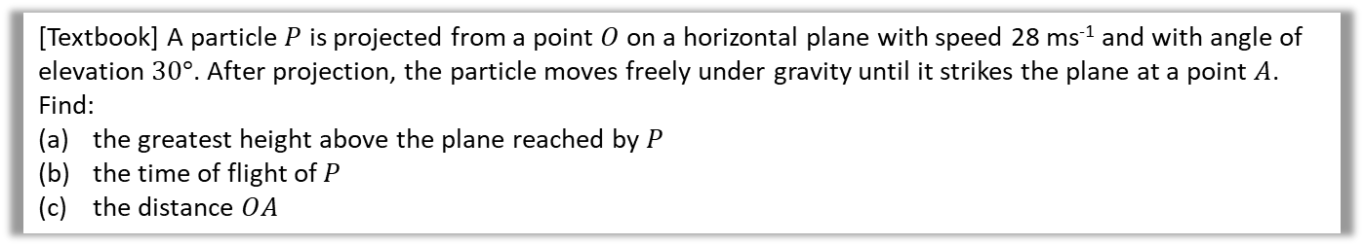



The Standard Example
[Textbook] A particle $P$ is projected from a point $O$ on a horizontal plane with speed 28 ms⁻¹ and with angle of elevation $30°$. After projection, the particle moves freely under gravity until it strikes the plane at a point $A$. Find:
the greatest height above the plane reached by $P$
the time of flight of $P$
the distance $OA$
a
?
$$R\left(↑\right): s=?, u=28\sin{30°},v=0,a=−9.8, t= \\ v^{2}=u^{2}+2as \\ 0={14}^{2}+2×\left(−9.8\right)×s \\ s=10$$
Greatest height is 10 m.
$$R\left(↑\right): s=0, u=28\sin{30°},v= ,a=−9.8, t=? \\ s=ut+\frac{1}{2}at^{2} \\ 0=14t−4.9t^{2}=t\left(14−4.9t\right) \\ t=0 or\frac{14}{4.9}=2.857…$$
Time of flight is 2.9 s (2sf)
$28\cos{30°}×2.857…=69.282…=69$ m (2sf)
$28$ ms⁻¹
$28\sin{30°}$ ms⁻¹
$$30°$$
$28\cos{30°}$ ms⁻¹
b
?
Vertically the particle has returned to its original position, so displacement is 0.
c
?

Slide 4
Exercise 6.2
Pearson Stats/Mechanics Year 2
Pages 50-51

Slide 5
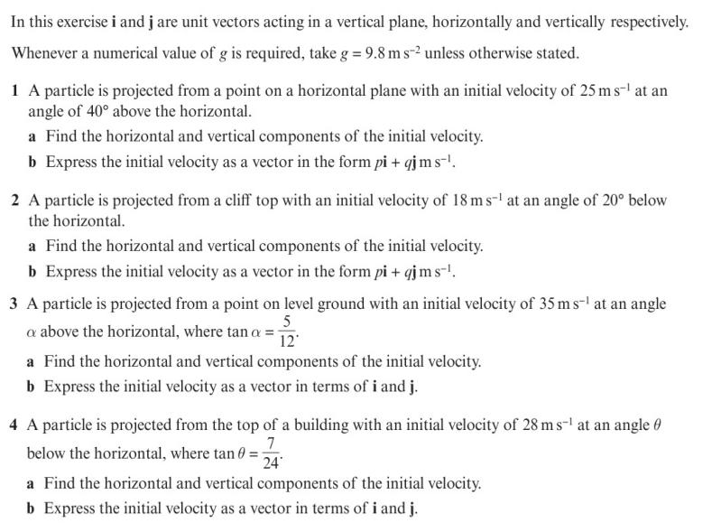
Homework Exercise

Slide 6
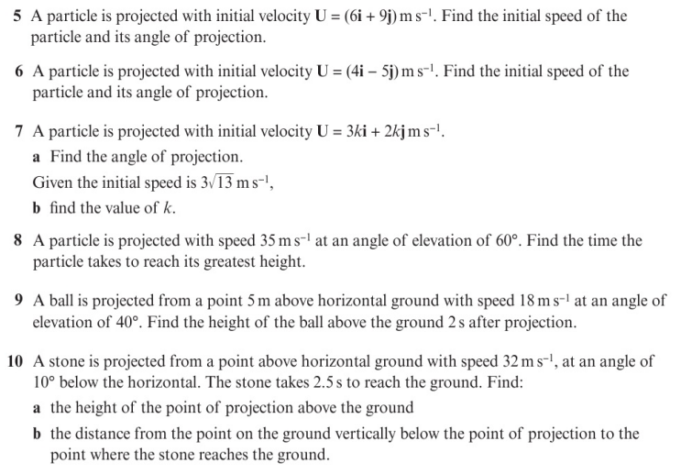
Homework Exercise

Slide 7
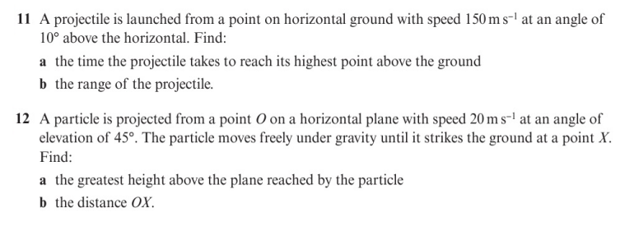
Homework Exercise

Slide 8
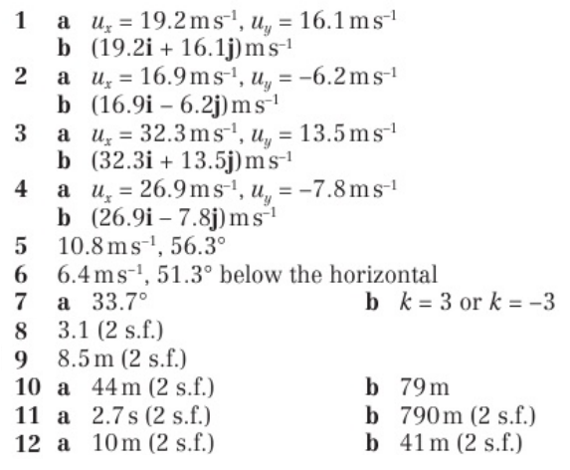
Homework Answers

