Slide 1
P1 Chapter 12: Differentiation
Chord Approximations

Slide 2
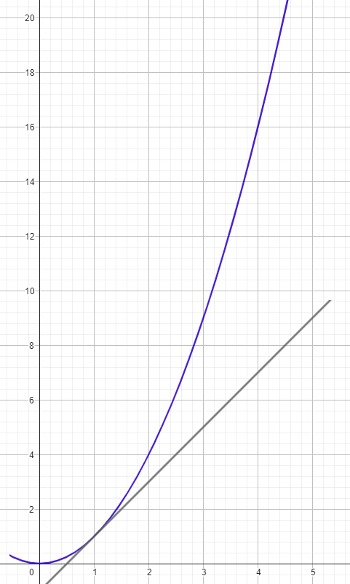
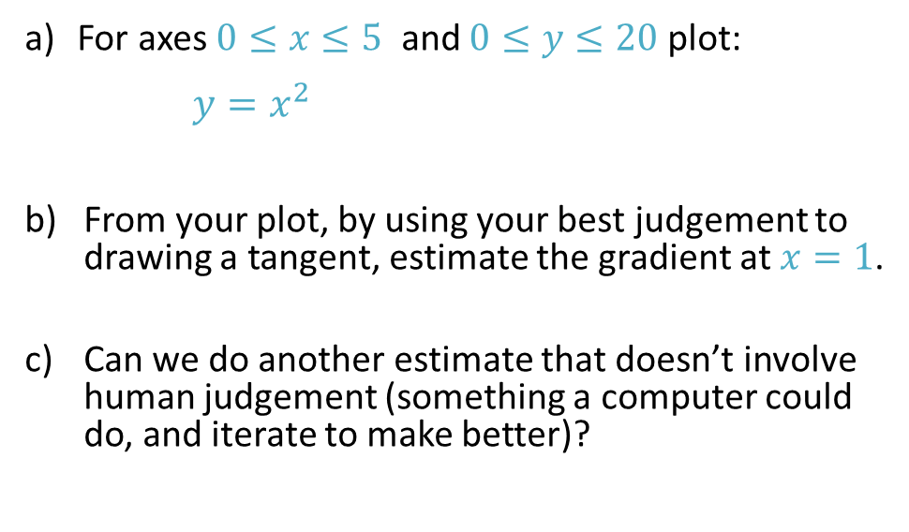
Gradients of Curved Graphs
For axes $0≤x≤5$ and $0≤y≤20$plot:
      $y=x^{2}$
From your plot, by using your best judgement to drawing a tangent, estimate the gradient at $x=1$.
Can we do another estimate that doesn’t involve human judgement (something a computer could do, and iterate to make better)?
?

Slide 3
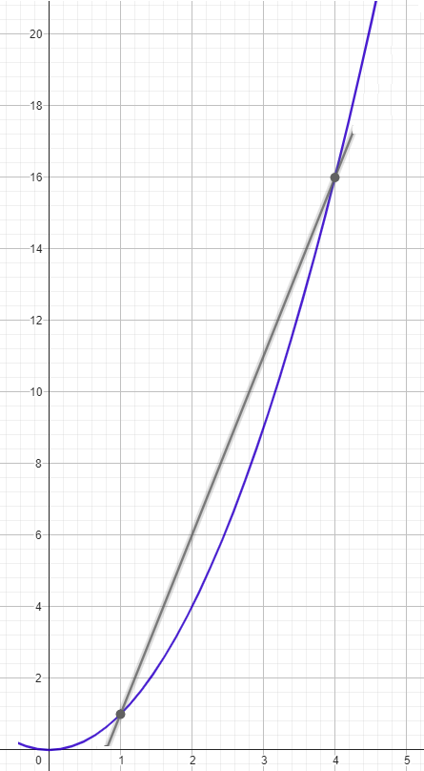
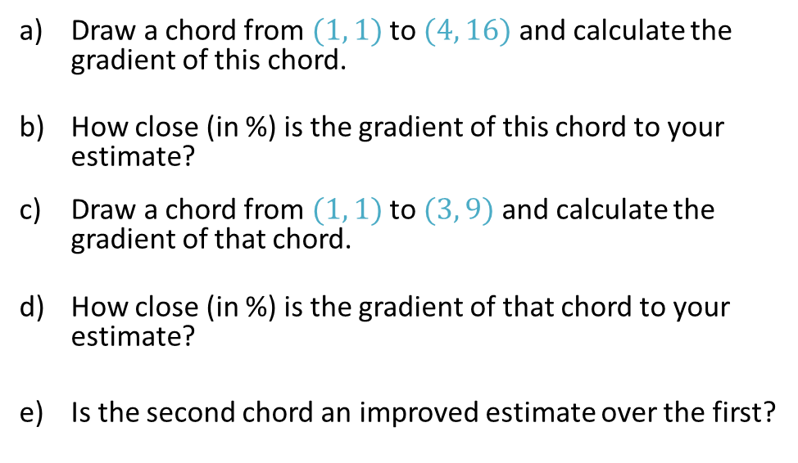
Gradients of Improved Chords
Draw a chord from $(1, 1)$ to $(4, 16)$ and calculate the gradient of this chord.
How close (in %) is the gradient of this chord to your estimate?
Draw a chord from $(1, 1)$ to $(3, 9)$ and calculate the gradient of that chord.
How close (in %) is the gradient of that chord to your estimate?
Is the second chord an improved estimate over the first?

Slide 4
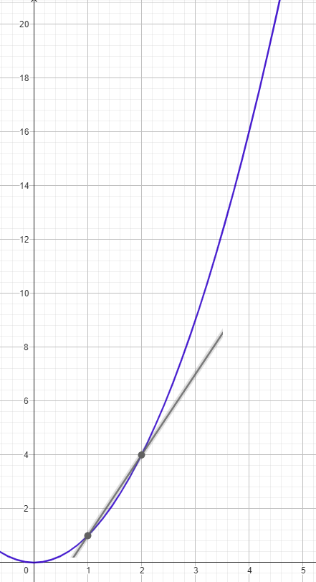
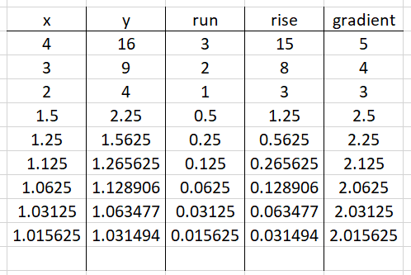

Chords of $x^{2}$
Repeat the process by halving the run $Δx$ each time.
Copy and complete the table using calculated values for rise $Δy=y−1$ and run $Δx=x−1$ .
What do you notice about the gradient?
What is the gradient to 1 decimal place?
?
?

Slide 5
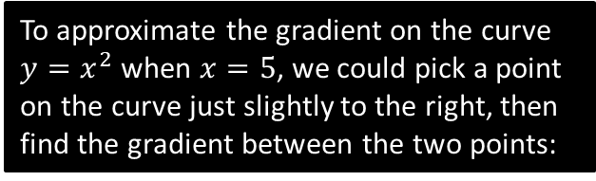
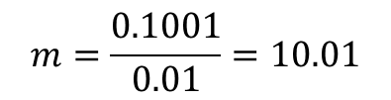

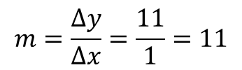








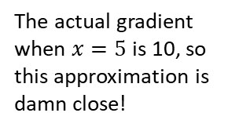
Approximating Gradients with Chords
The question is then: Is there a method to work out the gradient function without having to draw lots of tangents and hoping that we can spot the rule?
To approximate the gradient on the curve $y=x^{2}$ when $x=5$, we could pick a point on the curve just slightly to the right, then find the gradient between the two points:
As the second point gets closer and closer, the gradient becomes a better approximation of the true gradient:
$$y=x^{2}$$
?
$$\left(6,36\right)$$
?
$$11$$
$$\left(5.01,25.1001\right)$$
$$1$$
$$0.01$$
$$0.1001$$
$$\left(5,25\right)$$
$$\left(5,25\right)$$
?
?
?
$$m=\frac{Δy}{Δx}=\frac{11}{1}=11$$
$$m=\frac{0.1001}{0.01}=10.01$$
The actual gradient when $x=5$ is 10, so this approximation is damn close!

Slide 6
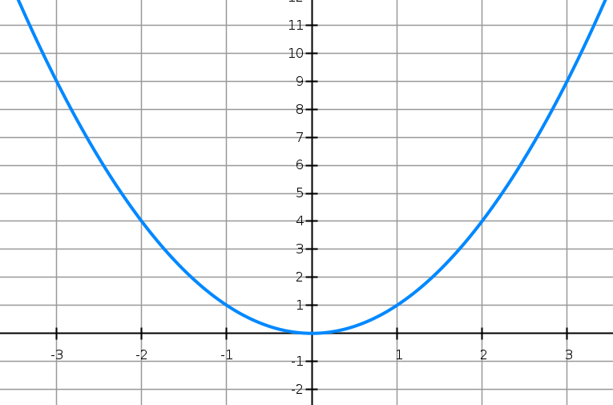





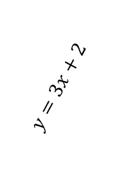
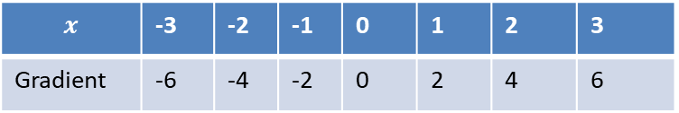

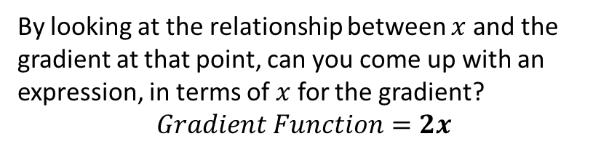

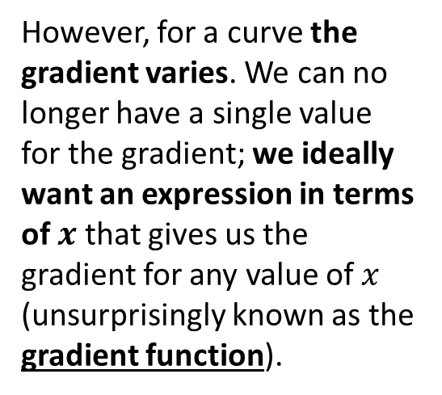


Gradient Function
For a straight line, the gradient is constant:
At GCSE, you found the gradient of a curve at a particular point by drawing a tangent.
$$m=6$$
$$m=−6$$
$$y=x^{2}$$
$$y=3x+2$$
$$m=3$$
$$m=−4$$
$$m=4$$
$$m=−2$$
$$m=2$$
$$m=0$$
However, for a curve the gradient varies. We can no longer have a single value for the gradient; we ideally want an expression in terms of $x$ that gives us the gradient for any value of $x$ (unsurprisingly known as the gradient function).
$$x$$ | -3 | -2 | -1 | 0 | 1 | 2 | 3
Gradient | -6 | -4 | -2 | 0 | 2 | 4 | 6
?
?
?
?
?
?
?
By looking at the relationship between $x$ and the gradient at that point, can you come up with an expression, in terms of $x$ for the gradient?
$$Gradient Function=2x$$
?

Slide 7
Exercise 12.1
Pearson Pure Mathematics Year 1/AS
Page 93

Slide 8
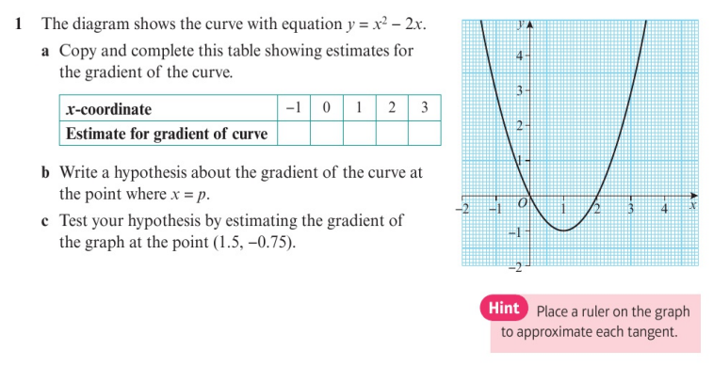
Homework Exercise

Slide 9
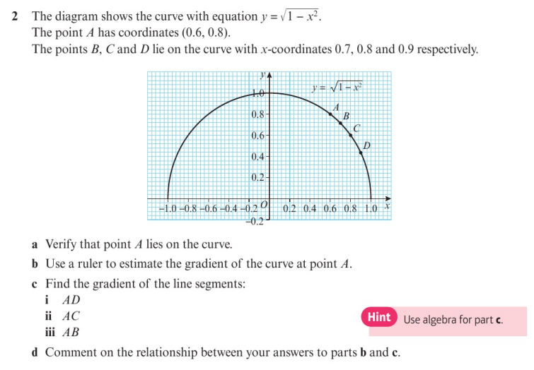
Homework Exercise

Slide 10
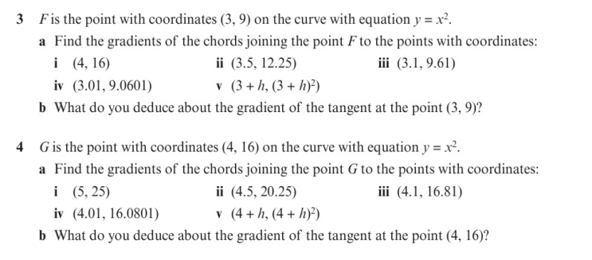
Homework Exercise

Slide 11
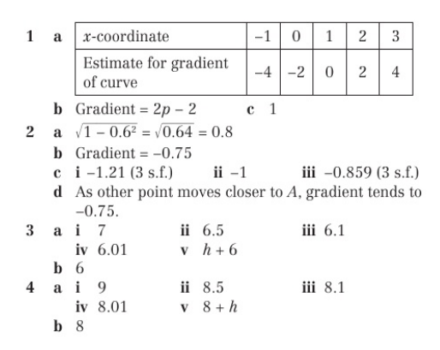
Homework Answers

